Slide 1
RESTful APIs
Laurie Mailloux
Web 420
Presentation 2.2 RESTful APIs
May 8, 2020

Slide 2
What are RESTful APIs
An API is an application programming interface. It is a set of rules that allow programs to talk to each other. The developer creates the API on the server and allows the client to talk to it.
REST determines how the API looks like. It stands for “Representational State Transfer”. It is a set of rules that developers follow when they create their API. One of these rules states that you should be able to get a piece of data (called a resource) when you link to a specific URL.
Each URL is called a request while the data sent back to you is called a response.

Slide 3
Key Terms
Client — the client is the person or software who uses the API. It can be a developer, for example you, as a developer, can use Twitter API to read and write data from Twitter, create a new tweet and do more actions in a program that you write. Your program will call Twitter’s API. The client can also be a web browser. When you go to Twitter website, your browser is the client who calls Twitter API and uses the returned data to render information on the screen.
Resource — a resource can be any object the API can provide information about. In Instagram’s API, for example, a resource can be a user, a photo, a hashtag. Each resource has a unique identifier. The identifier can be a name or a number.

Slide 4
Advantages
Due to its scalability. This protocol stands out due to its scalability. Thanks to the separation between client and server, the product may be scaled by a development team without much difficulty.
Due to its flexibility and portability. With the indispensable requirement for data from one of the requests to be properly sent, it is possible to perform a migration from one server to another or carry out changes on the database at any time. Front and back can therefore be hosted on different servers, which is a significant management advantage.
Due to its independence. Due to the separation between client and server, the protocol makes it easy for developments across the various areas of a project to take place independently. In addition, the REST API adapts at all times to the working syntax and platform. This offers the opportunity to try several environments while developing.

Slide 5
Disadvantages
REST-ful API unnecessarily exposes models
REST-ful API forces one to think in terms of manipulating models instead of the natural behavior of stating intent
REST-ful API Update action oversimplifies too much

Slide 6
Uses
Because the calls are stateless, REST is useful in cloud applications. Stateless components can be freely redeployed if something fails, and they can scale to accommodate load changes. This is because any request can be directed to any instance of a component; there can be nothing saved that has to be remembered by the next transaction. That makes REST preferable for web use, but the RESTful model is also helpful in cloud services because binding to a service through an API is a matter of controlling how the URL is decoded. Cloud computing and microservices are almost certain to make RESTful API design the rule in the future.

Slide 7
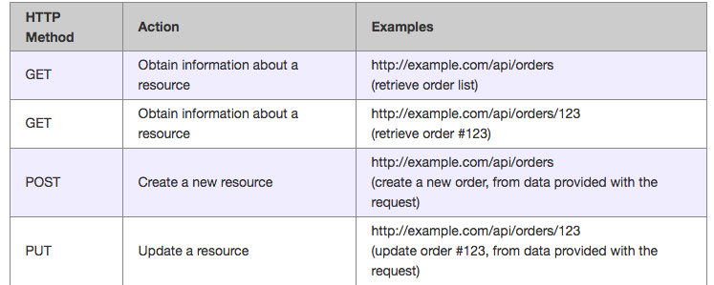
Methods

Slide 8
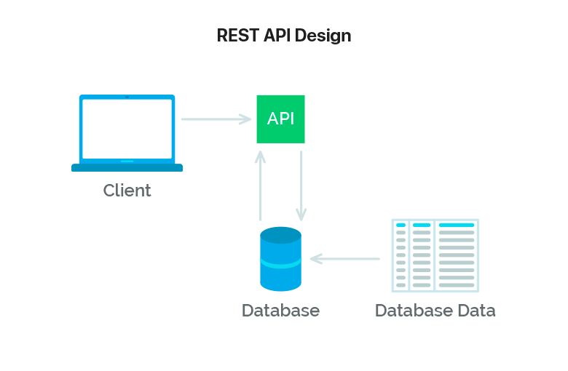
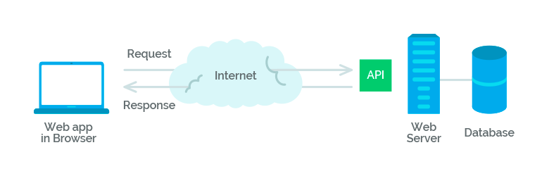
REST

Slide 9
When to use URI vs URL
There is a fair bit of discussion regarding when and how you should properly use the term URI vs URL. No matter how the URL is structured, it will always be technically correct if you use the term URI. This is because, as we mentioned above, a URI can identify a resource by location (URL), by name (URN), or both, therefore it is all encompassing.
However, due to the URI's versatility, some argue that using the term "URL", or the URL full form (Uniform Resource Locator) is a more appropriate choice when the resource contains a specific location identifier. Therefore, if the resource contains a protocol such as http://, ftp://, and so on, the term URL is often used as it is more specific. Alternatively, if the resource is less specific in terms of containing a location identifier, then the term URI should be used.

Slide 10
References
Avraham, Shif Ben. September 5, 2017. What is REST — A Simple Explanation for Beginners, Part 1: Introduction. Retrieved on May 5, 2020 from https://medium.com/extend/what-is-rest-a-simple-explanation-for-beginners-part-1-introduction-b4a072f8740f
Chakray. February 9, 2017. What are the advantages of a REST API? Retrieved on May 8, 2020 from https://www.chakray.com/advantages-of-rest-api/
(n.d.). Retrieved from https://searchapparchitecture.techtarget.com/definition/RESTful-API
Comparing URI vs URL. October 4, 2018 Retrieved on May 8, 2020 from https://www.keycdn.com/support/comparing-uri-vs-url

