Slide 1
Two-Team Pizza Rule
Laurie Mailloux
July 18, 2020
Presentation 2.2

Slide 2

The 2 pizza Rule
The two pizza rule…. The more people you pack into a meeting, the less productive the meeting will likely be. Never have a meeting where two pizzas couldn’t feed the entire group. A small group eating two pizzas around a conference table epitomizes coziness and close social interaction. Since recent studies suggest smaller teams tend to be more productive than larger ones, and that teams whose members have more face time and social contact often prove more productive.

Slide 3
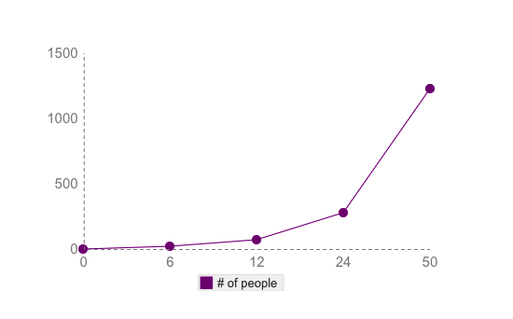
Communication declines
As group size increases, the links start to get unwieldy.
If you take a basic two-pizza team size of, say, 6. That’s 15 links between everyone.
Double that group for a team of 12. That shoots up to 66 links.
Small business of 50 people has an incredible 1225 links to manage.

Slide 4
Underestimation of work
The fact is, larger team size makes people overconfident. This is the tendency for people “to increasingly underestimate task completion time as team size grows,” as researchers Bradley Staats, Katherine Milkman, and Craig Fox explain. In one of their experiments, they discovered that when tasked to build the same Lego figure, two-person teams took 36 minutes while four-person teams took 52 minutes to finish — over 44% longer.

Slide 5

Work meetings
Work meetings are a notorious waste of time.
You've got to be smart to keep them from needlessly eating up your day. Those are precious minutes that you or your employees could be spending doing something useful.
When a meeting is absolutely unavoidable, though, he has one tip that boosts their productivity and usefulness.

Slide 6

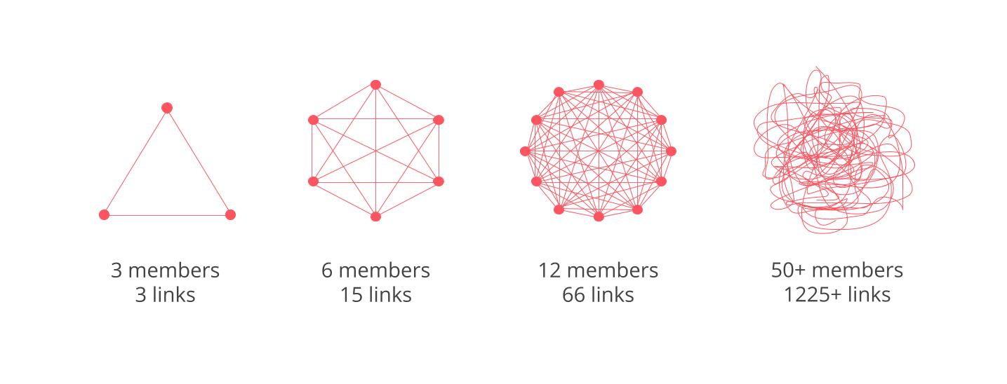
Manage the links between members
This means that a small startup of three people has three links to maintain. Doubling the size of this team would increase the number of links five-fold to 15. A larger team of 12 members has to worry about 66 links. And for a group of 50, the number of links skyrockets to 1225.

Slide 7
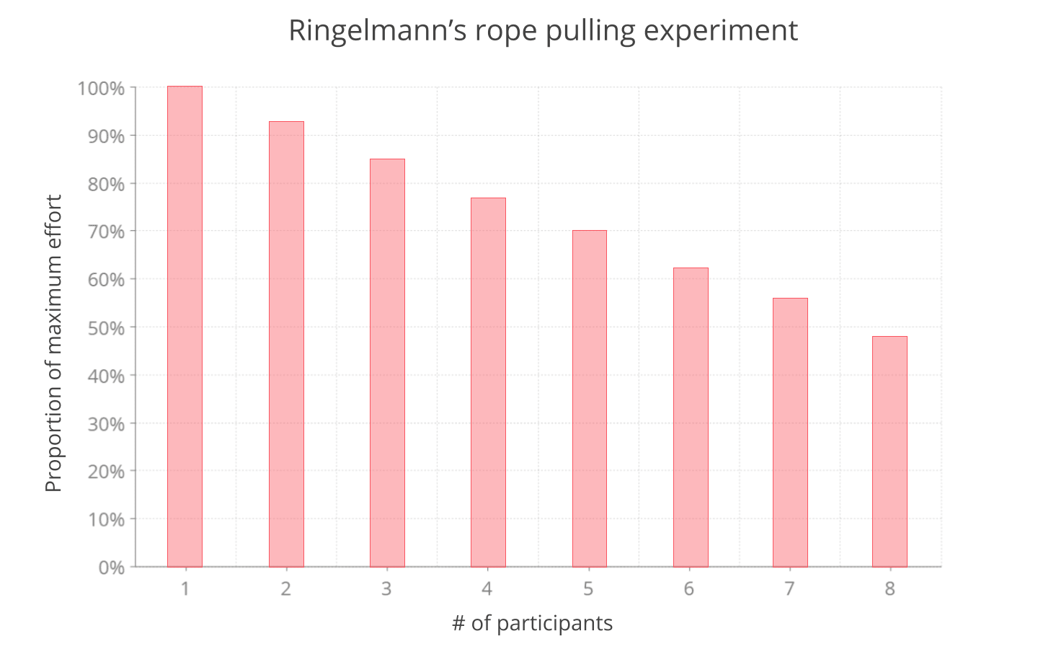
There is no strength in numbers
Larger team size also makes people feel overconfident. The bigger the team, the more likely it is that the members will underestimate the time it would take them to complete a task.

Slide 8
How to create your own version of the two-pizza rule
Find your unique pizza number
1
Know how much your employees’ time (and yours) is worth
2
Make sure your employees have complementary skill sets
3
Know the signs of groupthink and loafing—and stop them
4

Slide 9

How to optimize things
It’s totally normal for any organization to have a team with the size of more than one digit number, but the most important part is how I can improve your big team so that its efficiency is as good as a two large pizza team’s efficiency.
And the trick is simple, break your big teams into small teams or sub-teams of small groups of people. By breaking your large team into smaller teams, you ensure that the communication gap is filled properly between them and the tasks are being accomplished by the sub-teams.

Slide 10
Conclusion
The bottom line is that small teams outperform larger ones because they are able to coordinate more swiftly and effectively. They are better at creating an environment where individual contributions are observed and acknowledged.

Slide 11
References
no author. March 20, 2019. Two-Pizza Teas: The Science Behind Jeff Bezos’ Rule. Retrieved on July 19, 2020 from https://blog.nuclino.com/two-pizza-teams-the-science-behind-jeff-bezos-rule
Cain, Aine. June 7, 2017. Jeff Bezos’s Productivity Tip? The ‘2 Pizza Rule’. Retrieved on July 19, 2020 from https://www.inc.com/business-insider/jeff-bezos-productivity-tip-two-pizza-rule.html
Stack, Laura. November 22, 2016. Jeff Bezos’ two-pizza rule for building productive teams. https://www.bizjournals.com/bizjournals/how-to/human-resources/2016/11/jeff-bezos-two-pizza-rule-for-building-productive.html
Gupta, Mohit. January 21, 2018. Why “Two Large Pizza” team is the best team ever. Retrieved on July 19, 2020 from https://medium.com/plutonic-services/why-two-large-pizza-team-is-the-best-team-ever-4f19b0f5f719

