Slide 1
DevOps Automated Testing
Laurie Mailloux
July 21, 2020
Presentation 3.2 Testing

Slide 2
What is automated testing?
Continuous testing is the process of implementing end-to-end automated testing throughout all possible phases of the delivery lifecycle.
This process can be utilized with ay type of application (mobile, web, etc.) By employing the concept of continuous testing, the DevOps team makes an effort to catch bugs earlier in the development process where they are less expensive to fix, thus lowering the risk posed to the delivery schedule.
In addition to the lowering risk, continuous testing ensures that the incremental changes made to the application can be reliably deployed at any time, making the application consciously deliverable.

Slide 3

Who should be involved with the test Automation?
When evaluating a testing solution, it’s important to have a tool that fits the needs of all of the different team members who will be involved in the testing process. These include:
Manual testers: Record and replay is crucial for manual testers, especially those who are new to automation. Being able to use the same recorded script with variety of input data can come in handy while identifying and fixing problems across multiple environments.
Automation engineers: For automation engineers, robust support for scripting languages, integrations with CI systems, and the ability to scale tests easily could be important.
Developers: Implement testing into the development process requires the ability to conduct tests within IDEs such as Eclipse and Visual Studio.

Slide 4

Why Test Automation for DevOps?
Faster test outcomes: Test automation can be implemented by writing a test script on a tool. The code in development is put through that script and checked for expected outcomes. Any deviation is noted and investigated for possible errors. This is way faster than manual testing, where QA specialists find repetitive testing frustrating and have a tendency to miss errors.
Consistent results: Consistency in QA means the software behaves on expected lines throughout the delivery pipeline. Test automation can validate the code for variables at different stages and mitigate the chances of human errors.
Ease with regression testing: When a major update is implemented, certain types of tests, such as usability testing, are performed manually. However, when there are more variables and the software needs to be checked across devices, operating systems, browsers, geographies and networks, then automatic testing takes the cake. It can work non-stop and check for deviations or non-compliance.
Human resources utilization: During manual testing, scarce human testers are deployed in tasks that require constant attention. Further, to avoid boredom arising out of conducting repeated testing, QA testers can give certain tests a miss. Imagine the type or number of glitches escaping the test dragnet and later ruining the user experience. However, with test automation, repetitive testing can go unhindered wherein scarce human resources can be deployed for better activities.

Slide 5
Types of Automated Tests
Code Analysis - There are actually many different types of code analysis tools, including static analysis and dynamic analysis. Some of these tests look for security flaws, others check for style and form. These tests run when a developer checks in code. Other than configuring rules and keeping the tools up to date, there isn’t much test writing to do with these automated tests.
Unit Tests - You can also automate a unit test suite. Unit tests are designed to test a single function, or unit, of operation in isolation. They typically run on a build server. These tests don’t depend on databases, external APIs, or file storage. They need to be fast and are designed to test the code only, not the external dependencies.
Integration Tests - Integration tests are a different kind of animal when it comes to automation. Since an integration test—sometimes called end-to-end tests—needs to interact with external dependencies, they’re more complicated to set up. Often, it’s best to create fake external resources, especially when dealing with resources beyond your control. If you, for example, have a logistics app that depends on a web service from a vendor, your test may fail unexpectedly if the vendor’s service is down. Does this mean your app is broken? It might, but you should have enough control over the entire test environment to create each scenario explicitly. Never depend on an external factor to determine the outcome of your test scenario.
Automated Acceptance Tests - There are several practices today that use automated acceptance tests (AAT), but they’re basically doing the same thing. Behavior-driven development (BDD) and automated acceptance test-driven development (AATDD) are similar. They both follow the same practice of creating the acceptance test before the feature is developed. In the end, the automated acceptance test runs to determine if the feature delivers what’s been agreed upon. Therefore, it’s critical for developers, the business, and QA to write these tests together. They serve as regression tests in the future, and they ensure that the feature holds up to what’s expected.

Slide 6
Types of Automated test cont.
Regression Tests - Without AATs in place, you have to write regression tests after the fact. While both are forms of functional tests, how they’re written, when they’re written, and whom they’re written by are vastly different. Like AATs, they can be driven through an API by code or a UI. Tools exist to write these tests using a GUI.
Performance Tests - Many kinds of performance tests exist, but they all test some aspect of an application’s performance. Will it hold up to extreme pressure? Are we testing the system for high heat? Is it simple response time under load we’re after? How about scalability? Sometimes these tests require emulating a massive number of users. In this case, it’s important to have an environment that’s capable of performing such a feat. Cloud resources are available to help with this kind of testing, but it’s possible to use on-premises resources as well.
Smoke Tests - What’s a smoke test? It’s a basic test that’s usually performed after a deployment or maintenance window. The purpose of a smoke test is to ensure that all services and dependencies are up and running. A smoke test isn’t meant to be an all-out functional test. It can be run as part of an automated deployment or triggered through a manual step.

Slide 7
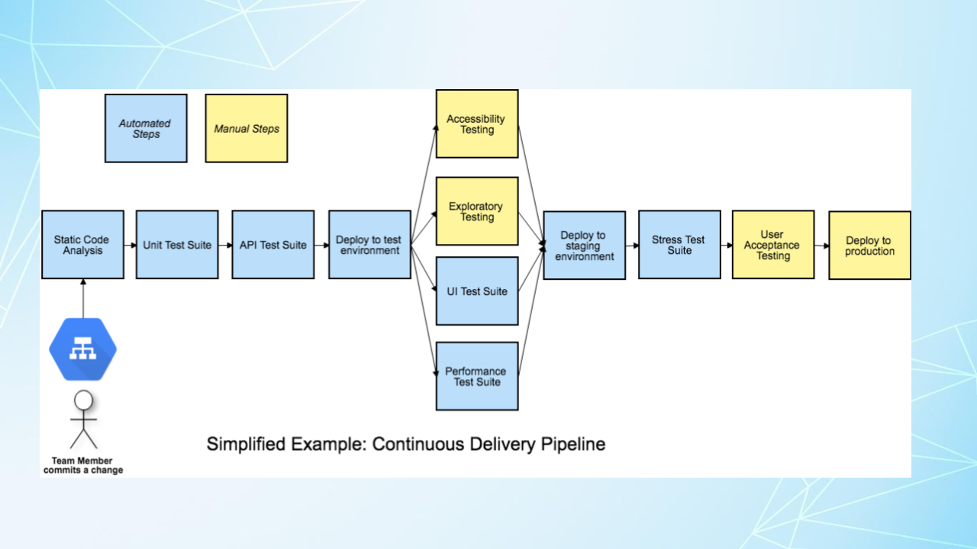
Continuous Delivery Pipeline

Slide 8
What does DevOps do with QA?
While waterfall development was a natural home for QA, where it fits into DevOps and agile is not as clear. Most people lump it into themes like continuous development, continuous integration, and continuous delivery, but there’s another way to look at it.
Enter test automation. In a world of nightly or weekend regression runs, the volume of testing has increased substantially. And with this increased volume of testing comes the need for test automation. DevOps can simply not succeed if it still requires a large number of test cases to be run manually.

Slide 9
Common misconceptions about automated testing
Automation will provide you with more free time
The Cost od Automation Testing is Too High
Automated Testing is Better Than Manual Testing
Automated Testing inhibits Human Interaction

Slide 10
Conclusion
In the fast changing technology world, quality can be ensured through a smooth DevOps-led pipeline ensuring CI and CD. Achieving consistency in testing and pre-empting issues like cybercrime are underpinned on implementing DevSecOps and enabling a culture of quality control at every step of the way.

Slide 11
References:
Choudhary, Akshaya. April 30, 2020. Why You Can’t Have DevOps Without Test Automation. Retrieved on July 21, 2020 from https://devops.com/why-you-cant-have-devops-without-test-automation/
Crispin, Lisa. July 1, 2019. Simplified Example: Continuous Delivery Pipeline Retrieved on July 21, 2020 from https://testingindevops.org/visualizing-pipelines-to-help-build-a-quality-culture/
Testim. August 6, 2019. What is Test Automation? A Simple Clear Introduction. Retrieved on July 21, 2020 from https://www.testim.io/blog/what-is-test-automation/
No author. (n.d.) SmartBear What is Automated Testing? Retrieved on July 20, 2020 from https://smartbear.com/learn/automated-testing/what-is-automated-testing/

