Slide 1
Ivan Petrakov
836 MIPT 2022
Addiction to Smart Phones

Slide 2
Agenda
Causes of smartphone addiction
Generation most susceptible to smartphone addiction
Ways to control smartphone addiction

Slide 3
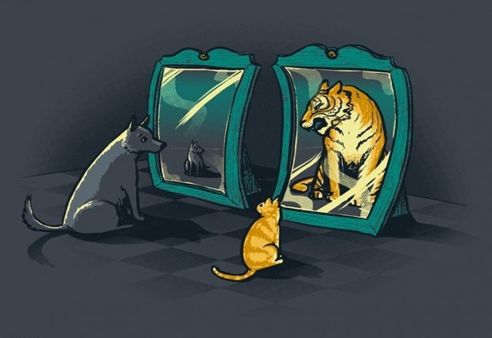
Causes of smartphone addiction
Self-esteem
https://www.psychologos.ru/articles/view/samouvazhenie

Slide 4

Causes of smartphone addiction
Emotions
https://www.mindsoother.com/blog/emotions-why-do-we-need-them

Slide 5

Causes of smartphone addiction
Imitation
https://ru.depositphotos.com/stock-photos/imitation.html

Slide 6
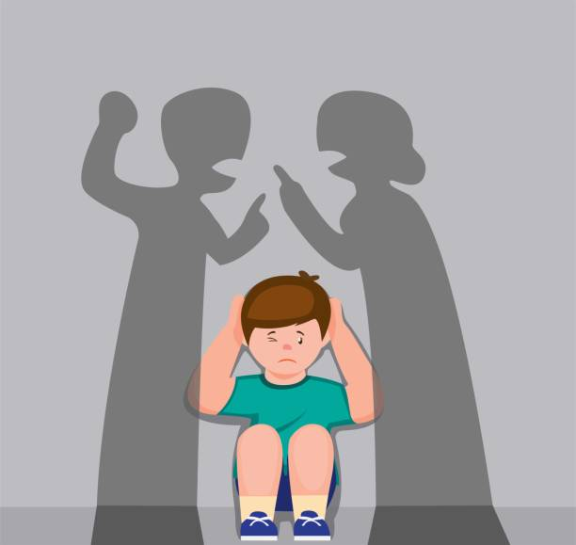
Causes of smartphone addiction
Family problems
https://www.istockphoto.com/ru/%D0%B8%D0%BB%D0%BB%D1%8E%D1%81%D1%82%D1%80%D0%B0%D1%86%D0%B8%D0%B8/family-problems

Slide 7
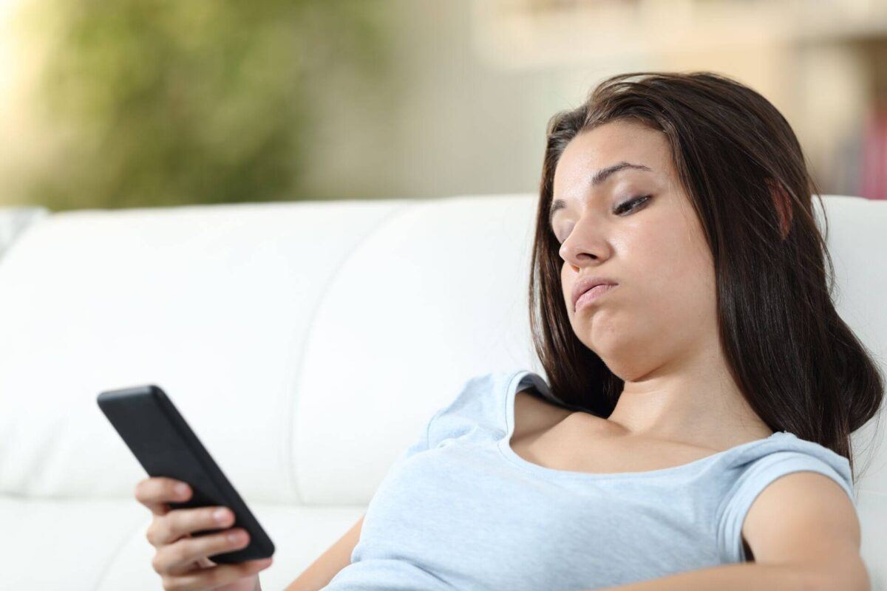
Causes of smartphone addiction
Boredom
https://www.tikvahlake.com/blog/why-we-get-bored-and-what-it-can-mean/

Slide 8
Summary
Looked at the “same strength” situation
Talked about “different strength” situation
Discussed the effect of external parameters

