Slide 1
Ivan Petrakov
836 MIPT 2022
Addiction to Smart Phones

Slide 2
Agenda
Causes of smartphone addiction
Generation most susceptible to smartphone addiction
Ways to control smartphone addiction

Slide 3
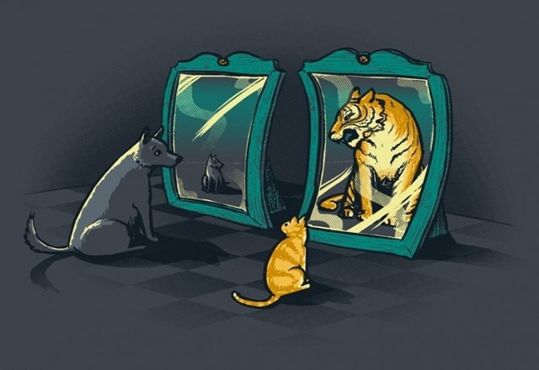
Causes of smartphone addiction
Self-esteem
https://www.psychologos.ru/articles/view/samouvazhenie

Slide 4

Causes of smartphone addiction
Emotions
https://www.mindsoother.com/blog/emotions-why-do-we-need-them

Slide 5

Causes of smartphone addiction
Imitation
https://ru.depositphotos.com/stock-photos/imitation.html

Slide 6
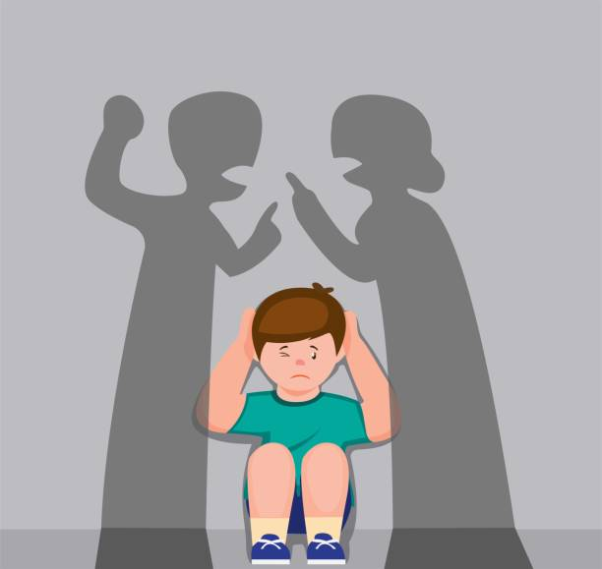
Causes of smartphone addiction
Family problems
https://www.istockphoto.com/ru/%D0%B8%D0%BB%D0%BB%D1%8E%D1%81%D1%82%D1%80%D0%B0%D1%86%D0%B8%D0%B8/family-problems

Slide 7

Causes of smartphone addiction
Boredom
https://www.tikvahlake.com/blog/why-we-get-bored-and-what-it-can-mean/

Slide 8

Generation most susceptible to smartphone addiction
Teenagers
https://www.advgazeta.ru/ag-expert/advices/ustraivaem-na-rabotu-podrostka/

Slide 9
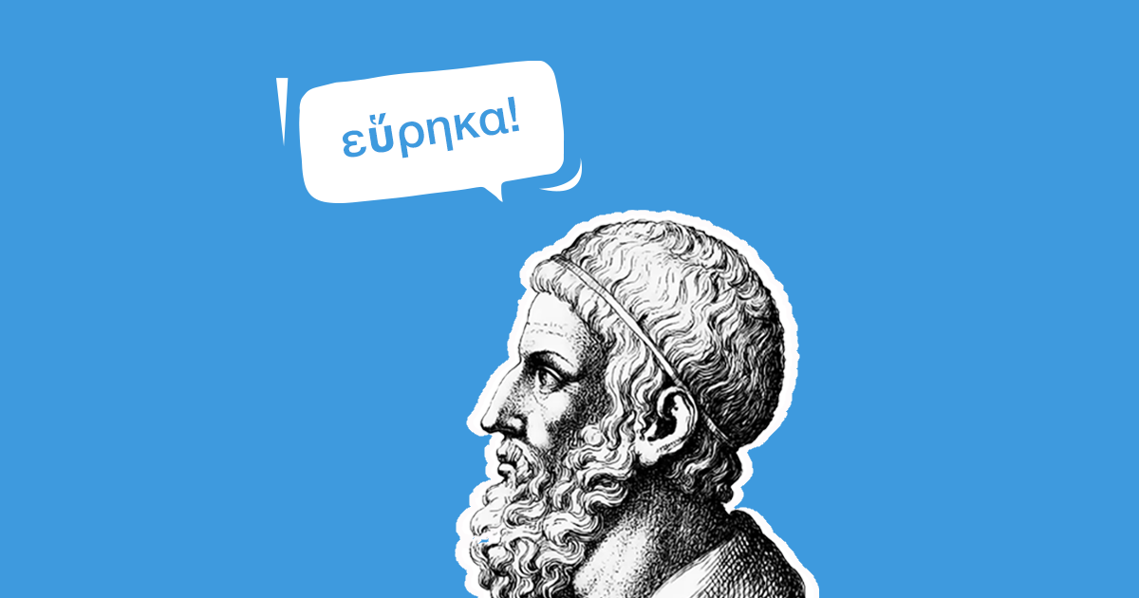
Ways to control smartphone addiction
Insight
https://pikabu.ru/story/ne_pyitaytes_yeto_ponyat_pochemu_ponimanie_problemyi_ne_privodit_k_izbavleniyu_ot_nee_6787896

Slide 10

Ways to control smartphone addiction
Accepting the reality
http://adityajhunjhunwala.com/post/how-to-accept-reality

Slide 11

Ways to control smartphone addiction
Changing the behavior
https://www.dreamstime.com/behavior-change-magnifiying-glass-behavior-change-magnifiying-glass-white-background-image214072743

Slide 12
Summary
Looked at causes of smartphone addiction
Talked about generation susceptible to addiction
Discussed the ways to control addiction

