Slide 1
Ivan Petrakov
836 MIPT 2021
Electronic Markets on robotics

Slide 2
Agenda
Division robots into two types
Discussion of autonomy
Application in real-life

Slide 3
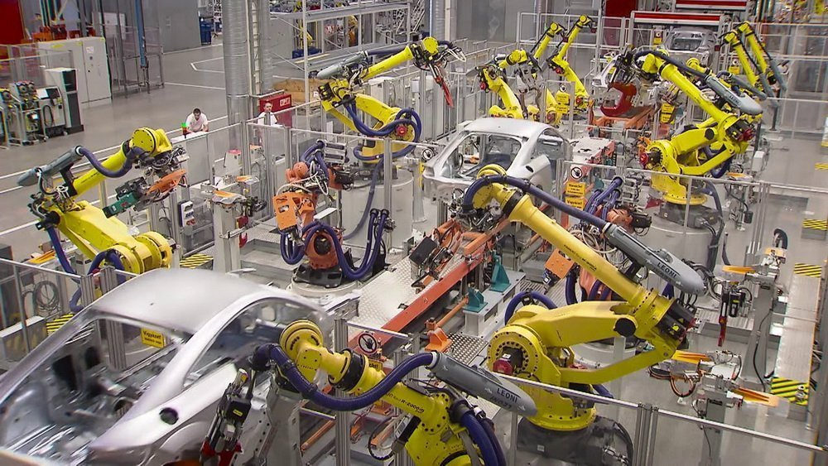
Division robots into two types
Hard robots
https://top3dshop.ru/blog/industrial-robots-apply-and-prospects.html

Slide 4
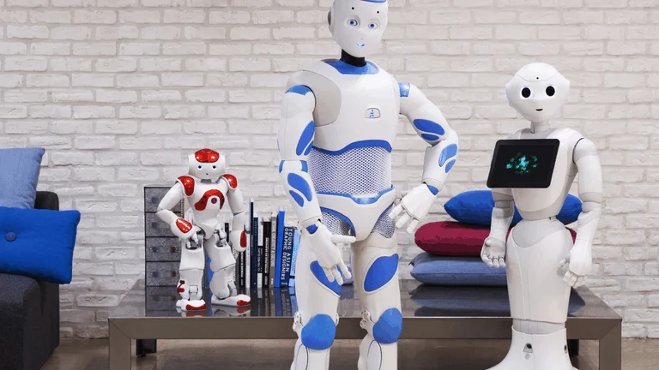
Division robots into two types
Hybrids
https://www.analyticsinsight.net/soft-robotics-vs-hard-robotics-different/

Slide 5
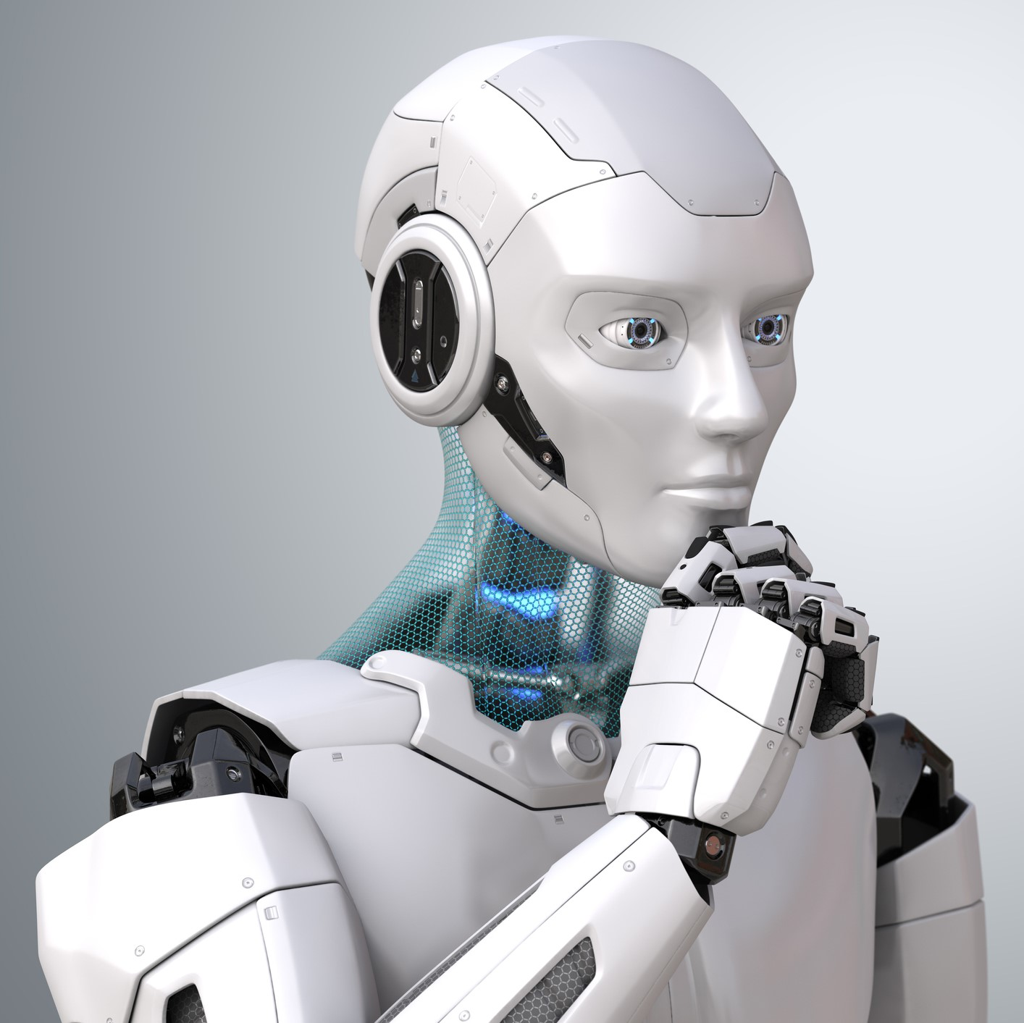
Discussion of autonomy
A thinking robot
https://blogs.3ds.com/northamerica/future-robots-and-ensuring-human-safety/

Slide 6
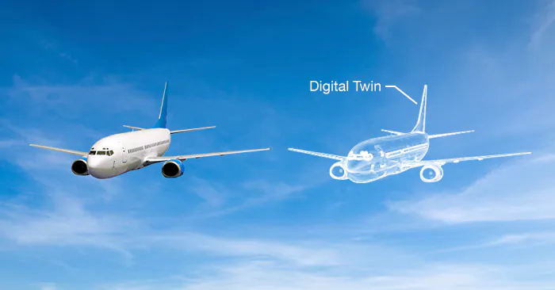
Discussion of autonomy
Digital twin of airplane
https://ru.mouser.com/applications/digital-twins-offer-insight/

Slide 7
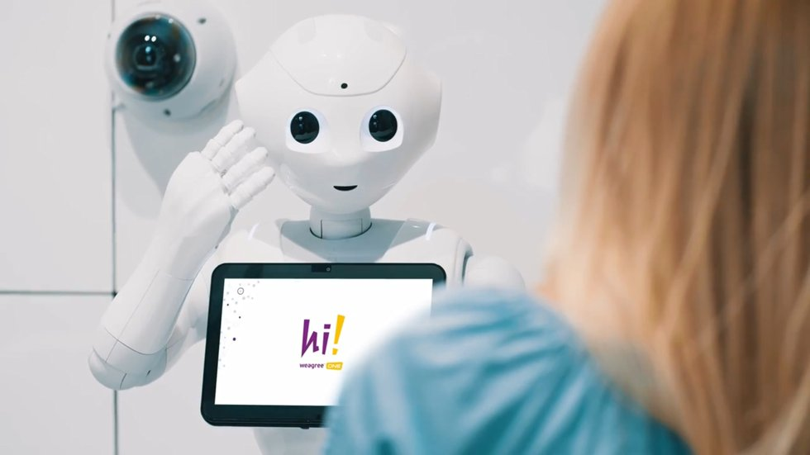
Application in real-life
Wegree One robot secretary
https://bloha.ru/news/predstavlen-novyy-polnostyu-avtonom/

Slide 8
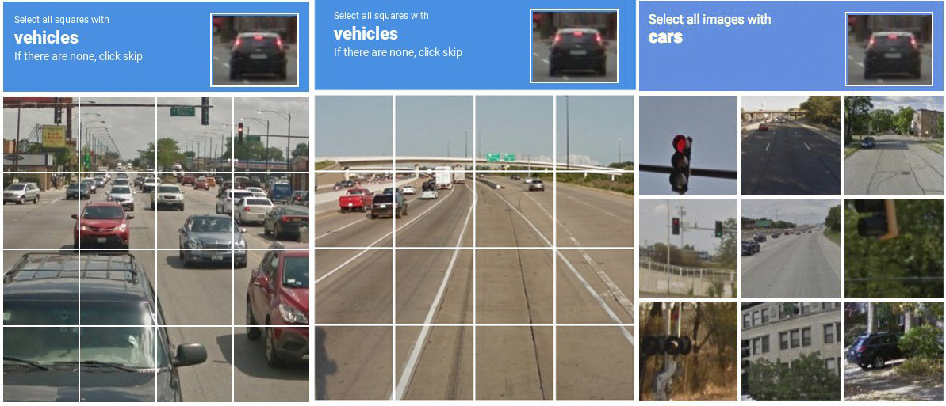
Application in real-life
Robot check
https://hi-tech.mail.ru/review/captcha-dostala-chto-delat/

Slide 9
Summary
Divided robots into two types
Discussed of autonomy
Considered application in real-life

