Slide 1
Ivan Petrakov
836 MIPT 2021
Allometry of Egg Size as a Factor Influencing Egg Shape in Birds

Slide 2
Agenda
Collecting statistics for the analyses
Obtaining results
Discussing results

Slide 3
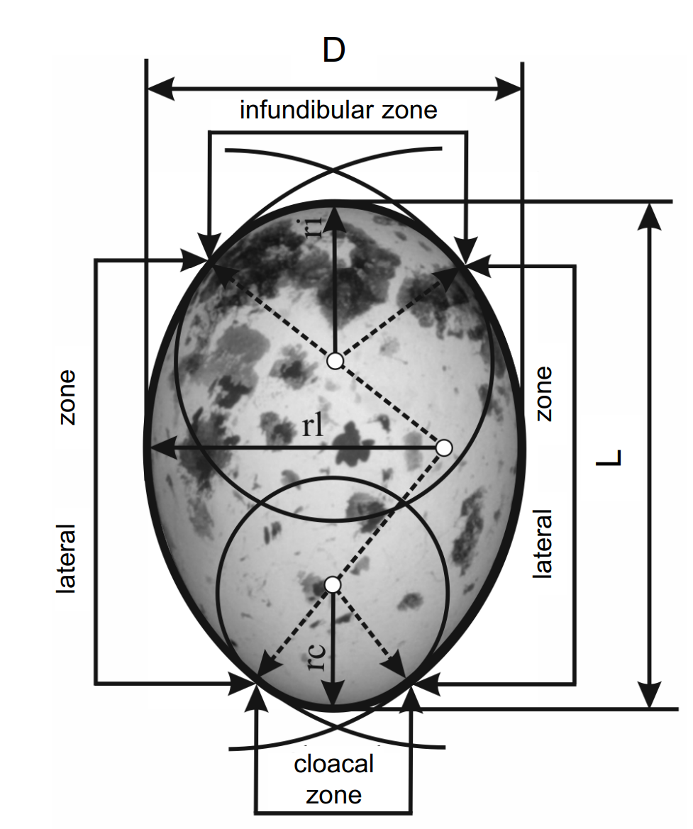
Collecting statistics for the analyses
Scheme of egg measurements

Slide 4
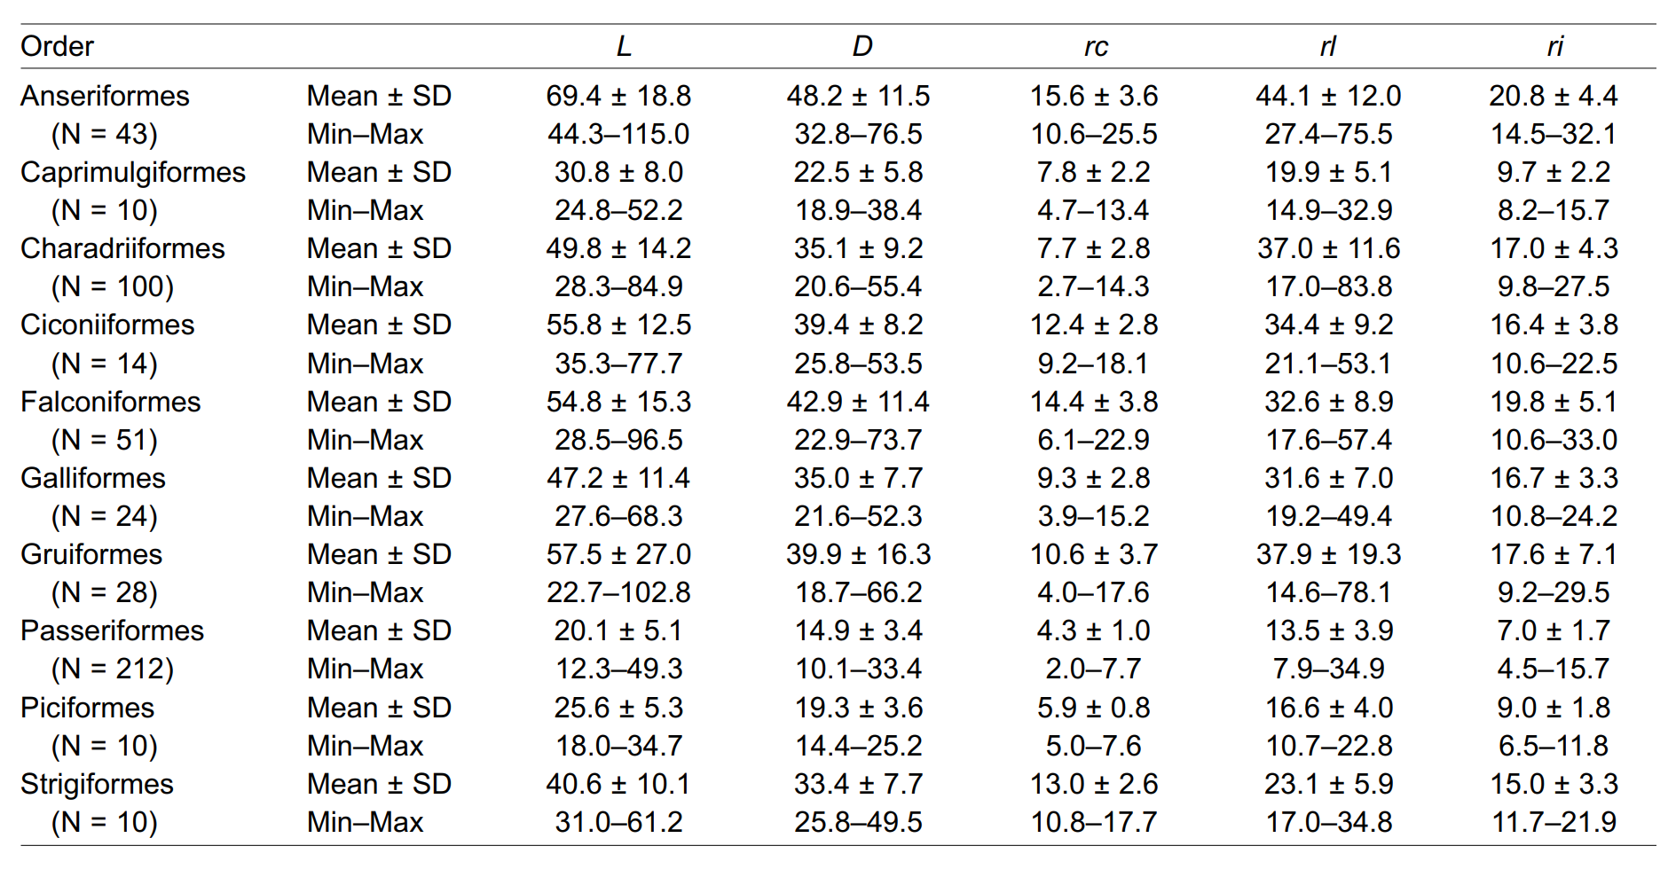
Collecting statistics for the analyses
Basic statistic

Slide 5
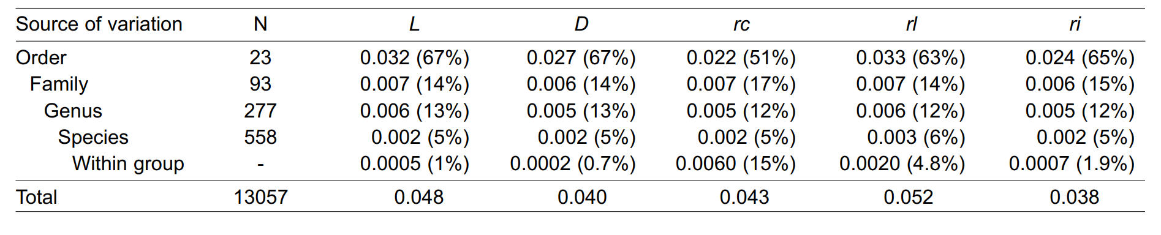
Collecting statistics for the analyses
Components of variance
among different taxonomic levels

Slide 6
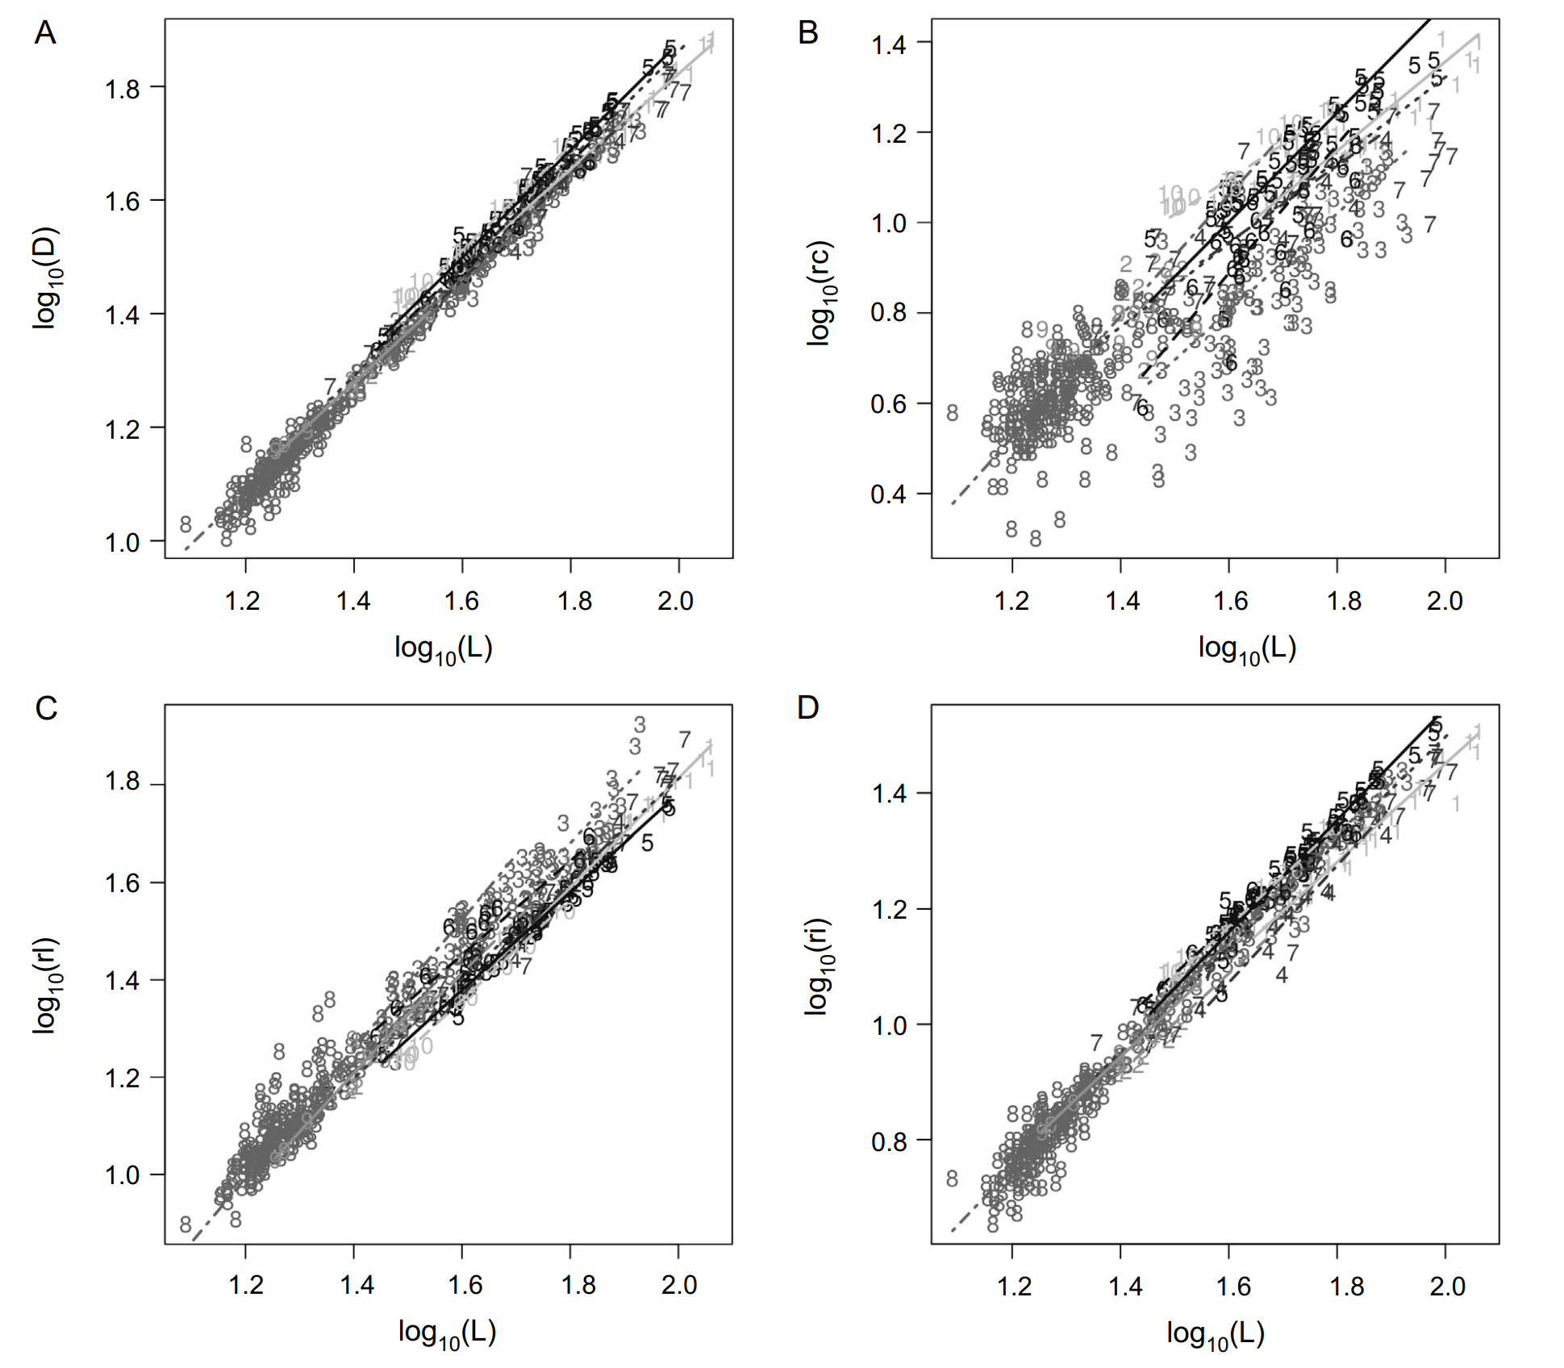
Obtaining results
Variability of scaling parameters

Slide 7
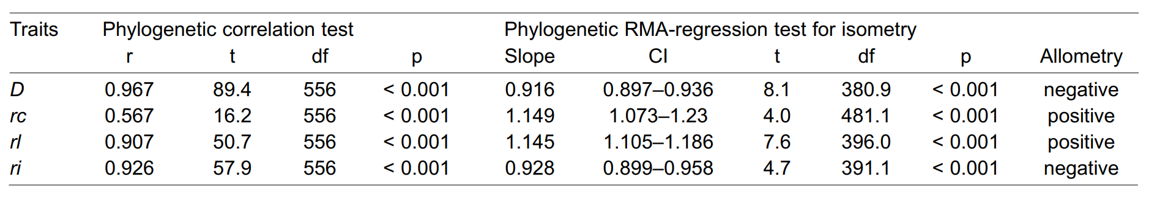
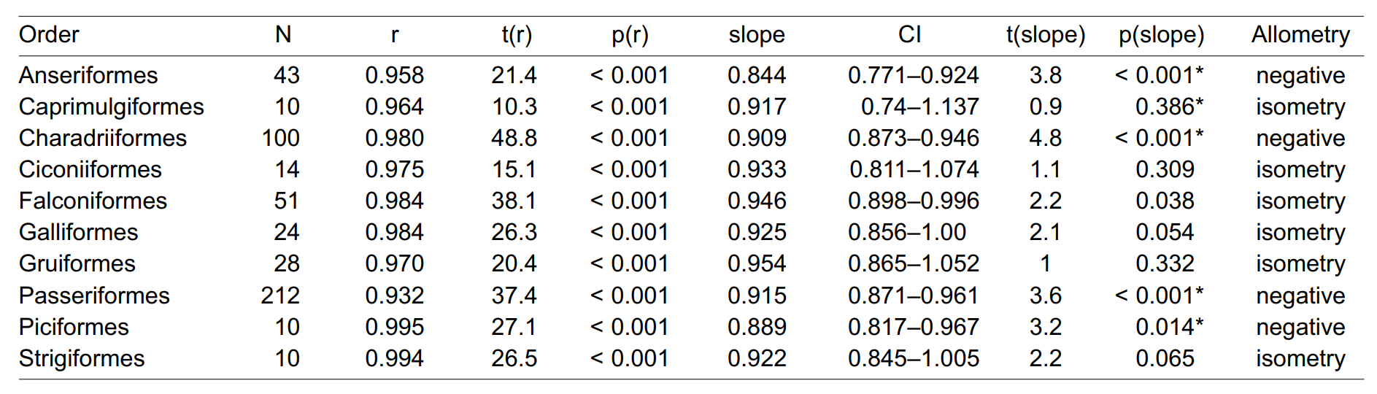
Obtaining results
Results of egg diameter on egg length

Slide 8
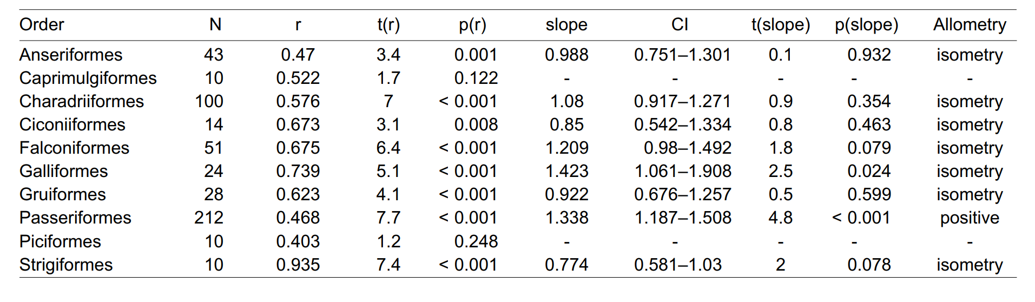
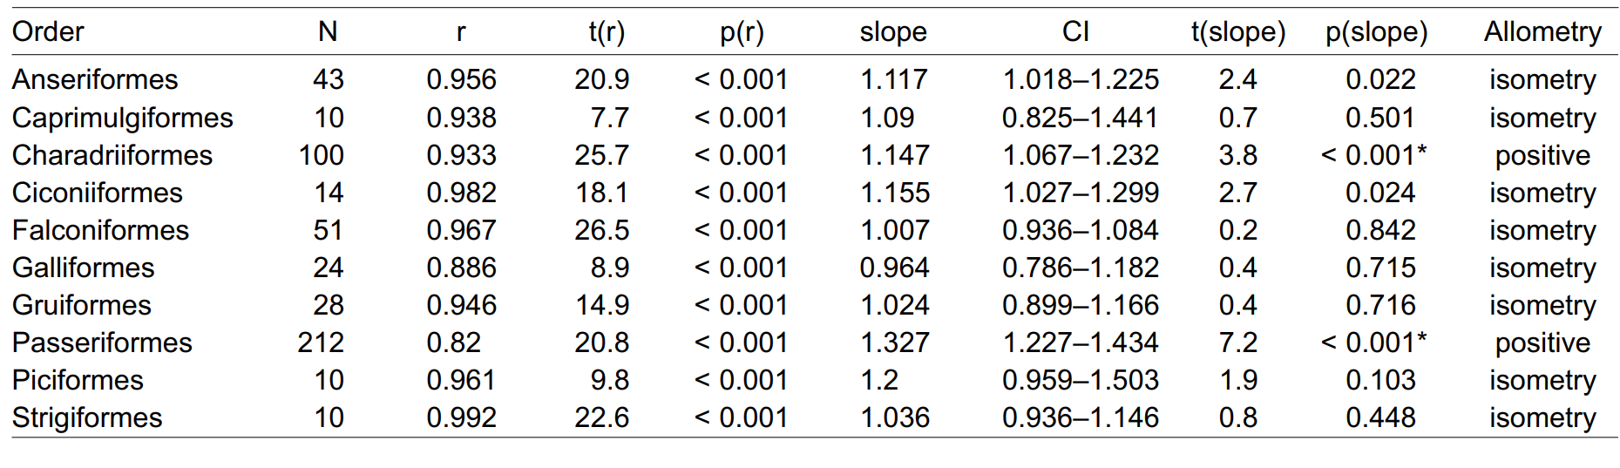
Discussing results
Results of rc and rl on egg length

Slide 9
Summary
Collected statistics for the analyses
Obtained results
Discussed results

Slide 10
Links to the source
https://www.researchgate.net/publication/354032387_Allometry_of_Egg_Size_as_a_Factor_Influencing_Egg_Shape_in_Birds

