Slide 1
Ivan Petrakov
836 MIPT 2022
Equilibria of Attacker-Defender Games

Slide 2
Agenda
Equal endowments
Unequal endowments
Outside options

Slide 3
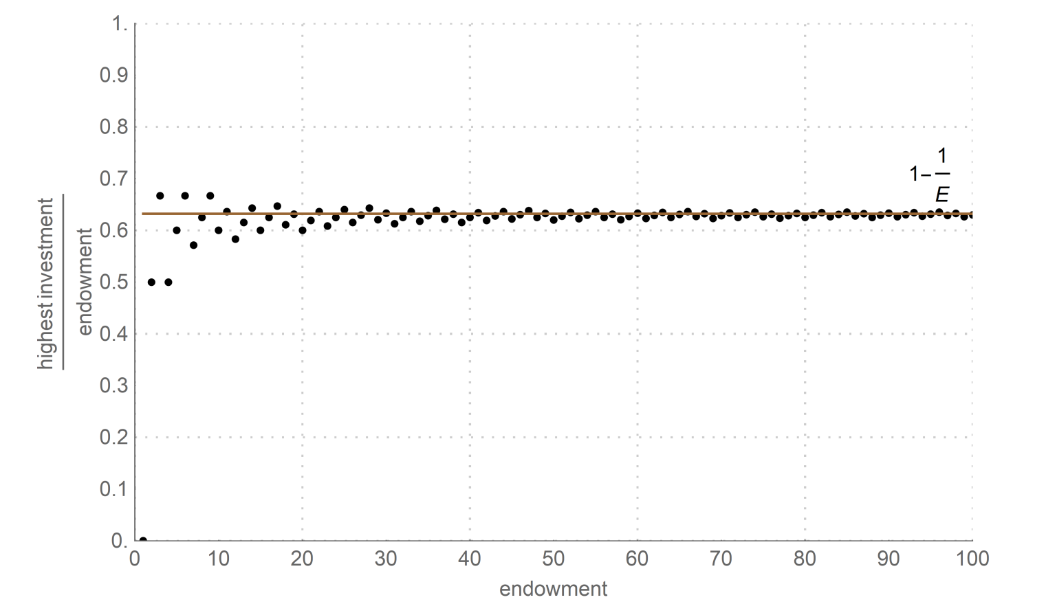
Equal endowments
The upper limit

Slide 4
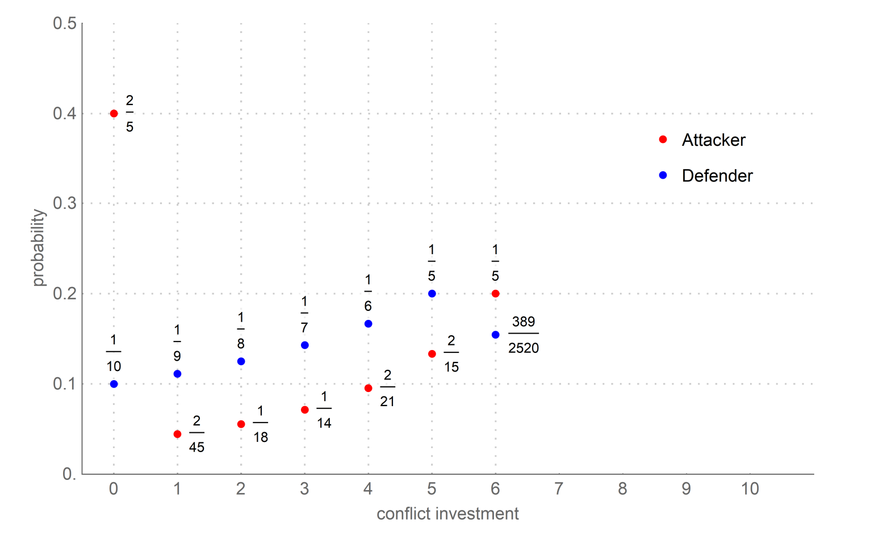
Equal endowments
Equilibrium strategies for equal endowments

Slide 5
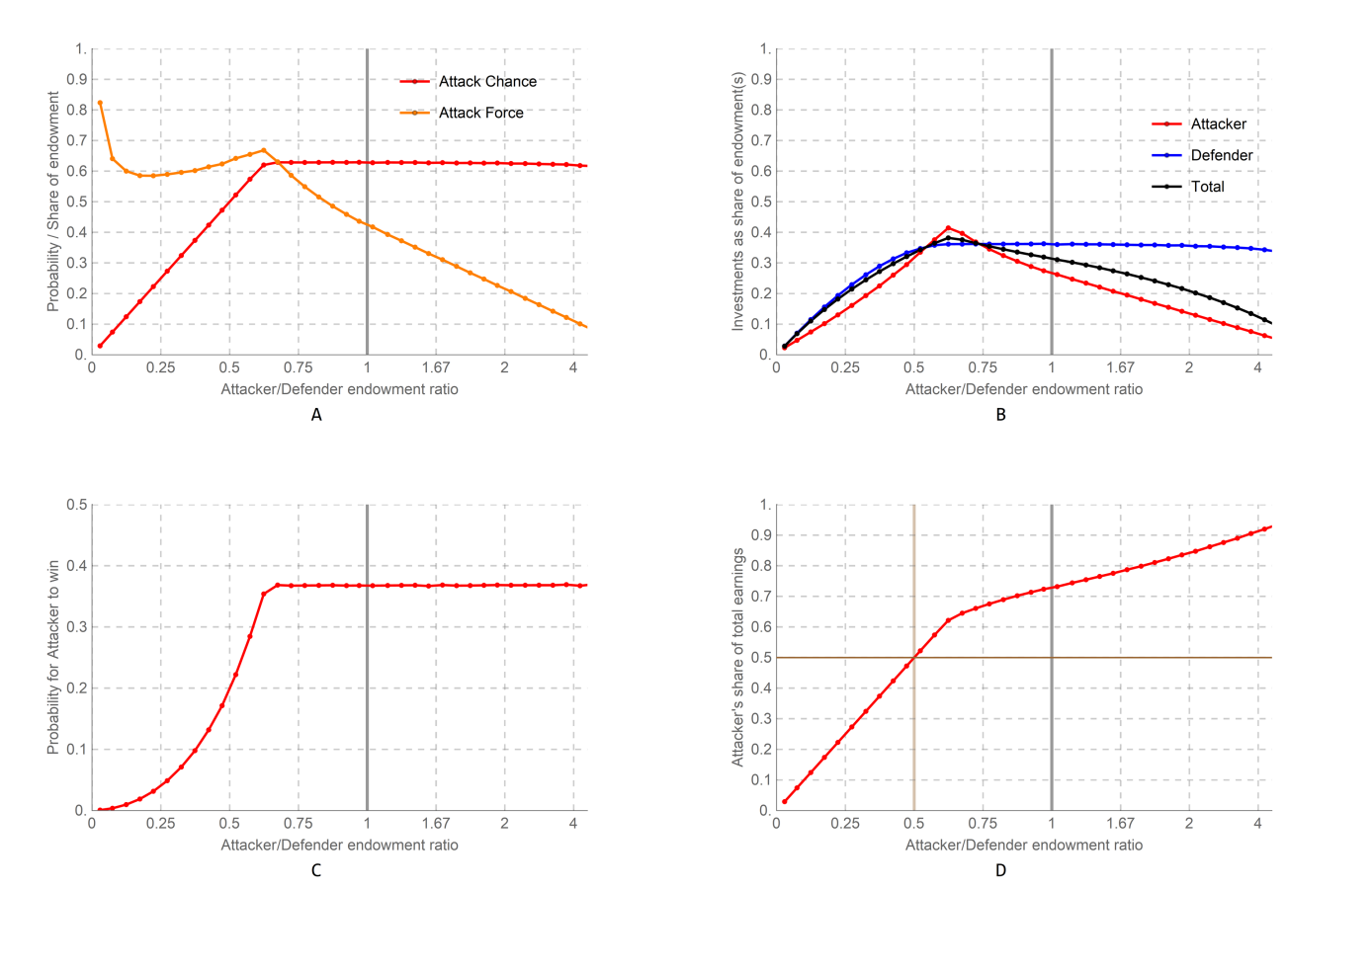
Unequal endowments
Properties of equilibrium under endowment ratios

Slide 6
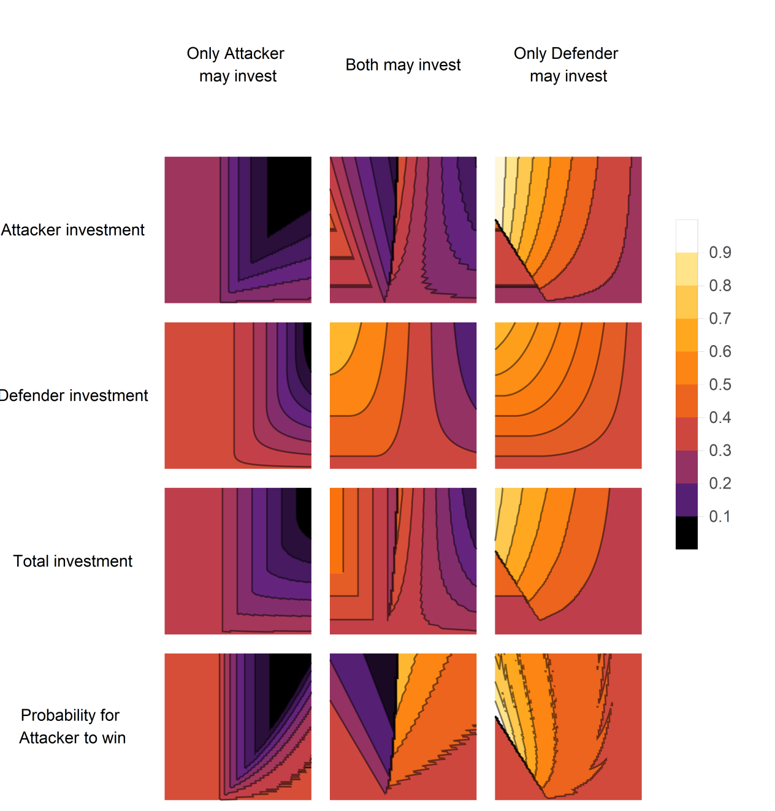
Outside options
Equilibrium values at cost and profit

Slide 7
Summary
Looked at the “same strength” situation
Talked about “different strength” situation
Discussed the effect of external parameters

