Slide 1
Time-optimal reorientation of a rigid spacecraft
Petrakov Ivan
836 group
MIPT
2021

Slide 2
Plan
Wording of the problem
Possible solution
Implementation as program code

Slide 3
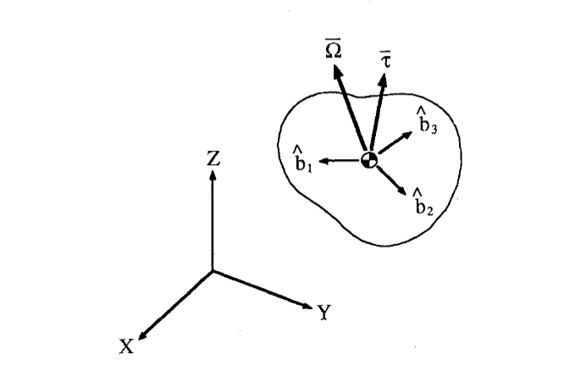
Wording of the problem
Inertial and body axes
https://www.researchgate.net/publication/234512816_Time-optimal_three-axis_reorientation_of_rigid_spacecraft

Slide 4

Possible solution
Symbol for a bang-bang control
https://en.wikipedia.org/wiki/Bang%E2%80%93bang_control

Slide 5
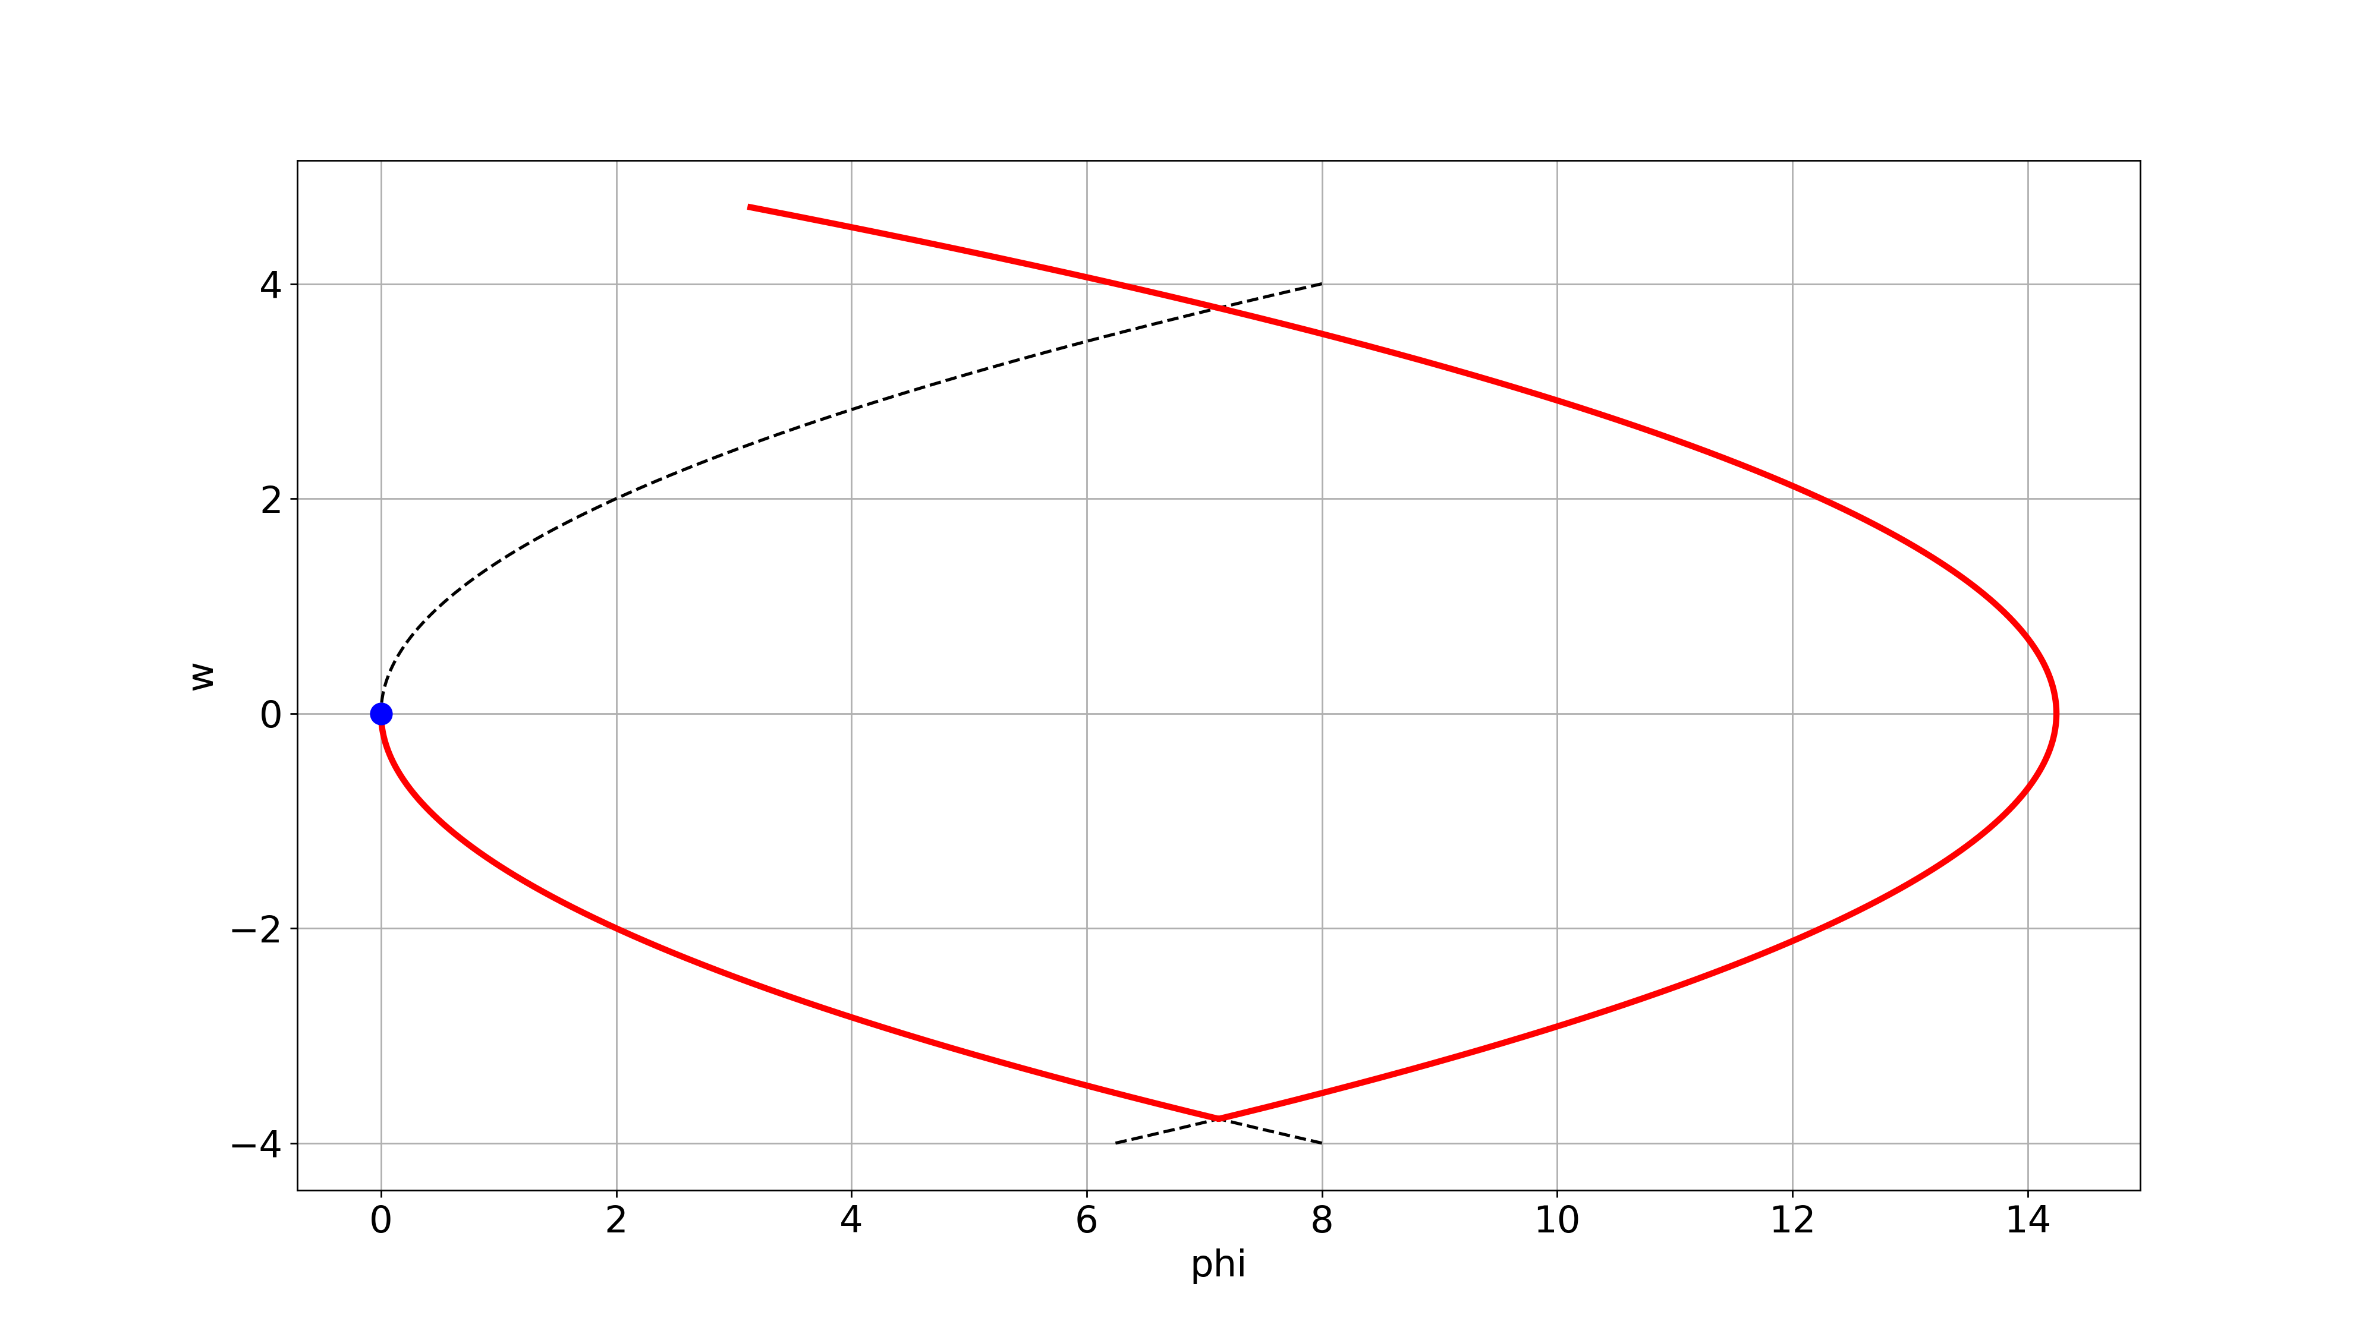
Implementation as program
Time-optimal maneuver

Slide 6
Summary
Wording of the problem
Bang-bang solution
Implementation as program code

