Slide 1
RUST IN
RHYMES
Notes:
Some folks call me a Rust Bard
But I don't think this stuff is too hard
if you want to join in
suit yourself for the win
Without further ado let us start / 00:18
Today I'm discussing in rhymes
a language that goes with the times
Of course I mean Rust
And I'll come up with just
enough stuff to talk 'till the bell chimes. / 00:36

Slide 2

Notes:
I'm coding in Java by day
sometimes it gets in my way
where in Rust I abstract
I need to counteract
runaway patterns joining the fray / 00:54

Slide 3

Notes:
Rust-land is a very strange place
without null deref nor data race
it has its own styles
but once it compiles
it will not blow up in your face / 1:12

Slide 4
☭
Notes:
Rust-land is a commie utopia
A zero-cost cornucopia
For we may freely loan
things that others must own
It's like ownership's causing myopia / 01:30

Slide 5

Notes:
Rustaceans will usually track
their heap usage forwards and back
so no allocation
lead to altercation
One could say that we code full-stack / 01:48

Slide 6

Notes:
As Rust has implicit Drop
Your data will silently plop
out of memory as one
unless you're holding on
to it until your program will stop / 02:06

Slide 7
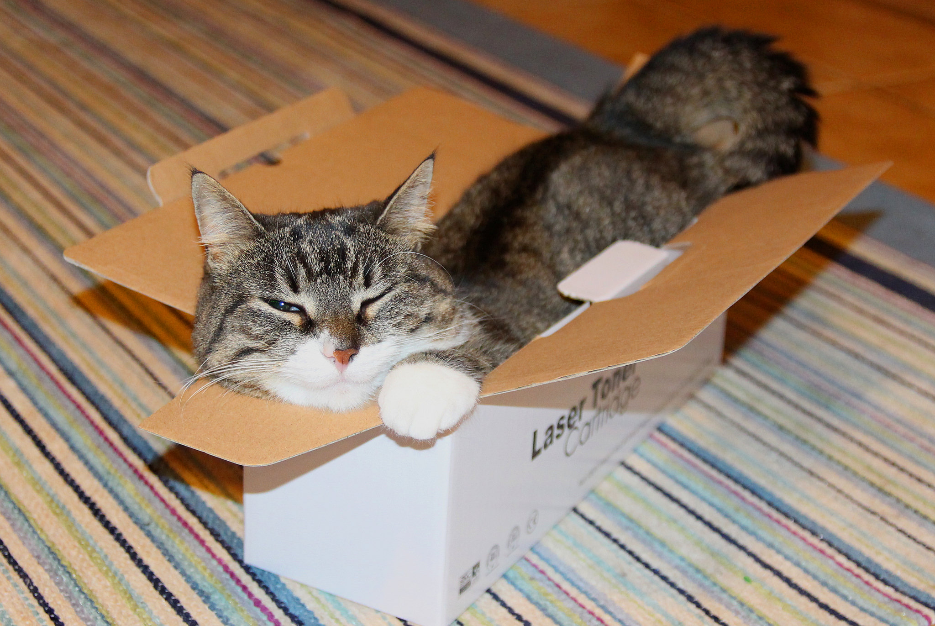
Notes:
With Box you put stuff on the heap
it is surprisingly cheap
and unlike on stack
things stay if you go back
from a function or otherwise leap / 2:24

Slide 8
Notes:
If in Rust code you need to store
one item of some type or more,
you say: "What the heck!
Let's simply use `Vec`!"
(the name is omitting a "tor") / 2:42

Slide 9

> RUST USED BORROW CHECK
> IT‘S SUPER EFFECTIVE!
Notes:
As many a Rust newbie feared
a wild borrowck appeared.
It's super effective
A reference detective
so your code becomes well-engineered.
/ 3:00

Slide 10
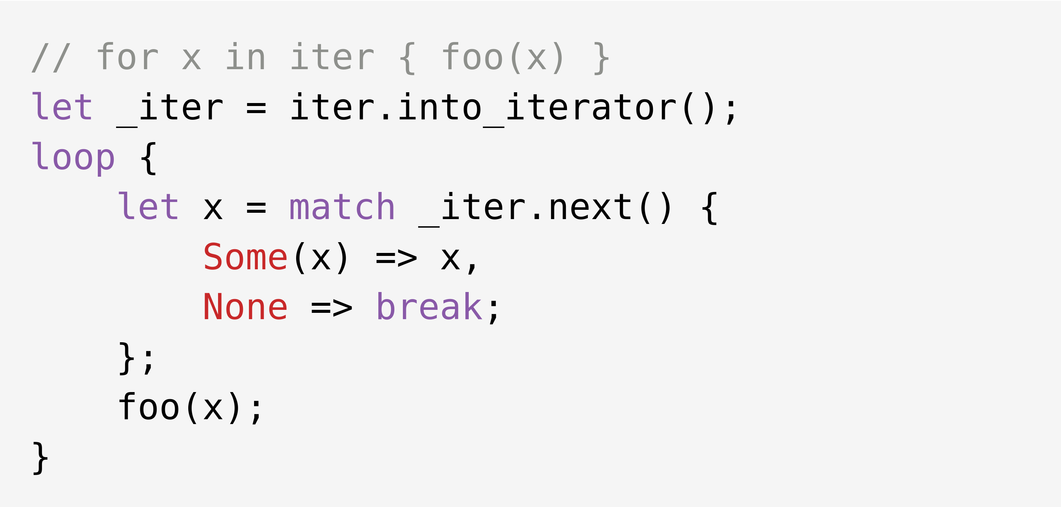
Notes:
When in Rust code you use a for
it'll loop and each time ask for more
if it does get a None
iteration is done
otherwise there's Some(value)in store / 3:18

Slide 11
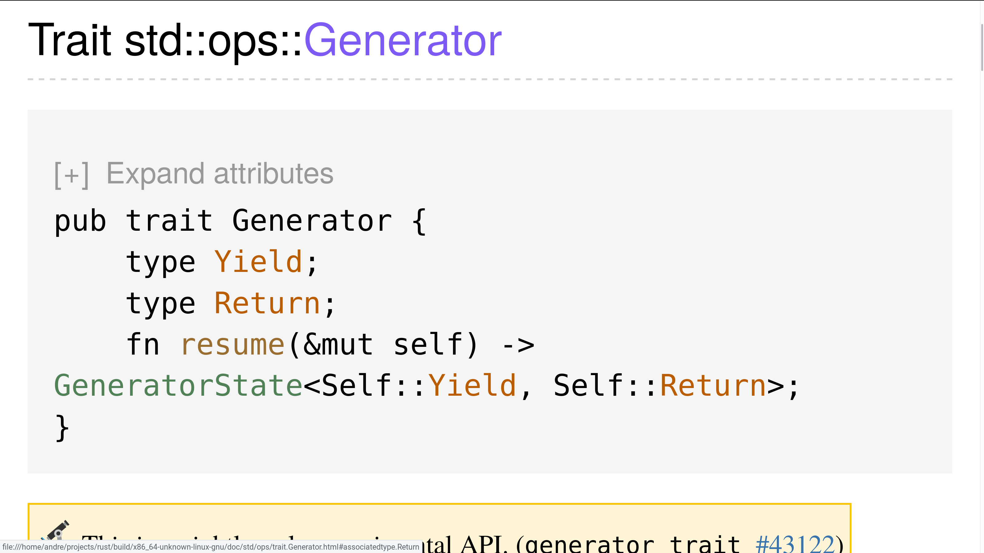
Notes:
Rust used to just iterate
but soon we, too, may generate
yield a sequence of stuff
then resume, that's no bluff
Look out python before it's too late / 3:36

Slide 12
DON‘T
PANIC!
Notes:
Don't panic! in Rust code for sport
only do it as a last resort
give Result back and
if an Error's on hand
you can handle it without abort. / 3:54
Result is a return type tailored
to functions that either do fail or
return on success
to the calling process
so Rust is quite candid on failure / 4:12

Slide 13

Notes:
With error-chain you can lay back
assume that your code is on track
to handle all faults
with nice sane defaults
unwrap is a lazy-ass hack / 4:30

Slide 14
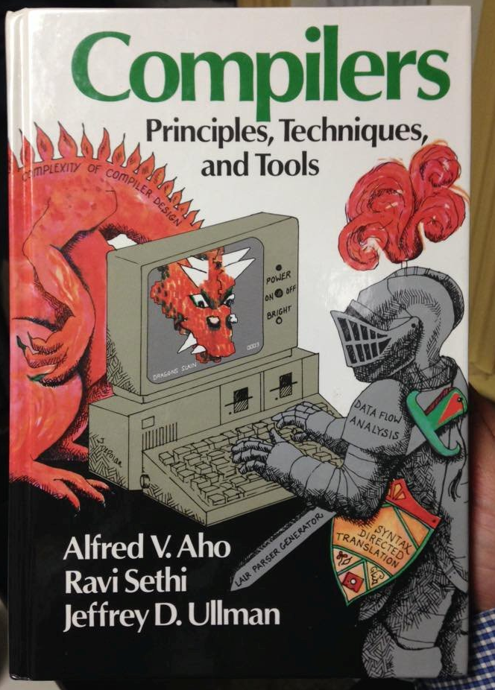
Notes:
You want Rust to parse – you may choose
nom, combine, chomp, LALRPOP, peruse,
pom, peel or another
there are many other
Now you still don't know which one to use / 4:48

Slide 15
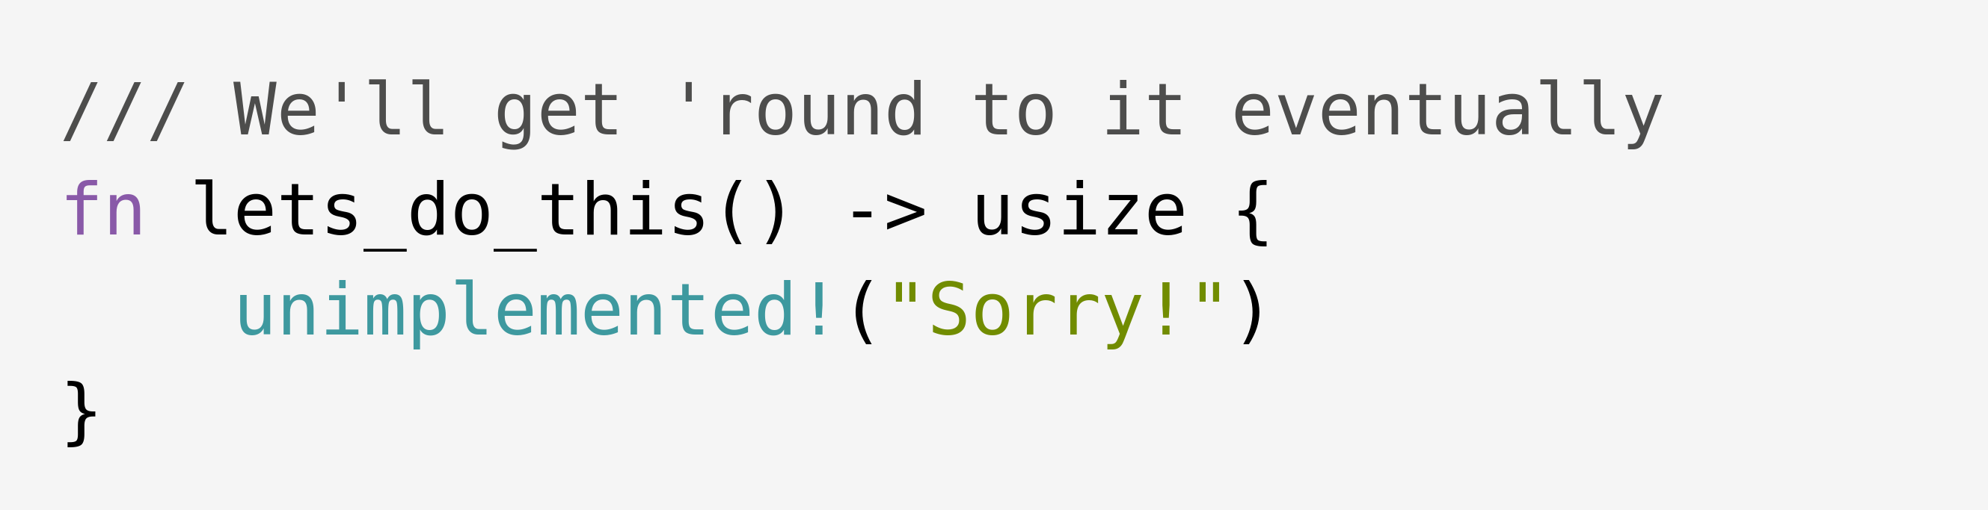
Notes:
With unimplemented!() confess
to your users the method is less
than done–you can now
add a message of how
to deal with the unfinished mess. / 5:06

Slide 16
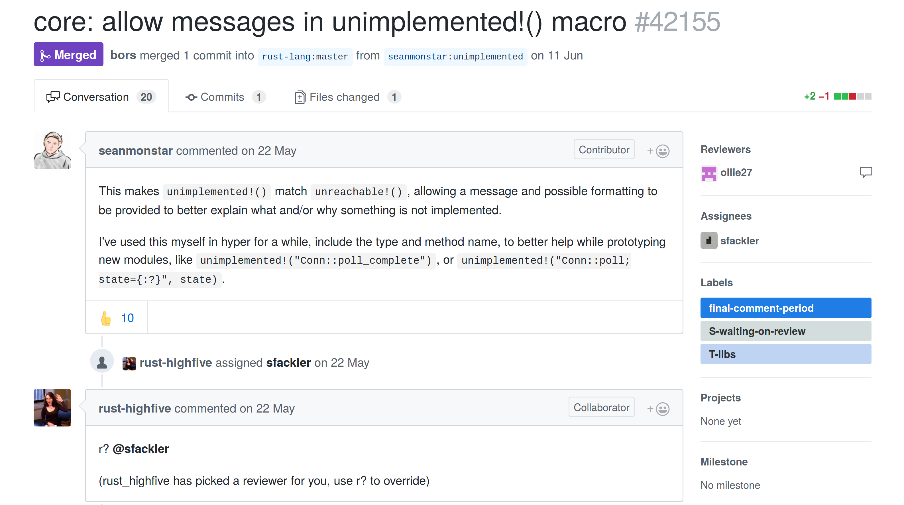
Notes:
To delve a bit more into what is new
PR 42155 brought to you
the way to get your message through
for things that you still intend to do / 5:24

Slide 17
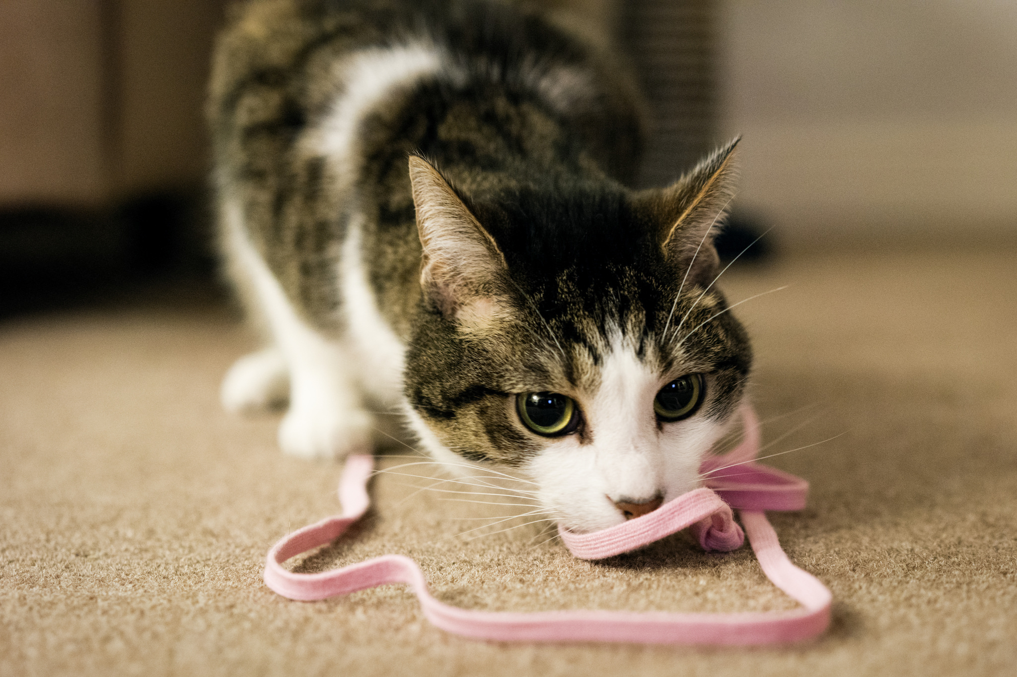
Notes:
Rust newbies get hung on a thing:
What is it with `&str` and `String`?
The former is loaned
while the latter is owned
and thus memory-allocating / 5:42

Slide 18
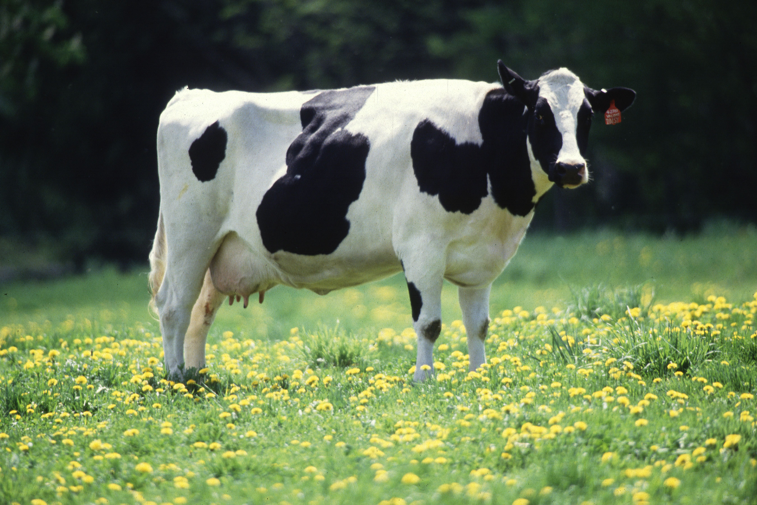
Notes:
Need to save memory & don't know how?
You want to consider a Cow
so instead of a clone
you can borrow or own
So use it all in your code now! / 6:00

Slide 19
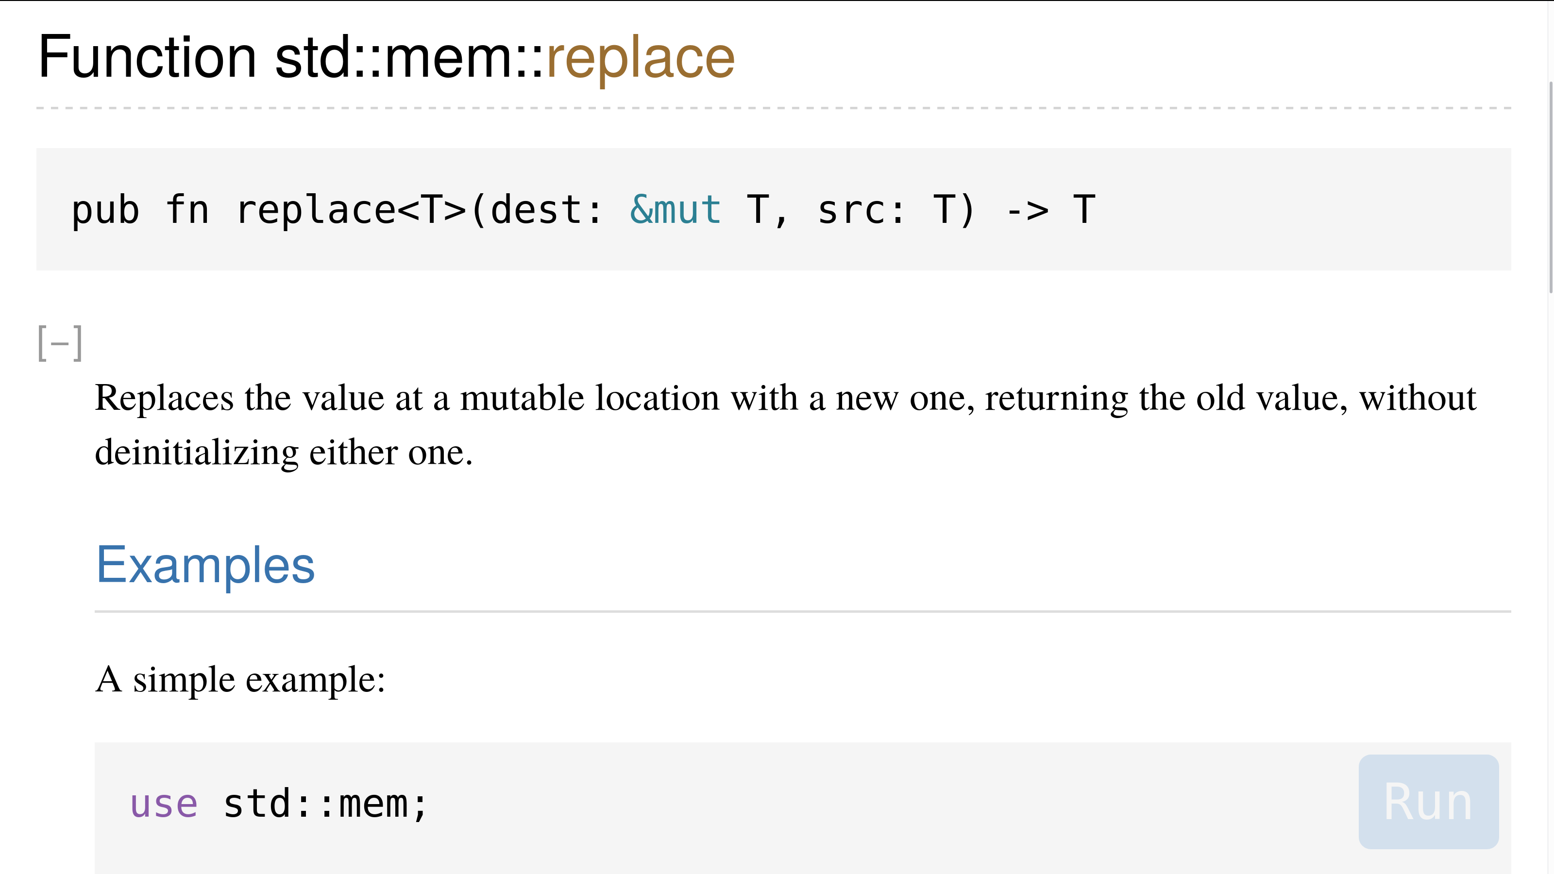
Screenshot mem::replace docs
Notes:
Let `x` be a mutable slice
of `T` where `T` has a size
then we can `mem::replace(..)`
it in various ways
I think that is awesomely nice / 6:18

Slide 20
Notes:
Whenever you write code like this
you may hum Indiana Jones' tune
'cause you do the same switcheroo trick
he employed in the temple of doom / 6:36

Slide 21

Notes:
crates.io has 10K crates in store
and every day is getting more
So Indy's secret lair
Looks relatively bare
Yet no crate to melt Nazis here – Or? / 6:54

Slide 22
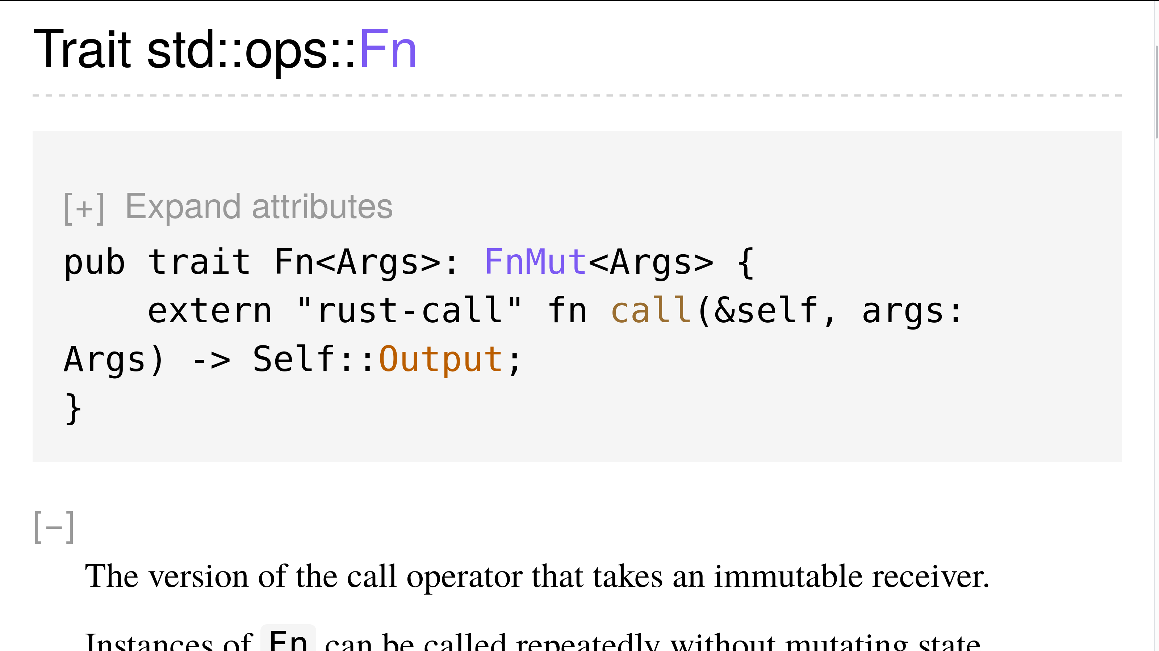
Notes:
Any closure will – if it can
implement a trait we call `Fn`
also be `FnMut`
(and that's double plus good)
and perhaps `FnOnce` once again / 7:12
Note that `FnOnce` consumes the self,
whereas `FnMut` and `Fn` borrow
so reach not for that `FnOnce` shelf
unless you can consume without sorrow. / 7:30

Slide 23
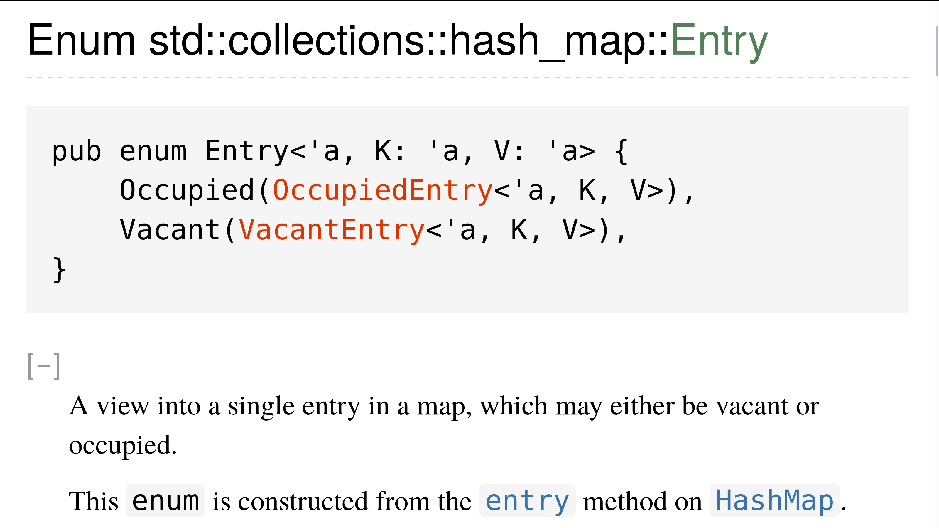
Notes:
Rust Maps do have Entries in store
don't need double takes anymore
They're vacant or not
anyway pretty hot
if you know what to employ'em for / 7:48

Slide 24
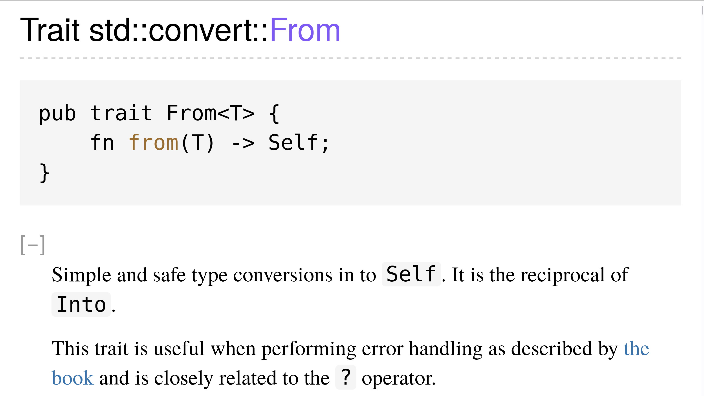
Notes:
If you implement From<T> for Foo
Rust will freely deliver Into
so use From if it fits
(and the orphan rule permits)
and the rest the compiler will do / 8:06

Slide 25

Notes:
Rust's Default trait gets more hype
the more you use it for a type
for you may wanna strive
to use auto-derive
Result: You have less code to type / 8:24

Slide 26
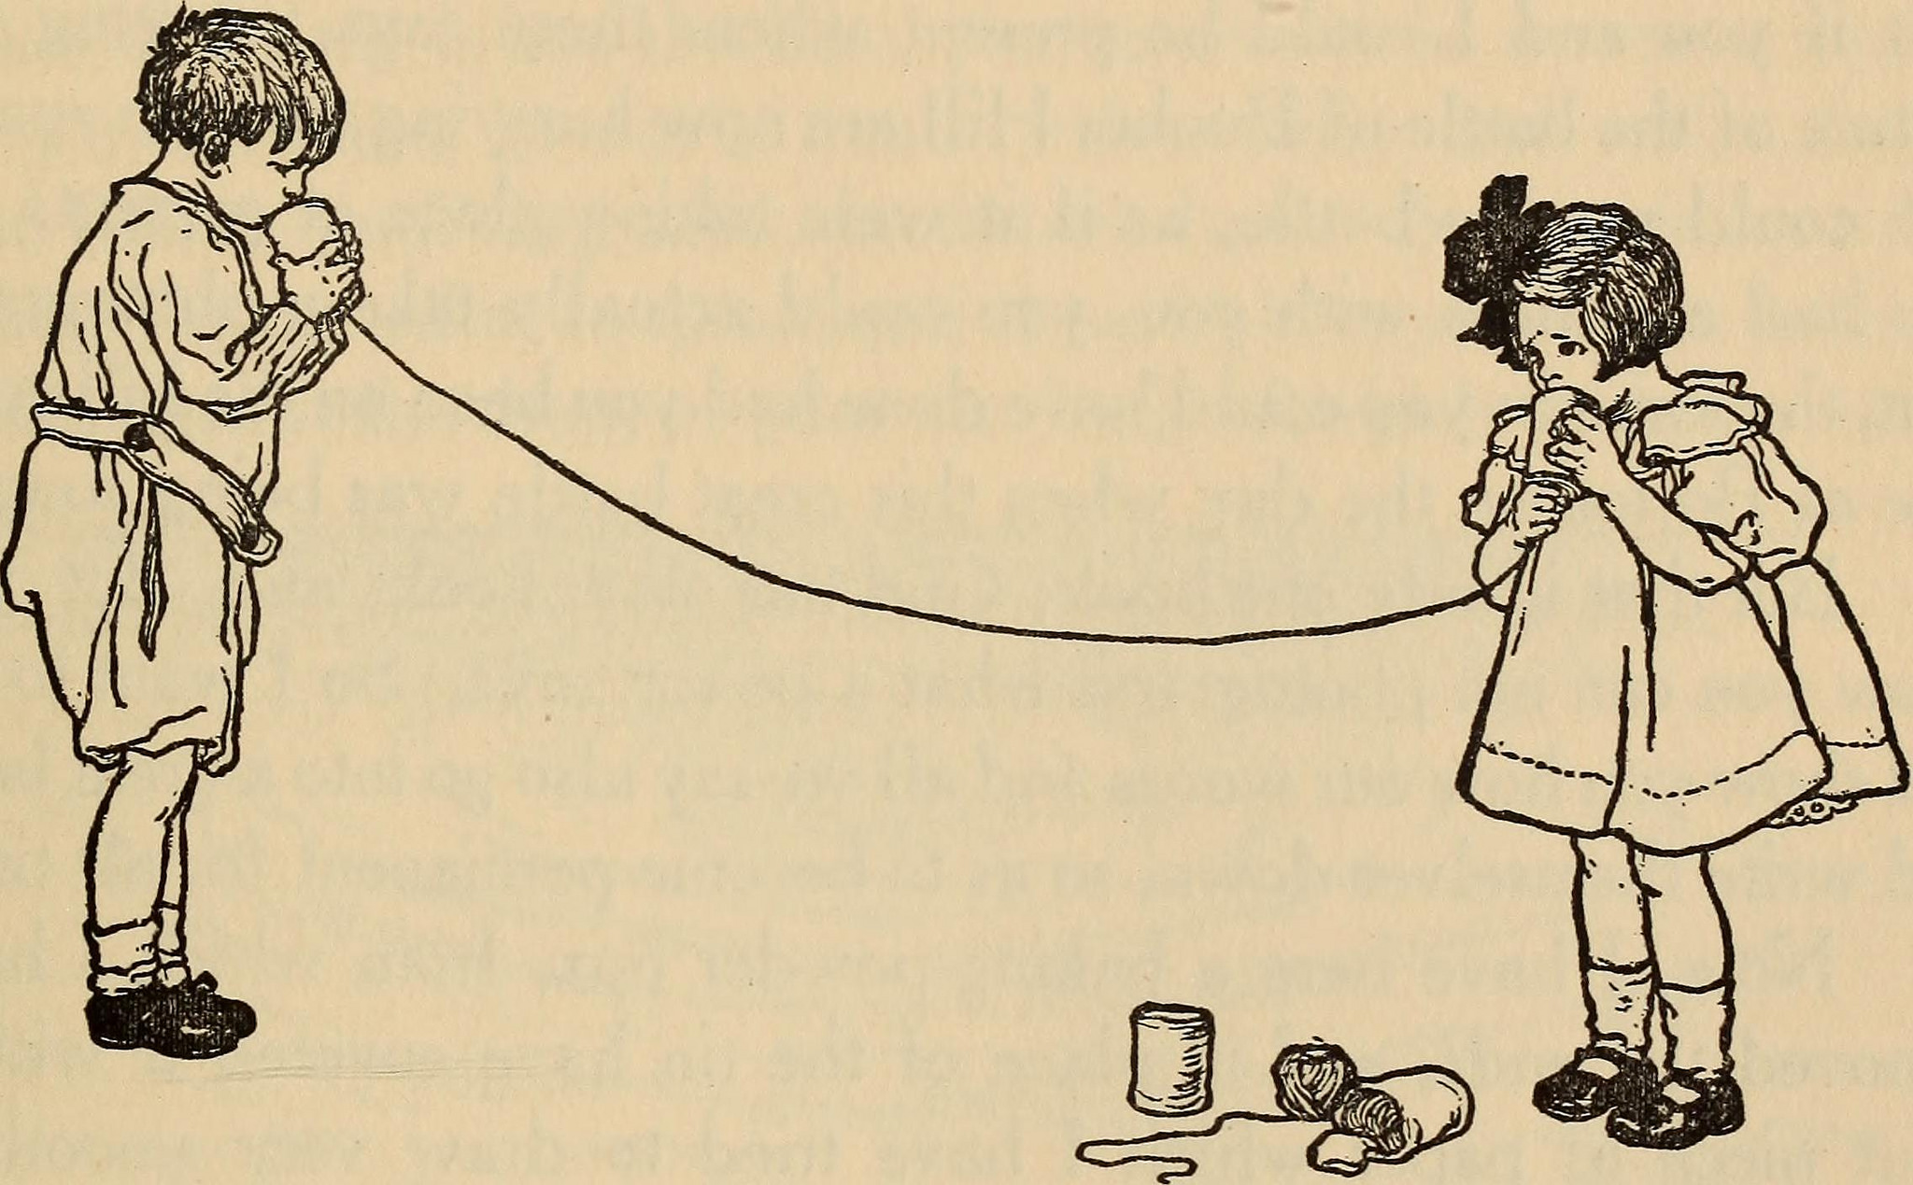
Trickle-Down-IO
“HELLO, WORLD“
Notes:
Surprise! by default Rust does read
and write without buffer, but speed
is less than fast
so newbies may blast
the wait for IO to complete / 8:42

Slide 27
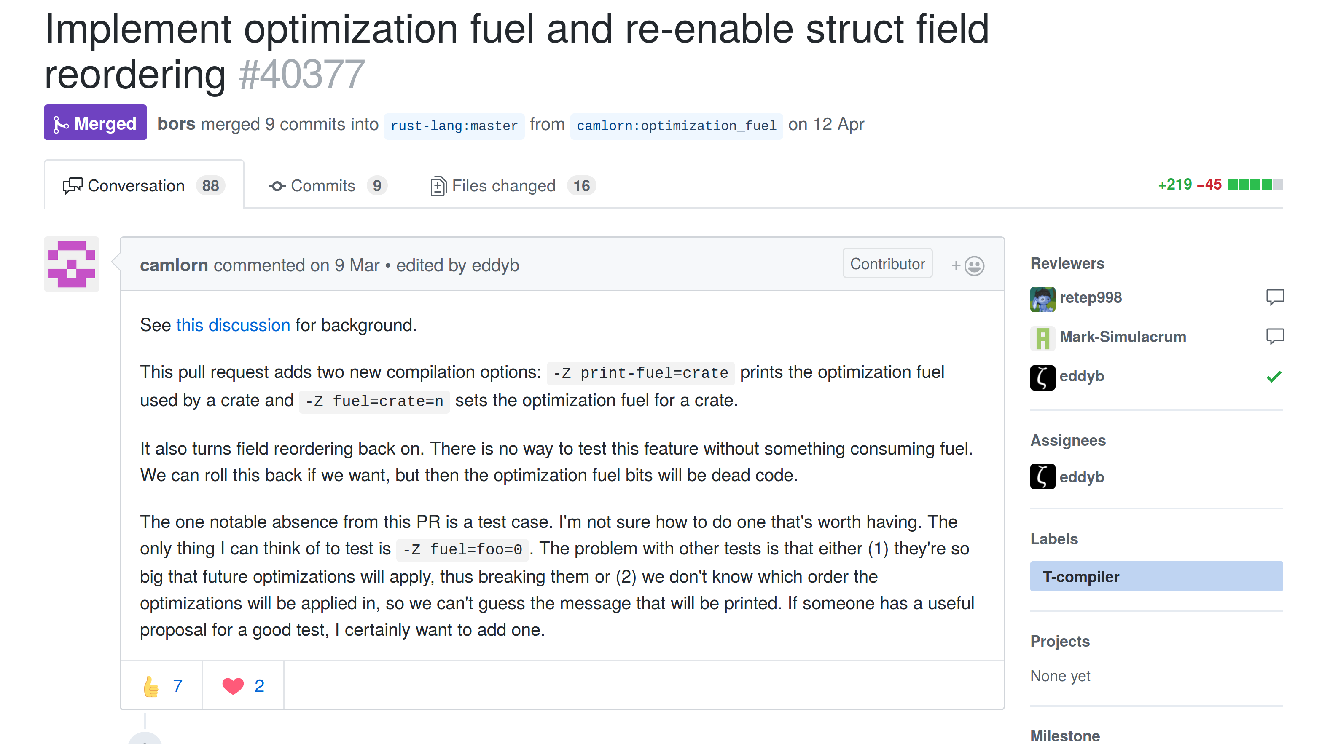
Notes:
Austin Hicks did a stellar job
reducing Rust memory slop
by teaching rustc
to reorder fields free
Unless repr(C) tells it to stop / 9:00
One thing with that stuff which is cool:
With "optimization fuel"
we can test where a change
leads to things weird or strange
it's a really great debugging tool / 9:18

Slide 28
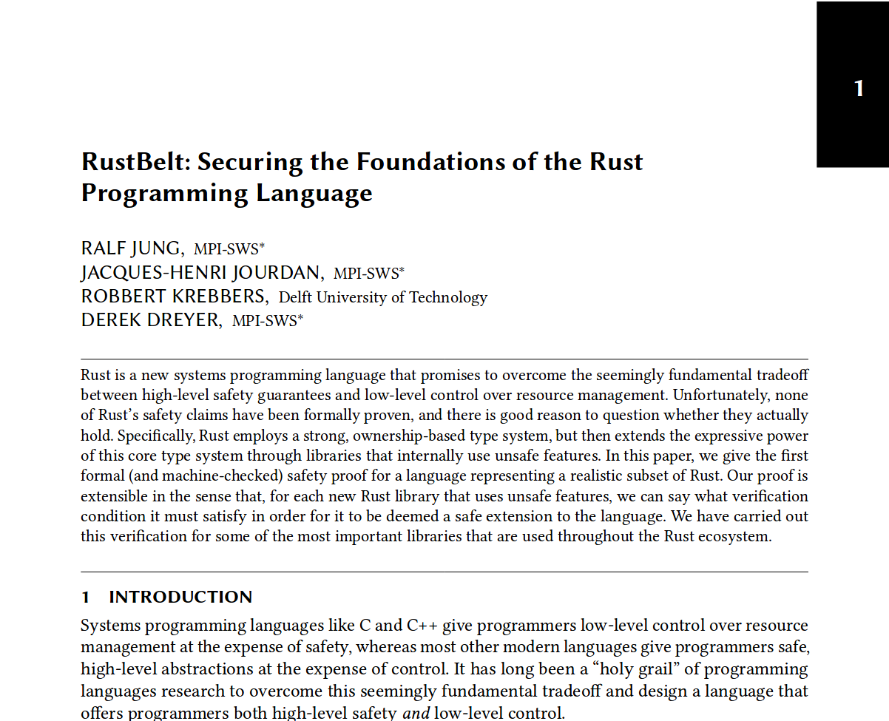
Notes:
Ralf Jung & his merry Rustaceans
performed some great verifications
of unsafe things Rust
so we can all trust
it's solid for all applications / 9:36

Slide 29
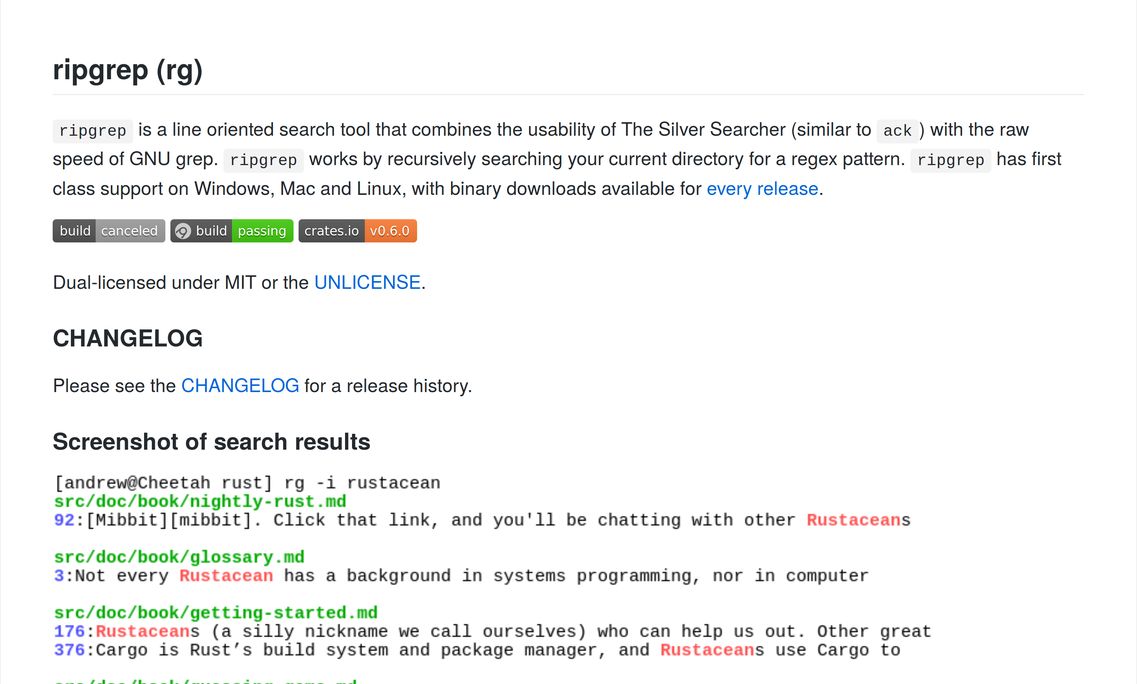
Notes:
Burntsushi when asked to rewrite
ripgrep in C++ said he might
but he'd like to refrain
from the need to maintain
it as that'd be hell of a fight / 9:54

Slide 30

SHAR screenshot (recent youtube?)
Notes:
SHAR Bringer, a game built in Rust
Got greenlit on Steam so we just
Send congratulations
amidst great celebrations
Soon we'll sate our rust gamedev lust / 10:12

Slide 31

Notes:
Our clippy will warn us on code
that may at some day corrode
through our source and about
it'll gladly look out
for patterns that do not well bode / 10:30

Slide 32
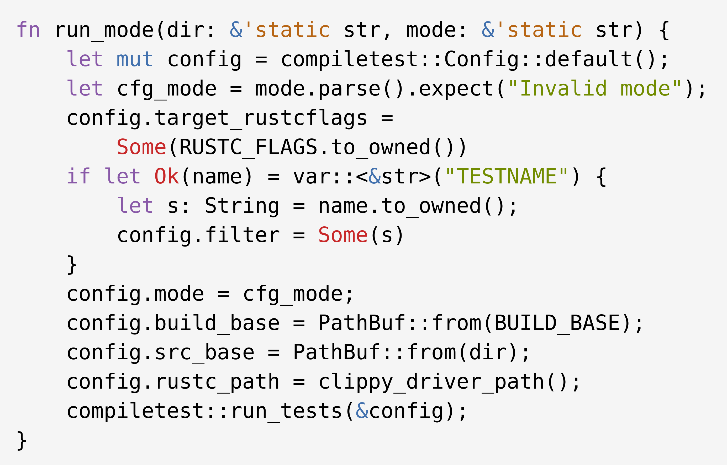
Notes:
Use Rust's typesystem to restrict
how your API is used and be strict?
You will love compiletest
to put your fears to rest
if the wrong restrictions you picked / 10:48

Slide 33
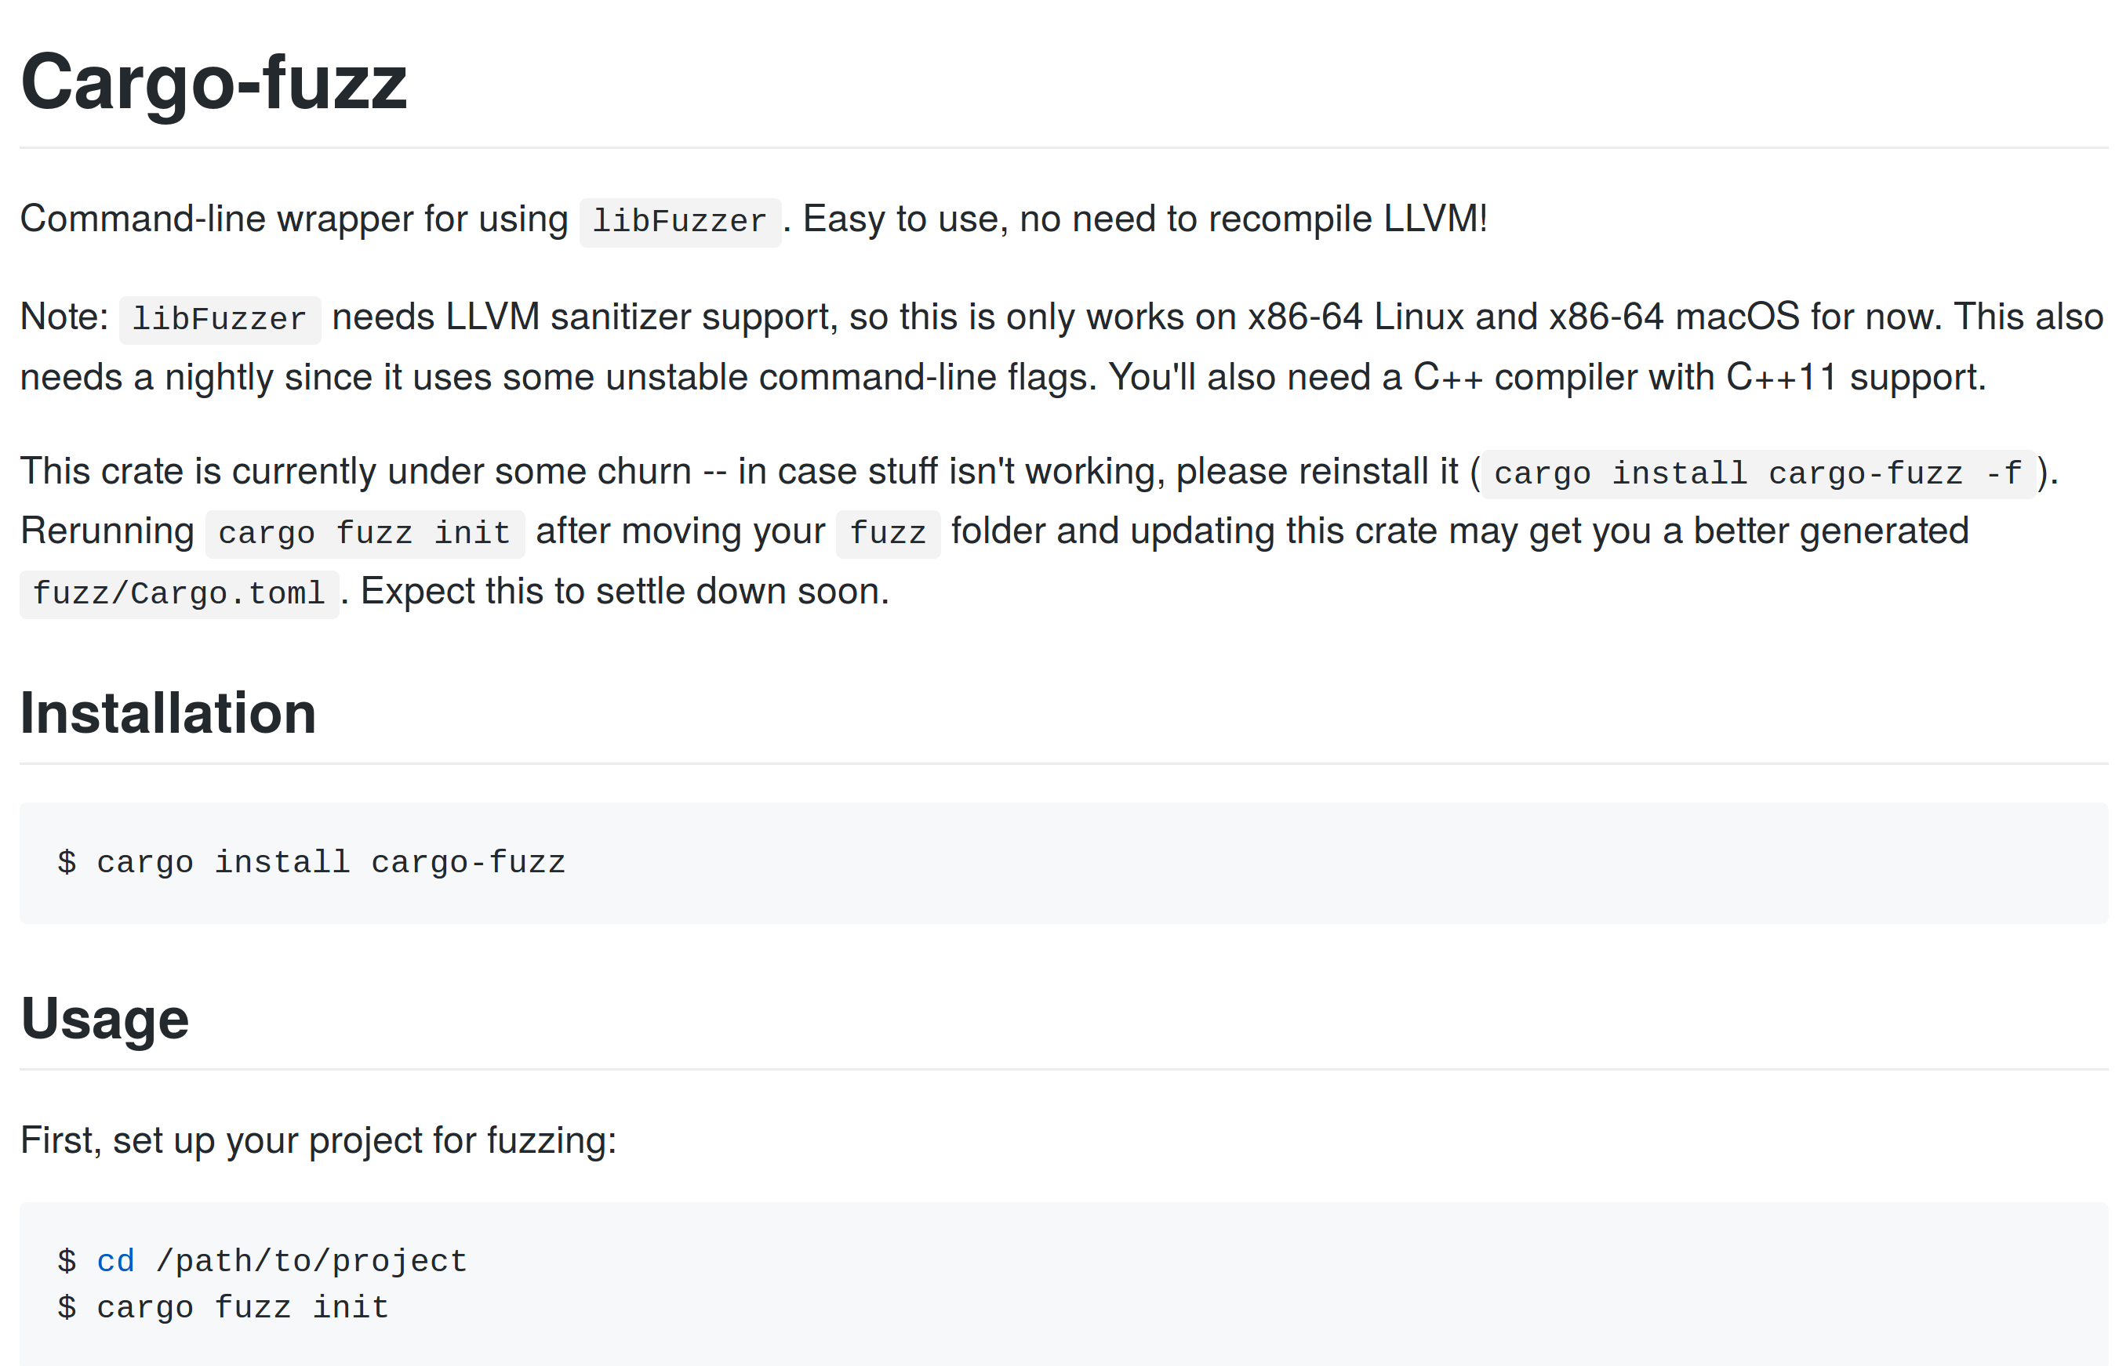
Notes:
Rust coding is one of the best
if you want to easily test
your code when given stuff
performs correct enough
cargo fuzz will take care of the rest / 11:06

Slide 34
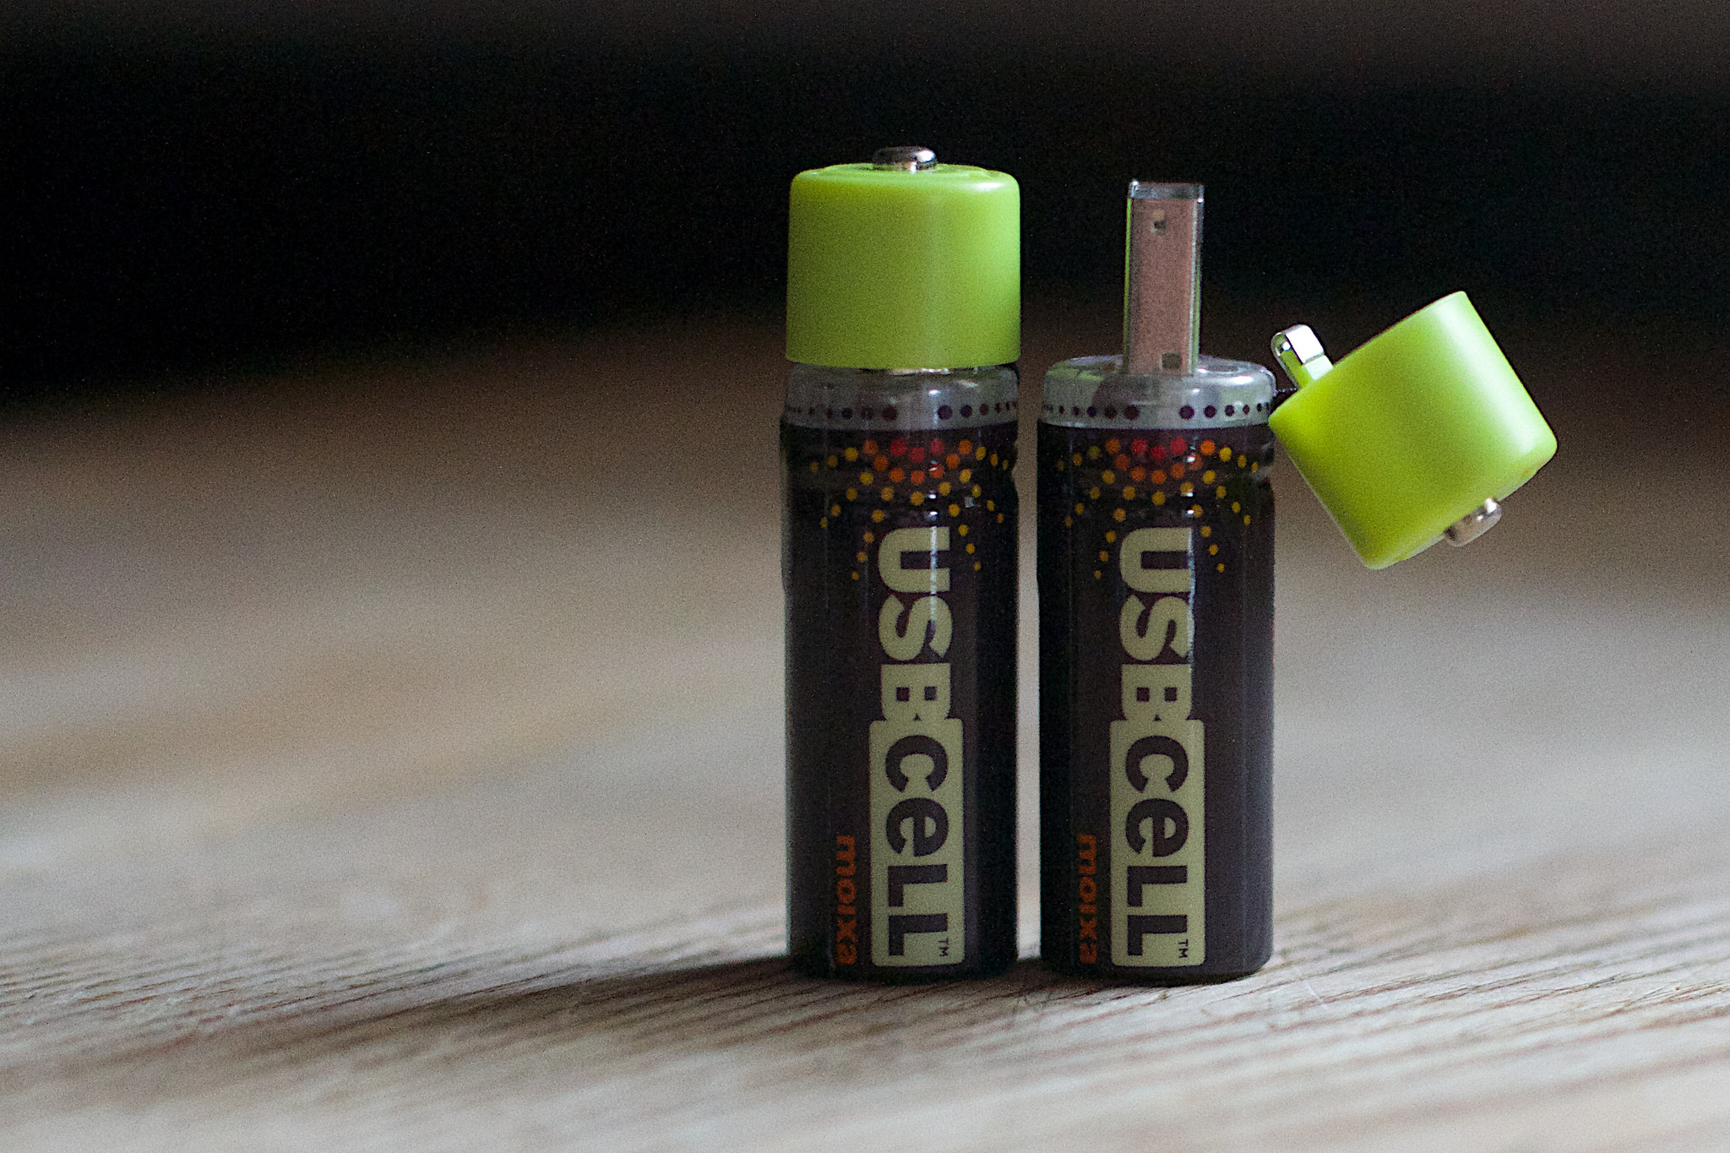
Notes:
Our Rust will help you conserve
The battery charge you reserve
for the code that you run
for your work or for fun,
or what from your servers you serve // 11:24

Slide 35

Notes:
Rust code with a value on `break`
may lead to a certain mistake
if you try to break rust
try it out if you must
in the Rust easter egg hunt partake / 11:42

Slide 36

Notes:
Who knows what Rust in six weeks
give us new features and tweaks
will it blend? will it slice?
and be awesome and nice?
Now I sound like a total geek / 12:00

Slide 37

Notes:
In May Rust will be three years old
The changes have been pretty bold
Every six weeks it grew
out the old, in the new
The stability promise will hold / 12:18

Slide 38

Notes:
Looking into my chrystal ball
I see much awesome progress this fall
with implementations
by merry rustaceans
it's the impl period after all / 12:36

Slide 39

Notes:
With Rust more folks get access
to systems programming with less
fearful footguns and stuff
– C++ has enough –
Here's to its ongoing success! / 12:54

Slide 40

Notes:
If into Rust you want to enter
join a project and find you a mentor
who'll help you for free
so you can easily
become a great Rust implementer / 13:12

Slide 41

Notes:
Rustaceans don't need to code Rust
we document, teach, blog and dust
off some or other test
lay our worries to rest
that our code may not do what it must / 13:30

Slide 42
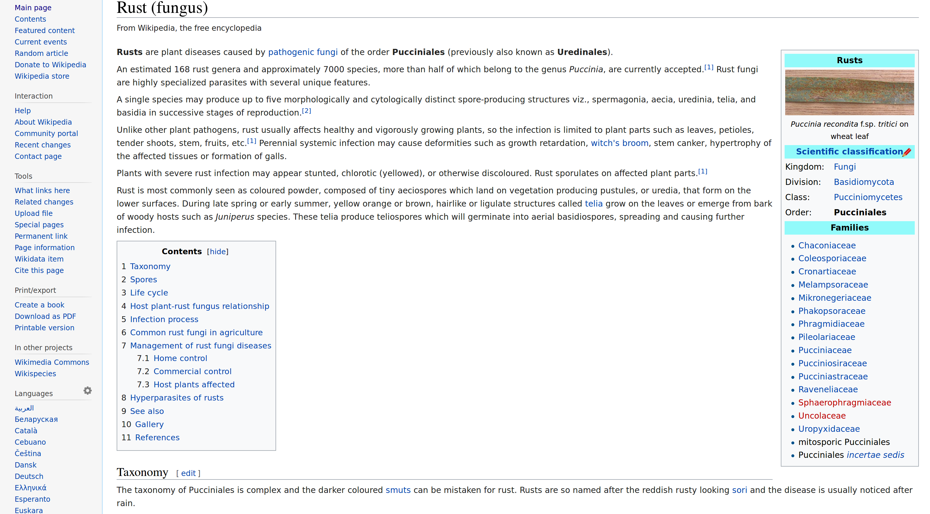
Notes:
Let's bring some elucidation:
Rust owes its denomination
to a fungus that has
three life stages, alas
many mistake it for oxidation. / 13:48

Slide 43
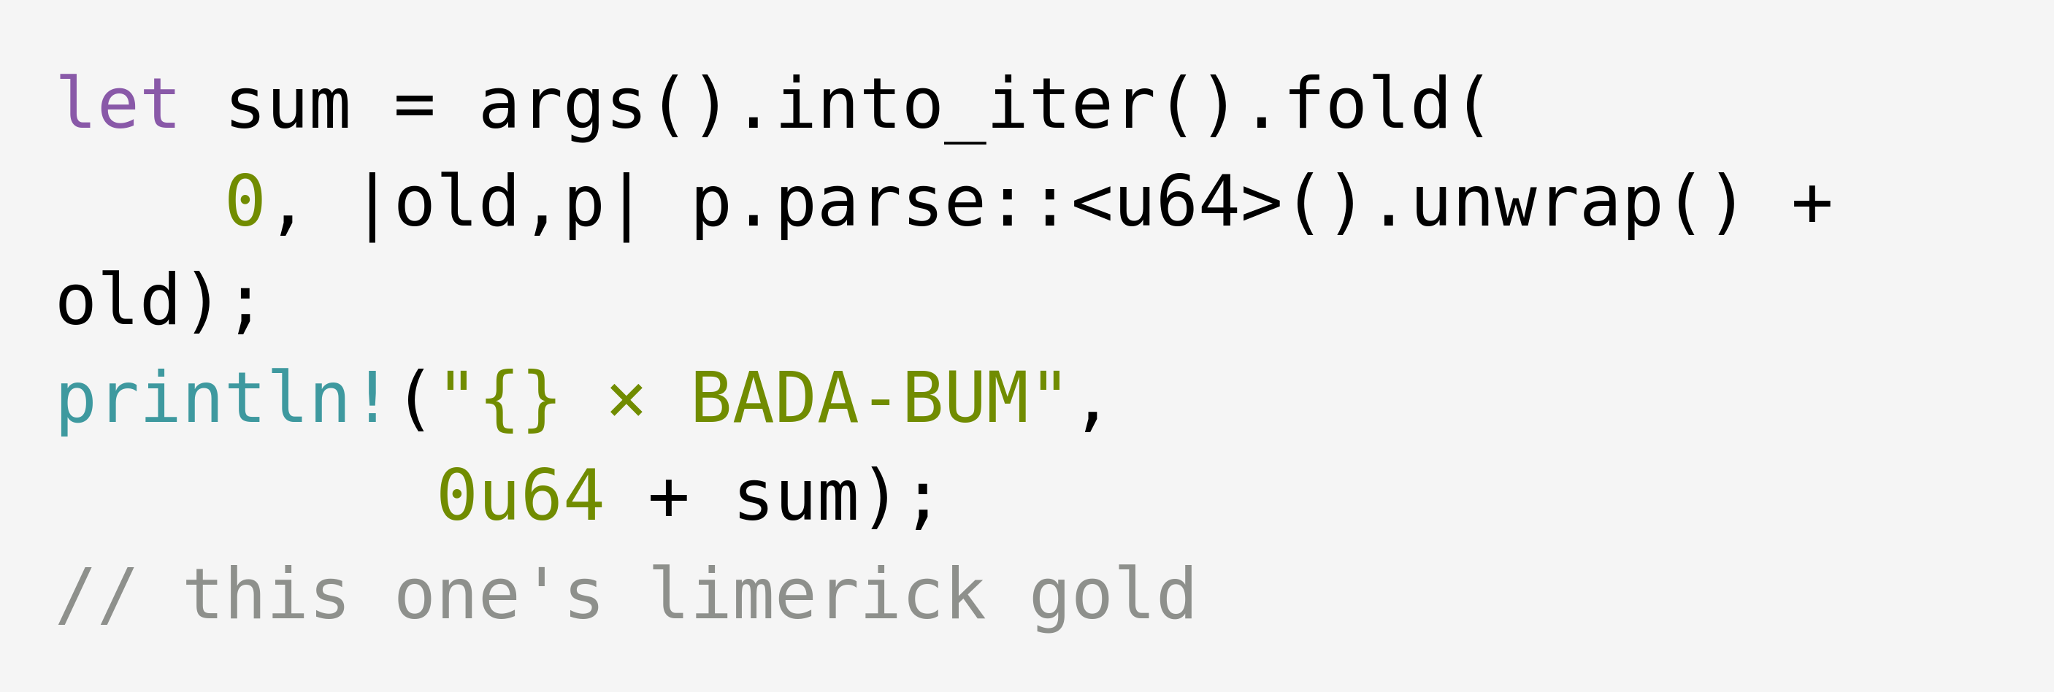
Notes:
let sum be args into-iter fold
Zero old,p p parse unwrap plus old
Println! times BADA-BUM,
0u64 plus sum
Slash slash this 1's limerick gold / 14:06

Slide 44
RUST IN
RHYMES
Notes:
Thanks for listening while I wax
poetically on multiple stacks
and I hope that you walk
happy out of this talk
otherwise there‘ll be no money backs! / 14:24

