Slide 1
Heart Disease Dataset

Slide 2
Logistic Regression
Goal: predict whether a patient will likely to have heart disease
Since this is a classification problem, we can use Logistic Regression
For data preprocessing, 13 features are picked from the original 76 and are polynomially transformed(degree = 2)
only 13 features are picked because all other features contain a lot of N/A value

Slide 3

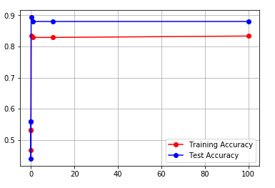
Logistic Regression with Lasso(L1)

Slide 4

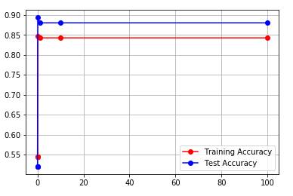
Logistic Regression with Lasso(L1)

Slide 5

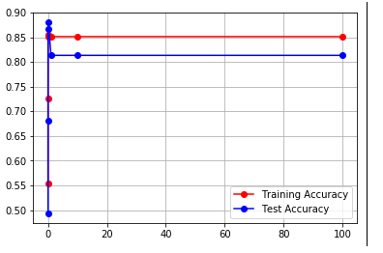
Logistic Regression with Ridge(L2)

Slide 6

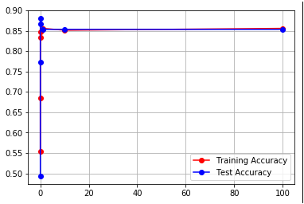
Logistic Regression with Ridge(L2)

Slide 7
Conclusions for Logistic Regression
For three of the four variations tested, performance of the Logistic Regression model peaks at C = 0.1(equivalent as lambda = 10)
For the model using Ridge(L2) regularization and polynomially transformed features(degree = 2), performance peaks at C = 0.01(equivalent to lambda = 100)
We can see that after a certain point, increasing the value of C(adjusting the penalty/regularization) doesn’t improve performance anymore

Slide 8
Support Vector Machines
SVM is generally a stronger classification model which finds the separating hyperplane that best fits the dataset
Time complexity for training is polynomial as it is essentially trying to solve an inequality with quadratic constraints(Linear Programming)
Only those examples that are closest to the hyperplane will affect the parameters, which means much more efficient than Logistic models

Slide 9

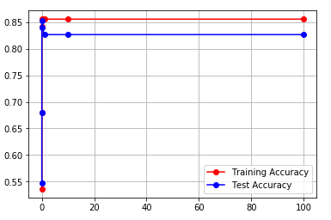
Support Vector Machines with Linear Kernel

Slide 10

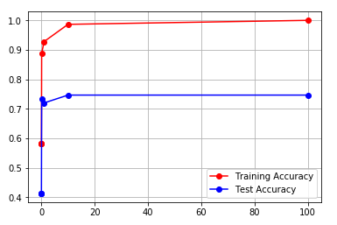
Support Vector Machines with RBF Kernel

Slide 11

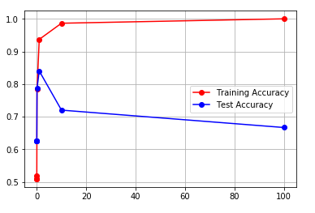
Support Vector Machines with Polynomial Kernel

Slide 12
Conclusions for SVM
Unfortunately, three models using three different kernels obtain the best performance at three different C values
No obvious pattern can be observed on how to choose appropriate C value
But luckily, the model with RBF kernel has a monotonously increasing performance while C increases(lambda decreases)

Slide 13
Neural Network (with Ridge Regularization)
Code(training):
def train_nn(nn_structure, X, y, iter_num=3000, alpha=0.5, lamb=0): …
Mostly same as the demo NN code posted on Classes
Adjustable nn_structure, number of iterations, learning rate, lambda
Cost function added with Ridge Regularization term: J += lambda*sum(W^2)
sum_W comes from summing up all elements in the weight matrix
W[l] += -alpha * (1.0/N * tri_W[l] + 2*lamb*sum_W)
Notes:
0,(no heart disease) 1,2,3,4 (level of severity, for the sake of simplicity, task is reduced to just 0/1)
2. W[l] += -alpha * (1.0/N * tri_W[l] + lamb*W[l]), the derivative of cost function that contains ridge regularization)

Slide 14
Varying parameters passed into training function
Try to vary number of neurons per layer; multiple hidden layers; activation function; tuning parameter for regularization; number of iterations …

Slide 15
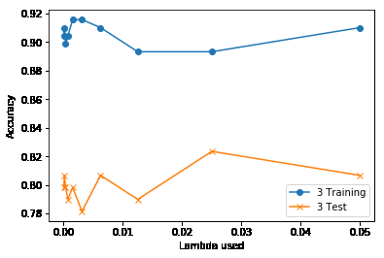
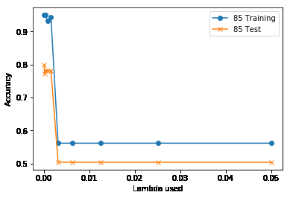
Single hidden layer, vary the number of neurons
Num_neurons = [3, 85, 168, 251, 334, 417, 500]
Lambdas = [0.0001 0.00019947 0.0003979 0.0007937 0.00158322 0.00315811
0.00629961 0.01256605 0.02506597 0.05 ]
3000 iterations, learning rate = 0.5
Notes:
The results are in the next slide, all the nne tried larger than 3 perform poorly.

Slide 16
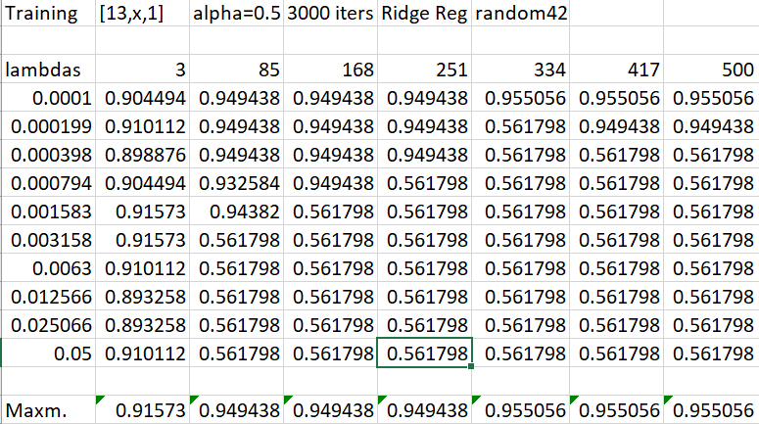
Notes:
Training acuracies. Observe that the training accuracy increases as nne increases. Also observe that from 85 and subsequent nne have sharp decrease at some point of lambda

Slide 17
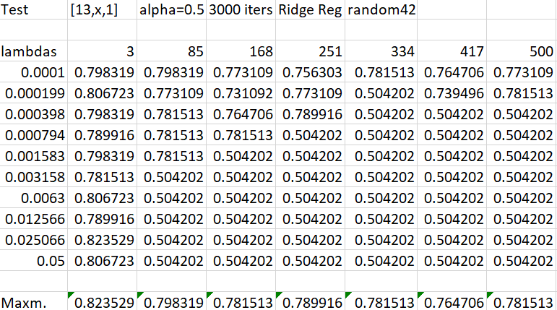
Notes:
The smallest nne used in fact has the best test accuracy, tho maximum don’t differ sharply, the averages are very different.

Slide 18
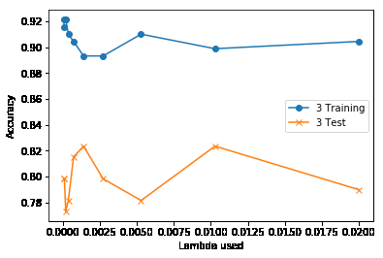
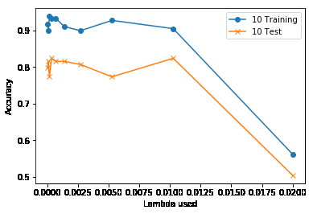
Reduce to smaller range
Num_neurons = [3, 10, 18, 26, 34, 42, 50]
Lambdas =[5.00000000e-05 9.72943859e-05 1.89323950e-04 3.68403150e-04
7.16871164e-04 1.39495079e-03 2.71441762e-03 5.28195190e-03
1.02780853e-02 2.00000000e-02]
3000 iterations, learning rate = 0.5
Notes:
Lots of up and downs, no clear pattern

Slide 19
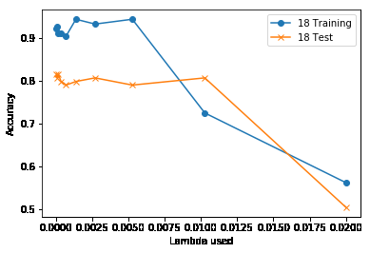
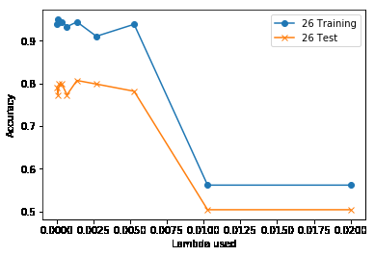

Slide 20
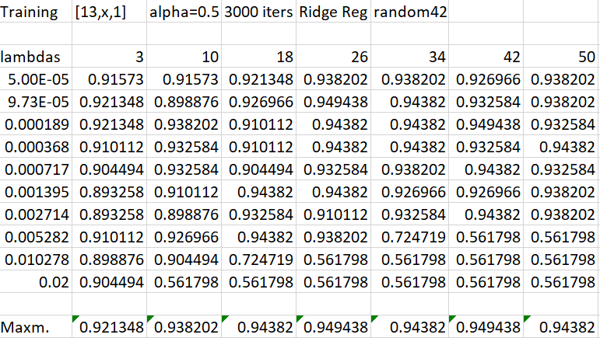

Slide 21
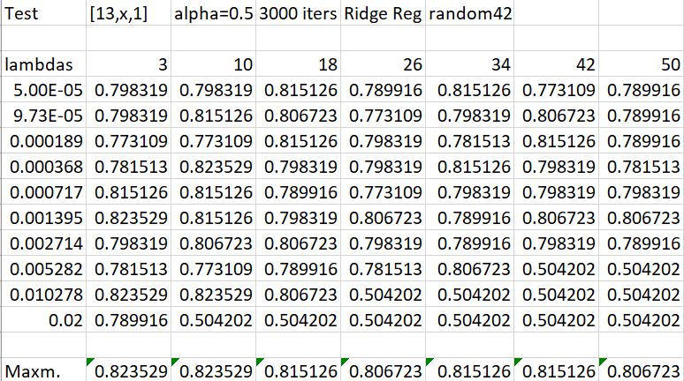
Notes:
3 neurons still perform better than the rest

Slide 22
Conclusion of NN performance
Multiple combinations result in a maximum test accuracy around 82%
No obvious pattern or trend to determine which lambda or what number of neurons give the best result
Rule of thumb: For a three layer NN, the number of neurons would be approximately sqrt(n*m) given n inputs neurons and m outputs neurons
In our case, sqrt(13*1) = 3.6 (neurons on the hidden layer)
Reference:
Masters, Timothy. Practical neural network recipes in C++. Morgan Kaufmann, 1993.
https://stats.stackexchange.com/questions/181/how-to-choose-the-number-of-hidden-layers-and-nodes-in-a-feedforward-neural-netw
Notes:
Given that the large number of neurons don’t perform better than 3 neurons, if possible (no further evidence to show that 4 neurons nn_structure is too simple), probably choose the one that costs least computational power. After searching for the number of neurons to select for hidden layer, we find that it is reasonable to choose a small number for the hidden layer since we have sqrt(13*1) = 3.6

