Slide 1
Mushrooms vs. textile (S₄₄₁)
preload
FBM fit

Slide 2
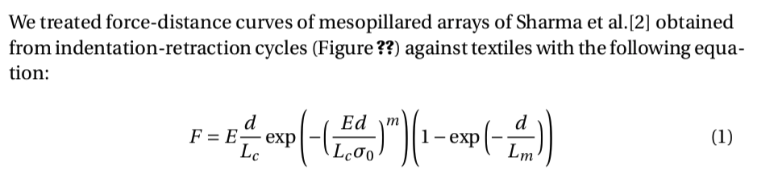
surface area!
number density?
Shouldn’t L_{m} be more
related to fibre stretch
and less to mushroom size?
Why would L_{c} depend on preload?
How is it obtained?

Slide 3
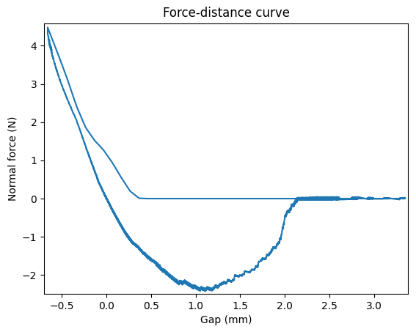
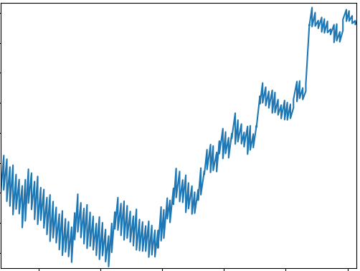
Suction cup detachment events
2
1
?

Slide 4
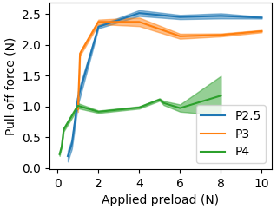
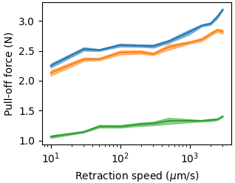
Suction cups

Slide 5
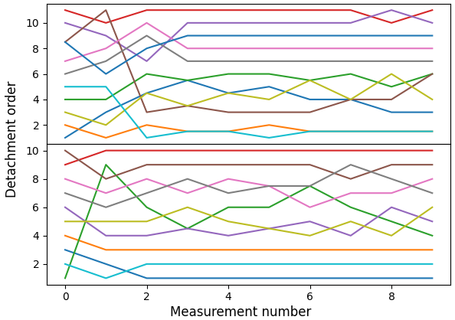
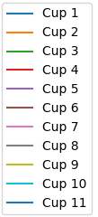
Detachment order

