Slide 1
PREPARED FOR NY RACING
NASCAR Sponsorship
Visibility Analysis
Strategic Recommendations for NY Racing
Lloyd Todaro • August 18, 2026
“Which sponsors deliver the best visibility per dollar invested?”
01 / 10

Slide 2
EXECUTIVE SUMMARY
The Bottom Line
477.6
Progressive — Total Visibility Points
Rank #1 of 5 sponsors
39.9
Cheddar's Scratch Kitchen — Points per $M
≈1.5× Progressive's efficiency rate
40%
Race Performance Weight in the Score
Media visibility can outweigh on-track results
PRIMARY RECOMMENDATION
Cheddar's Scratch Kitchen
The best efficiency in the group and #2 in total visibility — on the smallest budget of the five sponsors analyzed.
NASCAR SPONSORSHIP VISIBILITY ANALYSIS
02 / 10

Slide 3
PROJECT APPROACH
How We Measured Sponsorship Visibility
Data Sources
Scoring Model
Rankings
▸ Analyzed 5 primary sponsors across 53 tracked races from the 2025 season and 2026 season-to-date (each sponsor's own race count ranges from 11 to 29)
▸ Combined race results, social media, and news coverage into one composite score
▸ Weighted as race performance (40%), a PCA-weighted visibility index across Reddit, YouTube, and news (50%), and special events like wins and playoffs (10%)
WHY IT MATTERS
NY Racing has never had a single, consistent way to compare sponsor visibility across channels. This model gives them one.
NASCAR SPONSORSHIP VISIBILITY ANALYSIS
03 / 10

Slide 4
DATA AND LIMITATIONS
What We Measured
Category | Source | Note
Race Performance | Racing Reference | 53 races
Social Media | Reddit (Arctic Shift), YouTube Data API | Fan engagement
News Coverage | GDELT DOC 2.0 + BigQuery GKG, ~19 curated domains | Weighted by source tier
Costs | Forbes, Jayski, Speedway Media, RTR Sports, team/league press | Estimates, not disclosed contracts
IMPORTANT CAVEAT
Cost estimates are approximations, not actual contract values. Cheddar's Scratch Kitchen's $4.9M figure is the least certain number in this analysis: it borrows Castrol's own sourced per-race rate rather than a disclosed number for the Cheddar's/RCR deal itself.
NASCAR SPONSORSHIP VISIBILITY ANALYSIS
04 / 10

Slide 5
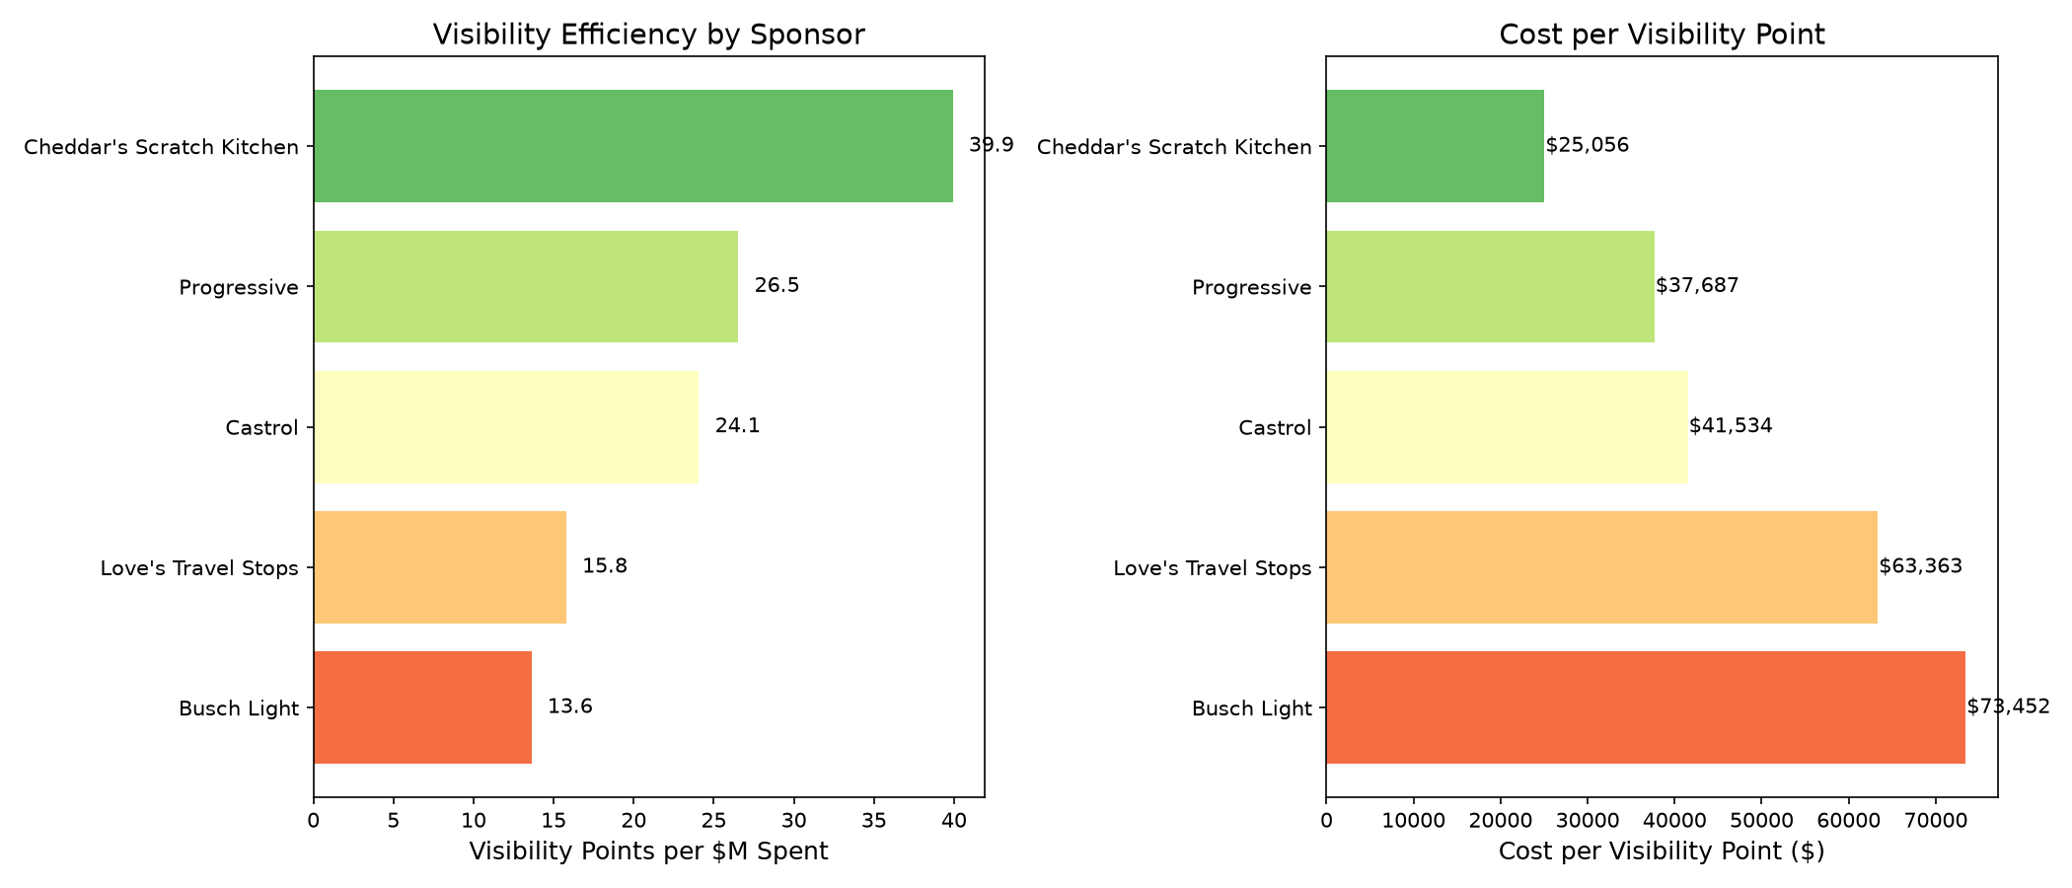
FINDING 01
Efficiency Leadership Doesn't Track Brand Prestige
Cheddar's Scratch Kitchen delivers the best visibility per dollar of any tracked sponsor, about 1.5x Progressive, while its budget sits close to Castrol's rather than Progressive's.
SO WHAT?
Cheddar's Scratch Kitchen is worth serious consideration as the primary target. It ranks #2 in total visibility despite the second-smallest race count in the group, at roughly a quarter of Progressive's cost.
NASCAR SPONSORSHIP VISIBILITY ANALYSIS
05 / 10

Slide 6
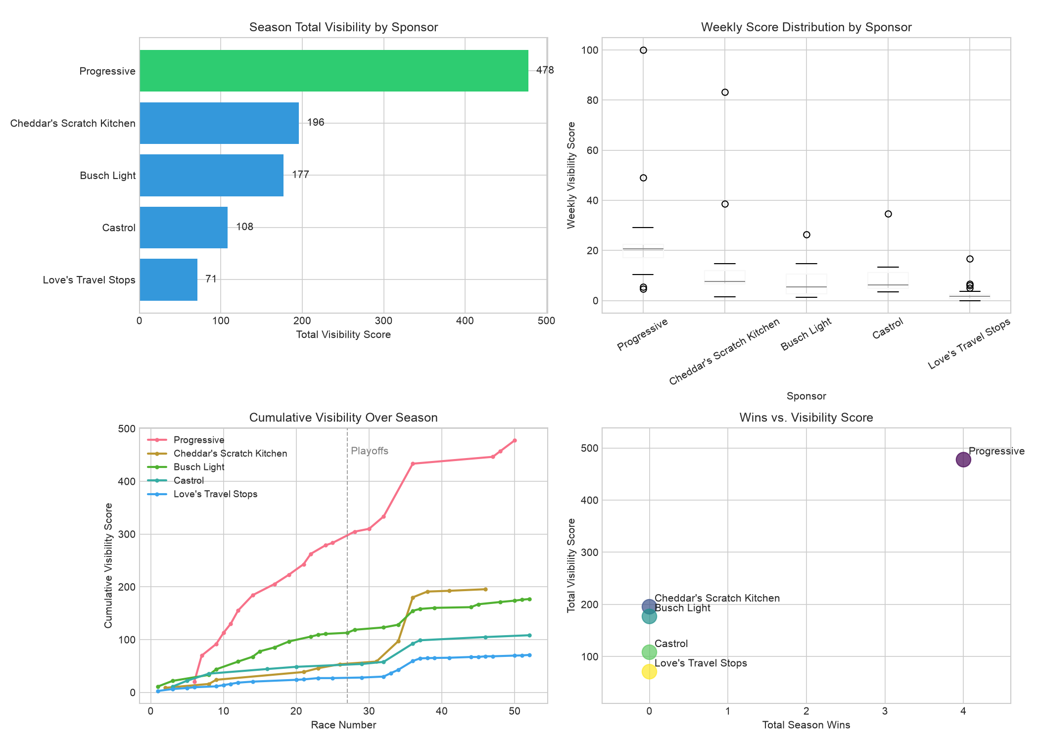
FINDING 02
A Playoff Race Is Worth More Than Double a Regular-Season One
Average visibility in playoff-window races (races 27 to 36) runs 129% higher than in regular-season races, a bigger swing than the win bonus (1.79x).
SO WHAT?
Treat the playoff window as a premium activation period, not just a higher-stakes version of a normal week. Content and hospitality spend should scale up specifically for that ten-race stretch.
NASCAR SPONSORSHIP VISIBILITY ANALYSIS
06 / 10

Slide 7
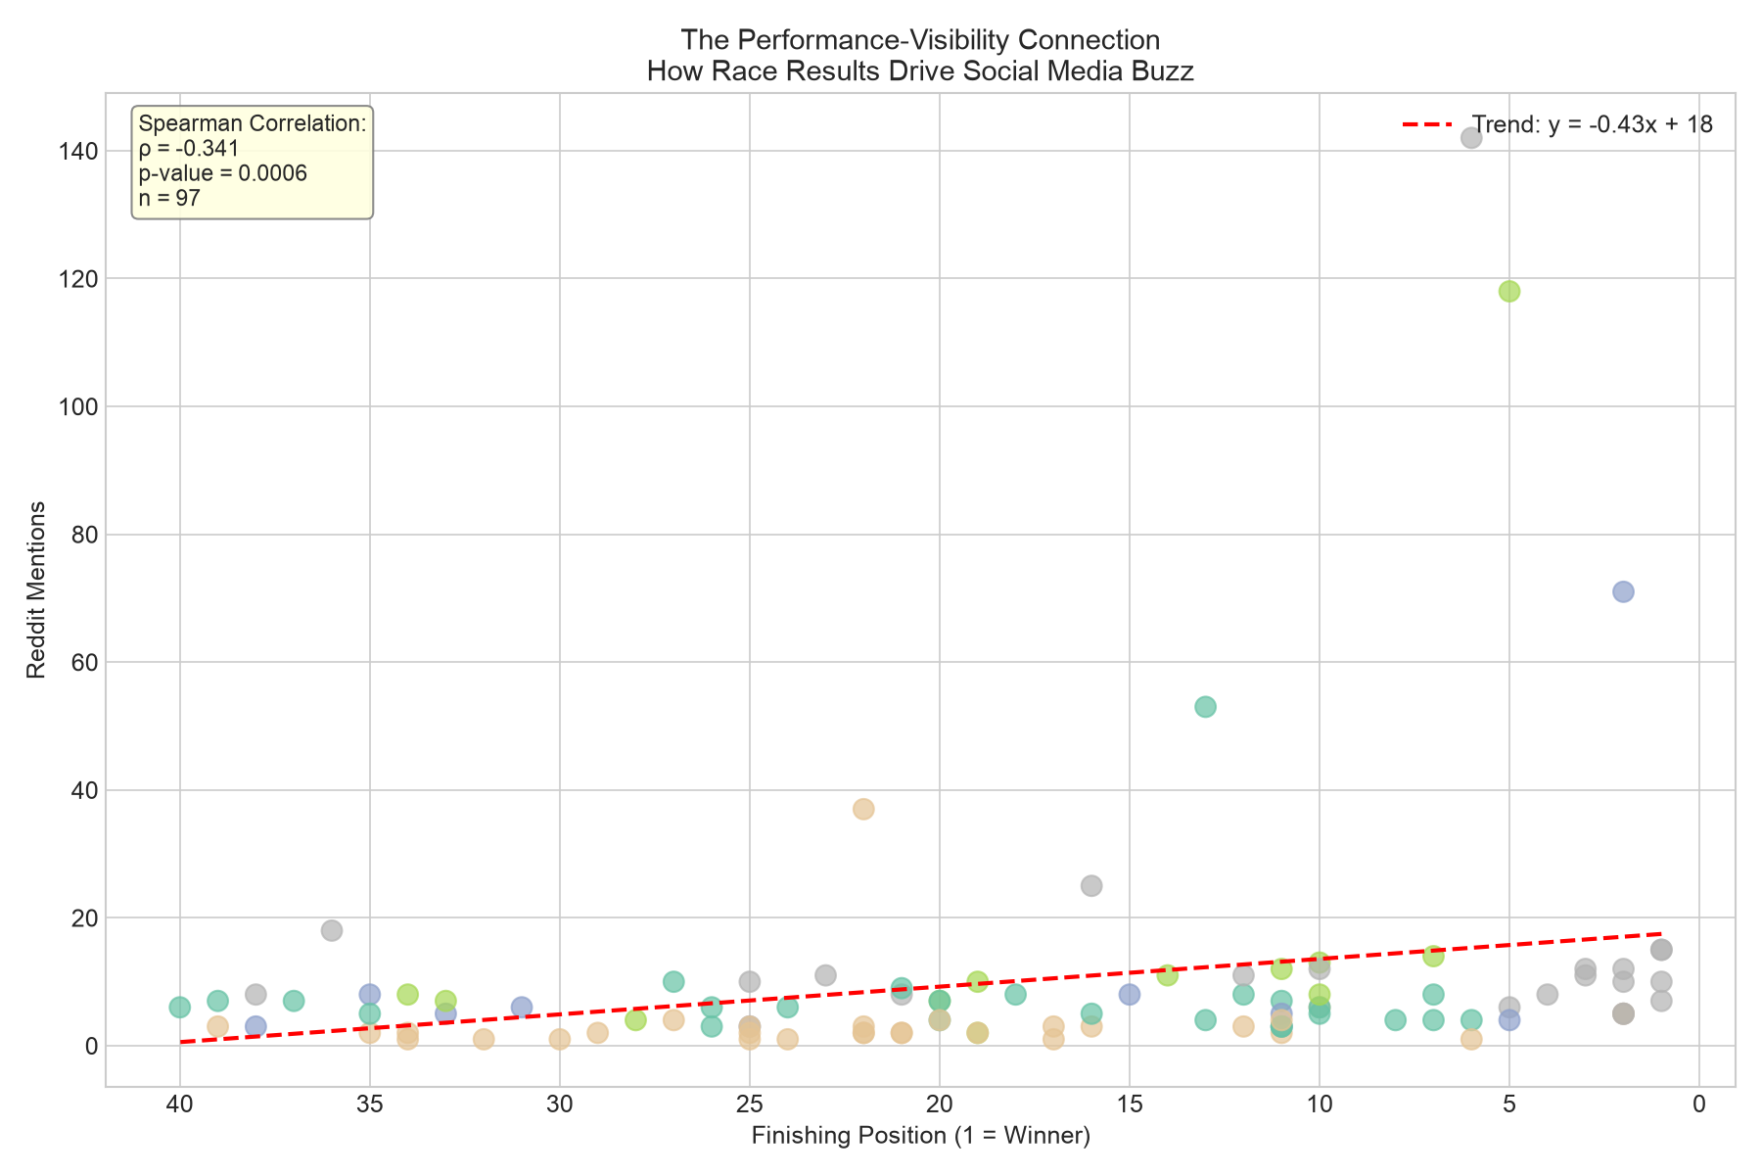
FINDING 03
Reddit Is the Only Channel With a Statistically Reliable Signal
Of the three visibility channels tracked, only Reddit's relationship with race performance clears standard significance thresholds (r = -0.34, p = 0.0006, N = 97). YouTube and news trend the same direction but aren't statistically distinguishable from noise at this sample size.
SO WHAT?
Weight Reddit most heavily in any future live-monitoring dashboard, and treat YouTube and news mentions as confirmatory rather than primary signals.
NASCAR SPONSORSHIP VISIBILITY ANALYSIS
07 / 10

Slide 8
RECOMMENDATIONS
Who Should NY Racing Pursue?
PRIMARY RECOMMENDATION
Cheddar's Scratch Kitchen
ALTERNATIVE
Progressive
VISIBILITY
195.6 pts
Rank #2 of 5
VISIBILITY
477.6 pts
Rank #1 of 5
EFFICIENCY
39.9 pts/$M
Rank #1 of 5
EFFICIENCY
26.5 pts/$M
WHY
The best return per dollar in the group, and still the #2 total-visibility sponsor, for roughly a quarter of Progressive's cost. Contingent on verifying the cost estimate directly.
WHY
Best for teams that want maximum reach and the best-sourced cost estimate of the group — willing to pay about 3.7× Cheddar's estimated cost for it.
NASCAR SPONSORSHIP VISIBILITY ANALYSIS
08 / 10

Slide 9
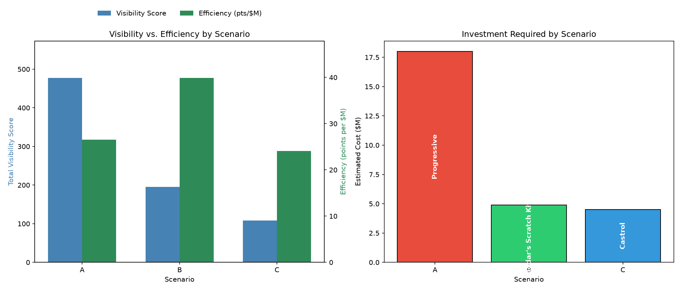
TRADE-OFFS
Choosing Your Strategy
Strategy | Sponsor | Visibility | Efficiency | Investment
Maximum Visibility | Progressive | 477.6 pts | 26.5 pts/$M | $18.0M
Maximum Efficiency | Cheddar's Scratch Kitchen | 195.6 pts | 39.9 pts/$M | $4.9M
Balanced / Hedge | Castrol | 108.3 pts | 24.1 pts/$M | $4.5M
Question for NY Racing: Does the budget call for maximum reach, the best return per dollar, or a well-sourced middle option?
NASCAR SPONSORSHIP VISIBILITY ANALYSIS
09 / 10

Slide 10
NEXT STEPS
Recommended Actions
1
IMMEDIATE
Get a direct cost quote for the Cheddar's Scratch Kitchen / Kyle Busch / RCR No. 8 deal. It's the single number that could change this recommendation.
2
SHORT TERM (1-2 WEEKS)
Run a sentiment check on the Kyle Busch Reddit and YouTube corpus to confirm the visibility is net positive before pitching this externally.
3
MEDIUM TERM (1 MONTH)
Revisit the ranking once Cheddar's and Castrol have more races on record. Both sit under 12 tracked races today.
Questions?
Lloyd Todaro • lloydltodaro@gmail.com

