Slide 1
Grading Campaigns How can we judge congressional campaigns sooner and better.
Presented by Lloyd Miller
June 3, 2015

Slide 2
Background On The Problem
Outside groups spent $790 million in 2014
Earlier decisions make for more efficient spending
Limited information available in the summer before the election
Campaign Finance Data is limited to quarterly reports:
First Quarter reports come out April 15
Second Quarter reports come out July 15
Third Quarter reports come out October 15

Slide 3
How can we help make better choices
Given the July 15th campaign finance report, what can we learn and predict about the eventual outcome of the election in November?

Slide 4
Communicating The Results
We’re not going to predict the outcome, only use a predicted outcome to judge the health of a campaign.
Using the % of the vote gives us a smaller range to work with (20-80%) and is much more easily understood.
Campaigns communicate health through polling, and the accepted MOE of +/- 3.5-5.0%
Our goal is to achieve predictions that test as close to that error as possible.

Slide 5
What do we already know
We only have 870 total samples due to redistricting
Elections are generally predictable, there are few surprises
Actually predicting a single election result in next to impossible due to the eccentricities of individual races (scandals)
The best we can do is create a scale of grading campaigns general health, based on their predicted total percent of the vote. Anything more specific would be laughably inaccurate.

Slide 6
Available Data Sources
Federal Election Commission campaign finance report data for individual campaigns including receipts, disbursements, and cash on hand.
US Census Bureau American Community Survey
Districts generally behave similarly given certain parameters:
Population Density: Rural, exurban, suburban, and urban districts
Diversity: White population versus minority population
Cost Of Living: Median income, home value, and rent
Cook Political Report
Partisan Voter Index: The inclination for a district to support one party over another. This is the effective “point spread”

Slide 7
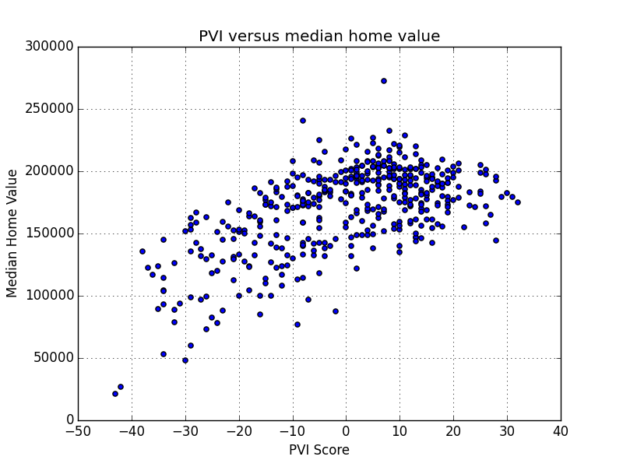
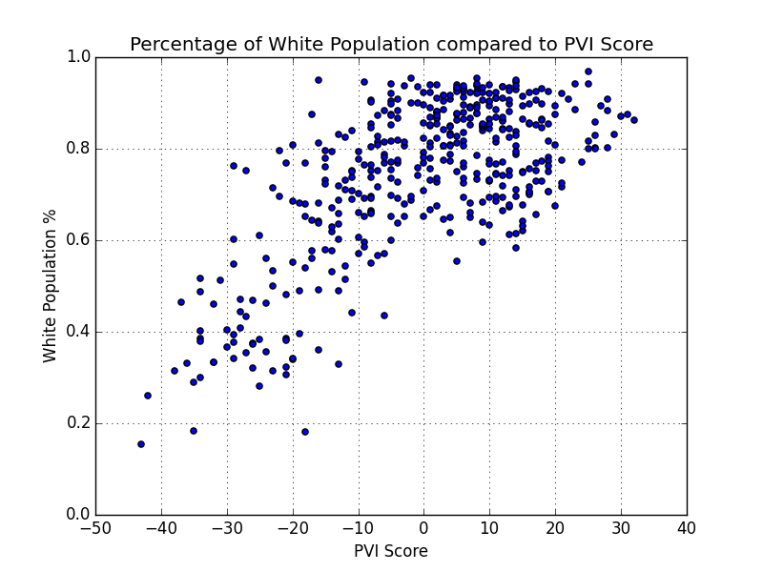
It Turns Out Demographics Don’t Matter
Although demographic data may play a role in party primaries, it is not the best indicator of general election results.

Slide 8
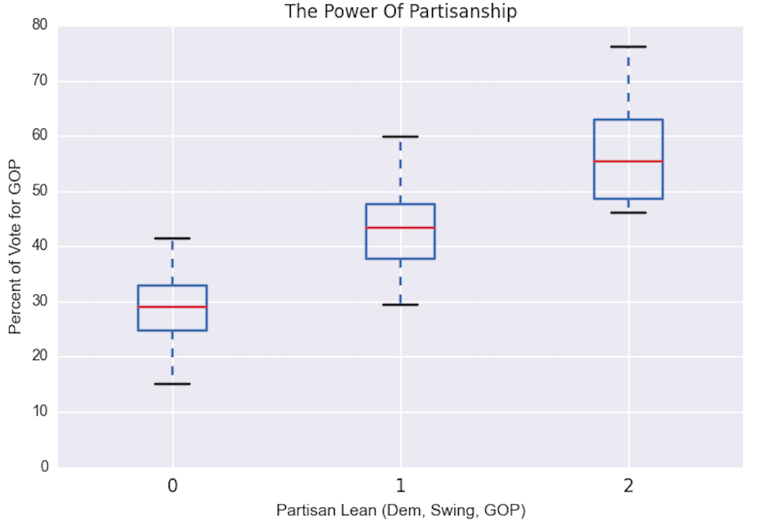
The Power of Partisanship

Slide 9
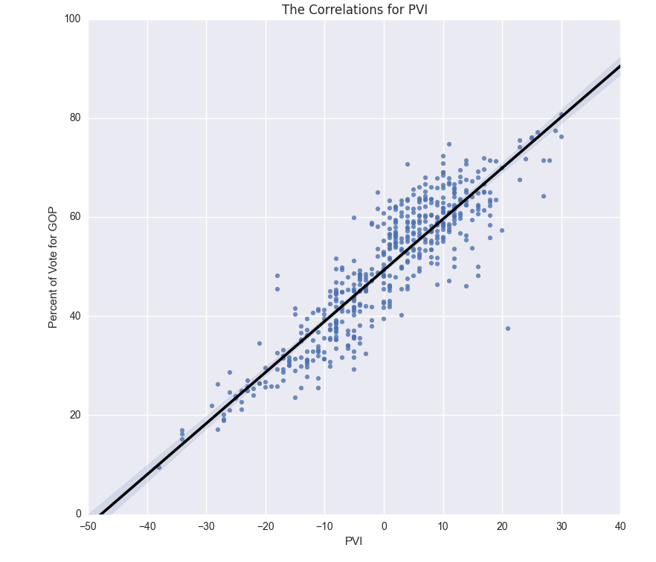
The Power of Partisanship

Slide 10
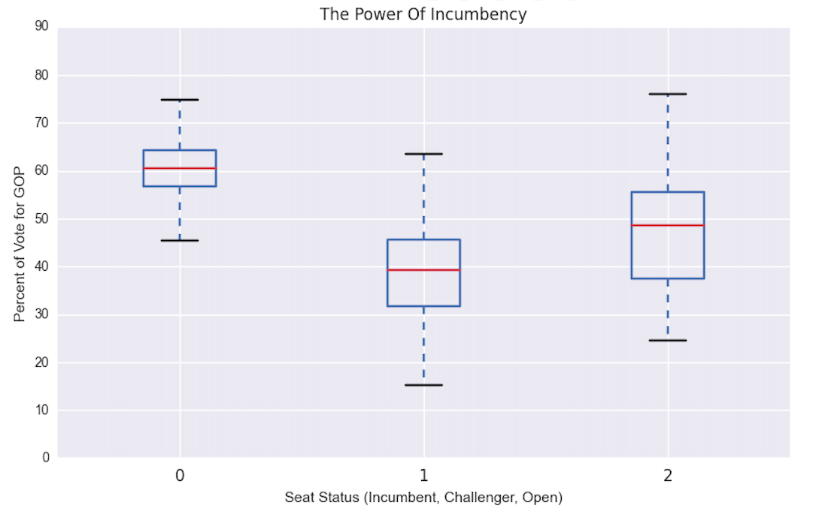
The Power of Incumbency

Slide 11
How Strong Are The Two Together?
A linear regression model using ONLY PVI score and Incumbent Status produced a model with an RMSE of
5.264

Slide 12
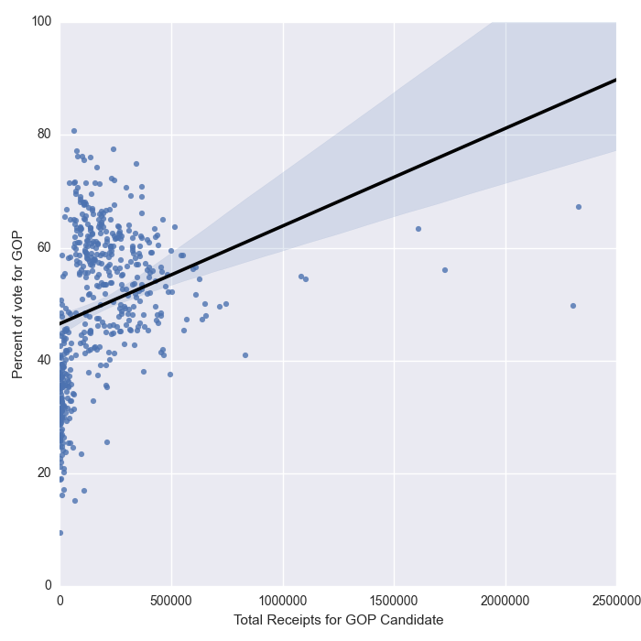
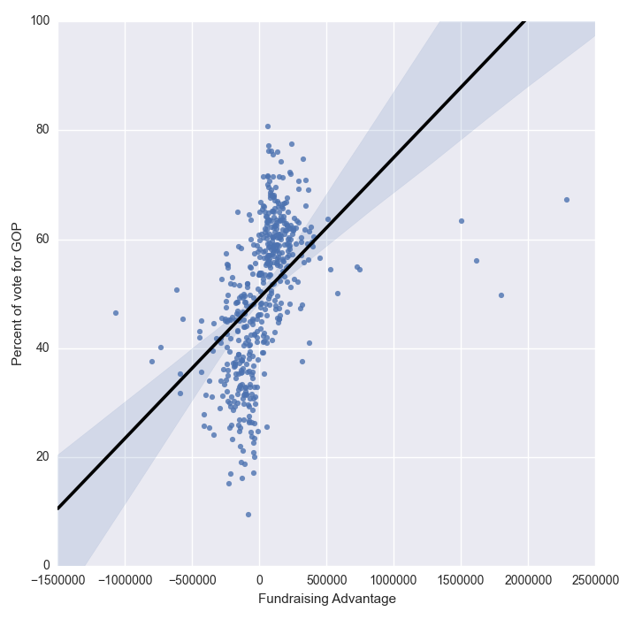
Is There A Magic Number?
Can we just look at how much a candidate raised, and set a threshold?

Slide 13
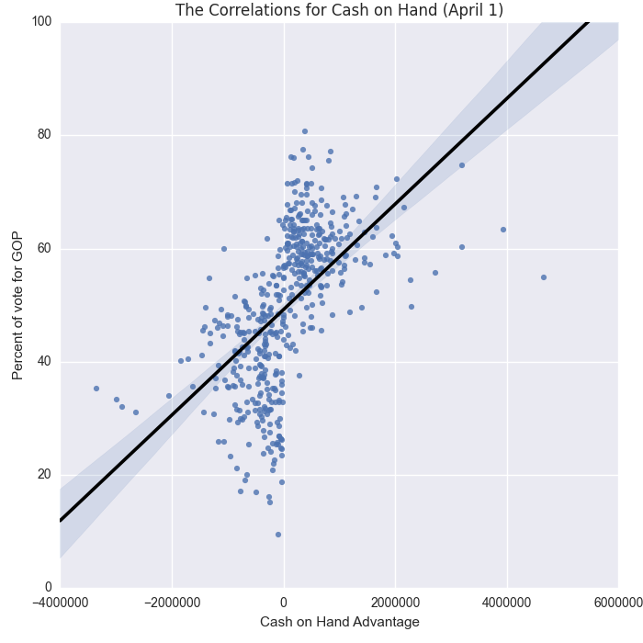
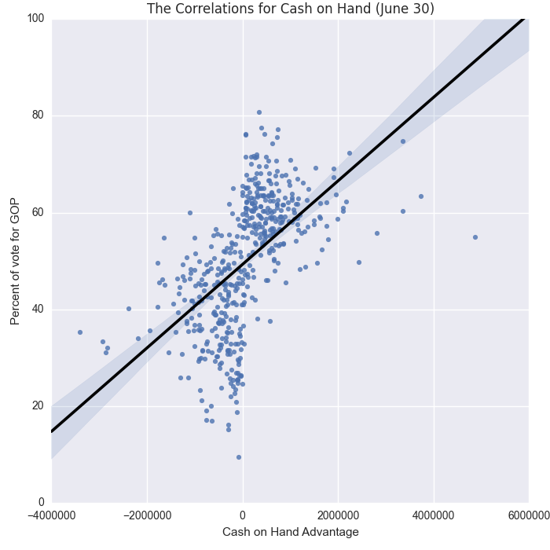
Is There A Magic Number?
What can the cash on hand advantage tell us?

Slide 14
Finding The Indicators
Input Features
Decision Tree
Random Forest RMSE
Eliminate Unimportant Features
Using a decision tree to locate important features
Eliminate features with low or no importance until we find the 2-3 most valuable features
Decision Tree and Random Forest Testing

Slide 15
Which Features Were Most Predictive?
Decision Tree Features
PVI Score
Cash on Hand Advantage at the Beginning of the Period
Total Receipts (amount raised by June 30)
Incumbency Status
Fundraising Advantage
Random Forest Features
PVI Score
Cash on Hand Advantage at the Beginning of the Period
Total Receipts (amount raised by June 30)
Incumbency Status

Slide 16
So, How Did We Do?
A random forest model using PVI, Incumbency, Beginning Cash Advantage and Final Receipts produced a model with an RMSE of
5.016

Slide 17
What did we learn?
Incumbency is a valuable predictor but not the most valuable because districts are generally represented by their favored party already.
Cash on Hand Advantage at the beginning of the period (April 1) matters more than the ending cash advantage because of primaries.

Slide 18
Ways To Improve The Model
Focus only on races in the middle zone of “toss-up” districts where the outcome is actually in question.
Use historical data to create more observations from 2002-2010
Questions?

