Slide 1
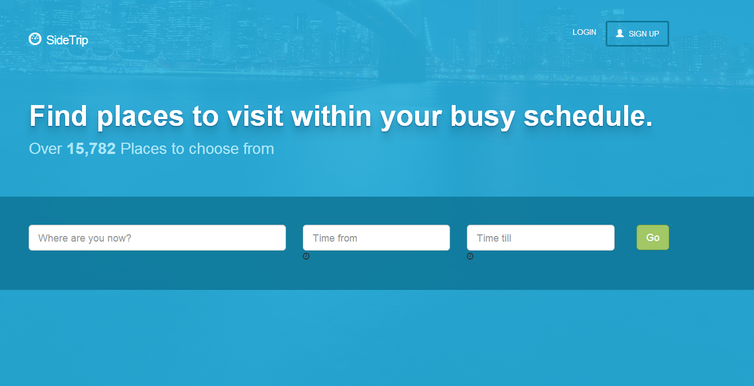
SideTrip
Lloyd / Yong Jie / Pranay / Gabriel

Slide 2


Meet John

Slide 3
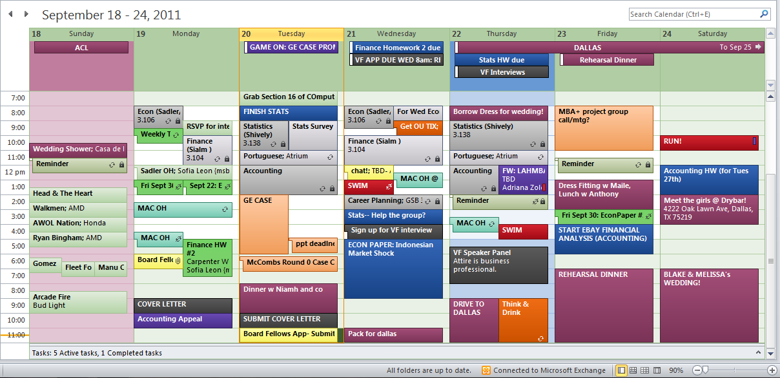
Meet John’s Calendar
What to do with the few free hours in between?

Slide 4
Problem
What are the best places to see?
How much time does it take to travel there?
Is the place open?
How much time should he spend there?
Can he reach back on time?
Notes:
Remove 2nd half

Slide 5

Meet SideTrip
Where are you? & How much time do you have?
Factors Used:
Points of Interest (SLA) + InSing / Trip Advisor / Wikipedia
Google Maps Geocoding
Google Maps Travel Timings
Local knowledge on how much time to spend at each spot
Notes:
Link to calendar

Slide 6
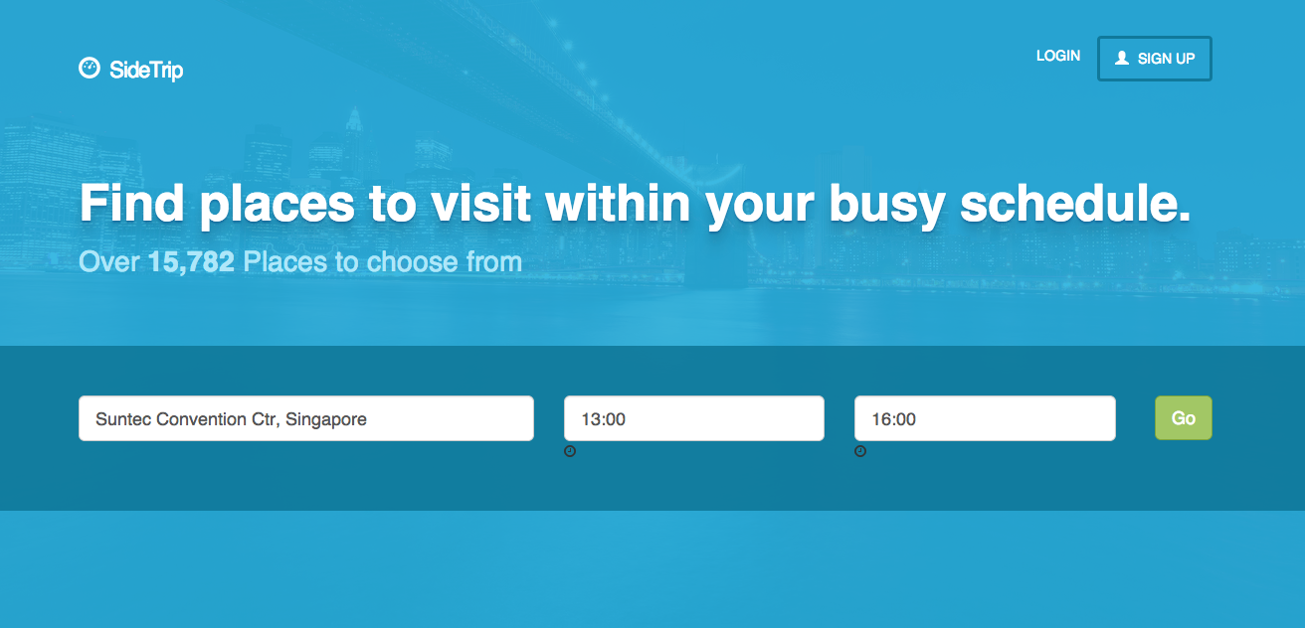
Demo

Slide 7
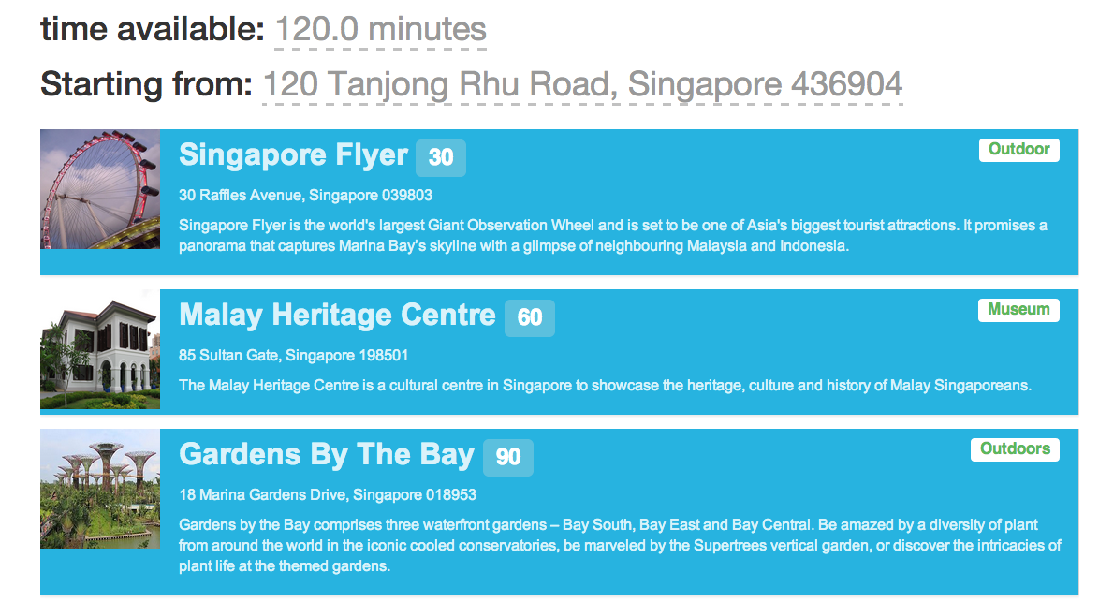
Demo

Slide 8
Contact Us
http://sidetrip-live.herokuapp.com
Lloyd D’Silva
Yong Jie
Pranay Roy
Gabriel Chaun

