Slide 1

Visit Scotland Tourism Data
CodeClan Final Project
Presented by: Lloyd Lombardi
12th October 2022
Notes:
Welcome to my final project presentation on Visit Scotland Tourism Data

Slide 2
Understand historical trends of British and International tourists
Identify potential target markets and demographics
Build a model to predict future spending and visits in Scotland
Future work – USA Tourists
Investigate a series of business questions
Notes:
The project is about Visit Scotland and analysing their data to answer some business questions.
In this presentation I will:
- Investigate a few of these questions but due to the time constraints of the presentation I will only focus on a few of these questiosns.
- Attempt to understand historical patterns in the data
- Try and identify key demographics and target markets
- Explain the process in building a predictive regression model
- Touch on future work that could help Visit Scotland in the future

Slide 3

Raw Data & Ethical Considerations
File Name | Description | Source | Open Source
activities.csv | Total visits and expenditure generated by tourism activities of British tourists. 2013 – 2019 | statistics.gov.scot
demographics.csv | Total visits and expenditure of British tourists, broken down by demographics. 2013 – 2019 | statistics.gov.scot
locations.csv | Total visits and expenditure of British tourists, broken down by location. 2013 – 2019 | statistics.gov.scot
transport.csv | Total visits and expenditure of British tourists, broken down by transport. 2013 – 2019 | statistics.gov.scot
regional_tourism.csv | Total visits, nights and expenditure of British tourists, broken down by Tourist Board. 2009 – 2019 | statistics.gov.scot
accommodation_occupancy.csv | Accommodation occupancy percentage of different accommodation types. 2013 – 2019 | statistics.gov.scot
international.csv | Total visits, nights and expenditure of International tourists. 2002 - 2019 | Scottish Tourism Observatory
Notes:
- SEVEN data sets that were used for this project
- SIX data sets came with the brief and are available on the statistics.gov.scot website
- AN ADDITIONAL data set 'International' was taken from the Scottish Tourism Observatory
- ALL data sets are OPEN SOURCE and NO OTHER ethical considerations were made

Slide 4
What kind of tourism activity generates the highest income for Scotland?
Notes:
Before I can discuss TRYING to build a PREDICTIVE mode
It is very important to understand the pattern and trends of tourists that visit Scotland, both from within the UK and from abroad
The first business question is:
What kind of tourism activity generates the highest income for Scotland?

Slide 5
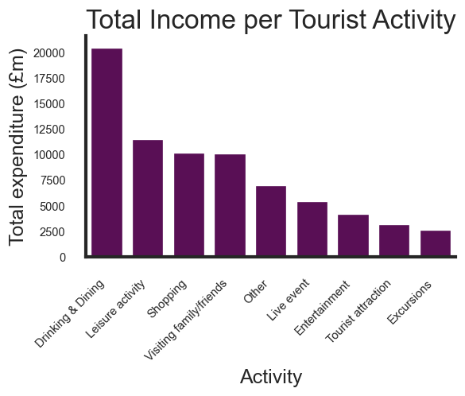
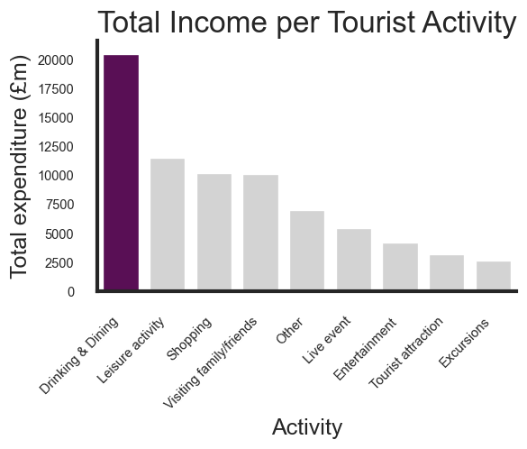
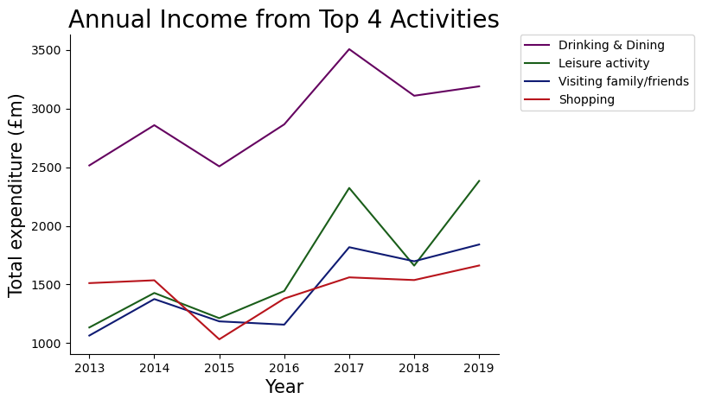
Tourism Activities
Drinking & Dining generates the most income.
Historical peak expenditure in 2017.
Pre-pandemic patterns were promising.
Visit Scotland should target these activities.
Notes:
SEVEN YEARS of data was provided and the TOTAL EXPENDITURE of each activity was plotted.
It can clearly be seen that Drinking & Dining generates the highest income, nearly double of any other activity.
When looking at the TOP 4 activities over time:
- There was a historical peak in 2017
- The general pre-pandemic trends were good
This is an IMPORTANT observation as the data stops before the pandemic and if Visit Scotland want to reach pre pandemic levels then it may be useful to review these strong performing years before making key business decisions

Slide 6
What type of locations do tourists visit most and where do they spend their money?
Notes:
Now we know what tourists are spending their money on, I wanted to touch on the types of location they are visiting most and where they are spending most of their money in an attempt to focus marketing

Slide 7
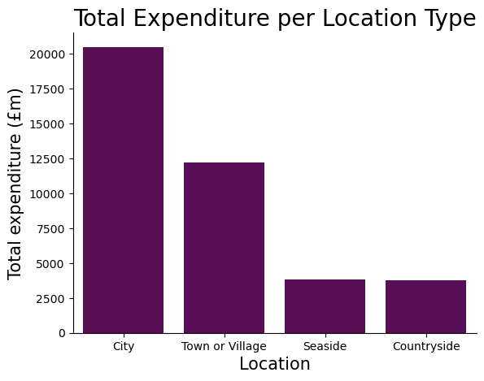
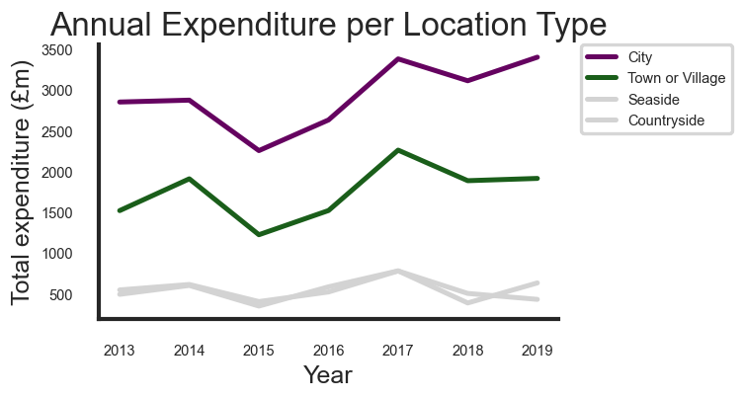
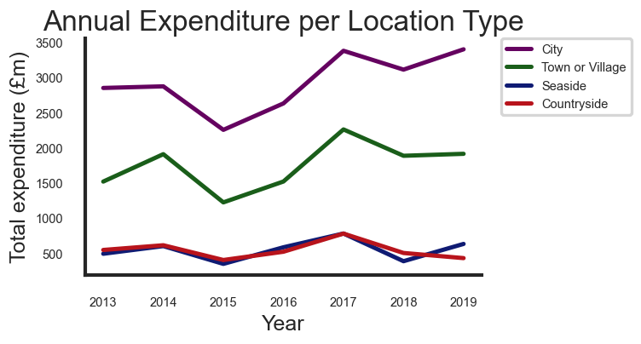
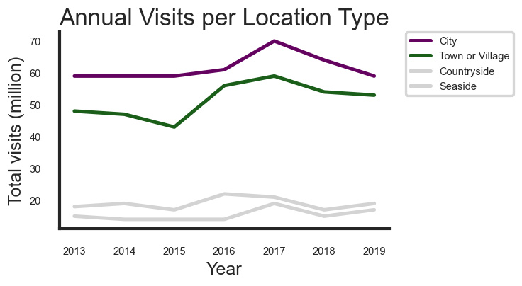
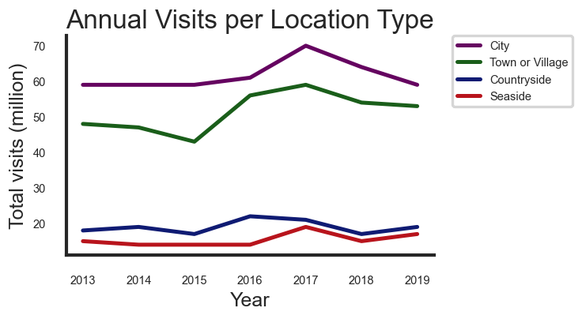
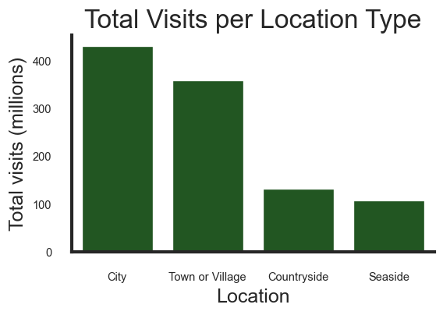
Tourist Locations
Cities are the most popular and generate the most money.
Towns & villages receive many visitors.
Cities and towns have a similar expenditure pattern.
The difference in total visits is decreasing.
Marketing should promote city breaks to Scotland.
Notes:
Looking at both TOTAL EXPENDITURE and TOTAL VISISTS it can clearly be seen that tourists from within the UK spend the most amount of TIME and MONEY in Scottish Cities.
CLICK
Plotting this data over time it can be seen that:
CLICK
- CITIES AND TOWNS had a similar PATTERN for TOTAL EXPENDITURE
- THE GAP WAS LOOKING TO BE DESCREASING in terms of TOTAL VISITS
VISIT SCOTLAND should target this market by PROMOTING CITY BREAKS in SCOTLAND

Slide 8
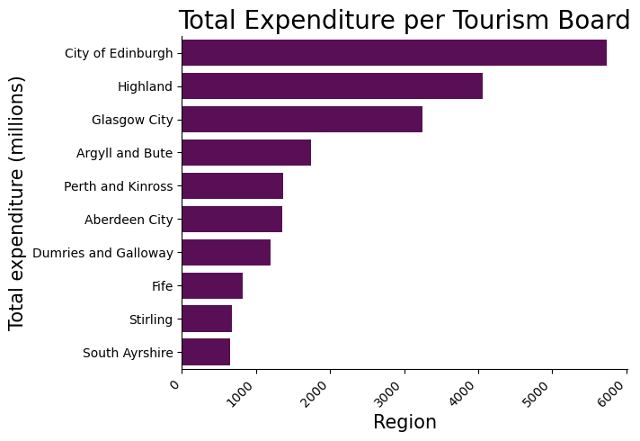
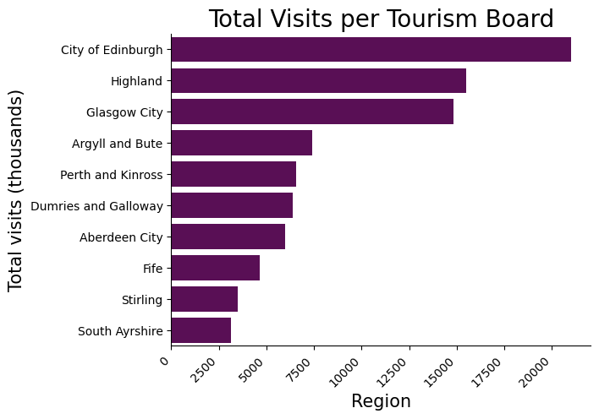
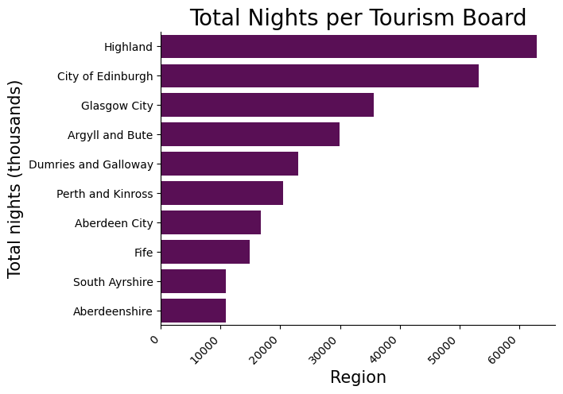
Regional Tourism
The City of Edinburgh generates the highest income and receives the most visits.
Highland has the largest number of tourists spending nights.
Top 4 regions:
The City of Edinburgh
Highland
Glasgow City
Argyll and Bute

Slide 9
Is there a key tourist demographic we should be focusing on?
Notes:
Now we have touched on what the customer likes to do, and where they like to go...
IS THERE A KEY DEMOGRAPHIC WE SHOULD BE FOCUSING ON??

Slide 10
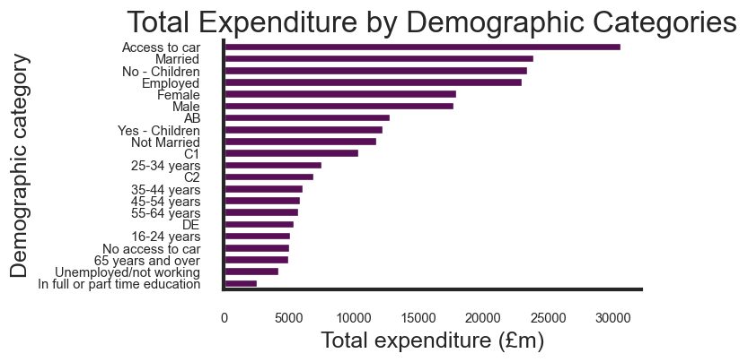
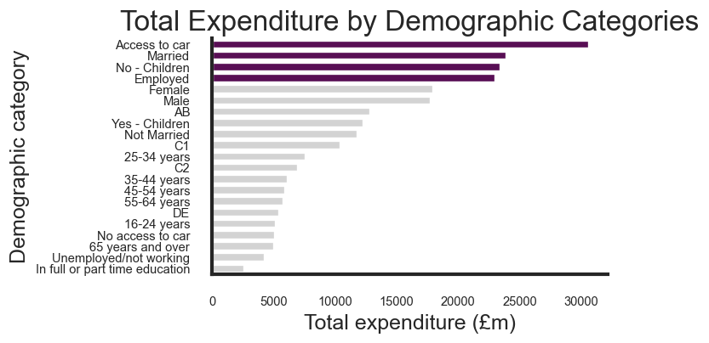
UK Tourist Demographic
Access to a car
Married
Tends not to have children
Employed
Notes:
To attempt to answer this, I plotted ALL of the DEMOGRAPHIC CATEGORIES in terms of TOTAL EXPENDITURE.
It should be noted that this data set was formatted in such a way that made analysis quite difficult, but this plot ALLOWS US TO BUILD A PICTURE of a TARGET DEMOGRAPHIC.
We can see that a key demographic:
- Has access to a car
- Is married
- Has no children, or perhaps grown-up children
- Is employed

Slide 11
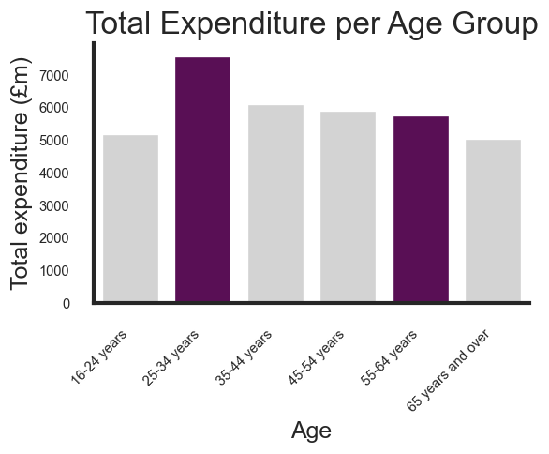
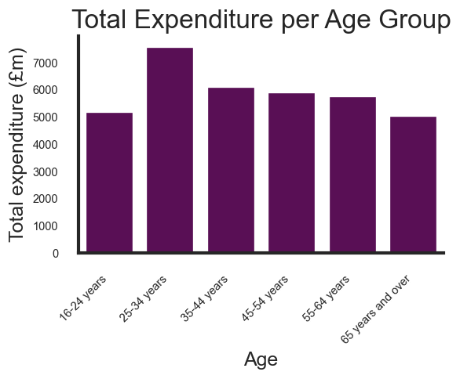
Total Expenditure by Age Group
25 – 34 year-olds spend the most.
Who should we be targeting?
Notes:
When focusing on the age of our customers:
- 25-34 year olds have spent the most overall
BUT IS THIS WHO WE SHOULD BE TARGETING?
I want to focus on these two age groups in more detail, with the image we have already established that our target demographic is someone: - with access to a car
- married
- no children
- employed

Slide 12
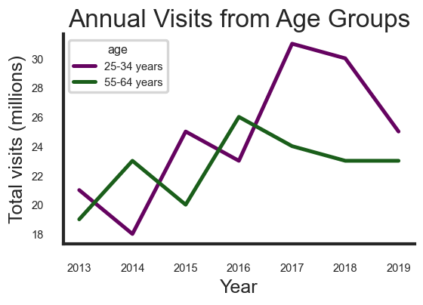
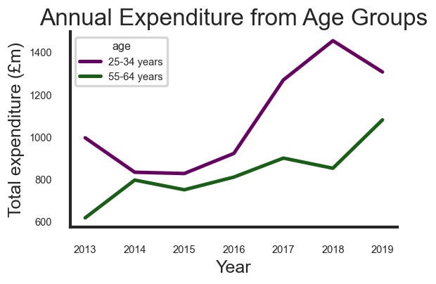
Target Age Demographic Over Time
Notes:
Plotting these two age groups over time, we can see that:
**CLICK**
- FROM 2017 - 2019 these two age groups were beginning to converge in terms of expenditure
And were following a similar pattern in terms of visits
I would therefore recommend that 55-64 year olds should be considered a target demographic - if these pre-pandemic patterns continued

Slide 13
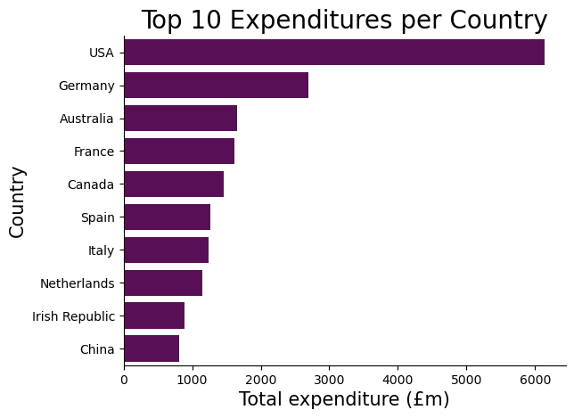
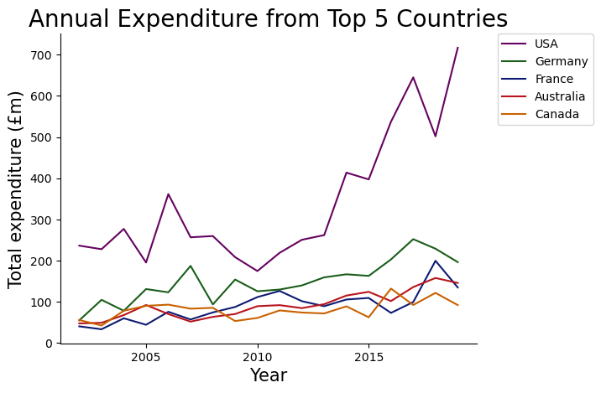
International Tourist Demographics
Tourists from USA have brought in more than double of any other country.
Looking at the pattern over time, the USA will continue to dwarf the other nations.
Notes:
Regarding our INTERNATIONAL tourists - WHAT CAN WE SEE?
The USA is BY FAR our greatest international market
**CLICK**
And looking at this pattern over time the USA market was expanding rapidly whilst the other top 5 nations were relatively stagnant

Slide 14
Is there any way to predict spending and visits for Scotland?
Notes:
Now we have looked at some business questions, is there a way to use this for modelling?
The data in its current form does not lend itself well to modelling as it is reported in a heavily summarized way.
Compounded with this is the fact that the data is split into different data sets with no easy way to join the data to try and build a better model.
In its current form, the best outcome was an explanatory model which co nfirmed some of the previous analysis.
For example, when looking at Locations, the model found the location type to be a significant factor in explaining both total expenditure and total visits, when all other factors were held constant.

Slide 15
Improvements to data collection for model building
Collect the data more regularly.
Report data that has not been summarised.
Combine variables into a single data set.
Or, collect data systematically that allows tables to be joined.
Notes:
To help linear regression models work, data should not be summarized before being published.
Data should be in a standardized format that allows joining to take place, or collect all data in one table.

Slide 16
FUTURE work USA case study
Notes:
If Visit Scotland would like to benefit from advanced analytics and modeling of their data and learn more about tourists that visit Scotland, data should be collected and stored in a more appropriate manner.
To give a quick example of how this potentially could work, I looked at some external data that lends itself better to analysis and modelling.
I used the International data set and filtered the USA data as these accounted for the highest expenditure and visits.

Slide 17
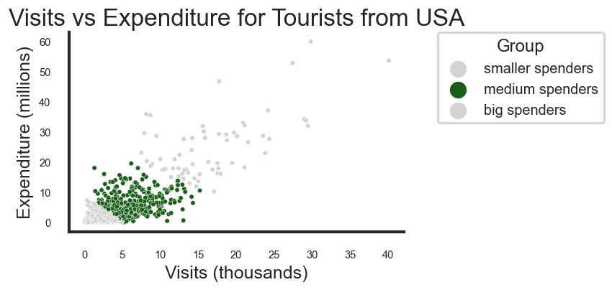
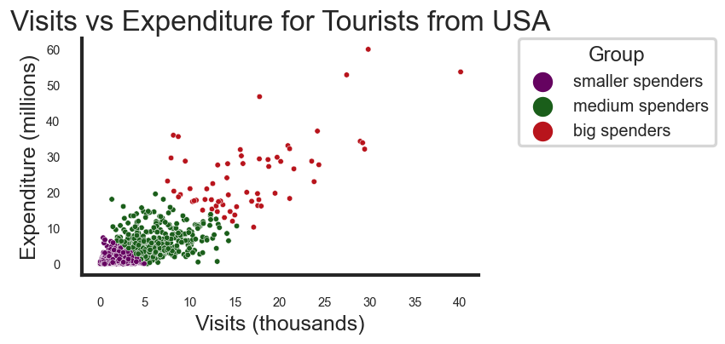
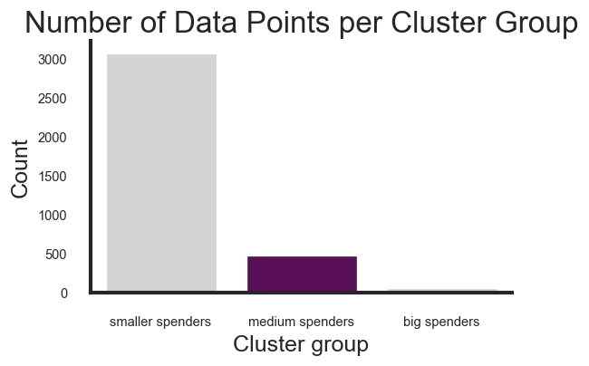
Clustering USA Tourists
Data points were put into 3 groups using the k-means clustering method.
These groups were labelled based on their spending habits.
Notes:
I first of all wanted to try and label these customers and used an UNSUPERVISED LEARNING technique called K-MEANS CLUSTERING
Data points were split into 3 cluster groups based on this method
These groups were then labelled based on their spending habits: SMALLER, MEDIUM AND BIG spenders
I want to quickly focus on MEDIUM SPENDERS who made up around 1/8th of the data points

Slide 18
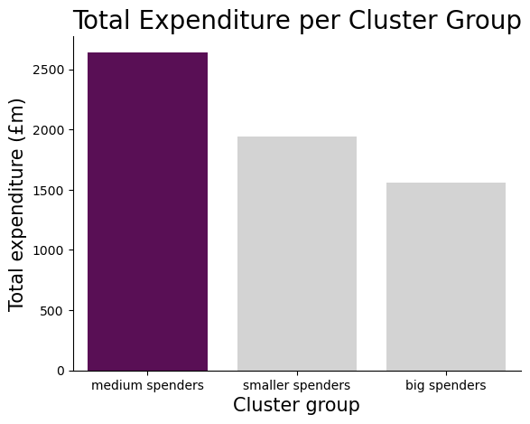
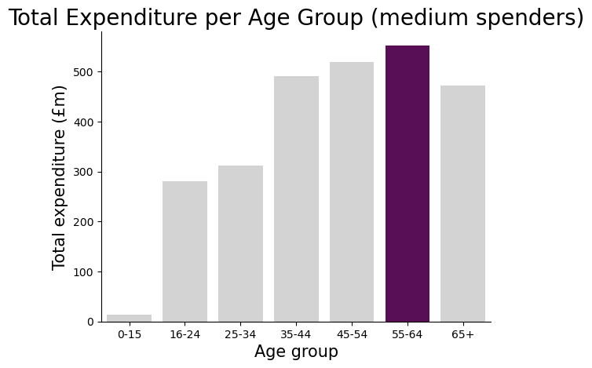
Analysing the clustered groups
Notes:
When using these labels for analysis, it can be seen that the MEDIUM SPENDERS actually had the highest TOTAL EXPENDITURE
Looking at this group in terms of AGE GROUP, the group that spent the MOST MONEY in Scotland were 55-64 year olds, which is the target age group that was highlighted earlier for UK TOURISTS.
That was a quick example of how this clustering method could be used for analysis.
This method could be applied to analysing other areas of interest.

Slide 19
Modelling using the cluster groups
The USA data was modelled without cluster groups.
A second model was created using only the cluster groups as predictors.
The cluster groups were added as labels to the USA data and re-modelled.
They were found to be significant predictors and increased the adjusted r-squared of the original model.
Notes:
HOW COULD THESE LABELS HELP MODELLING??
- A model was created on the US data without these cluster groups that explained around 70% of the variance of expenditure
- A SEPARATE MODEL was then PRODUCED using ONLY the cluster groups as predictors, and returned a similar r-squared with these groups being SIGNIFICANT
- This gave me the confidence to ADD the labels into the original model
- and it was found that the labels improved the r-squared of the model and were STILL SIGNIFICANT
THIS METHOD COULD BE IMPLEMENTED to VISIT SCOTLAND DATA in the FUTURE

Slide 20
Summary
It is possible to answer all business questions, although these were pre-pandemic patterns and will need to be reviewed.
For Visit Scotland to be able to use a predictive model in the future, data should be collect in a more in depth and standardized format.
Further work is possible and this could lead to better analysis and modelling.
Notes:
To summarise:
- It was possible to answer all business questions, although not all were addressed in the presentation.
- An important note is that these trends were pre-pandemic and will need to be reivewed before implementing recommendations.
- If Visit Scotland would like to use predictive modeling, data should not be summarised and collected more regularly and reported in a better format.
- Further work is definitely possible and I would like to improve the US case study and implement this on Visit Scotland data.

