Slide 1
MET OFFICE HACKATHON
Team Epic data

Slide 2
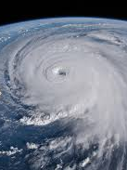
Tropical Cyclone CLIMATOLOGY
Our challenge TOPIC -

Slide 3
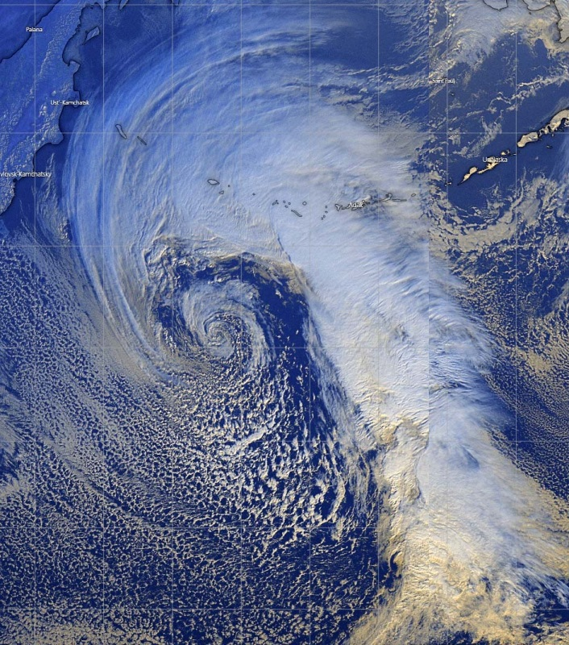
The problem we intended to solve
Met office hackathon
Contextualisation of past tropical cyclones
Our implementation
Plot colour-coded cyclone tracks
UI to input locations with a radius
Filter based on year, intensity, location
Historical counter of paths through given radius

Slide 4
Demo

Slide 5
Technologies used
Met office hackathon
Google’s WebGL Globe Graphical Interface
dat.GUI
Python
Javascript
geoPy

Slide 6
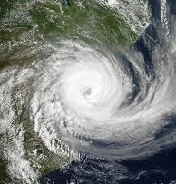
future improvements
Met office hackathon
Parallel Processing
Improved UI with easier search input
More detailed path diagrams
Insights from filtered data sets
Storm labels and statistics

