Slide 1
CPU
Main Memory (DRAM)
PCIe
NIC 1
NIC 2
NIC 3
NIC 4

Slide 2
Network Processing Unit
TCAM (Patterns to Match)
CPU
(Control)
Forwarding Pipeline
PCIe
SRAM (Packet Buffers)
SFI
48x40G SFP+
(Ports 1~48)
. . .

Slide 3
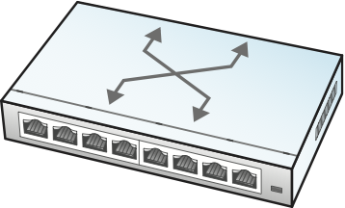
Control
App
Control
App
Control
App
Control
App
. . .
Network OS
Global
Network
Map
Control Plane
Abstract
Forwarding Model
(e.g., OpenFlow, P4)
Data Plane

Slide 4
64
48
48
16
16
Preamble
DestAddr
SrcAddr
Type
… Body …
CRC
802.1
802.1Q
Hdr
Preamble
DestAddr
SrcAddr
Type
… Body …
CRC
802.1Q
16:
4:
12:
Type
Control
Tag
32 =

Slide 5
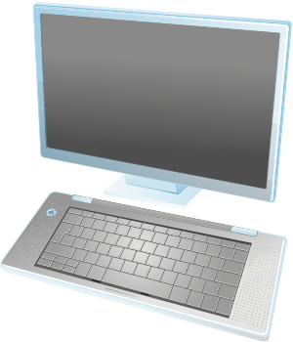

Host A
Host B
S3
S7
S5
S2
S1
Host C
S6
S4

Slide 6
Host A
Host B
S3
S7
S5
S2
S1
Host C
S6
S4

Slide 7
Host W
Host X
VLAN 100
VLAN 100
S1
S2
VLAN 200
VLAN 200
Host Y
Host Z

Slide 8
Outer Ethernet
Header
Outer
IP
Header
Outer
UDP
Header
VXLAN
Header
Inner Ethernet
Header
… Body …
DestPort=4789
8
24
24
8
Flags
Reserved
VNI
Reserved

