Slide 1
TEAM 333

Slide 2
TABLE OF CONTENTS
01
04
About AnytimeFood
Architecture
02
05
Problem
Cost Analysis
03
06
Solution
Demonstration

Slide 3
AnytimeFood
Nation-wide fast-food chain
More than 7000 outlets across the nation
Uses a centralized IT core

Slide 4
PROBLEM
DISRUPTION AT CENTRAL DATA CENTER
48 HOUR DOWNTIME, LONG SERVICE DELAYS
LOSS OF CUSTOMERS AND REVENUE

Slide 5
SOLUTION
CONTAINER TECHNOLOGY
MICROSERVCES AND HA CLUSTERS
HYBRID CLOUD ARCHITECTURE

Slide 6
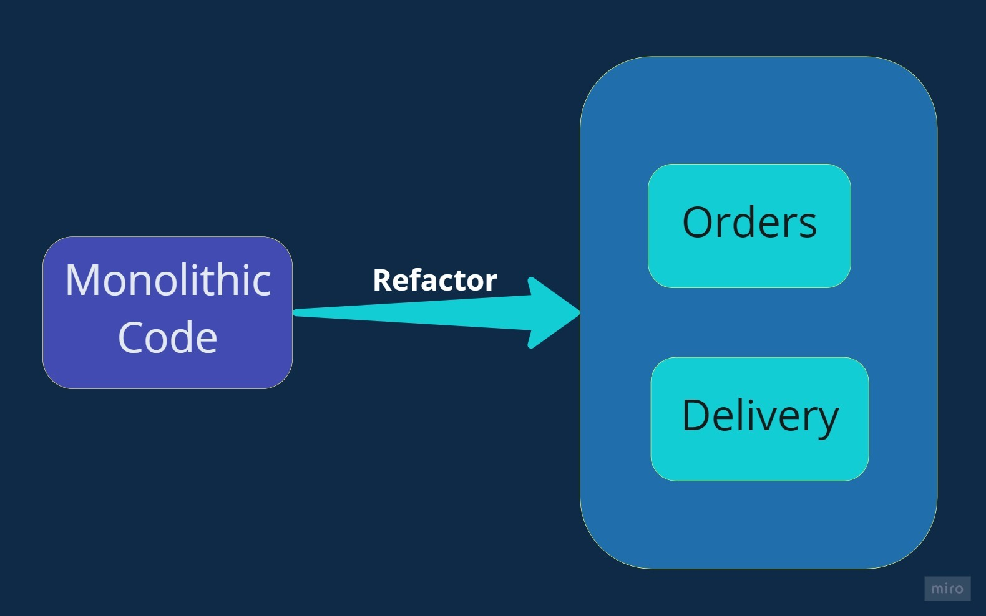
REFACTORING MONOLOTHIC CODE

Slide 7
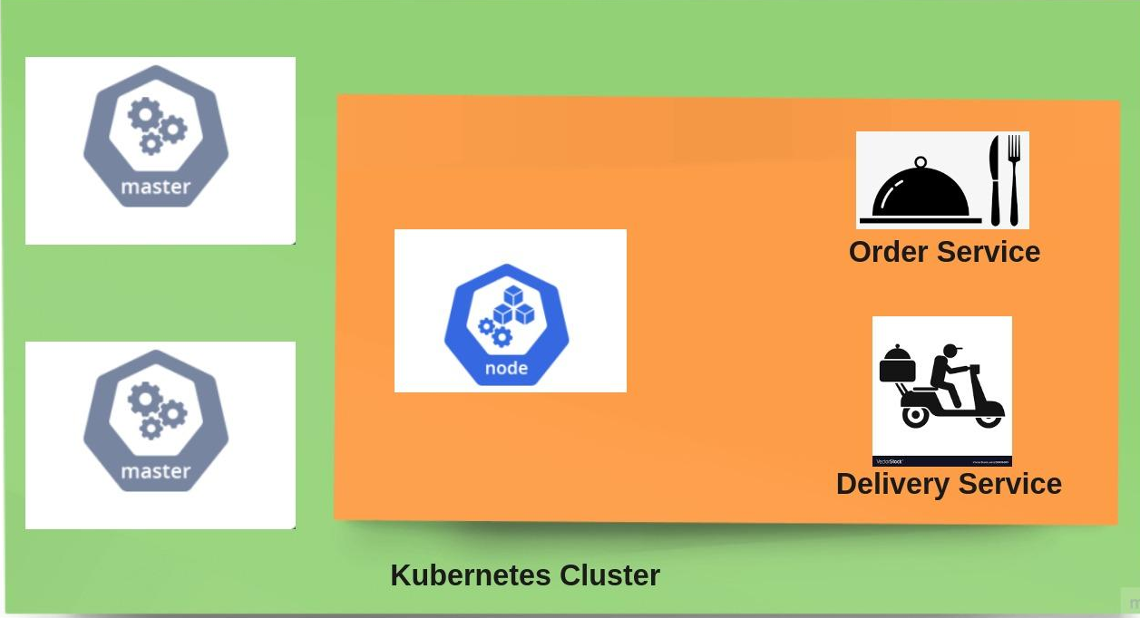
CONTAINERIZATION OF THE ENDPOINTS

Slide 8
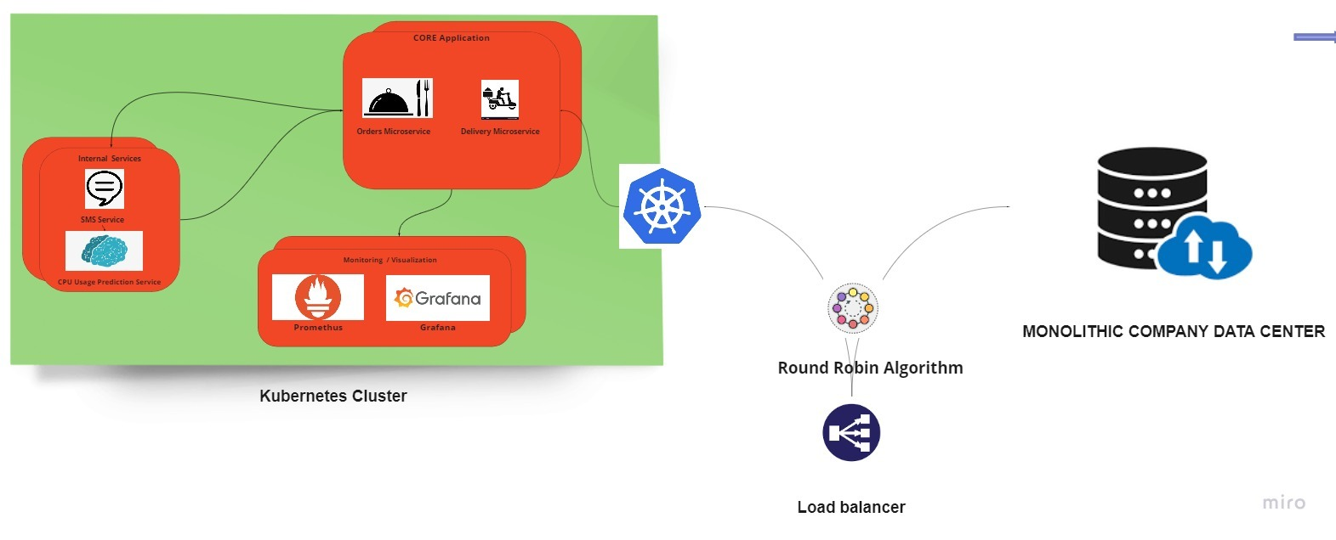
ARCHITECTURE OVERVIEW

Slide 9
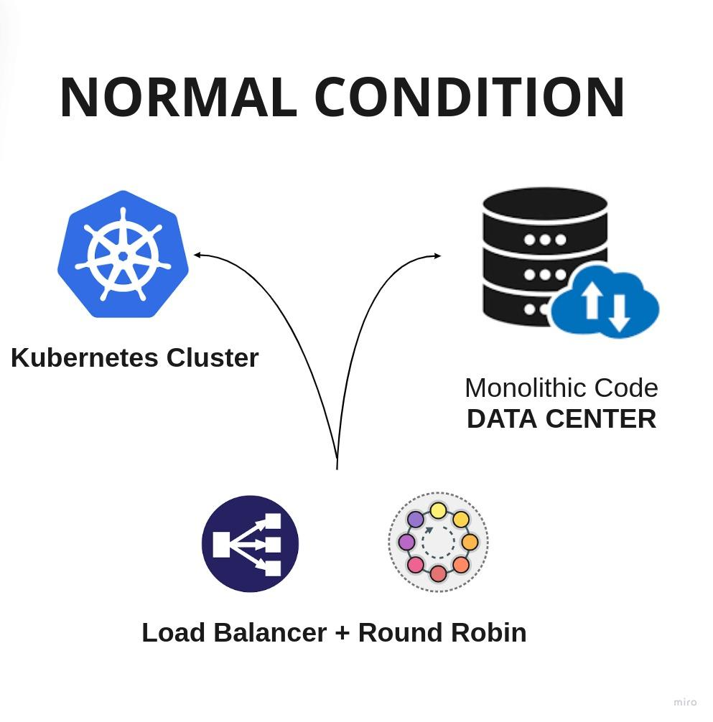

Slide 10
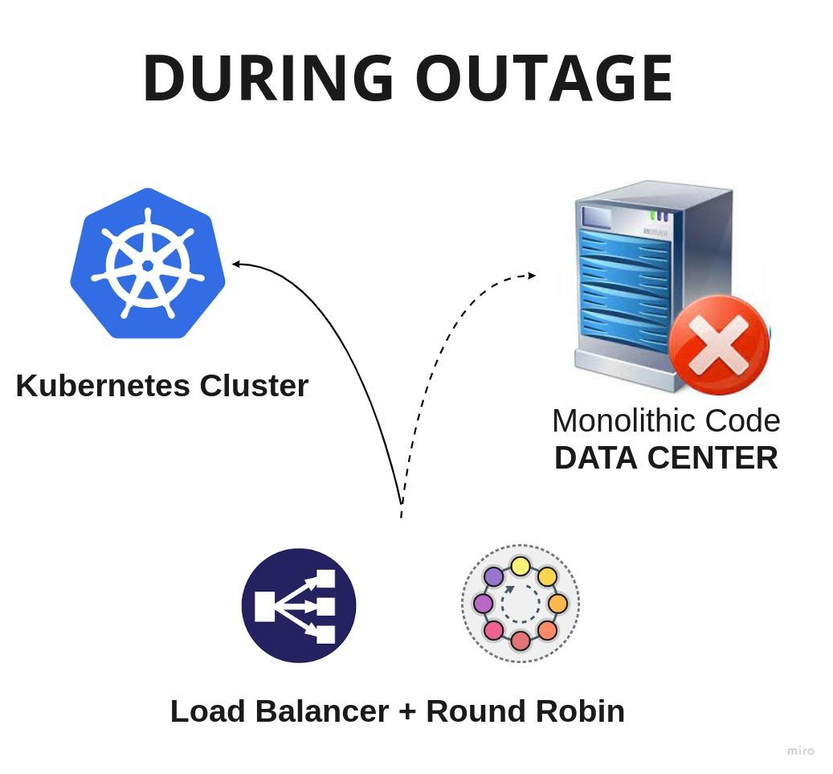

Slide 11
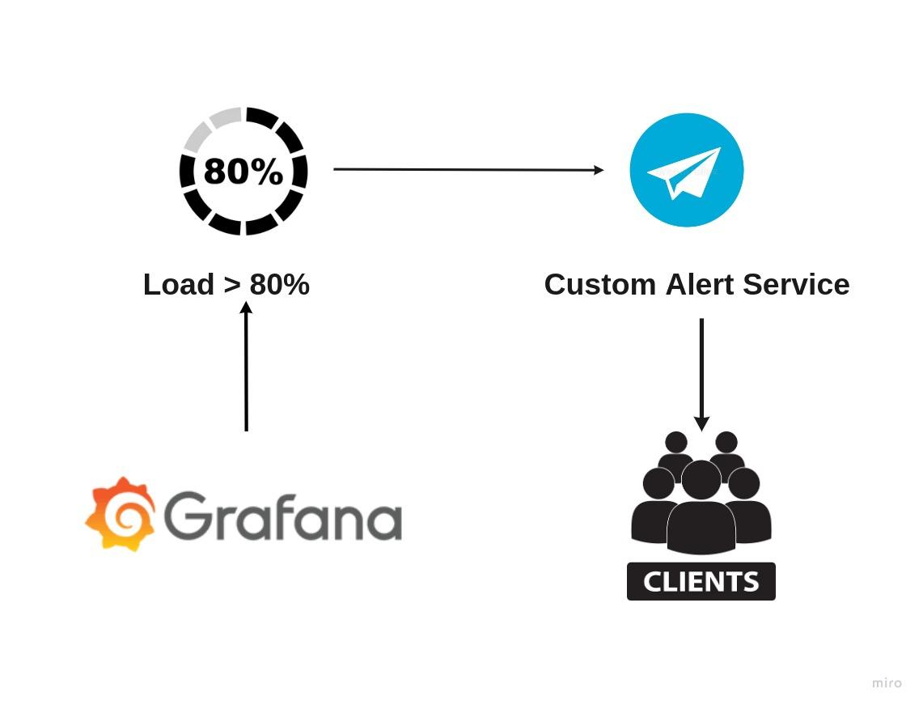
ALERT SERVICE SIGNAL FLOW

Slide 12
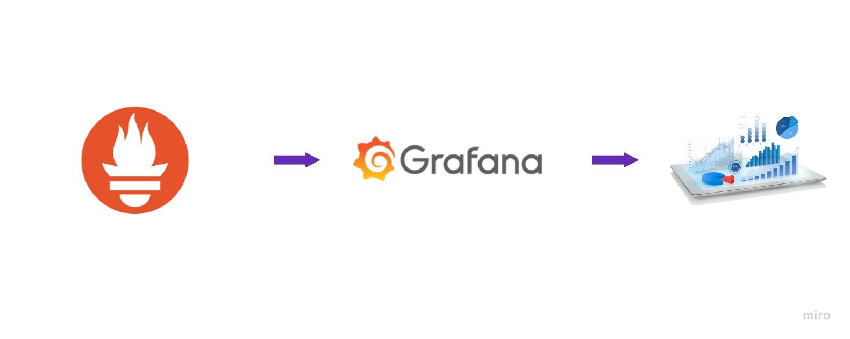
MONITORING AND VISUALIZATION

Slide 13
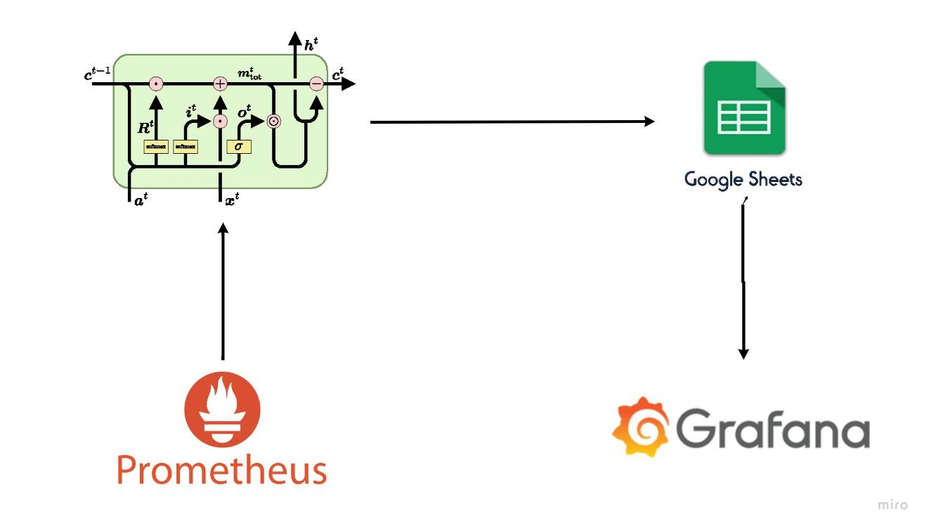
PREDICTION SERVICE USING LSTM

Slide 14
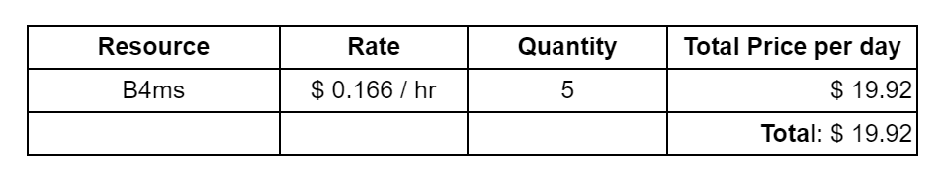
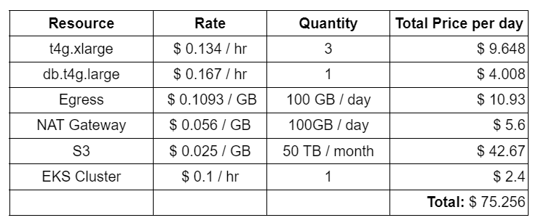
COST ANALYSIS
OUR SOLUTION
PAID CLOUD SOLUTIONS

Slide 15
DEMONSTRATION

Slide 16
THANK YOU!
We are open to questions now!

