Slide 1

Functional MRI Imaging in Conscious Animals
Applications in NeuroScience Research
Professors Craig Ferris, Jean King, Reinhold Ludwig, and John Sullivan
Center for Comparative Neuroimaging
A Joint Collaboration between Umass Medical School and Worcester Polytechnic Institute

Slide 2
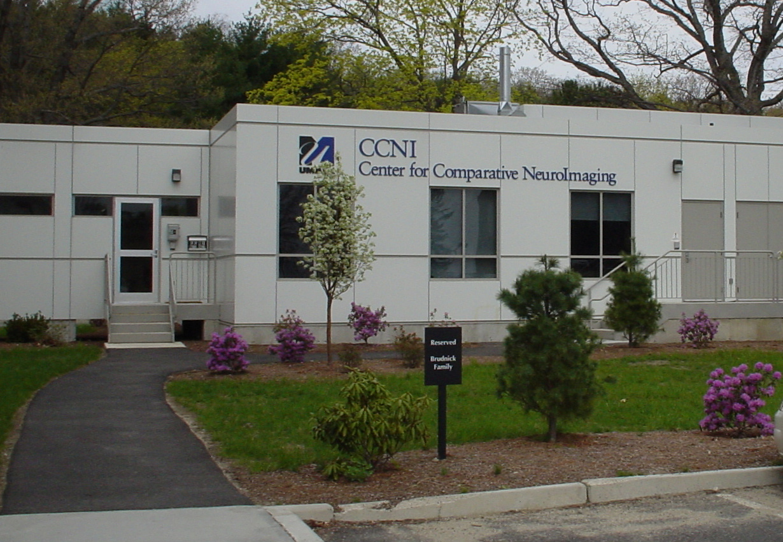
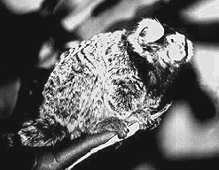
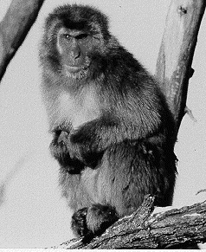
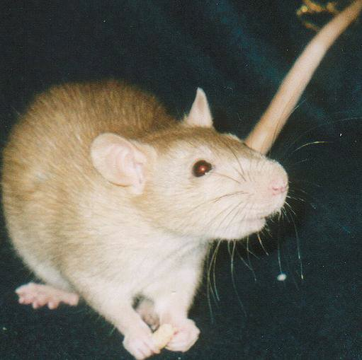
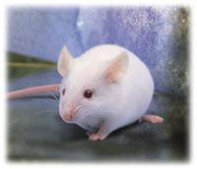
CENTER FOR
COMPARATIVE NEUROIMAGING

Slide 3
PRESENT BIOMEDICAL APPLICATIONS
Depression
Sexual Violence
Post-Traumatic Stress Disorder/Fear
Drugs of Abuse
General Convulsive Seizure
Hemorrhagic and Ischemic Stroke
Cancer

Slide 4
SUPPORT
National Institute of Mental Health
National Institute on Drug Abuse
National Institute of Neurological Disorders and Stroke
National Cancer Institute
National Science Foundation
Whitaker Foundation
CCNI Faculty were awarded twelve grants and near eight million dollars in federal funding to support imaging. (During the 2000-2005 timespan)

Slide 5
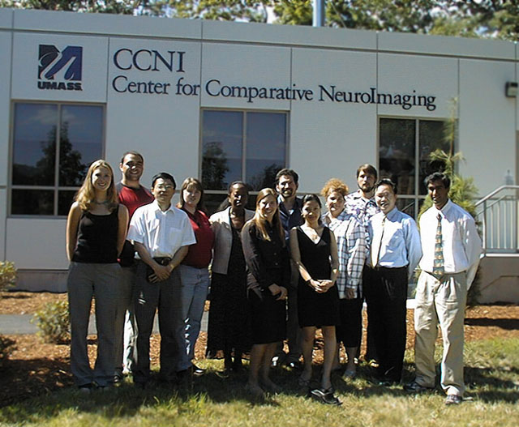
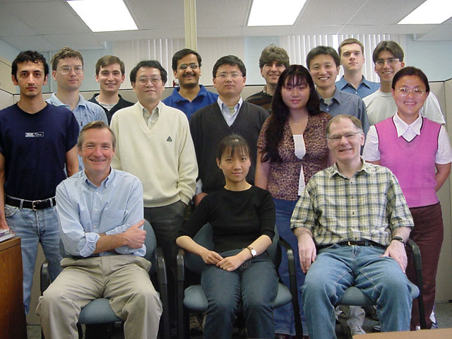
Thank You

Slide 6
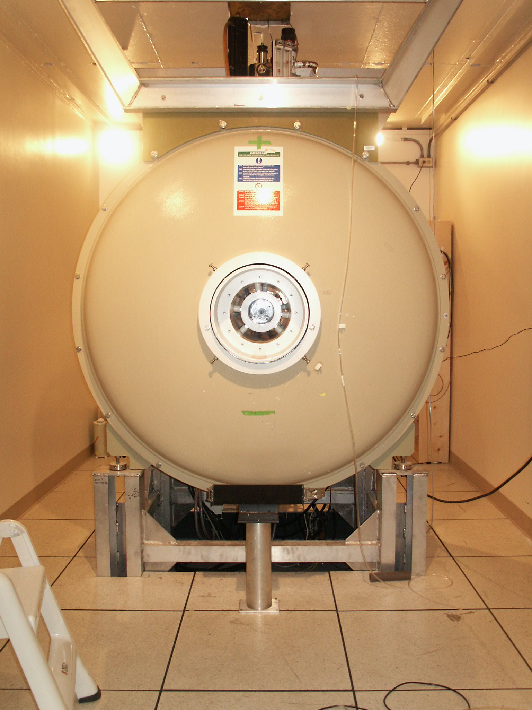
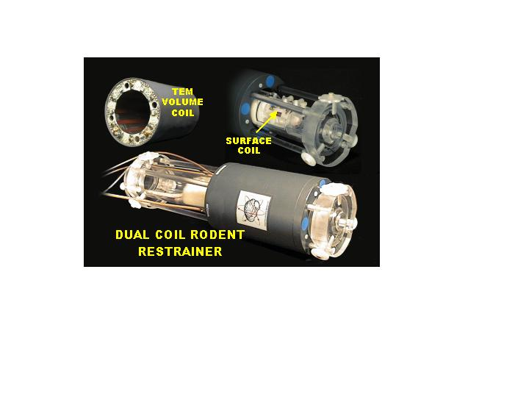
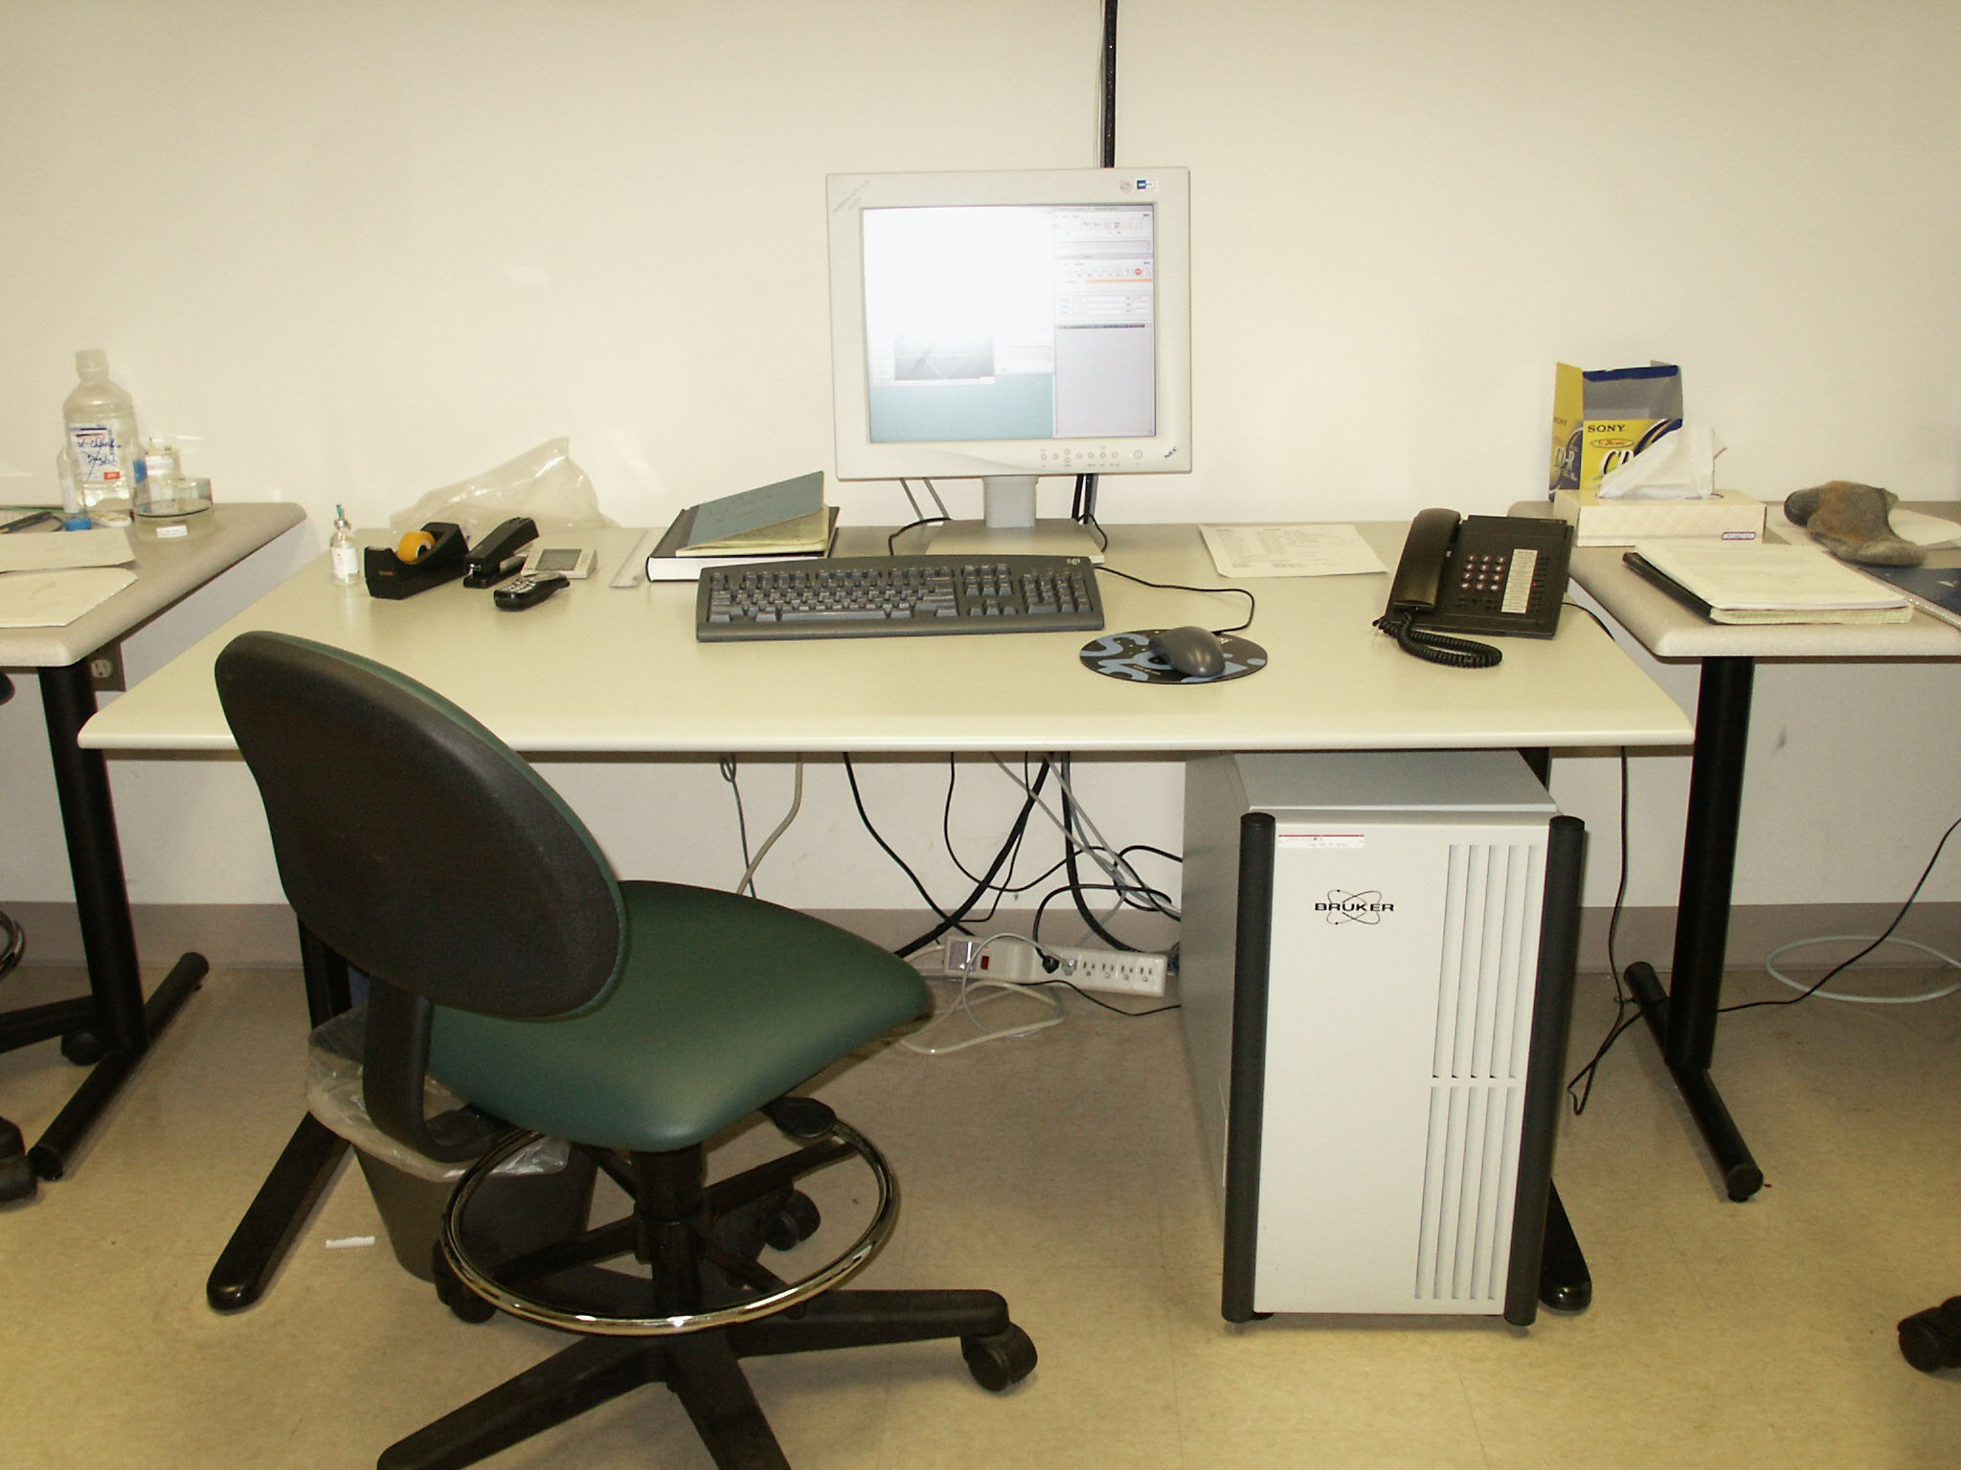
MAGNETIC RESONANCE SPECTROMETER (4.7 T)
Passive Shielding
RF Probes
Computer Console

Slide 7

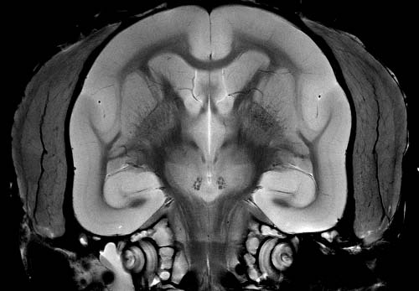
MAGNETIC RESONANCE IMAGING “THEN & NOW”
Damadian et al., Science 194:1431, (1976)
CCNI, 9.4T (2000)

Slide 8
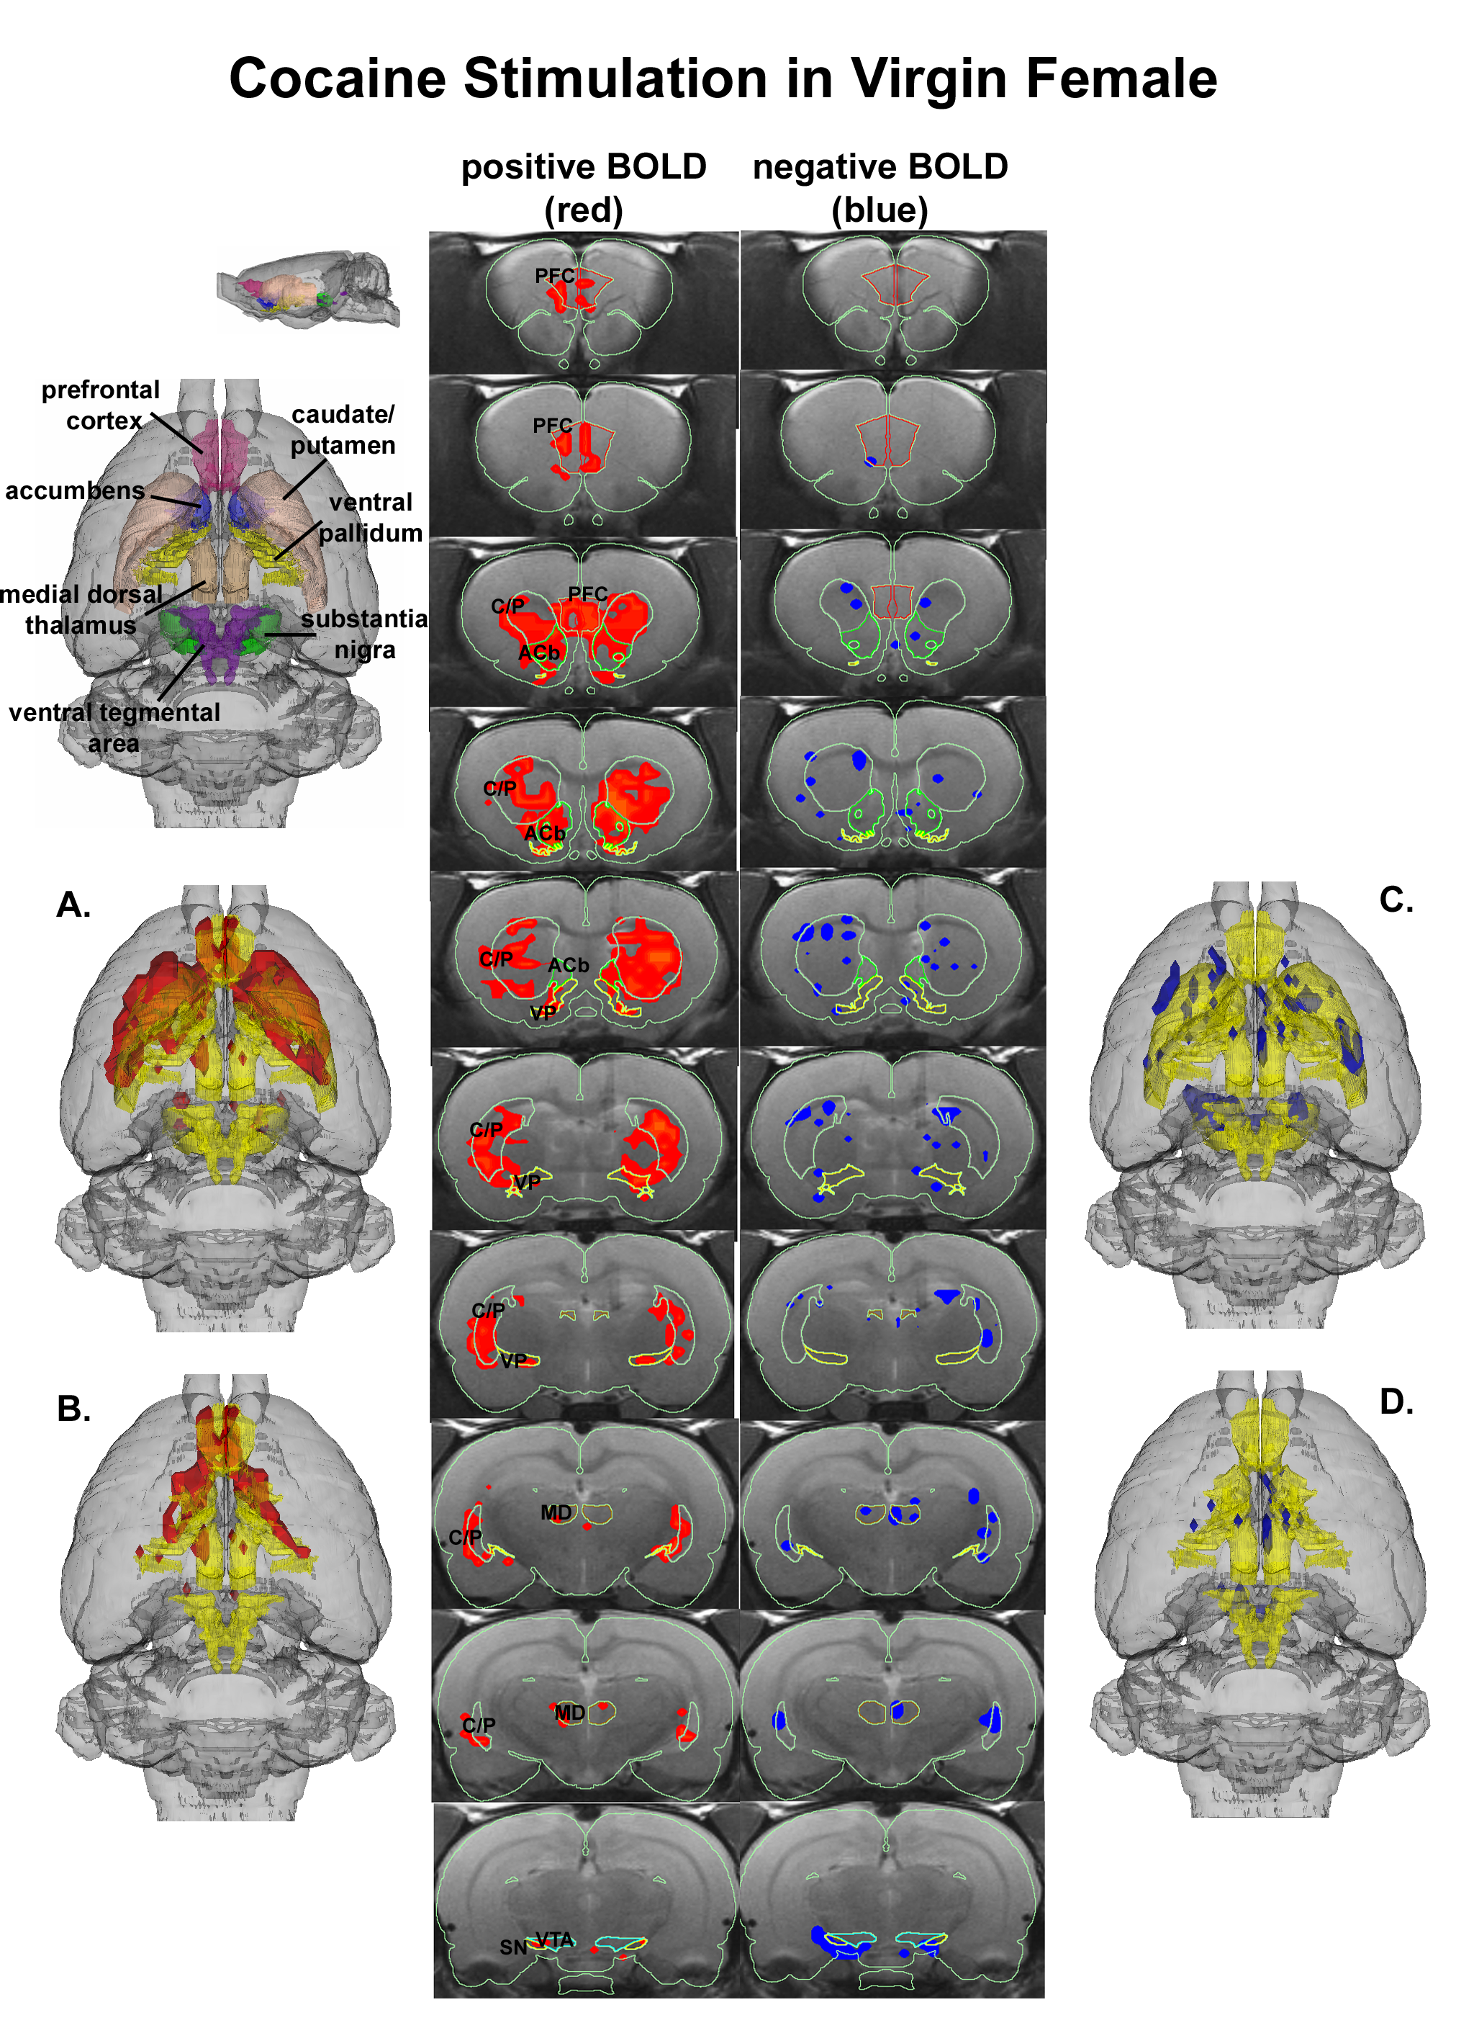
Cocaine Story

Slide 9
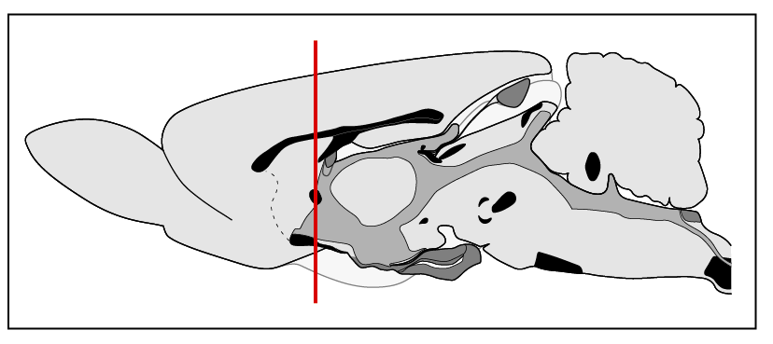
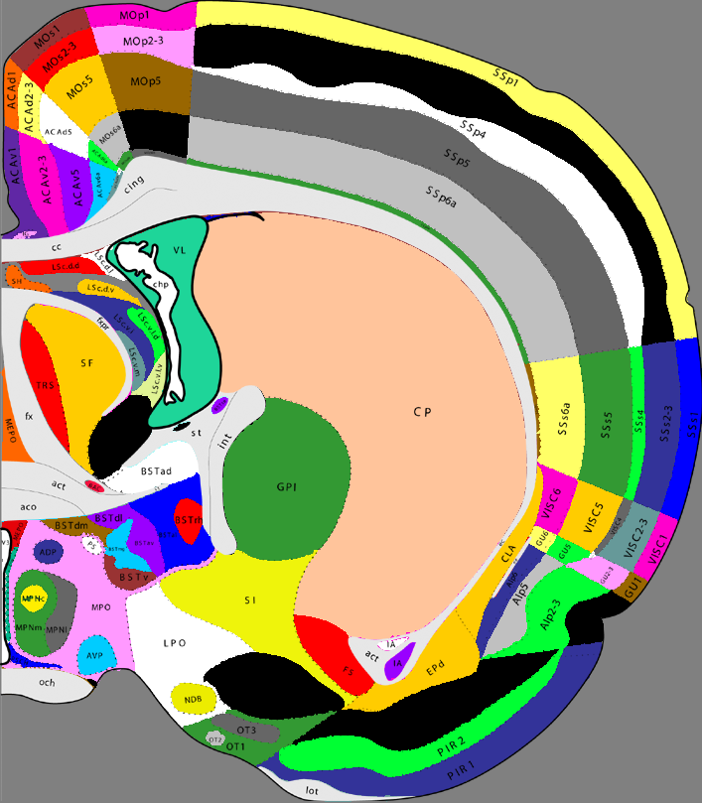
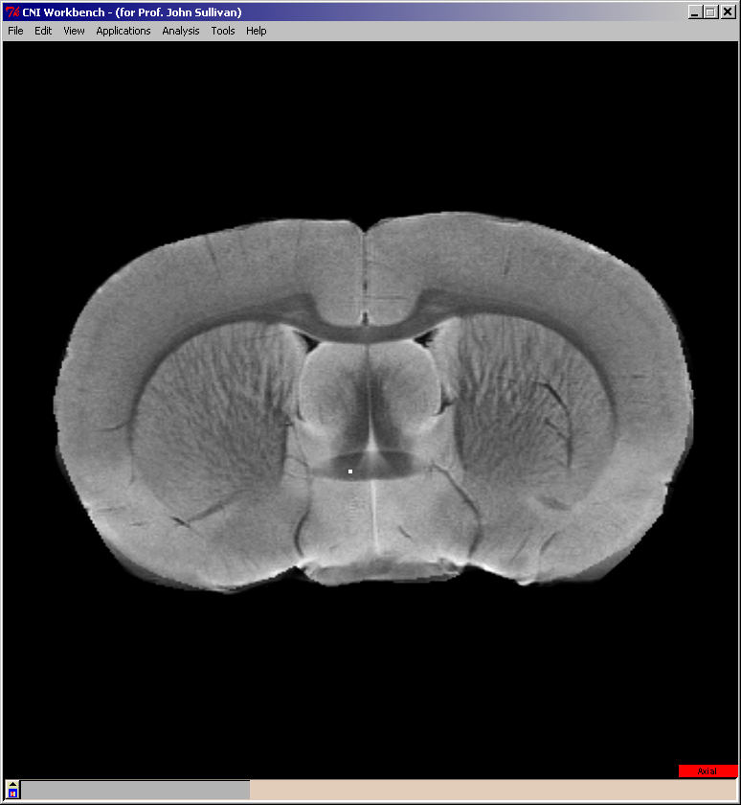
Segmentation
Praveen Kulkarni and Hamid Ghadyani, Segmentation

Slide 10
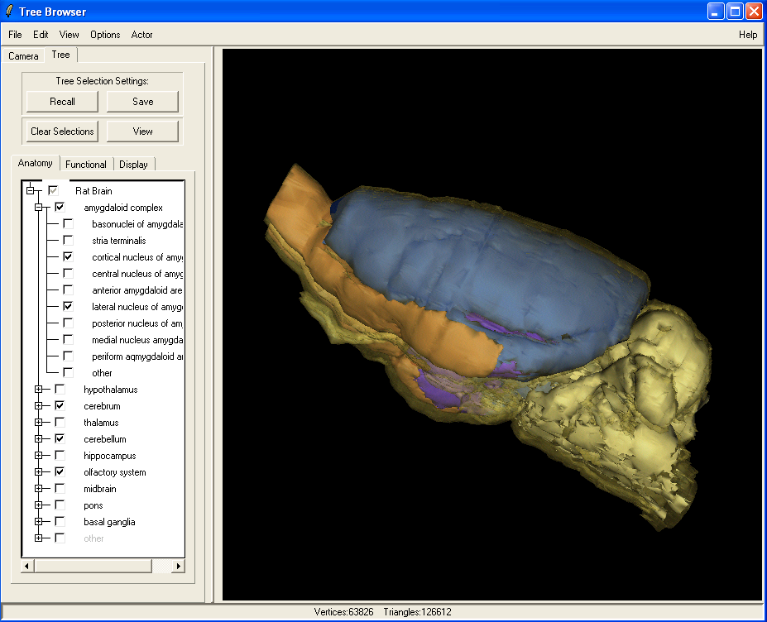
Selection ROIs: Tree Browser

Slide 11
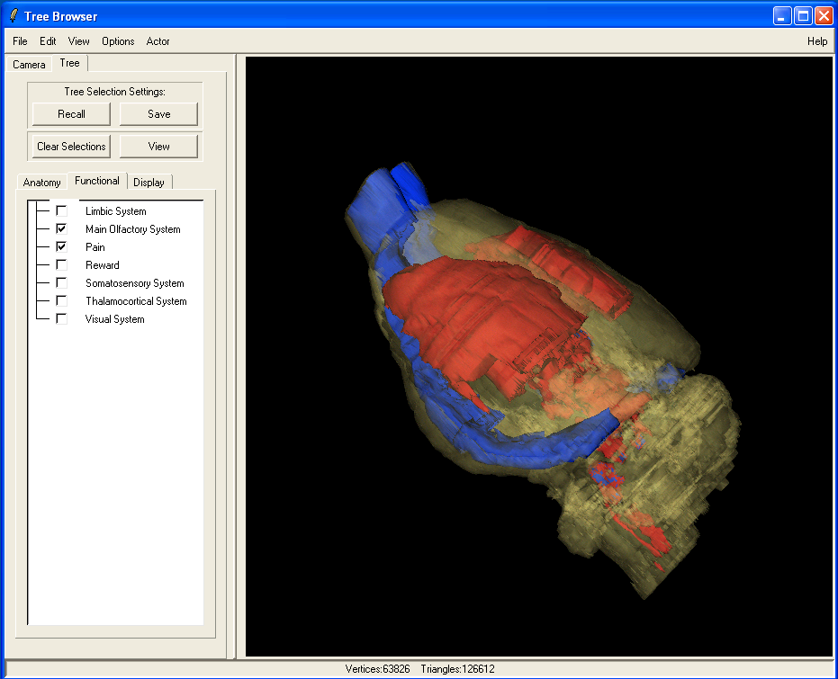
Functional Area

Slide 12




IMAGING BRAIN ACTIVITY IN RESPONSE TO COCAINE

Slide 13
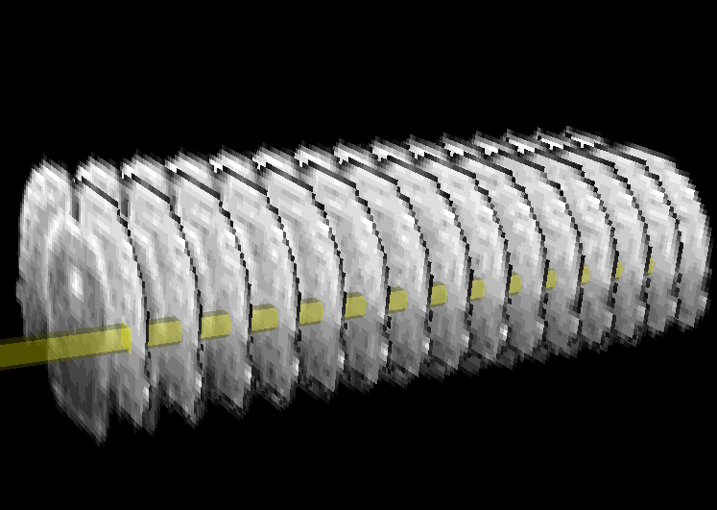
Analysis
Time History for single Voxel
Intensity
Time

Slide 14
Perform a Student t-Test
to Determine Significance
Mean = 0.001
σ= 0.003
Mean = 0.001
Mean = 0.01
σ= 0.005
σ= 0.006
Significant
Mean = 0.001
Mean = 0.06
σ = 0.005
σ = 0.013

Slide 15
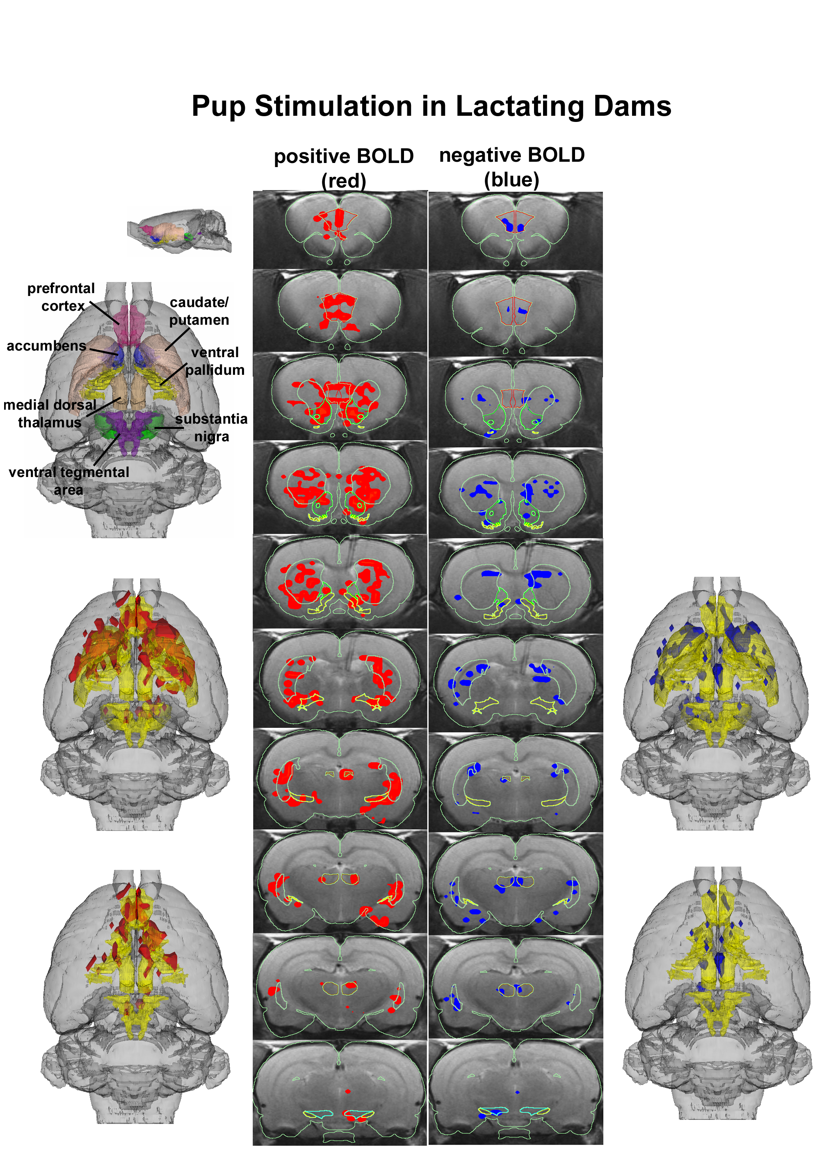
Cocaine Effects

Slide 16
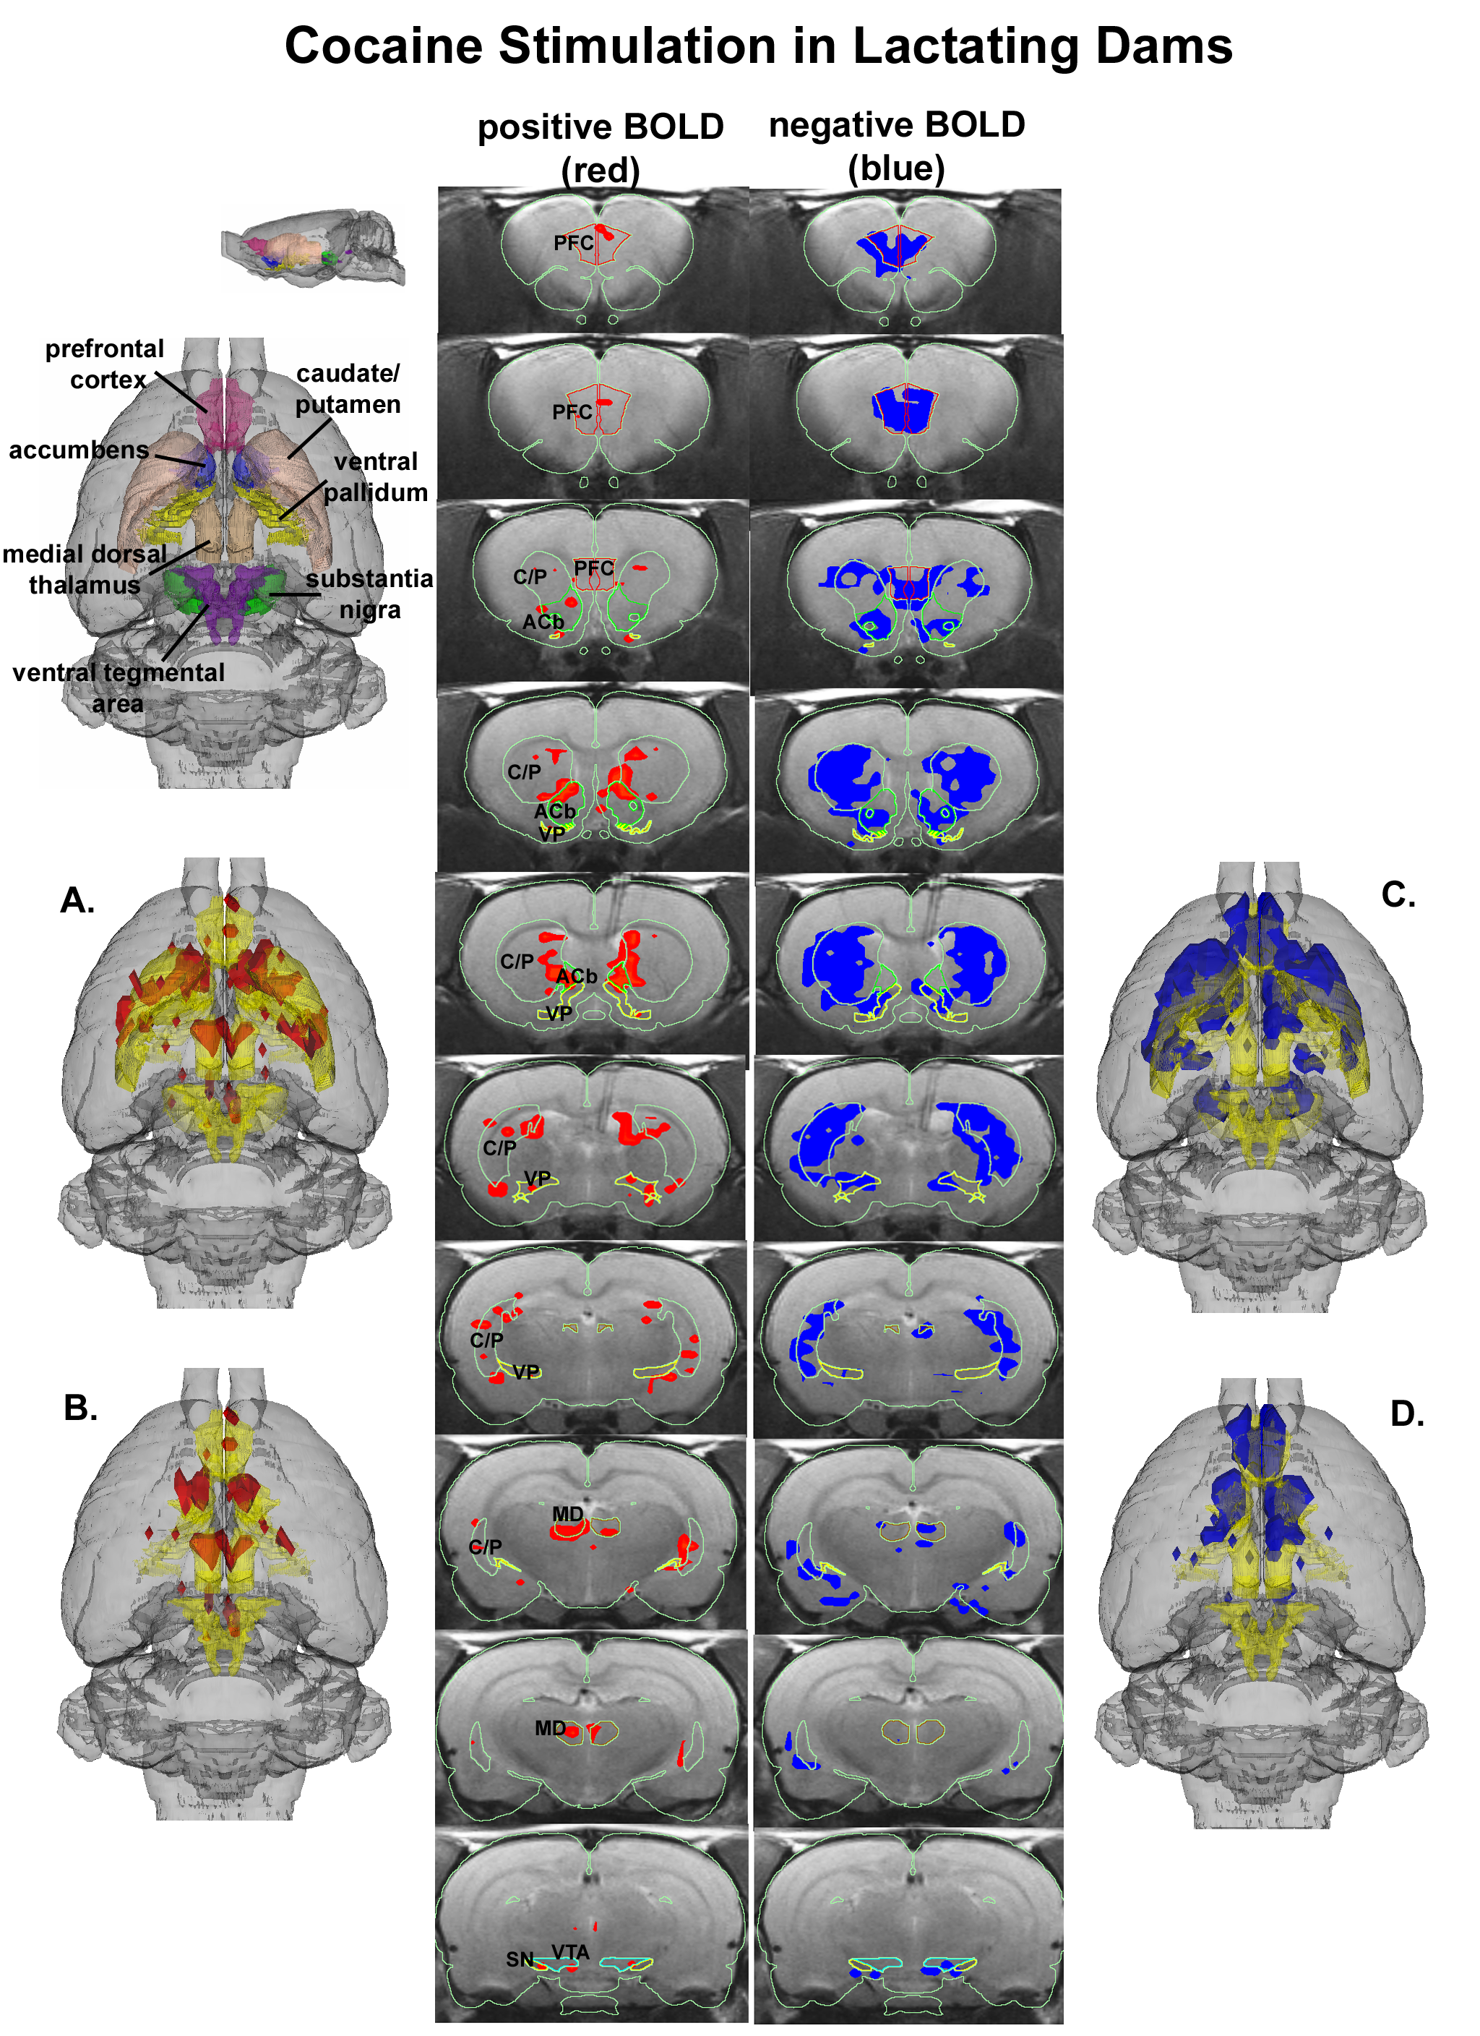
C.F. Ferris, P Kulkarni, J.M. Sullivan Jr, J.A. Harder, T.L. Messenger, and M. Febo,
“Pup Suckling Is More Rewarding Than Cocaine: Evidence from Functional Magnetic Resonance Imaging and Three-Dimensional Computational Analysis”,
J NeuroScience, V25, N1, (2005)

Slide 17
Your Tasks:
Find the Folder Containing All the Codes and Data
Open the File “SingleSliceRatBrain_t_Test.py”
Replace the Variable “dataDir” with your directory path:
# set the paths to the data and read in the file listing all the jobs to run dataDir = "/Users/sullivan/Dropbox/UMass/JMS-RPi-Tests/"
Run the Code on your Headnode
Did it work???
Open the File “MultipleSliceRatBrain_t_Test.py”
Replace the Variable “dataDir” with your path
Run the Code on your Headnode
Did it work???

