Slide 1


Slide 2








OVERVIEW
GOAL
Develop a learning management system (LMS) with functionalities for user registration and login, user profiles, role-based access control, and grade-tracking.
TOOLS USED

Slide 3
ENVIRONMENT SETUP
Initialization: Set up the project with Express.js, set a new Node project, and installed necessary dependencies.
Database: Configured PostgreSQL using Sequelize ORM for database interactions. Created models for User and Grades.

Slide 4
USER AUTHENTICATION
Passport.js: Used Passport.js with JWT strategy for authentication. Implemented registration and login routes to handle user authentication.
Role-based Access Control: Defined user roles (student, teacher, admin) and implemented middleware for the restriction of access to specific routes based on user roles.

Slide 5
DATABASE MODELS
User Model: Defined attributes such as id, name, email, password, role, and studentId. Used hooks to hash passwords before saving them to the database.
Grades Model: Defined attributes such as id, studentId, subject, and grade. Established relationships between the User and Grades models.
Migrations: Used Sequelize migrations to manage database schema changes, including creating the Users and Grades tables.

Slide 6
API ROUTES
User Routes: Implemented routes for user registration, login, and profile fetching.
Grades Routes: Implemented routes for teachers to submit grades and for students to fetch their grades. Protected these routes using JWT authentication and role-based middleware.

Slide 7
FRONTEND IMPLEMENTATION
React Setup: Initialized a React project for the frontend. Set up components for user registration, login, profile, and grades management.
Profile Page: Created a profile page that fetches and displays user information and grades for students.
Grades Page: Created a grades page for teachers to submit grades and for students to view their grades. Utilized Axios for making HTTP requests to the backend.

Slide 8
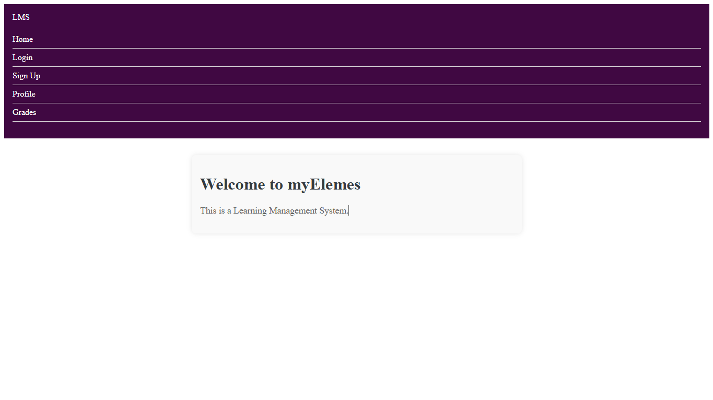
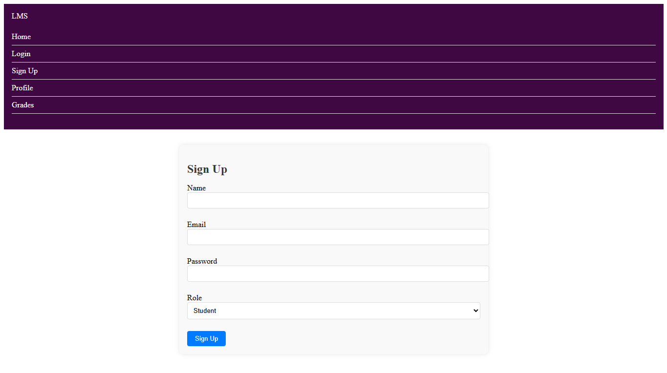
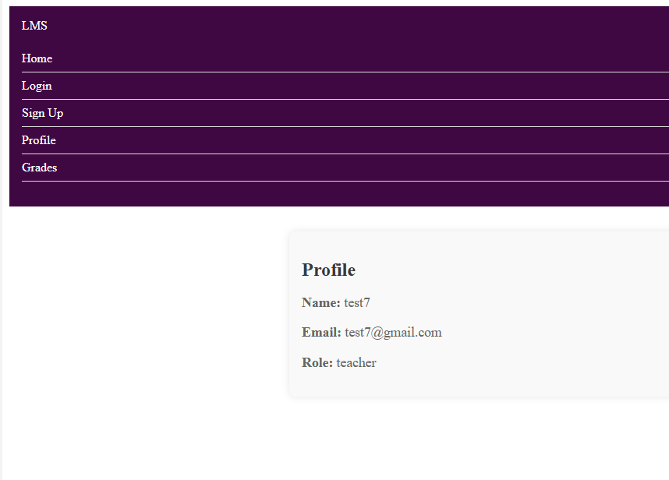
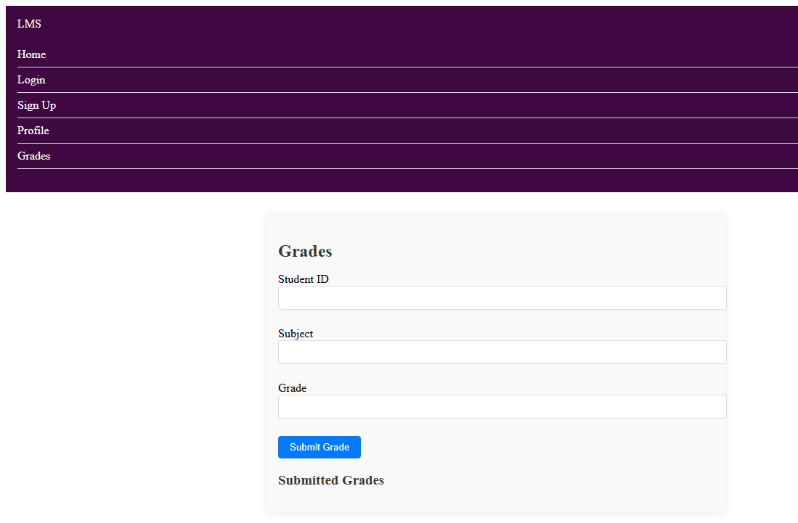
HOME PAGE
SIGNUP
PROFILE
GRADES

Slide 9
DEBUGGING
Error Handling: Implemented error handling for API routes to provide meaningful error messages. Used try-catch blocks and error middleware in Express.
Debugging: Utilized logging and debugging tools to troubleshoot issues. Fixed issues related to database connectivity, model definitions, and route handling.

Slide 10
SECURITY MEASURES
Password Hashing: Ensured passwords are securely hashed using bcrypt before storing them in the database.
JWT Authentication: Implemented JWT tokens for secure authentication and authorization.
Input Validation: Validated user inputs to prevent SQL injection and other common security vulnerabilities.

Slide 11
TESTING
Testing: Tested the application thoroughly to ensure the functionalities work as expected. Used tools like Postman and Bash to test the endpoints.

Slide 12
SYSTEM SIMULATION

Slide 13
Thank you for listening!

