Slide 1
ShuffleFaceNet: A Lightweight Face Architecture for Efficient and Highly-Accurate Face Recognition
Yoanna Martínez-Díaz¹, Heydi Mendez-Vázquez, ¹ Miguel Nicolás-Díaz¹ Luis S. Luevano², Leonardo Chang², Miguel Gonzalez-Mendoza²
1. Advanced Technologies Application Center (CENATAV) Havana, Cuba
2. Tecnológico de Monterrey Mexico

Slide 2
Outline
Introduction
Face recognition using deep neural networks
Lightweight FaceNets
Approach
ShuffleNetV2
ShuffleFaceNet
Experiments
MegaFace
YouTube Face
Retina & LFR Track 1
Efficiency in inference time
Conclusion

Slide 3
Introduction

Slide 4
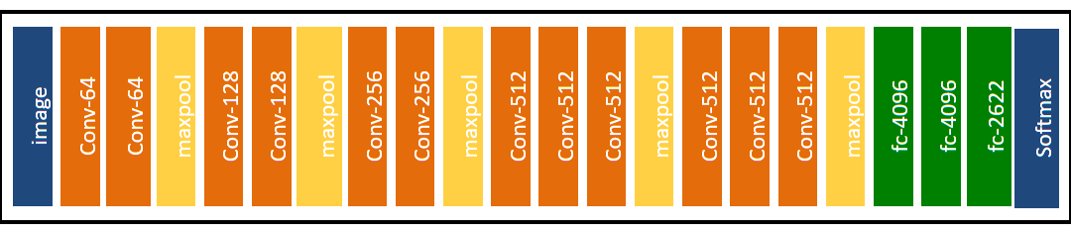
Face recognition with Deep neural networks
Effective but very expensive
E.g. VGGFace
138 million parameters
500MB model size
15G FLOPs
Not feasible for real-time
Need powerful hardware (GPUs)
Very expensive

Slide 5
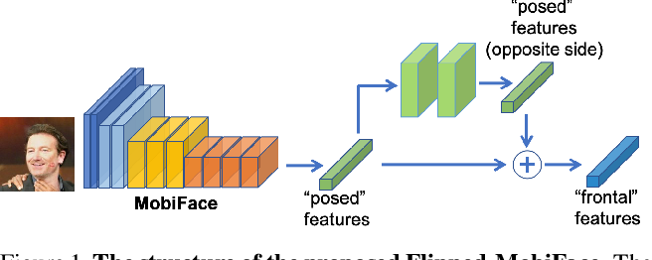
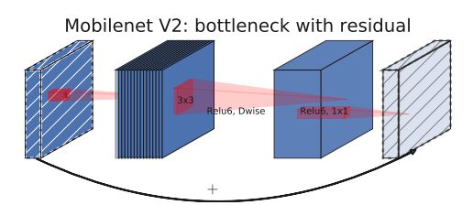
Lightweight FaceNets
General Purpose
specialized on Face Recognition
Most popular
SqueezeNets
MobileNets
ShuffleNets
MobileFaceNets (Chen et al, 2018)
Mobiface (Duong et al, 2018)
LightCNN (Wu et al, 2018)

Slide 6
Approach

Slide 7
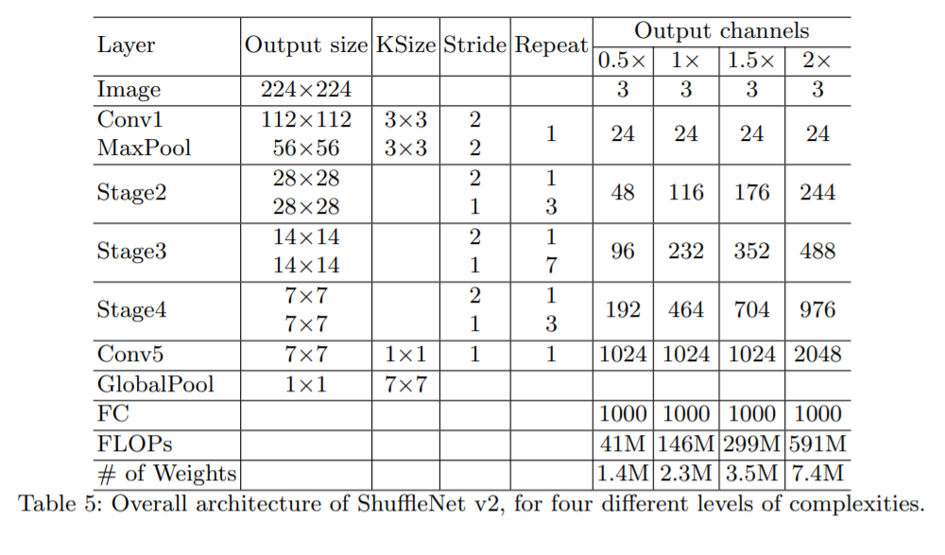
ShuffleNetV2
N. Ma, X. Zhang, H.-T. Zheng, and J. Sun. Shufflenetv2: Practical Guidelines for Efficient CNN Architecture Design. ECCV, 2018

Slide 8
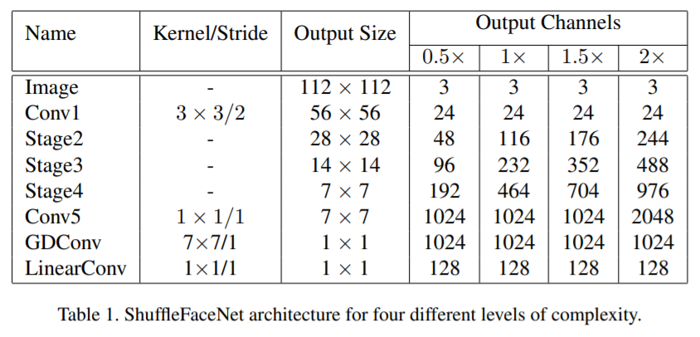
ShuffleFaceNet: the face recognition strategy

Slide 9
ShuffleFaceNet: the face recognition strategy
Global DepthWise convolution after Conv5
GAP less accurate for face recognition (Wu, 2018; Chen, 2018; Deng, 2018)
Eliminates face discriminative information from feature vector units
PReLU activation
Allows negative responses, improving face recognition performance (J.-C. Chen, 2016; S. Chen, 2018; Duong, 2018)
ReLU offers usually high dimensional and sparse features
Fast downsampling
Retain more input data using strides instead of convolution + pooling at Conv1
Compact 128-dimensional face representation
Notes:
a Global Depth-wise Convolution (GDC) layer was used in [2, S. Chen, 2018] to treat different units of the output feature map with different importance, showing be an efficient structure for face recognition. In this work, we replace the GAP layer of ShuffleNetV2 with a GDC layer

Slide 10
Experiments

Slide 11
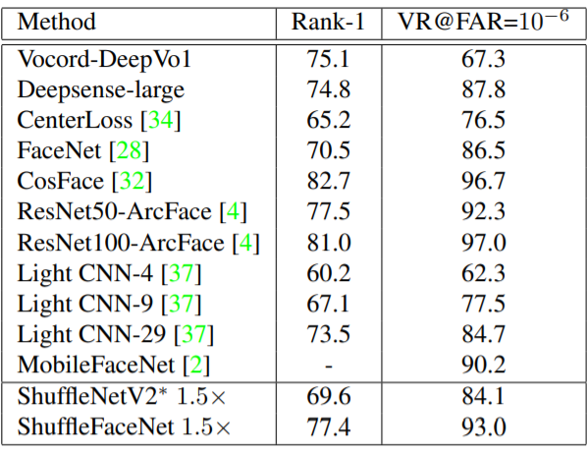
Evaluation on MegaFace Challenge 1 using Facescrub as test set
Notes:
As we can see, on this large database, ShuffleFaceNet outperforms ShuffleNetV2∗ by almost 9% for both Rank-1 and VR@FAR=10−6 evaluation measures and shows its superiority with respect to the rest of light models such as MobileFaceNet and Light CNNs -4,-9 and -29. The obtained results are even better than existing very deep models such as Vocord and Deepsense, which are provided as baseline methods on the benchmark [17]. Other very deep models which provide better results need higher computational resources and storage space, as we will analyze later. For example, the LResNet100E model, that obtains the best results in this benchmark database, has a size of 250 MB.

Slide 12
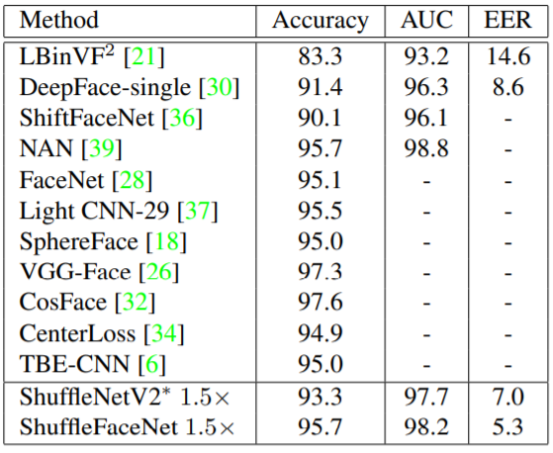
Evaluation on YouTube Face database

Slide 13
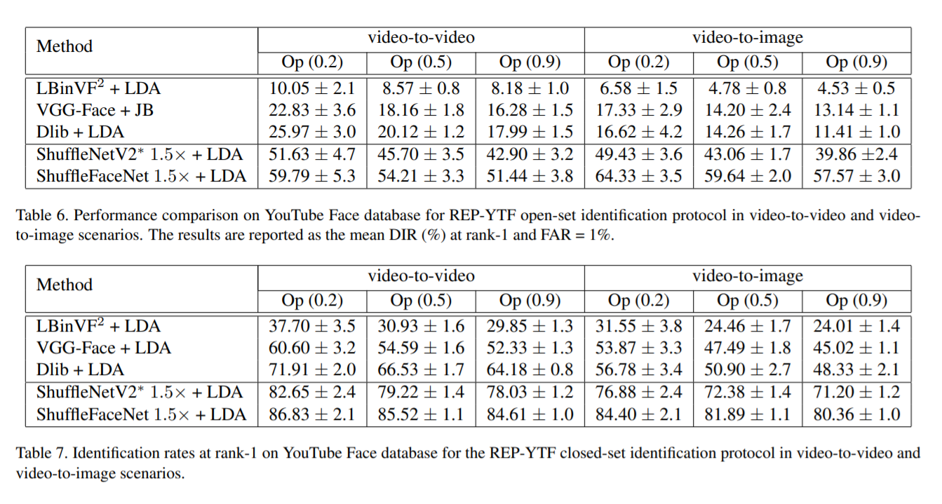
REP-YTF protocol
Notes:
Under these protocols, the YTF database is divided into ten random trials of training and test sets. On each trial, for both open and closed-set identification protocols, three different configurations of the test set are obtained by using the openness values: 0.2, 0.5, and 0.9, resulting in different gallery sizes

Slide 14
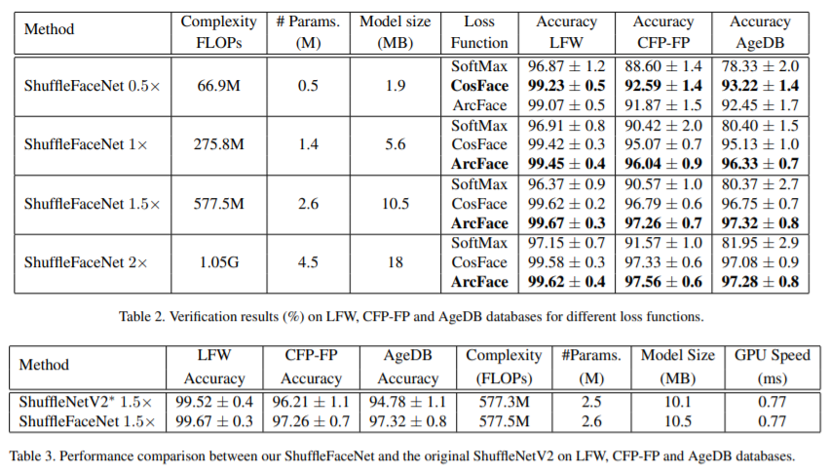
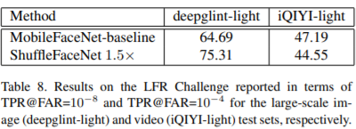
Training on MS1M-RetinaFace and LFR track 1 test results
Notes:
As expected, the higher the complexity, the higher the accuracy. However, there is not a significant difference between levels 1.5× and 2×. Thus, in order to get a better speed-accuracy trade-off, we have decided to use in the remaining experiments, the ShuffleFaceNet 1.5× trained with ArcFace loss function
It can be seen that the proposal outperforms the original ShuffleNetV2 model on the three datasets. On the other hand, although the model size and number of parameters increase a little bit, the inference time remains the same. This means that the guidelines considered in the design of the efficient ShuffleNetV2 were maintained

Slide 15
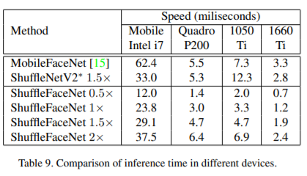
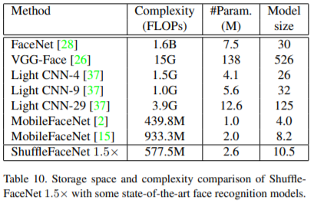
Efficiency tests and complexity comparison
Notes:
As expected, the higher the complexity, the higher the accuracy. However, there is not a significant difference between levels 1.5× and 2×. Thus, in order to get a better speed-accuracy trade-off, we have decided to use in the remaining experiments, the ShuffleFaceNet 1.5× trained with ArcFace loss function
It can be seen that the proposal outperforms the original ShuffleNetV2 model on the three datasets. On the other hand, although the model size and number of parameters increase a little bit, the inference time remains the same. This means that the guidelines considered in the design of the efficient ShuffleNetV2 were maintained

Slide 16
Conclusions

Slide 17
Conclusions
ShuffleFaceNet 1.5x exhibits the best speed-accuracy trade-off
Mobile CPU and Mobile GPU performance make it feasible for real-time and mobile applications
Around 30fps in inference performance on Mobile Intel i7 7700HQ
Modifications made improve face recognition performance over original ShuffleNetV2 network
Global DepthWise Convolution
PReLU
Stride downsampling
Drastically improves efficiency
Notes:
a Global Depth-wise Convolution (GDC) layer was used in [2, S. Chen, 2018] to treat different units of the output feature map with different importance, showing be an efficient structure for face recognition. In this work, we replace the GAP layer of ShuffleNetV2 with a GDC layer

Slide 18
Thank you!

