Slide 1


Team 16: Solar Power Battery
Bi-Weekly Update 2 Lauren Lugo, Tarik Dawson, Clement Ong, Nathan Gil Sponsor: Peng-Hao Huang TA: Dalton W. Cyr
Notes:
Michelle

Slide 2
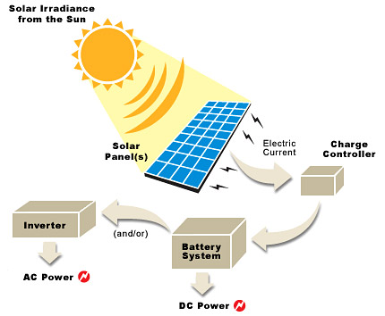
Project Summary
Problem Statement:
Provide the user with an independent solar power generating system that can charge both AC and DC devices
Solution proposal:
Develop independent power grid using a solar panel that can charge the majority of items throughout the day and night. Both AC and DC power provided.
Notes:
Kyle

Slide 3
Project/Subsystem Overview
Clement
DC-AC Inverter
Tarik
Solar Panel
DC-DC Converter
Switch
DC Load
Lauren
DAC
Batteries
Switch
MPPT Algorithm (MCU)
Voltage Regulation
Nathan
Computer Application
Phone Application
Notes:
Eric

Slide 4
Project Timeline
(Complete)
(Ongoing)
(Ongoing)
(Not Started)
(Not Started)
Finalize Subsystems
Validate Individual Subsystems
Integration Between Subsystems
Validate System
Final Demo
Team members have finalized their designs and making finishing touches on subsystem
Team will finalize and validate individual subsystems
ESP32 and Database is undergoing integration for bi-direction communication. Sensors/switches undergoing integration between DC-DC and ESP32.
Team will validate entire system to ensure accuracy and functionality
Team will demo the final completed system
Notes:
Eric

Slide 5
Max Power Point Tracking
Lauren Lugo
Accomplishments since Update 1 15 hrs of effort | Ongoing progress/problems and plans until the next presentation
Ordered and Finalized MCU & Battery switch/sensor PCBs with Tarik Order Parts for all PCBs Reconnected Esp32 and connected to Wifi | Integration to Computer Application (Firebase) with ESP IDF Clean up Code to output readable power, voltage, and current Began putting together PCB boards

Slide 6
DC-DC Converter
Tarik Dawson
Accomplishments since Update 1 18 hrs of effort | Ongoing progress/problems and plans until the next presentation
Battery switch/sensor PCB designed and ordered Microcontroller PCB finalized and ordered DC-DC control fixed and tested, showing a range of output of 0-12V | Finalizing integration in DC-DC PCB By next review, subsystem will be ordered and integration testing begins. Receive/Solder all ordered PCBs

Slide 7
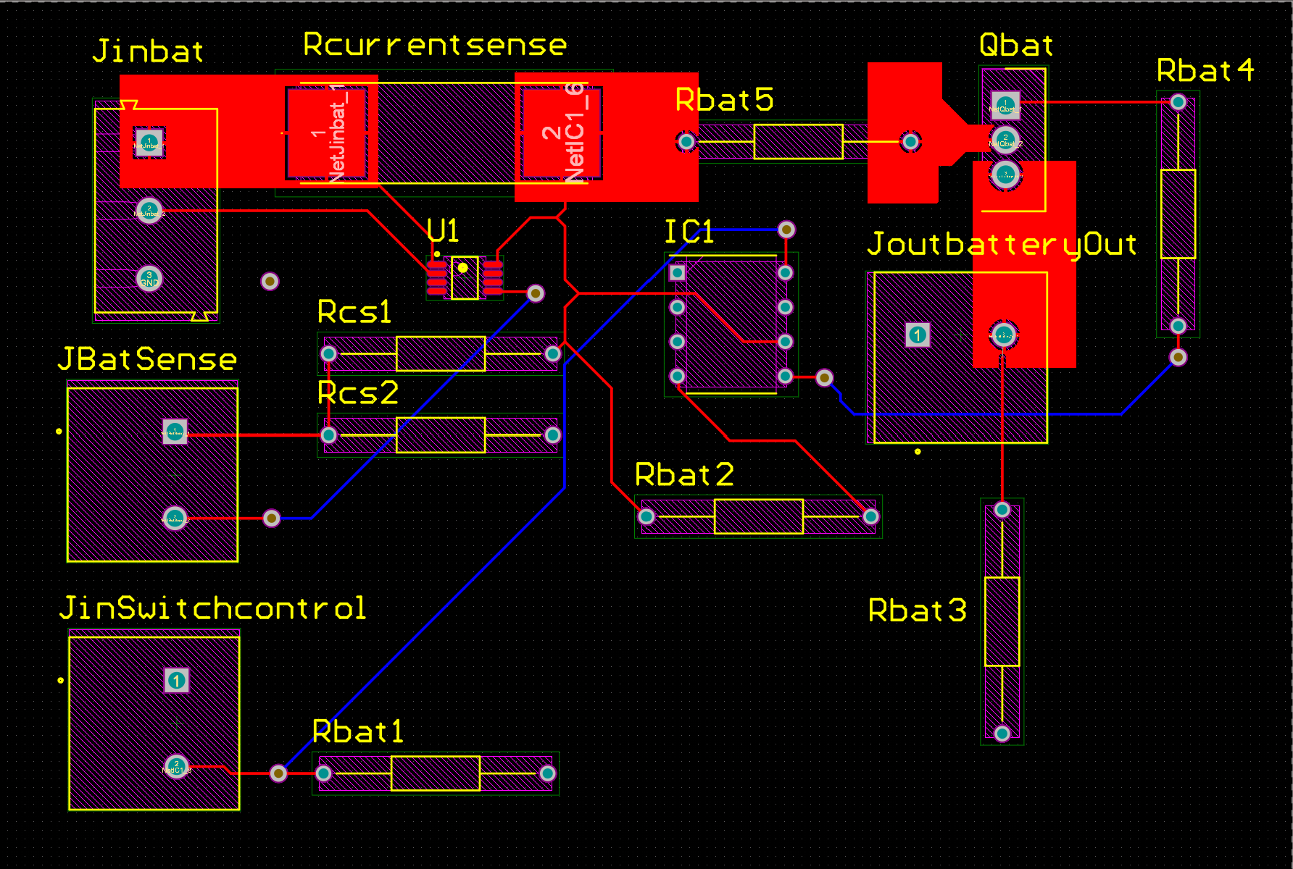
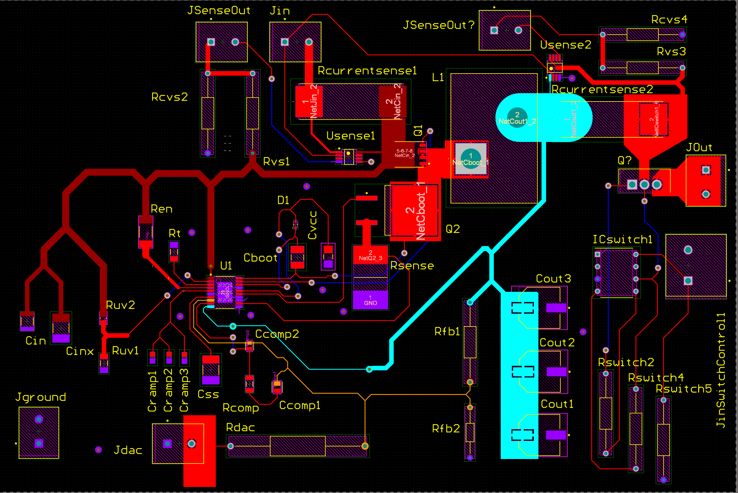
DC-DC Converter
Tarik Dawson
Battery PCB
Designed and ordered
Once soldered, testing begins
DC-DC PCB
Switch and sensors integrated
A few last checks before ordering

Slide 8
DC-AC Inverter
Clement Ong
Accomplishments since update 1 13 hrs of effort | Ongoing progress/problems and plans until the next presentation
PWM code is successfully completed and tested Transformer obtained | H-bridge not functioning, having problems with gate driver

Slide 9
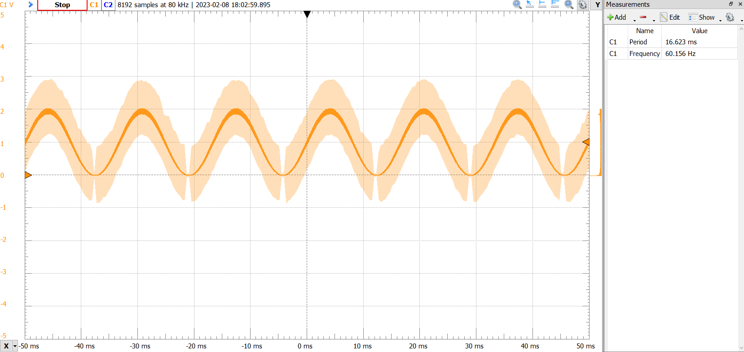
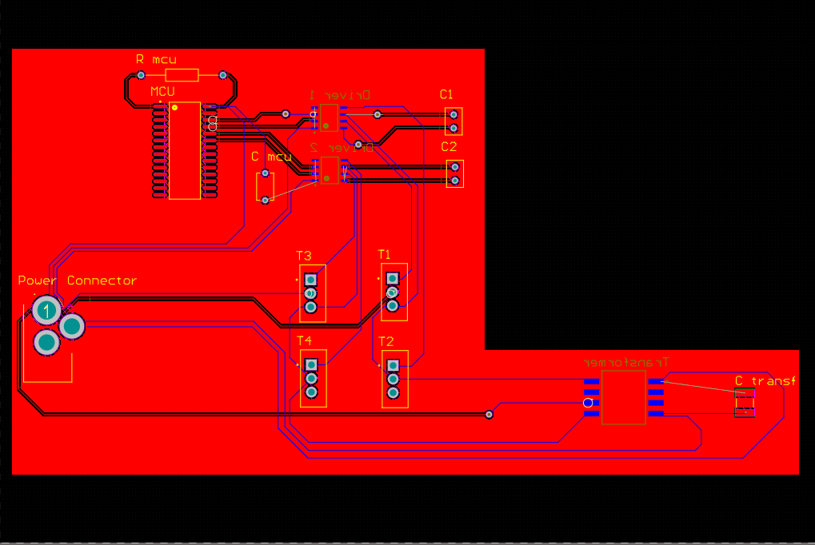
DC-AC Inverter
Clement Ong
MCU
PWM completed and tested
PWM frequency -> 25 Khz
PWM period -> 40 us
Wave frequency -> 60 Hz
H-Bridge
Gate driver not functioning properly
Tried two different gate drivers, still no signal at output
Transformer
Obtained from WEB
Testing to ensure functionality
PCB
Completed as of now (with current parts)
Waiting for fully functional H-bridge before ordering

Slide 10
Website and Android App
Nathan Gil
Accomplishments since Update 1 8 hrs of effort | Ongoing progress/problems and plans until the next presentation
Organized database by User with their Data / Preferences in preparation for ESP32 data Completed research on connection between firebase and ESP32 Tested “ESP32” data inputs by using dummy data to send to firebase from front-end | On-going integration with Lauren to get ESP32 and backend bi-directionally communicating

Slide 11
Validation Plan
Paragraph # | Test Name | Success Criteria | Methodology | Status | Responsible Engineer
3.2.1.1 | Solar Panel Maximum Output | The Solar/battery power system functions when connected to a 220W source | Connect a 220W source to the solar/battery system and check node data | Not Tested | Clement Ong
3.2.1.2 | Range of Loads | System can power a device consuming up to 100W | Plug a 100W load into either the DC or AC output. | Not Tested | Tarik Dawson
3.2.1.3 | Switch Check | System will switch to battery power when the solar panel is not producing enough; system will open switch when solar panel is not producing; and the system will open the load switch when the battery is charging | Observe voltage output using voltage sensor (voltage divider), update status through MCU | Testing Success | Lauren Lugo
3.2.1.4 | AC Output | AC output will be identical to standard US AC outlet power | Use a multimeter to test the AC output of the system | Not Tested | Clement Ong
3.2.1.5 | Max Power Point Track | System can track the max power the solar panel can give the system | Track power through system, using voltage dividers and current sensors | Testing Success | Lauren Lugo

Slide 12
Validation Plan
Paragraph # | Test Name | Success Criteria | Methodology | Status | Responsible Engineer
3.2.1.6 | System Shut Off | System disconnects when not enough power is being supplied | Disconnect all inputs and ensure all switches receive no power | Testing Success | Lauren Lugo
3.2.2.1 | Mass | System will be no heavier than 32 kilograms | Weigh the whole system with the solar panel included | Testing Success | Tarik Dawson
3.2.3.1.1 | Power Consumption | The system will not consume more than 260W | allow the system to charge with no load, if the battery charges at all, success criteria is fulfilled | Not Tested | Lauren Lugo
3.2.3.1.2 | Input Voltage | System works with input voltage from 20V to 60V | Connect load to the system in complete darkness and when the solar panel produces max voltage | Not Tested | Tarik Dawson
3.2.3.2.1 | Data Output | The website/application subsystem is receiving data | Run system normally. If the website is getting data, success criteria is fulfilled | Testing Success | Nathan Gil
3.2.3.2.2 | Diagnostic Output | The website/application subsystem is receiving data dynamically | Run system normally. If the website is getting internal data, success criteria is fulfilled | Tested | Nathan Gil

Slide 13
Validation Plan
Paragraph # | Test Name | Success Criteria | Methodology | Status | Responsible Engineer
3.2.4.1 | Thermal | System works in the temperature range of -15 to 50 degrees Celsius | Test system functionality at -15C and 50 using heating and cooling device | Not Tested | Nathan Gil
3.2.4.2 | Rain | System works in the rain | Test system functionality in the rain | Not Tested | Tarik Dawson
3.2.4.3 | Humidity | System works for all humidity levels | Test system functionality from 0% humidity to 100% in increments of 25 | Not Tested | Tarik Dawson
3.2.5.1 | Database Operations | Firebase Backend Database successfully receives and categorizes data | Test database functionality by measuring voltage, power, etc. directly and matching it to database | Testing Success | Nathan Gil
3.2.5.2 | Application and Website Post Request | Website and Application successfully pulls data from firebase backend database | Test by outputting to the local console of website and app to confirm correct data is being pull | Testing Success | Nathan Gil
3.2.5.3 | System Display of Crucial Data | Application and Website provides correct data depending on day, week, and month | Compare display data to database, and physical components in real time (updates dynamically) | Testing Success | Nathan Gil

Slide 14
Validation Plan
Paragraph # | Test Name | Success Criteria | Methodology | Status | Responsible Engineer
3.2.5.4 | Physical Requirement | Website and Application works on android phone along with displaying properly | Test app and website on Android physical phone and interact with the applications | Testing Success | Nathan Gil
3.2.5.5 | User Authentication | Website and App will check if a user exist and if the new username is already used | Test application and check firebase authentication database to see new user and current users | Testing Success | Nathan Gil
3.2.5.6 | Existing User Authentication | Website and App will check if email is correct format, if user has right password | Test by creating a user, and trying to login with wrong password and try and make a fake email | Testing Success | Nathan Gil
N/A | Full system demo | System converts solar power to usable AC or DC power while charging a battery | Place solar panel under the sun and check outputs on both the DC and AC terminals. | Not Tested | Full team
3.2.6.1 | DC-DC Feedback Validation | DC-DC converter uses feedback from the MPPT to adjust output voltage | Vary the feedback voltage and observe if it has an effect on the output voltage | Testing Success | Tarik Dawson
3.2.6.2 | DC-DC Load Current Validation | DC-DC converter supplies 12V up to 20 Amps | Attach the system to an Eload and test the system from 0 amps to 20 amps | Test Failed | Tarik Dawson

Slide 15
Validation Plan
Paragraph # | Test Name | Success Criteria | Methodology | Status | Responsible Engineer
3.2.6.3 | DC-DC Input Range Validation | DC-DC converter works as intended with an input of 20V to 60V | Vary the input from 20 to 60 volts using high current power supply and record the results | Testing Success | Tarik Dawson
3.2.6.4 | DC-DC efficiency Validation | Efficiency is around 75% | Measure power input and power output, then calculate efficiency | Testing Success | Tarik Dawson

Slide 16
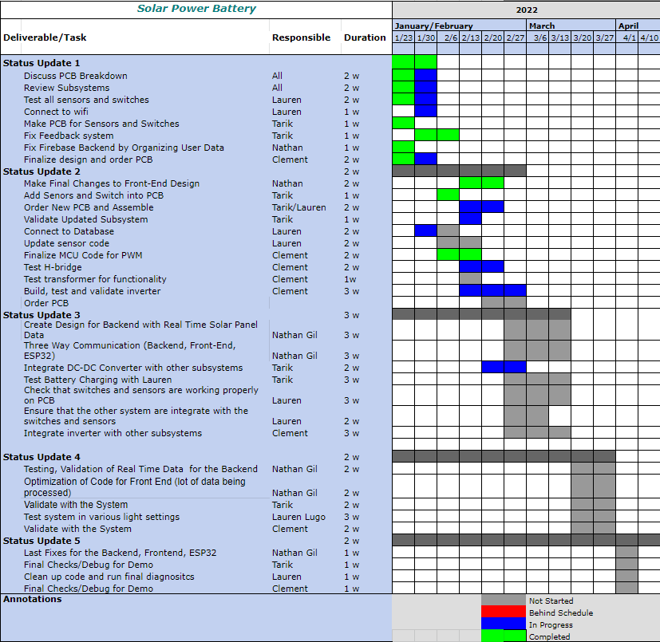
Execution Plan
Notes:
Michelle

Slide 17
Thank You!
Questions?

