Slide 1


Team 16: Solar Power Battery
Bi-Weekly Update 3 Lauren Lugo, Tarik Dawson, Clement Ong, Nathan Gil Sponsor: Peng-Hao Huang TA: Dalton W. Cyr
Notes:
Michelle

Slide 2
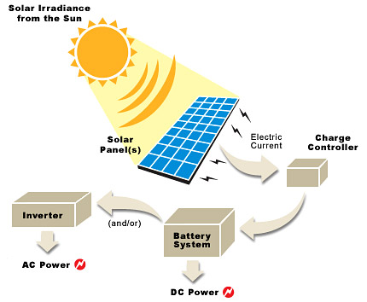
Project Summary
Problem Statement:
Provide the user with an independent solar power generating system that can charge both AC and DC devices
Solution proposal:
Develop independent power grid using a solar panel that can charge the majority of items throughout the day and night. Both AC and DC power provided.
Notes:
Kyle

Slide 3
Project/Subsystem Overview
Clement
DC-AC Inverter
Tarik
Solar Panel
DC-DC Converter
Switch
DC Load
Lauren
DAC
Batteries
Switch
MPPT Algorithm (MCU)
Voltage Regulation
Nathan
Computer Application
Phone Application
Notes:
Eric

Slide 4
Project Timeline
(Complete)
(Ongoing)
(Ongoing)
(Not Started)
(Not Started)
Finalize Subsystems
Validate Individual Subsystems
Integration Between Subsystems
Validate System
Final Demo
Team members have finalized their designs and making finishing touches on subsystem
Team will finalize and validate individual subsystems
ESP32 and Database is undergoing integration for bi-direction communication. Sensors/switches undergoing integration between DC-DC and ESP32.
Team will validate entire system to ensure accuracy and functionality
Team will demo the final completed system
Jan 17th - Feb 1st
Feb 1st - Feb 20th
Feb 20th - Apr 1st
Apr 1st - Apr 28th
Apr 28th -
Notes:
Eric

Slide 5
Max Power Point Tracking
Accomplishments since last update 15 hrs of effort | Ongoing progress/problems and plans until the next presentation
Connected ESP 32 to the TAMU internet wifi Sent data to Firebase, first step in integration with Web/Computer App | Continued integration with Web/Computer App, cleaning up code Integration with DC-DC Converter

Slide 6
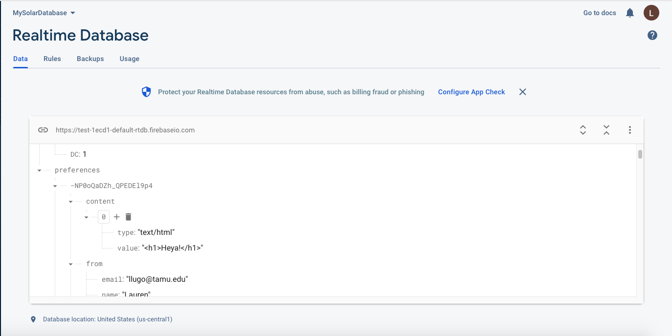
MPPT
Interesting figure showing functional integrated subsystems
Best to show:
Integration results and Functional system testing results for what has been integrated.

Slide 7
DC-DC Converter
Accomplishments since last update 21 hrs of effort | Ongoing progress/problems and plans until the next presentation
Soldered battery sensor, microcontroller, and integrated DC-DC converter PCBs | Begin functional system tests Test Integration with Microcontroller

Slide 8
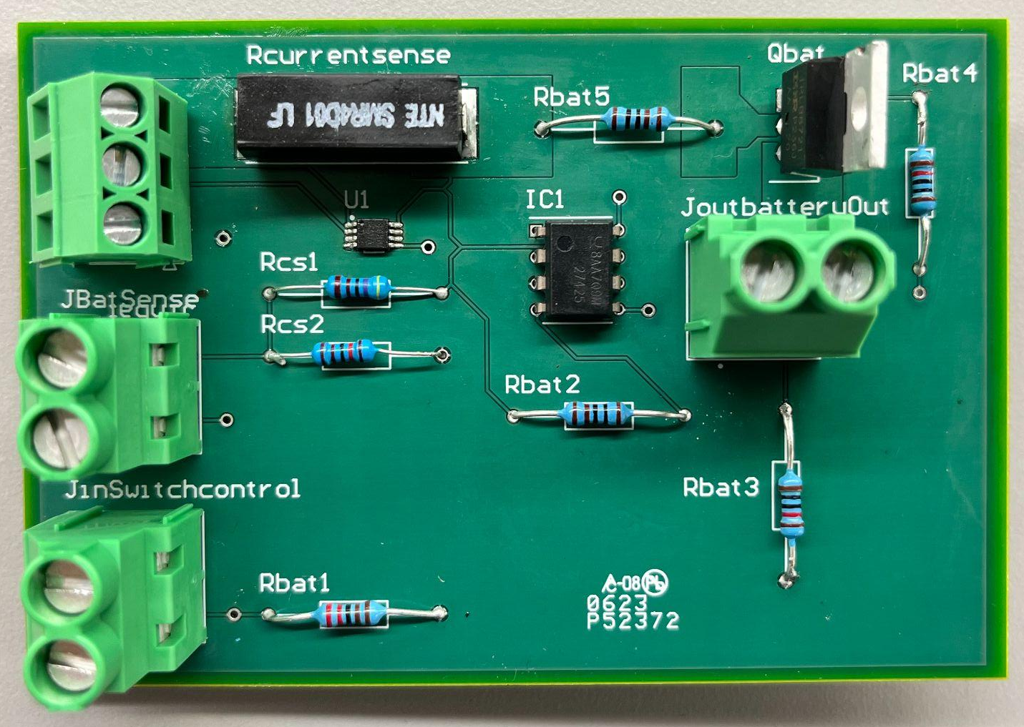
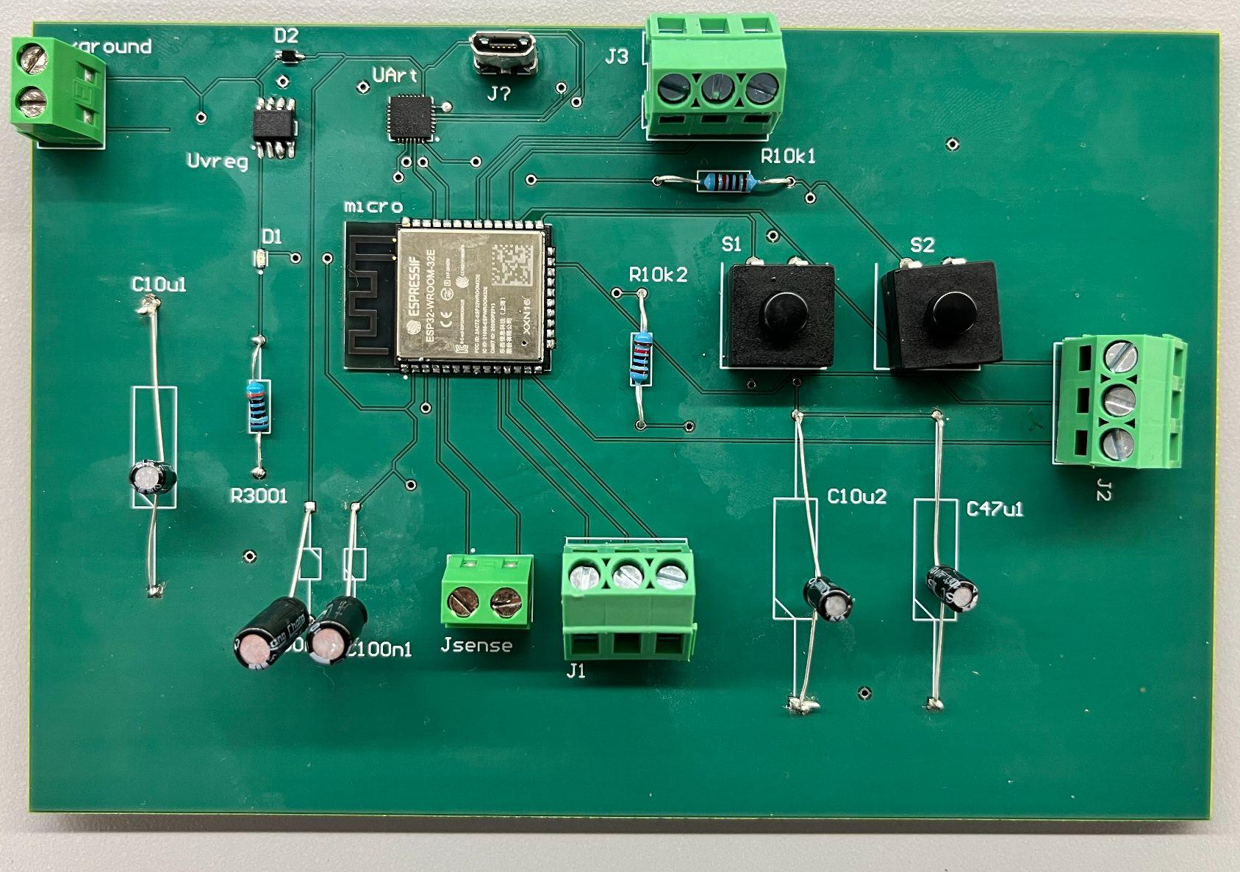
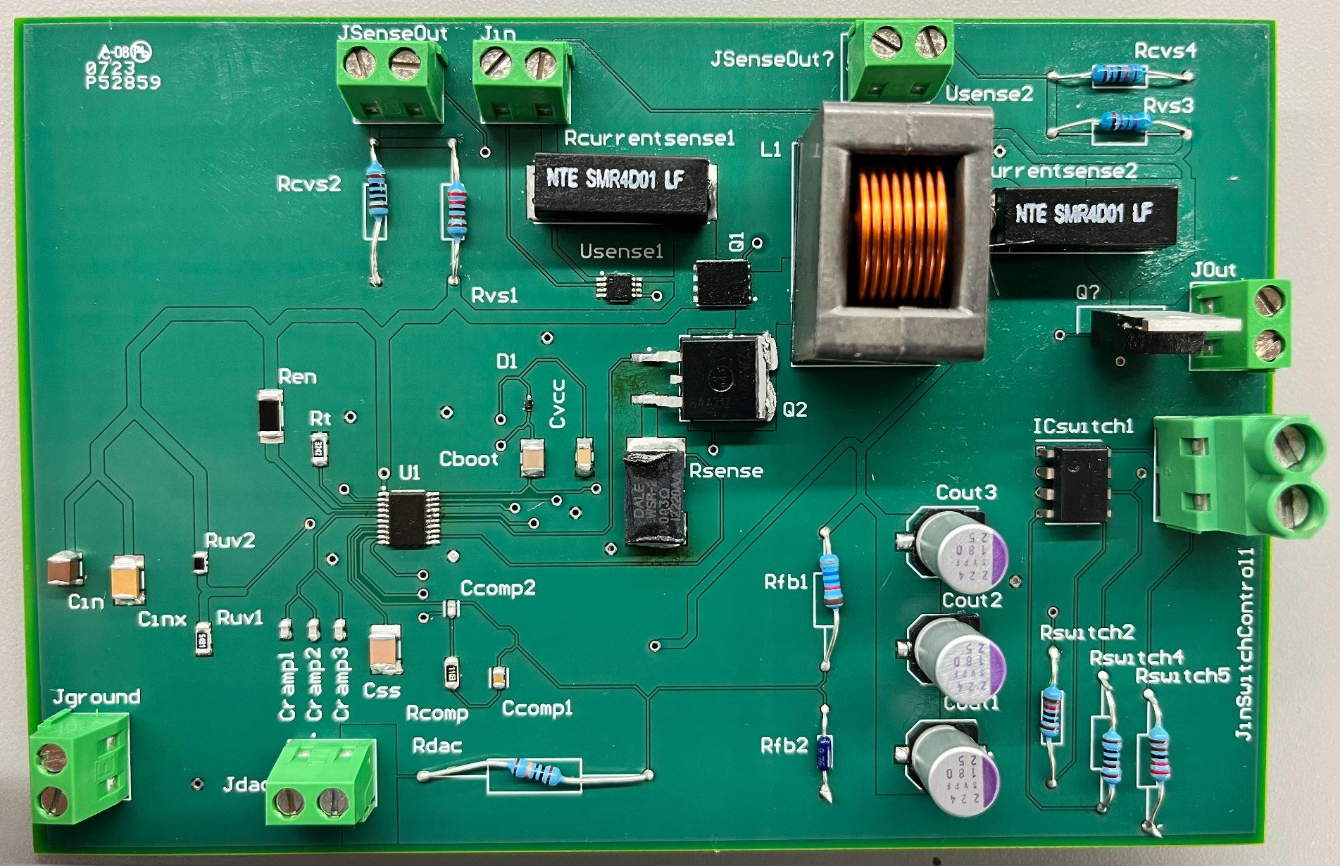
DC-DC Converter / Integrated PCBs
With the PCBs finished, it's time to start putting things together and testing.
Next Tests
Testing control with Lauren
Testing Battery Charging with Lauren

Slide 9
DC-AC Inverter
Accomplishments since last update 15 hrs of effort | Ongoing progress/problems and plans until the next presentation
Completed inverter testing and validation All parts, including PCB, ordered | Implement deadband gap in PWM code Build, test, and validate circuit board

Slide 10
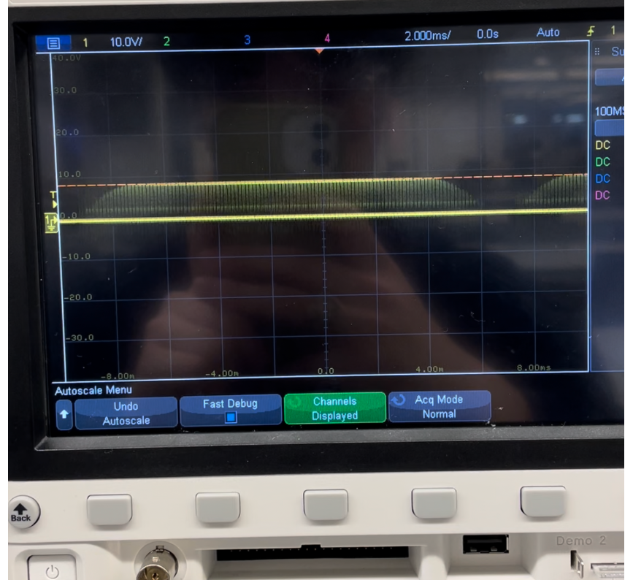
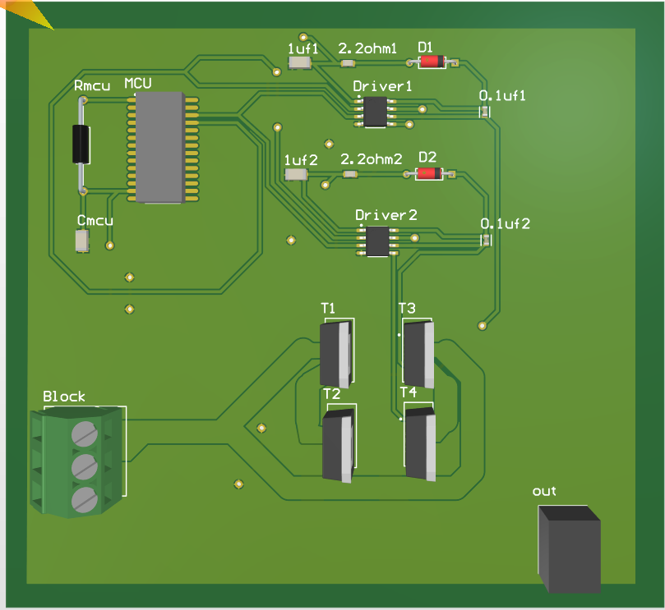
DC-AC Inverter
Half-Bridge output functioning properly
Full-Bridge not functioning properly due to PWM code or loose breadboard wiring
Solution: Add deadband gap to ensure safety
PCB and all necessary parts ordered
Soldering and Testing

Slide 11
Website / Android Application
Accomplishments since last update 8 hrs of effort | Ongoing progress/problems and plans until the next presentation
Helping Lauren with Integration of the ESP32 with the Backend | Use my own ESP32 to connect to the backend and help Lauren testing / code Be able to display information from ESP32 to front-end of application

Slide 12
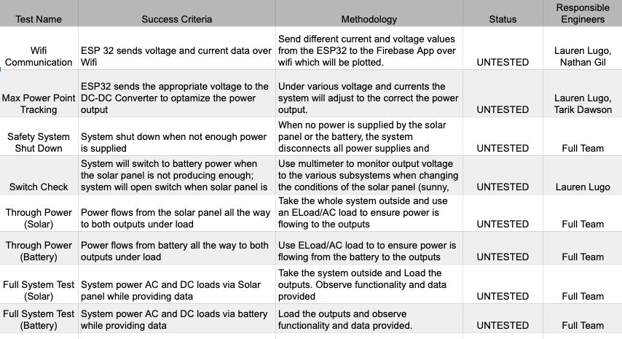
Validation Plan

Slide 13
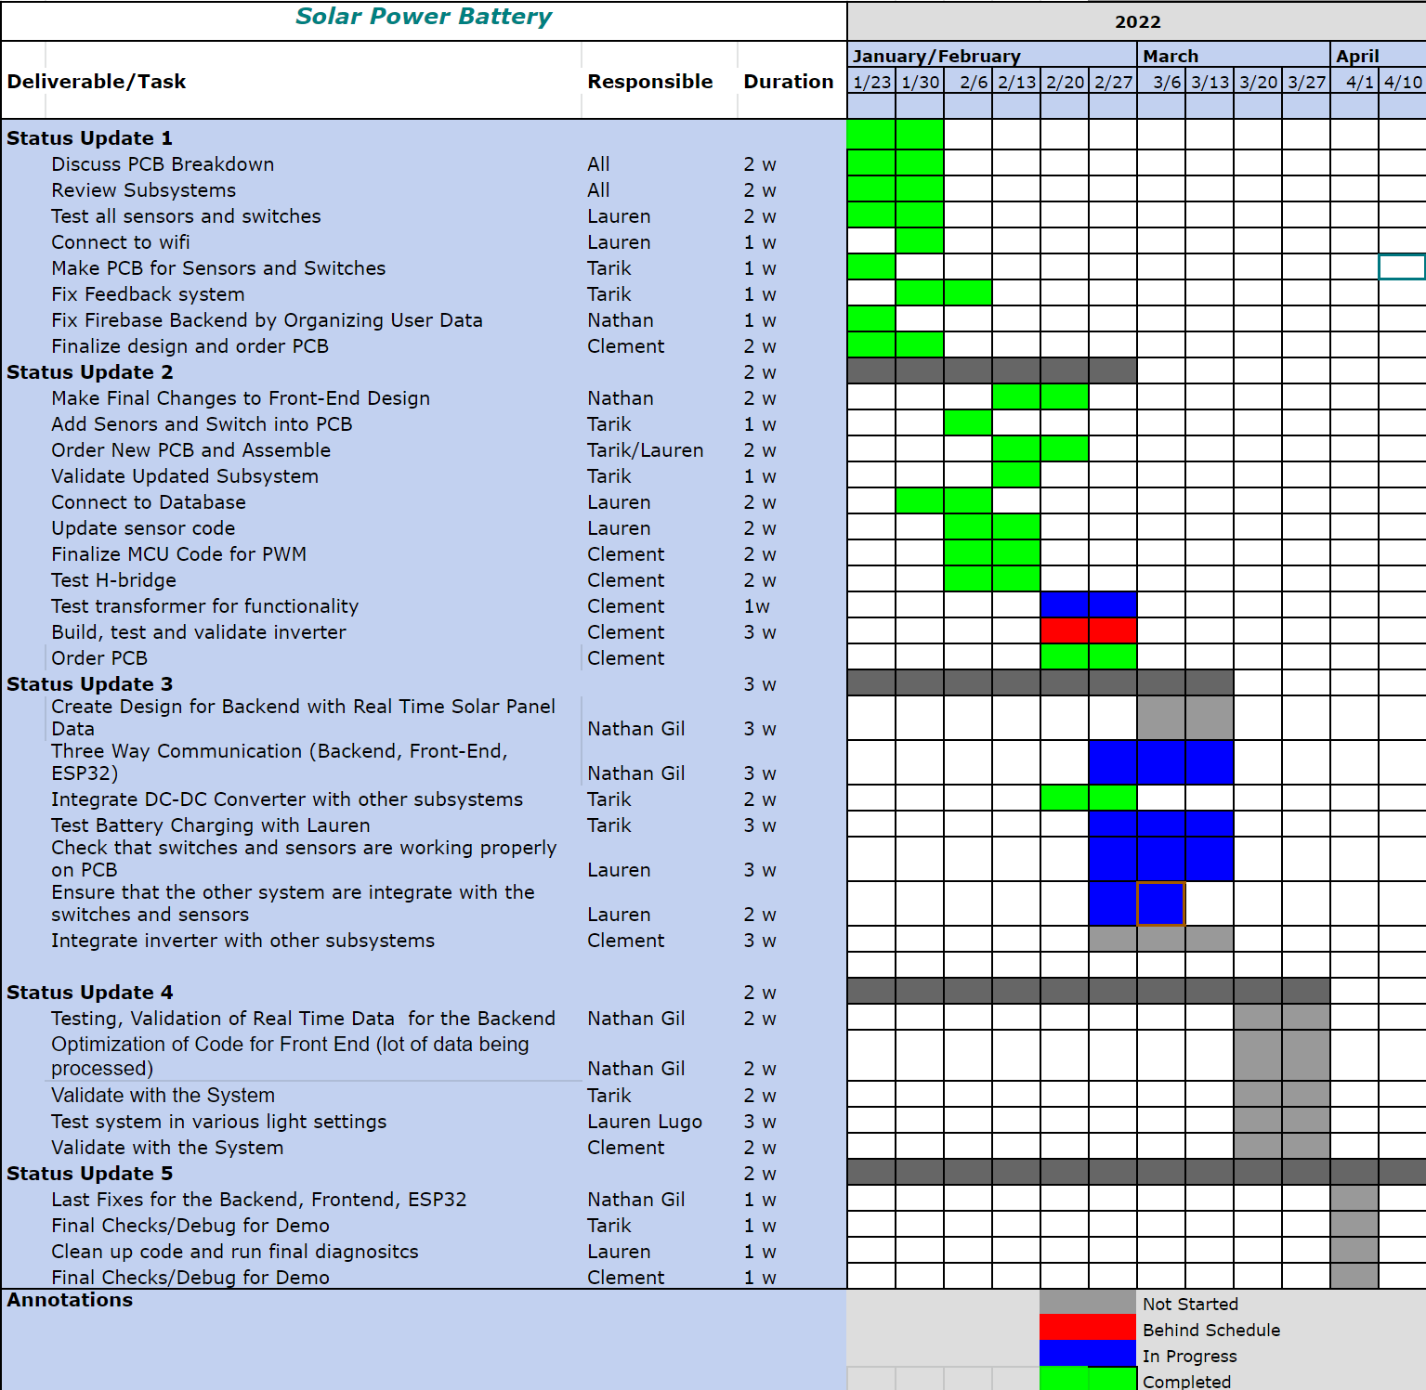
Execution Plan
Notes:
Michelle

Slide 14
Thank You!
Questions?

