Slide 1
DRONE
GCS
Autonomous Ground Control System
Real-Time Navigation · LiDAR SLAM Mapping · Inventory Detection
Raspberry Pi 5 · ROS2 Jazzy · Electron · Point-LIO SLAM · MAVLink · OpenCV

Slide 2
What is Drone GCS?
A complete ground control station for autonomous UAV operations.
Built on ROS2 + Electron, it runs on a Raspberry Pi 5 on board the
drone and streams all telemetry and video to a laptop over Wi-Fi.
No internet needed — everything works on a local network.
SYSTEM ARCHITECTURE
LiDAR Sensor Unitree 4D | Ethernet eth0
Pi Camera Module picamera2 | ROS topic
📡 Live Telemetry
MAVLink attitude, GPS, battery, speed
🗺️ LiDAR SLAM
3D maps at 800 k pts/scan in real time
Raspberry Pi 5 ROS2 Jazzy | gcs_control.py
Pixhawk FC ArduCopter | GPIO UART 57600
📷 Dual Camera
MJPEG dashboard + ROS barcode stream
📦 Auto Inventory
Barcode → SLAM position → SQLite DB
Wi-Fi / rosbridge :9090
GCS — Laptop Electron | ws://Pi:9090

Slide 3
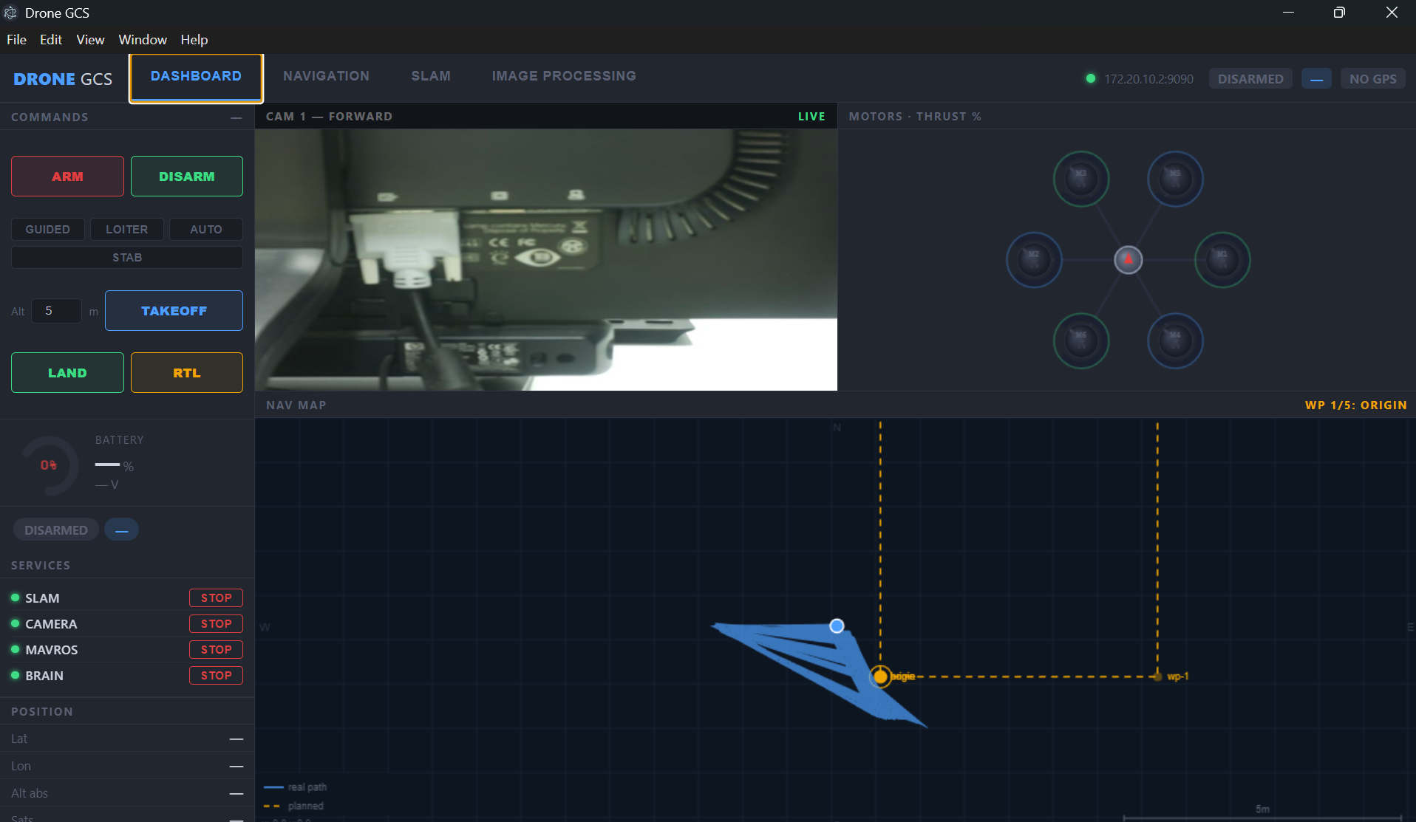
Mission Control Dashboard
🎮 ARM / DISARM
One-click arming via MAVLink command
📹 Live Camera Feed
MJPEG stream from forward camera
🗺️ Navigation Map
Real-time SLAM path + waypoints
⚙️ Service Manager
Start/stop SLAM · MAVROS · Brain · Camera
🔋 Battery & Motors
Voltage, charge %, thrust per motor
✈️ Flight Mode Control
GUIDED · LOITER · AUTO · STAB · RTL

Slide 4
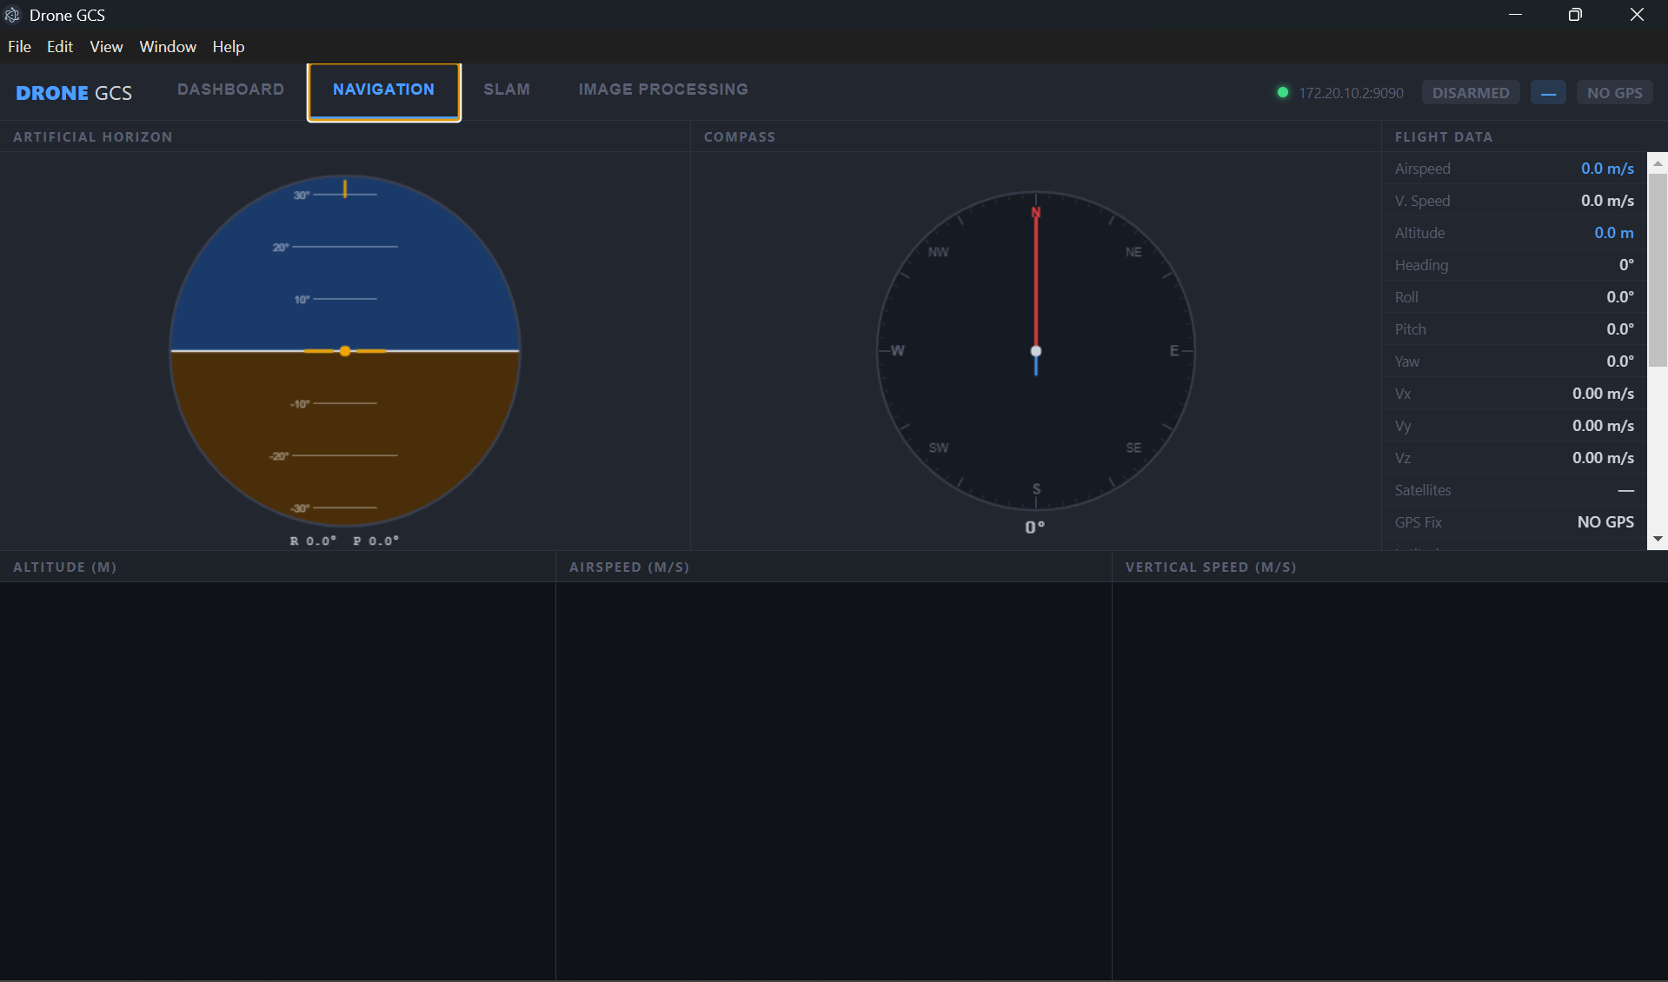
Real-Time Flight Navigation
🎯 Artificial Horizon
AHRS roll & pitch visualisation
🧭 Compass Rose
Live magnetic heading indicator
📊 Live Charts
Altitude, airspeed & vertical speed
📐 Attitude Data
Roll, pitch, yaw in real time
🛰️ GPS Status
Fix type, satellite count, coordinates
💨 Body Velocities
Vx · Vy · Vz from GLOBAL_POSITION_INT

Slide 5
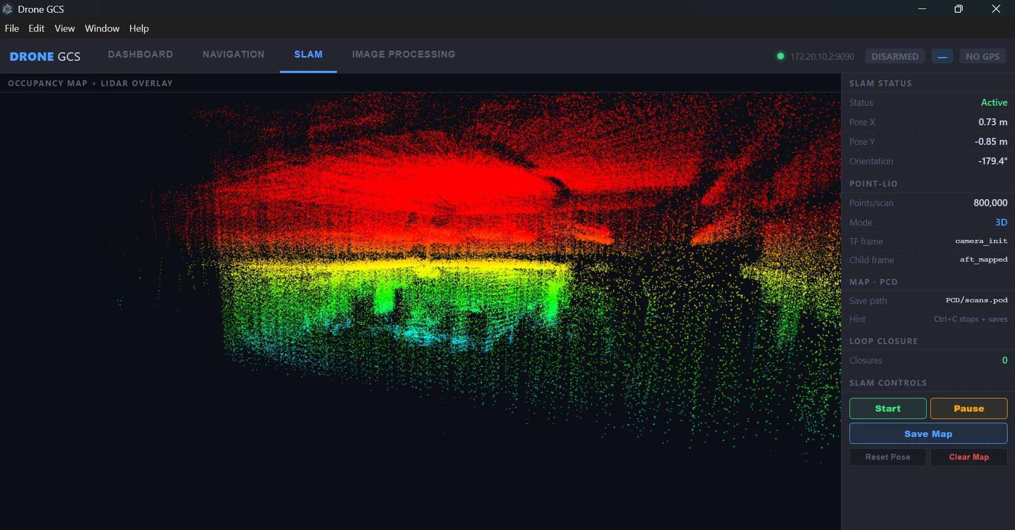
3D LiDAR SLAM Mapping
📡 800 000 Points/Scan
High-density 3D environment model
🧮 Point-LIO Algorithm
Tightly-coupled LiDAR-inertial odometry
📍 Live Pose Tracking
x, y, z + orientation at 4 Hz
🎨 Height Colormap
Red = high · Yellow = mid · Blue = low
💾 Map Export
Save occupancy scan to .pcd file
🔄 Loop Closure
Automatic drift correction

Slide 6
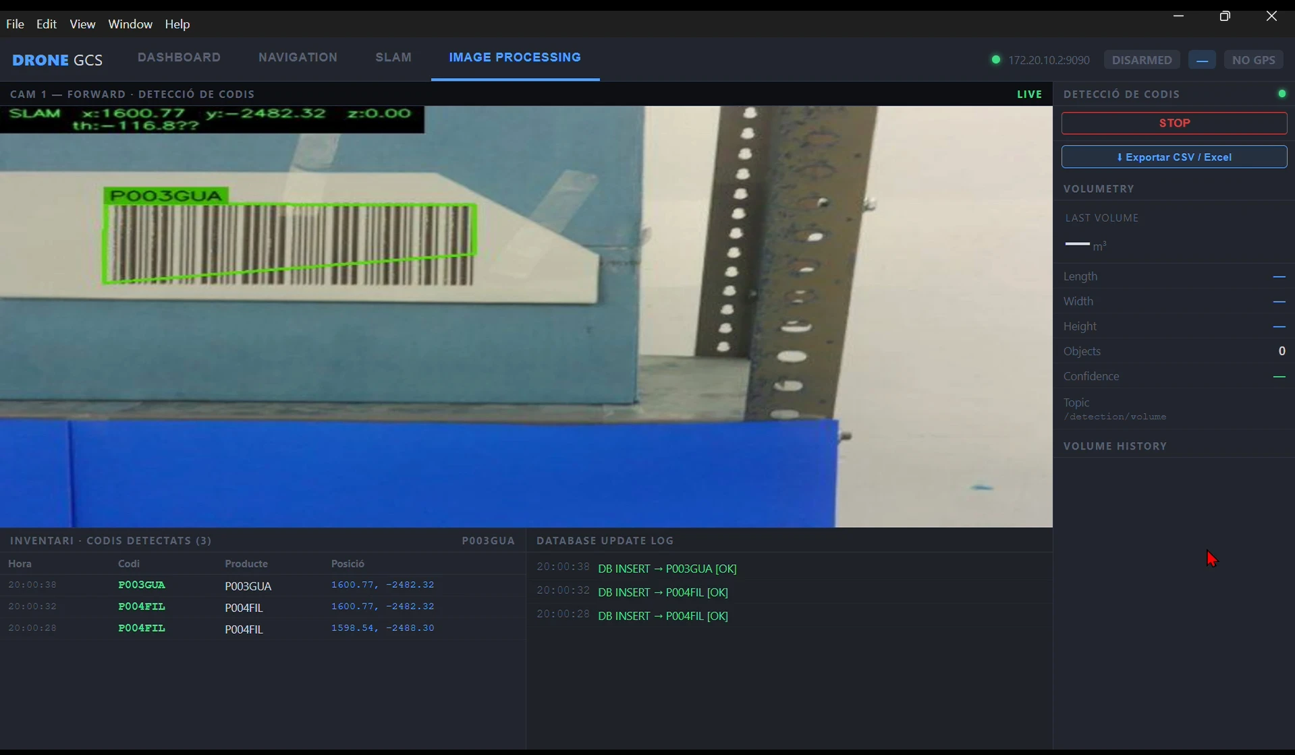
Autonomous Inventory Detection
📦 Barcode + QR Detection
pyzbar + zlib, real-time recognition
📍 SLAM-Tagged Position
x, y, z coordinates logged per scan
🗄️ Auto DB Insert
SQLite record on every new detection
📊 CSV / Excel Export
Full inventory with position + timestamp
🔁 Dedup Filter
3-second re-scan protection per code
🔲 ROI Overlay
Green polygon + label on detected codes

Slide 7
Technology Stack
Hardware
Pi Software
GCS App
Protocols
Raspberry Pi 5 — 8 GB
ROS2 Jazzy
Electron + Node.js
MAVLink v2 (serial)
Unitree 4D LiDAR
Point-LIO SLAM
ROSLIB.js
rosbridge :9090
RPi Camera Module
pymavlink bridge
Chart.js
MJPEG HTTP :8080
Pixhawk FC
pyzbar / OpenCV
Leaflet maps
ROS2 DDS / RTPS
ArduCopter
rosbridge WS
SQLite3
JSON command bus

Slide 8
Demo time!
Questions?
800K
4
ROS2
Wi-Fi
LiDAR pts/scan
App modules
Jazzy middleware
zero cable needed
DRONE GCS · Autonomous Ground Control System · UPC 2026

