Slide 1





Albert Gordo
Lluís Gómez
1

Slide 2
Closing remarks
Large advances in scene-text localization and recognition during the last few years
Some of the techniques are already known in the document analysis community
Improvements can be transferred back to the documents domain
Standard benchmarks almost solved. Need for new challenging tasks
Text localization and recognition not as an end goal, but as a part of a larger system
2

Slide 3
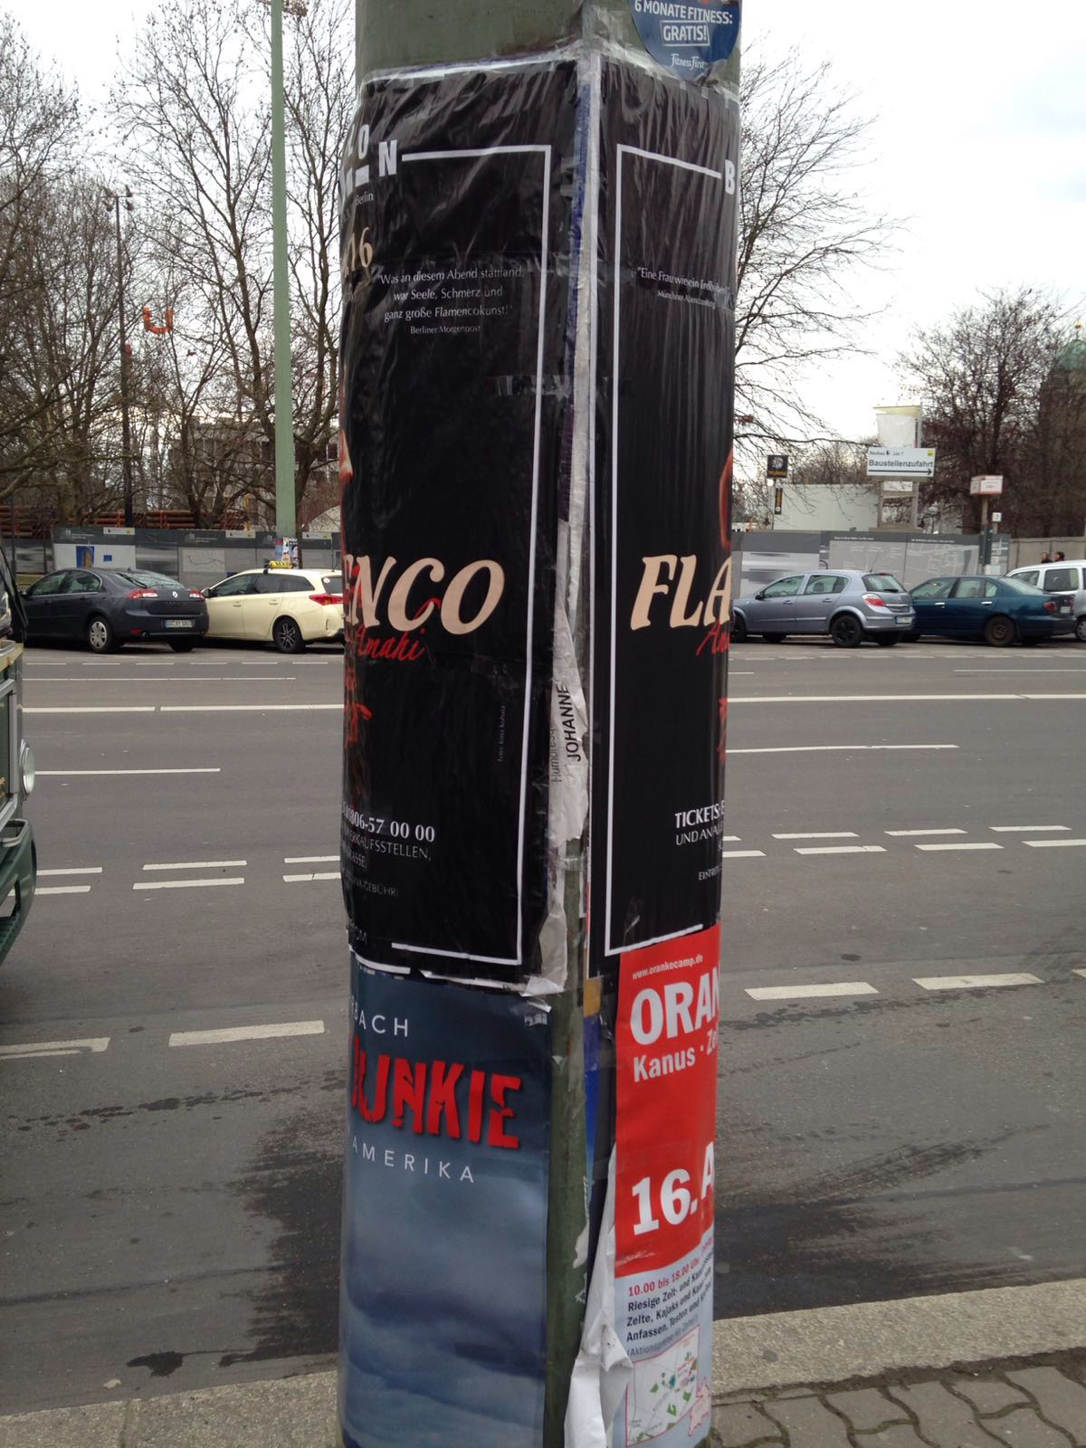


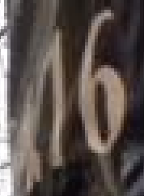

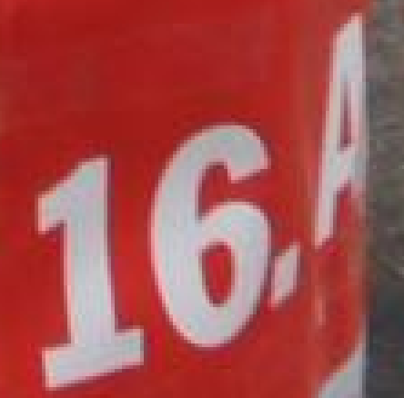

Closing remarks
3

