Slide 1
Line locking
Lluis Mas Ribas

Slide 2
CIV Line Locking
C IV
Notes:
Consider a black hole. The gas in close proximity to it (accretion disk) is compressed and heated so emits radiation. Imagine it emits a spectrum that the one in the picture, and focus on CIV emission - In reality, CIV is two lines but due to thermal motion of the atoms and doppler shifts it appears as one

Slide 3
CIV Line Locking
v
C IV
C IV
Notes:
Now imagin a gas cloud in the outflow. It is made of only CIV for simplicity and moving at a velocity v with respect to the emission source

Slide 4
CIV Line Locking
v
C IV
C IV
C IV
C IV
500 km/s
v
Notes:
The gas cloud absorbs CIV emission and produces two CIV absorption lines blueshifted a distance v (in velocity space) corresponding to the velocity of the cloud. Note that atomic physics dictates that the separation between the two lines of CIV is approx. 500 km/s

Slide 5
CIV Line Locking
v
v-500 km/s
C IV
C IV
C IV
Notes:
Now imagine another cloud appearing in between the first one and the source. It moves at 500 km/s slower than the previous one. Thus, this cloud will absorb CIV and produce two lines but at a position v-500

Slide 6
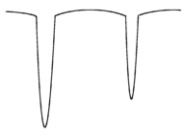
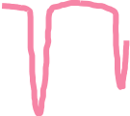

CIV Line Locking
v
v-500 km/s
C IV
C IV
C IV
v-500 km/s
Notes:
Highlighted in red is the absorption of the second cloud. Note that there is an overlap between two lines (one of each cloud). Because the second cloud is closer to the source, it will absorb all the radiation it can (left red line), so the cloud in front will not be able to absorb much. In other words, the second cloud masks the emission to the first cloud. This makes the first cloud loose acceleration. However, when the second cloud increases the relative speed a little bit, the overlap between lines disappears and the first cloud recovers acceleration again, quickly reaching an overlap between lines. This will end up in setting these two clouds in a stable position where the two lines are overlapping, and therefore the two clouds will get locked to a relative velocity of 500 km/s between them. Now, the spectrum of carbon IV shows 3 lines instead of two, indicating that line locking happens and that radiation acceleration is present. Because the clouds are not made of only CIV but many metals, every single metal line now will also show another component of itself at 500 km/s. CIV line locking is set.

Slide 7
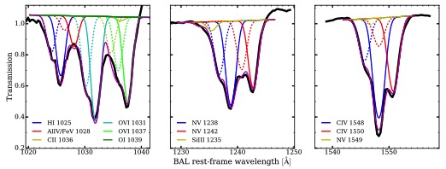
Mas-Ribas & Mauland 2019
Notes:
See the 3 features in the CIV absorption feature due to line locking. Dashed lines are the locked components, and solid the original lines.

Slide 8
Mas-Ribas & Mauland 2019
Notes:
All lines (solid) have a companion component at 500 km/s due to CIV line locking

