Slide 1
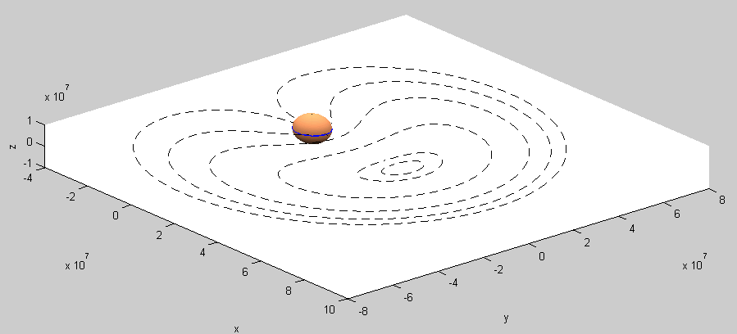
e=0
e=0.999
e=0.1
e=0.9
e=0.75
e=0.5
e=0.25
Fig 4.1: Orbits and Ground tracks for GEO i=0 orbits

Slide 2
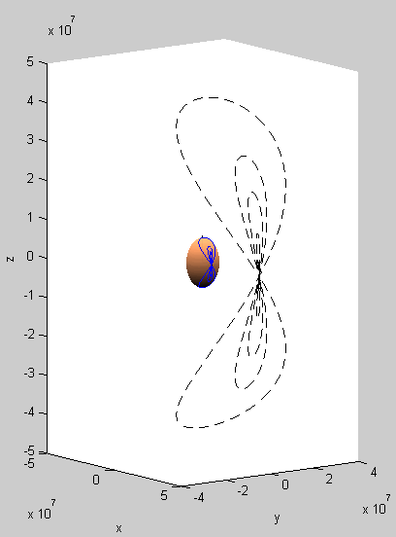
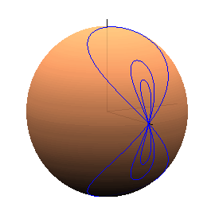
i=90°
i=45°
i=30°
i=90°
i=15°
i=45°
i=30°
i=0°
i=0°
Fig 4.2: Orbits and Ground tracks for GEO e=0 orbits

Slide 3
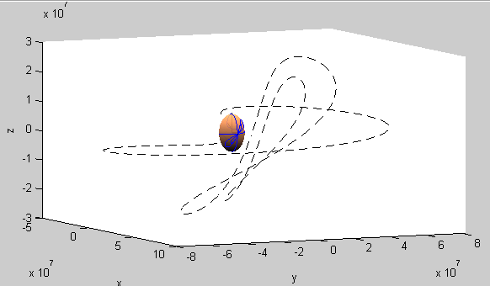
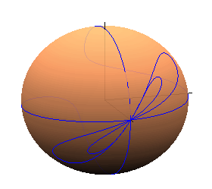
i=90°; e→1
i=45°; e=0.5
i=30°; e=0.25
Fig 4.3: Orbits and Ground tracks for GEO e>0 and i>0 orbits

Slide 4
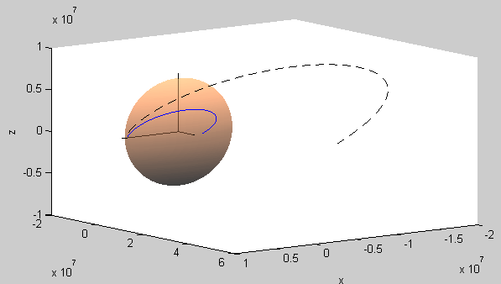
Fig 4.4: Ground track of the elliptical transfer orbit; υ ϵ [0, π]

Slide 5
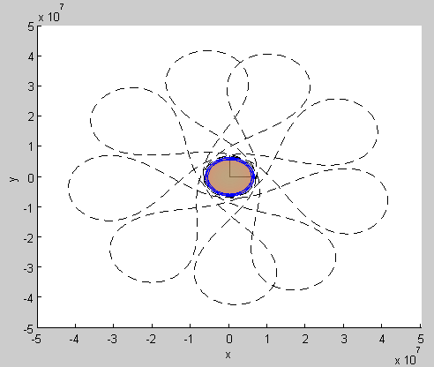
Δv₂₁
Possible positions for Δv₂
Δv₂₃
Δv₁
Δv₂₂
Fig 4.5: 2nd impulse possible positions; υ = π·(2n + 1)

