Slide 1
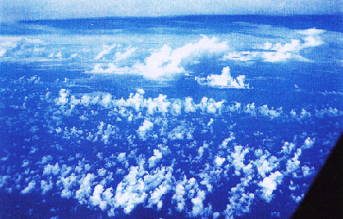
Cloud Cover: The problem
Most schemes presume cloud fills GCM box in vertical
Still need to represent horizontal cloud cover, a
GCM Grid cell: 40-400km
a
GCM Grid
Notes:
ECMWF Training Course
May 2001
clouds 2

Slide 2
First: Some assumptions!
q_{v} = water vapour mixing ratio
q_{c} = cloud water (liquid/ice) mixing ratio
q_{s} = saturation mixing ratio = F(T,p)‏
q_{t} = total water (vapour+cloud) mixing ratio
RH = relative humidity = q_{v}/q_{s}
(#1) Local criterion for formation of cloud: q_{t} > q_{s}
This assumes that no supersaturation can exist
(#2) Condensation process is fast (cf. GCM timestep)‏
q_{v} = q_{s}, q_{c}= q_{t} – q_{s}
!!Both of these assumptions are suspect in ice clouds!!
Notes:
ECMWF Training Course
May 2001
clouds 2

Slide 3
Partial cloud cover
Homogeneous Distribution of water vapour and temperature:
q
Note in the second
case the relative humidity=1 from our assumptions
x
One Grid-cell
Partial coverage of a grid-box with clouds is only possible if there is a inhomogeneous distribution of temperature and/or humidity.
Notes:
ECMWF Training Course
May 2001
clouds 2

Slide 4
Heterogeneous distribution of T and q
cloudy=
q
RH=1
RH<1
x
Another implication of the above is that clouds must exist before the grid-mean relative humidity reaches 1.
Notes:
ECMWF Training Course
May 2001
clouds 2

Slide 5
The interpretation does not change much if we only consider humidity variability
cloudy
q_{t}
RH=1
RH<1
x
Throughout this talk I will neglect temperature variability
In fact : Analysis of observations and model data indicates humidity fluctuations are more important
Notes:
ECMWF Training Course
May 2001
clouds 2

Slide 6
Simple diagnostic schemes: RH-based schemes
q_{t}
RH=60%
x
Take a grid cell with a certain (fixed) distribution of total water.
At low mean RH, the cloud cover is zero, since even the moistest part of the grid cell is subsaturated
1
C
0
RH
60
80
100
Notes:
ECMWF Training Course
May 2001
clouds 2

Slide 7
Simple diagnostic schemes: RH-based schemes
q_{t}
RH=80%
x
1
Add water vapour to the gridcell, the moistest part of the cell become saturated and cloud forms. The cloud cover is low.
C
0
RH
60
80
100
Notes:
ECMWF Training Course
May 2001
clouds 2

Slide 8
Simple diagnostic schemes: RH-based schemes
q_{t}
RH=90%
x
1
Further increases in RH increase the cloud cover
C
0
RH
60
80
100
Notes:
ECMWF Training Course
May 2001
clouds 2

Slide 9
Simple diagnostic schemes: RH-based schemes
RH=100%
q_{t}
x
1
The grid cell becomes overcast when RH=100%,
due to lack of supersaturation
C
0
RH
60
80
100
Notes:
ECMWF Training Course
May 2001
clouds 2

Slide 10
Simple Diagnostic Schemes:
Relative Humidity Schemes
Many schemes, from the 1970s onwards, based cloud cover on the relative humidity (RH)‏
e.g. Sundqvist et al. MWR 1989:
1
C
0
RH
60
80
100
RH_{crit} = critical relative humidity at which cloud assumed to form
(function of height, typical value is 60-80%)‏
Notes:
ECMWF Training Course
May 2001
clouds 2

Slide 11
Diagnostic Relative Humidity Schemes
Since these schemes form cloud when RH<100%, they implicitly assume subgrid-scale variability for total water, q_{t}, (and/or temperature, T) exists
However, the actual PDF (the shape) for these quantities and their variance (width) are often not known
“Given a RH of X% in nature, the mean distribution of q_{t} is such that, on average, we expect a cloud cover of Y%”
Notes:
ECMWF Training Course
May 2001
clouds 2

Slide 12
Diagnostic Relative Humidity Schemes
Advantages:
  Better than homogeneous assumption, since clouds can form before grids reach saturation
Disadvantages:
  Cloud cover not well coupled to other processes
  In reality, different cloud types with different coverage can exist with same relative humidity. This can not be represented
Can we do better?
Notes:
ECMWF Training Course
May 2001
clouds 2

Slide 13
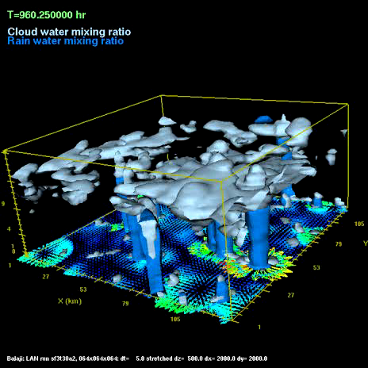
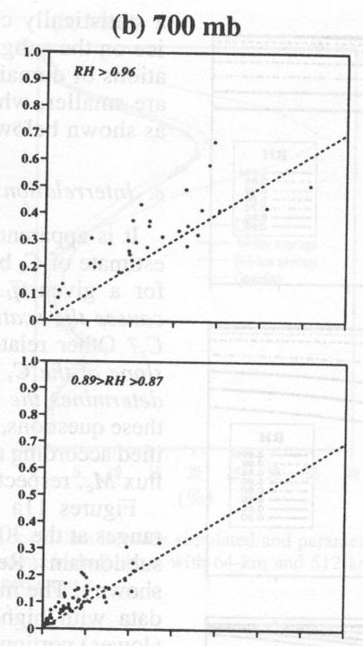
Diagnostic Relative Humidity Schemes
Could add further predictors
E.g: Xu and Randall (1996) sampled cloud scenes from a 2D cloud resolving model to derive an empirical relationship with two predictors:
More predictors, more degrees of freedom=flexible
But still do not know the form of the PDF. (is model valid?)‏
Can we do better?
Notes:
ECMWF Training Course
May 2001
clouds 2

Slide 14
Diagnostic Relative Humidity Schemes
Another example is the scheme of Slingo, operational at ECMWF until 1995.
This scheme also adds dependence on vertical velocities
use different empirical relations for different cloud types, e.g., middle level clouds:
Relationships seem Ad-hoc? Can we do better?
Notes:
ECMWF Training Course
May 2001
clouds 2

Slide 15
Statistical Schemes
These explicitly specify the probability density function (PDF) for the total water q_{t} (and sometimes also temperature)‏
q_{t}
x
PDF(q_{t})‏
Cloud cover is integral under supersaturated part of PDF
q_{t}
q_{s}
Notes:
ECMWF Training Course
May 2001
clouds 2

Slide 16
Statistical Schemes
Others form variable ‘s’ that also takes temperature variability into account, which affects q_{s}
LIQUID WATER TEMPERATURE
conserved during changes of state
Cloud mass if T
variation is neglected
q_{s}
q_{t}
S
T
S is simply the ‘distance’ from the linearized saturation vapour pressure curve
INCREASES COMPLEXITY
OF IMPLEMENTATION
Notes:
ECMWF Training Course
May 2001
clouds 2

Slide 17
Statistical Schemes
PDF(q_{t})‏
Knowing the PDF has advantages:
  More accurate calculation of radiative fluxes
  Unbiased calculation of microphysical processes
However, location of clouds within gridcell unknown
q_{t}
q_{s}
C
y
x
e.g. microphysics
bias
Notes:
ECMWF Training Course
May 2001
clouds 2

Slide 18
Statistical schemes
Two tasks: Specification of the:
  (1) PDF shape
  (2) PDF moments
Shape: Unimodal? bimodal? How many parameters?
Moments: How do we set those parameters?
Notes:
ECMWF Training Course
May 2001
clouds 2

Slide 19
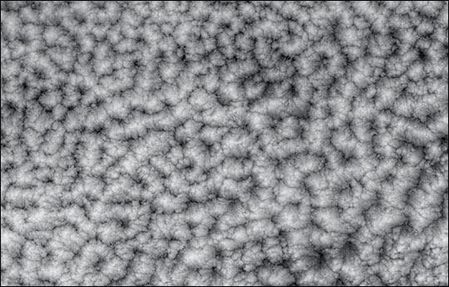
TASK 1: Specification of the PDF
Lack of observations to determine q_{t} PDF
  Aircraft data
    limited coverage
  Tethered balloon
    boundary layer
  Satellite
    difficulties resolving in vertical
    no q_{t} observations
    poor horizontal resolution
  Raman Lidar
    only PDF of water vapour
Cloud Resolving models have also been used
    realism of microphysical parameterisation?
modis image from NASA website
Notes:
ECMWF Training Course
May 2001
clouds 2

Slide 20
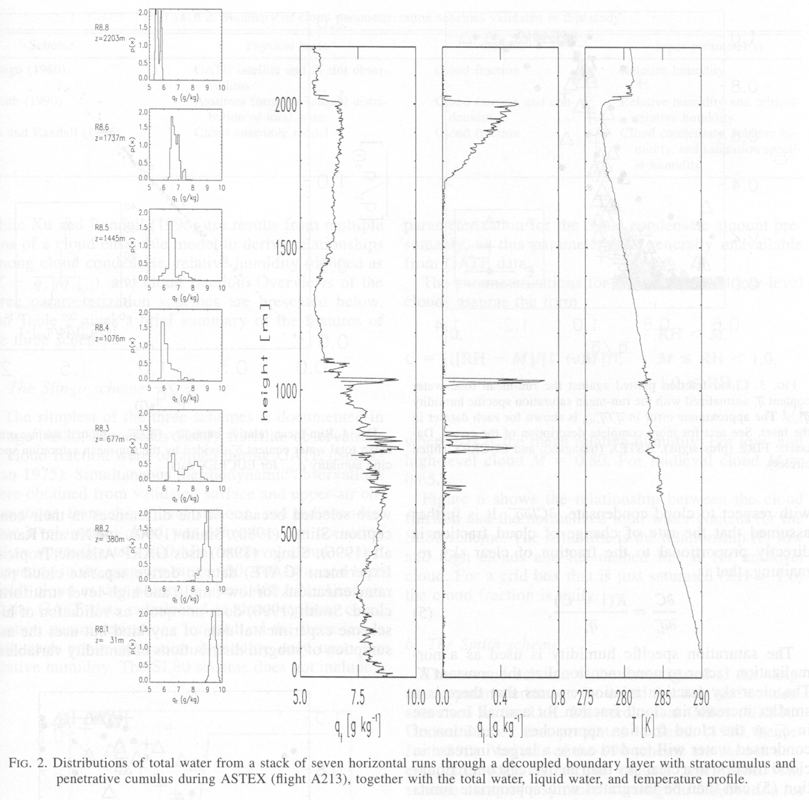
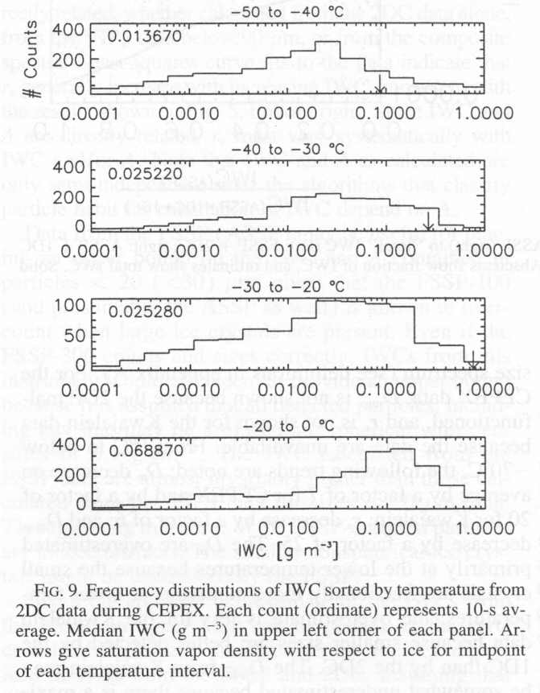
Aircraft Observed PDFs
Wood and field JAS 2000
Aircraft observations low clouds < 2km
Height
Heymsfield and McFarquhar
JAS 96
Aircraft IWC obs during CEPEX
PDF(q_{t})‏
q_{t}
Notes:
ECMWF Training Course
May 2001
clouds 2

Slide 21
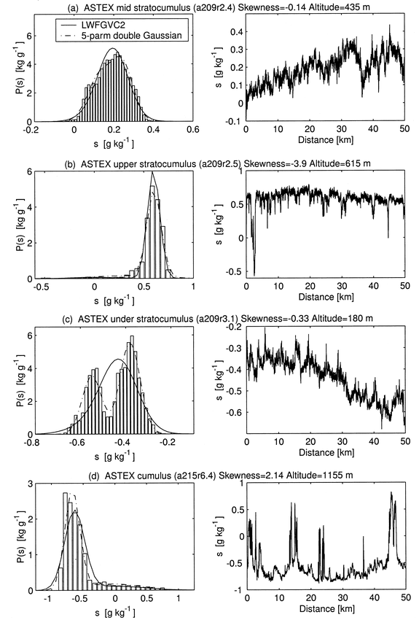
PDF
Data
More examples from Larson et al. JAS 01/02
Note significant error that can occur if PDF is unimodal
Conclusion: PDFs are mostly approximated by uni or bi-modal distributions, describable by a few parameters
Notes:
ECMWF Training Course
May 2001
clouds 2

Slide 22
TASK 1: Specification of PDF
Many function forms have been used
symmetrical distributions:
PDF( q_{t})‏
q_{t}
q_{t}
Uniform:
Letreut and Li (91)‏
Triangular:
Smith QJRMS (90)‏
q_{t}
q_{t}
Gaussian:
Mellor JAS (77)‏
s⁴ polynomial:
Lohmann et al. J. Clim (99)‏
Notes:
ECMWF Training Course
May 2001
clouds 2

Slide 23
TASK 1: Specification of PDF
skewed distributions:
PDF( q_{t})‏
q_{t}
q_{t}
q_{t}
Exponential:
Sommeria and Deardorff JAS (77)‏
Lognormal:
Bony & Emanuel JAS (01)‏
Gamma:
Barker et al. JAS (96)‏
q_{t}
q_{t}
Beta:
Tompkins JAS (02)‏
Double Normal/Gaussian:
Lewellen and Yoh JAS (93), Golaz et al. JAS 2002
Notes:
ECMWF Training Course
May 2001
clouds 2

Slide 24
TASK 2: Specification of PDF moments
Need also to determine the moments of the distribution:
  Variance (Symmetrical PDFs)‏
  Skewness (Higher order PDFs)‏
  Kurtosis (4-parameter PDFs)‏
saturation
PDF(q_{t})‏
cloud forms?
q_{t}
e.g. HOW WIDE?
Skewness
Kurtosis
Moment 1=MEAN
Moment 2=VARIANCE
Moment 3=SKEWNESS
Moment 4=KURTOSIS
negative
positive
positive
negative
Notes:
ECMWF Training Course
May 2001
clouds 2

Slide 25
TASK 2: Specification of PDF moments
(1-RH_{crit})q_{s}
Some schemes fix the moments (e.g. Smith 1990) based on critical RH at which clouds assumed to form
If moments (variance, skewness) are fixed, then statistical schemes are identically equivalent to a RH formulation
e.g. uniform q_{t} distribution = Sundqvist form
G(q_{t})‏
C
1-C
q_{t}
where
Sundqvist formulation!!!
Notes:
ECMWF Training Course
May 2001
clouds 2

Slide 26
Clouds in GCMs
Processes that can affect distribution moments
convection
microphysics
turbulence
dynamics
Notes:
ECMWF Training Course
May 2001
clouds 2

Slide 27
Example: Turbulence
In presence of vertical gradient of total water,
turbulent mixing can increase horizontal variability
dry air
moist air
Notes:
ECMWF Training Course
May 2001
clouds 2

Slide 28
Example: Turbulence
In presence of vertical gradient of total water,
turbulent mixing can increase horizontal variability
dry air
moist air
while mixing in the horizontal plane naturally reduces the horizontal variability
Notes:
ECMWF Training Course
May 2001
clouds 2

Slide 29
Specification of PDF moments
If a process is fast
compared to a GCM timestep, an equilibrium can be assumed, e.g. Turbulence
turbulence
local
equilibrium
Source
dissipation
Example: Ricard and Royer, Ann Geophy, (93), Lohmann et al. J. Clim (99)‏
Disadvantage:
  Can give good estimate in boundary layer, but above, other processes will determine variability, that evolve on slower timescales
Notes:
ECMWF Training Course
May 2001
clouds 2

Slide 30
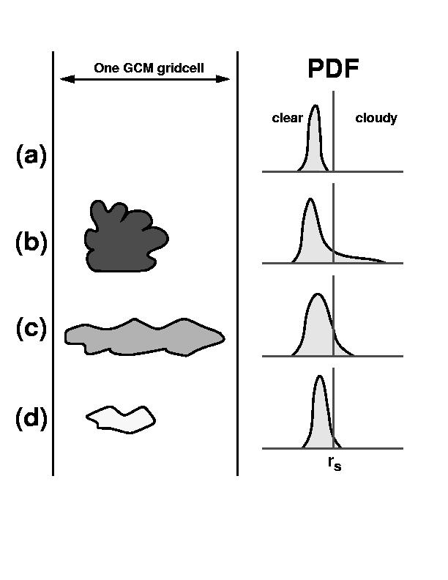
Prognostic Statistical Scheme
I previously introduced a prognostic statistical scheme into ECHAM5 climate GCM
Prognostic equations are introduced for the variance and skewness of the total water PDF
Some of the sources and sinks are rather ad-hoc in their derivation!
convective detrainment
precipitation
generation
mixing
q_{s}
Notes:
ECMWF Training Course
May 2001
clouds 2

Slide 31
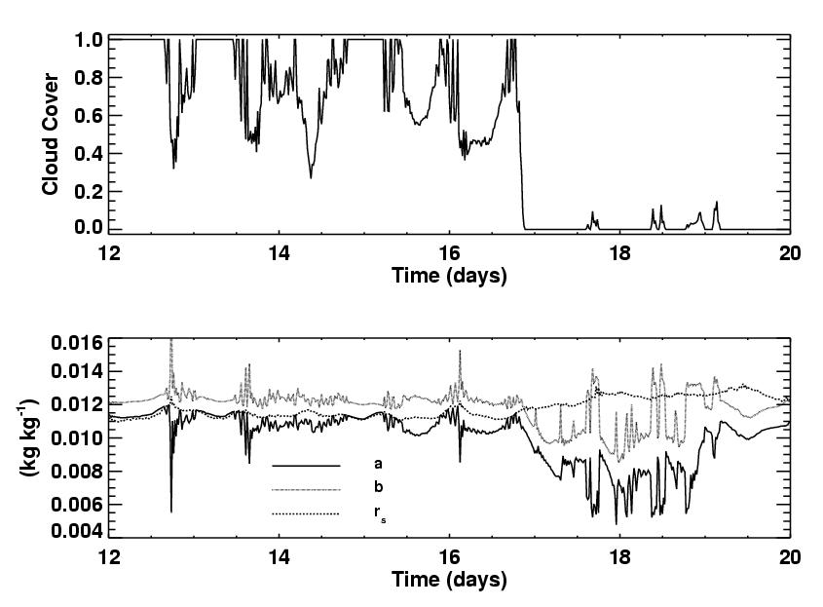
Scheme in action
Minimum
Maximum
q_{sat}
Notes:
ECMWF Training Course
May 2001
clouds 2

Slide 32
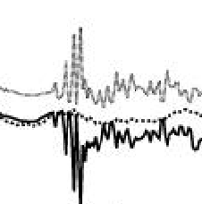
Scheme in action
Turbulence breaks up cloud
Minimum
Maximum
q_{sat}
Notes:
ECMWF Training Course
May 2001
clouds 2

Slide 33
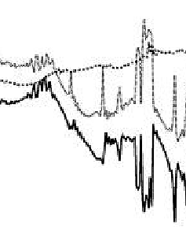
Scheme in action
Turbulence breaks up cloud
Turbulence creates cloud
Minimum
Maximum
q_{sat}
Notes:
ECMWF Training Course
May 2001
clouds 2

Slide 34
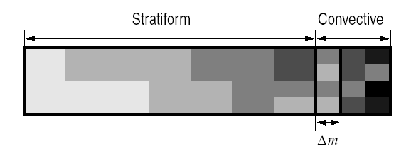

Production of variance
Courtesy of Steve Klein:
Change due to difference in means
Transport
Change due to difference in variance
Also equivalent terms due to entrainment
Notes:
ECMWF Training Course
May 2001
clouds 2

Slide 35
Microphysics
Change in variance
However, the tractability depends on the PDF form for the subgrid fluctuations of q, given by G:
Where P is the precipitation generation rate, e.g:
Can get pretty nasty!!!
Depending on form for P and G
Notes:
ECMWF Training Course
May 2001
clouds 2

Slide 36
But quickly can get complicated
E.g: Semi-Lagrangian ice sedimentation
Source of variance is far from simple, also depends on overlap assumptions
In reality of course wish also to retain the sub-flux variability too
Notes:
ECMWF Training Course
May 2001
clouds 2

Slide 37
Summary of statistical schemes
Advantages
  Information concerning subgrid fluctuations of humidity and cloud water is available
  It is possible to link the sources and sinks explicitly to physical processes
  Use of underlying PDF means cloud variables are always self-consistent
Disadvantages
  Deriving these sources and sinks rigorously is hard, especially for higher order moments needed for more complex PDFs!
  If variance and skewness are used instead of cloud water and humidity, conservation of the latter is not ensured
Notes:
ECMWF Training Course
May 2001
clouds 2

Slide 38
Issues for GCMs
If we assume a 2-parameter PDF for total water, and we prognose the mean and variance such that the distribution is well specified (and the cloud water and liquid can be separately derived assuming no supersaturation) what is the potential difficulty?
Notes:
ECMWF Training Course
May 2001
clouds 2

Slide 39
Which prognostic equations?
Take a 2 parameter distribution & Partially cloudy conditions
Can specify distribution with
Mean
Variance
of total water
Can specify distribution with
Water vapour
Cloud water
mass mixing ratio
q_{t}
q_{sat}
q_{sat}
Cloud
Cloud
q_{v}
q_{l+i}
Variance
Notes:
ECMWF Training Course
May 2001
clouds 2

Slide 40
Which prognostic equations?
q_{sat}
Cloud water budget conserved
Avoids Detrainment term
Avoids Microphysics terms (almost)‏
Water vapour
Cloud water
mass mixing ratio
q_{v}
q_{l+i}
But problems arise in
Overcast conditions
(…convection +
microphysics)‏
(al la Tiedtke)‏
q_{sat}
Clear sky conditions
(turbulence)‏
q_{v}
q_{v}+q_{l+i}
Notes:
ECMWF Training Course
May 2001
clouds 2

Slide 41
Which prognostic equations?
Take a 2 parameter distribution & Partially cloudy conditions
q_{sat}
Mean
Variance
of total water
“Cleaner solution”
But conservation of liquid water compromised due to PDF
Need to parametrize those tricky microphysics terms!
Notes:
ECMWF Training Course
May 2001
clouds 2

Slide 42
q_{cloud}
q_{s}
q_{crit}
If supersaturation allowed, equation for cloud-ice no longer holds
PDF(q_{t})‏
q_{t}
q_{s}
q_{crit}
If assume fast adjustment,
derivation is straightforward
PDF(q_{t})‏
q_{t}
q_{s}
q_{crit}
Much more difficult if want to integrate nucleation equation explicitly throughout cloud
PDF(q_{t})‏
q_{t}
Notes:
ECMWF Training Course
May 2001
clouds 2

Slide 43
Issues for GCMs
What is the advantage of knowing the total water distribution (PDF)?
Notes:
ECMWF Training Course
May 2001
clouds 2

Slide 44
You might be tempted to say…
Hurrah! We now have cloud variability in our models, where before there was none!
WRONG! Nearly all components of GCMs contain implicit/explicit assumptions concerning subgrid fluctuations
e.g: RH-based cloud cover, thresholds for precipitation evaporation, convective triggering, plane parallel bias corrections for radiative transfer… etc.
Notes:
ECMWF Training Course
May 2001
clouds 2

Slide 45
Variability in Clouds
Is this desirable to have so many independent tunable parameters?
‘N’ Metrics
e.g. Z500 scores, TOA radiation fluxes
‘M’ tuning
parameters
With large M, task of reducing error in N metrics
Becomes easier, but not necessarily for the right reasons
Solution: Increase N, or reduce M
Notes:
ECMWF Training Course
May 2001
clouds 2

Slide 46
Advantage of Statistical Scheme
Microphysics
Convection Scheme
Can use information in
Other schemes
Statistical Cloud Scheme
Thus ‘complexity’ is not synonymous with ‘M’: the tunable parameter space
Radiation
Notes:
ECMWF Training Course
May 2001
clouds 2

Slide 47
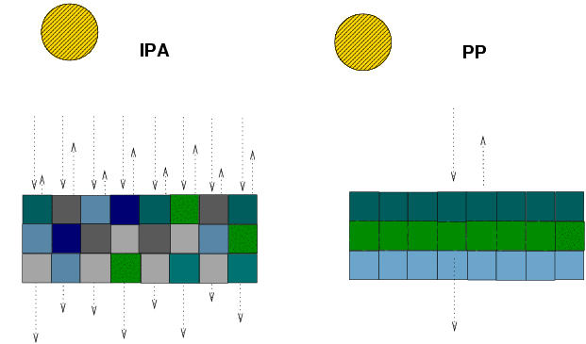
Use in other Schemes (II) IPA Biases
Knowing the PDF allows the IPA bias to be tacked
Use variance to calculate Effective thickness Approximation
Effective Liquid = K x Liquid
Cahalan et al 1994
G(q_{t})‏
ETA adjustment
Total
Water
q_{sat}
Use Moments to find best-fit Gamma Distribution PDF and apply Gamma weighted TSA Barker (1996)‏
Gamma Function
G(q_{t})‏
Total
Water
q_{sat}
Thick
Cloud etc.
Split PDF and perform N radiation calculations
G(q_{t})‏
Total
Water
q_{sat}
Notes:
ECMWF Training Course
May 2001
clouds 2

Slide 48
Cloud Inhomogeneity and microphysics biases
q_{s}
Most current microphysical schemes use the grid-mean cloud mass (I.e: neglect variability)‏
G(q_{t})‏
q_{t}
cloud
cloud range
Result is not equal in the two cases since microphysical processes are non-linear
Example on right: Autoconversion based on Kessler
Grid mean cloud less than threshold and gives zero precipitation formation
precip
generation
mean
q_{L0}
q_{L}
Notes:
ECMWF Training Course
May 2001
clouds 2

