Slide 1
The Lifelong Code Optimization Project:
Addressing Fundamental Bottlenecks
In Link-time and Dynamic Optimization
Vikram Adve
Computer Science Department University of Illinois
Joint work with
Chris Lattner, Shashank Shekhar, Anand Shukla
Thanks: NSF (CAREER, NGS00, NGS99, OSC99)

Slide 2
Outline
Motivation
  Why link-time, runtime optimization?
  The challenges
LLVM: a virtual instruction set
Novel link-time transformations
Runtime optimization strategy

Slide 3
Modern Programming Trends
Interprocedural + Runtime
Interprocedural + Link-time
Runtime
Static optimization is increasingly insufficient
Object-oriented programming
  many small methods
  dynamic method dispatch
  extensive pointer usage and type conversion
Component-based applications
  “assembled” from component libraries
  libraries are separately compiled and reused
Long-lived applications
  Web servers, Grid applications

Slide 4
Challenges at Link-Time and Runtime
C
X
Static Compiler 1
LLVM
C++
Machine
code
Fortran
Machine
code
Linker
• • •
IP Optimizer
Code-gen
+LLVM
C
Static Compiler N
X
LLVM
C++
Machine
code
Fortran
Machine
code
X
LLVM
Compiler
IR
LLVM
C
Static Compiler N+1
C++
Precompiled
Libraries
Fortran

Slide 5
Low-level Virtual Machine
A rich virtual instruction set
RISC-like architecture & instruction set
  load, store, add, mul, br[cond], call, phi, …
Semantic information:
  Types: primitive types + struct, array, pointer
  Dataflow: SSA form (phi instruction)
Concise assembly & compact bytecode representations

Slide 6
An LLVM Example
/* C Source Code */
int SumArray(int Array[],
int Num)
{
int i, sum = 0;
for (i = 0; i < Num; ++i)
sum += Array[i];
return sum;
}
;; LLVM Translated Source Code
int "SumArray"([int]* %Array, int %Num)
begin
%cond62 = setge int 0, %Num
br bool %cond62, label %bb3, label %bb2
bb2:
%reg116 = phi int [%reg118, %bb2], [0, %bb1]
%reg117 = phi int [%reg119, %bb2], [0, %bb1]
%reg114 = load [int]* %Array, int %reg117
%reg118 = add int %reg116, %reg114
%reg119 = add int %reg117, 1
%cond20 = setlt int %reg119, %Num
br bool %cond20, label %bb2, label %bb3
bb3:
%reg120 = phi int [%reg118, %bb2], [0, %bb1]
ret int %reg120
end1
Architecture neutral
SSA representation
High-level semantic info
Low level operations
Strictly typed

Slide 7
Compiling with LLVM
Runtime
Optimizer
Final LLVM +
LLVM-to-native maps
C, C++
Static Compiler 1
Fortran
Java
LLVM
Linker
IP Optimizer
Code-gen
• • •
Machine
code
C, C++
Static Compiler N
LLVM
Fortran
Java
LLVM or
Machine code
Precompiled
Libraries

Slide 8
Key LLVM Features
No machine idiosyncracies
phi : lower analysis cost; sparse optimizations
malloc, free, alloca : typed memory operations
cast : single instruction for violating type rules

Slide 9
Outline
Motivation
  Why link-time, runtime optimization?
  The challenges
LLVM: a Virtual Instruction set
Novel link-time transformations
Runtime optimization strategy

Slide 10
Novel Link-time Optimizations
Identify disjoint, logical data structures
  Interprocedural, context-sensitive analysis
Automatic pool allocation
  Separate heap (pool) for each logical structure
Replace 64-bit pointers with small offsets

Slide 11
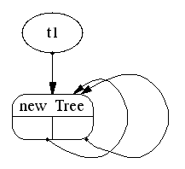

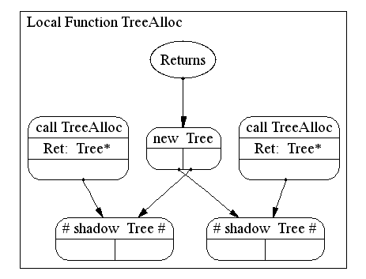
Disjoint Logical Data Structures
MakeTree(Tree** t1,
Tree** t2)
{
*t1 = TreeAlloc(…);
*t2 = TreeAlloc(…);
}
Tree* TreeAlloc(…)
{
if (notDone) {
node = malloc(…);
node->l = TreeAlloc(…);
node->r = TreeAlloc(…);
}
return node;
}

Slide 12
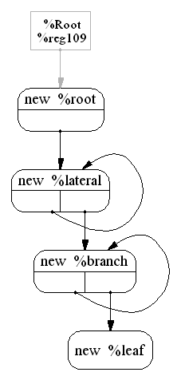
A More Complex Data Structure
(Olden) Power Benchmark
build_tree()
t = malloc(…);
t->l = build_lateral(…);
build_lateral()
l = malloc(…);
l->next = build_lateral(…);
l->b = build_branch(…);
This is a sophisticated interprocedural analysis
and it is being done at link-time!

Slide 13
Automatic Pool Allocation
Widely used manual technique
Many advantages
Never automated before
Pool 1
Pool 2
Pool 3
Pool 1
Pool 2
Pool 4

Slide 14
Olden Benchmarks
Pointer-intensive C benchmarks; 66 – 600 LOC
Benchmark | Structure | Time | Graph size | DS Size
bisort | B tree | 0.097 sec | 22 | 1
perimeter | Q tree | 0.11 sec | 14 | 1
power | Hierarchy of lists | 0.50 sec | 22 | 4
treeadd | B tree | 0.02 sec | 16 | 1
tsp | 2D tree | 0.22 sec | 26 | 1
matrix | 2D matrix | 0.013 sec | 14 | 6

Slide 15
Pointer Compression
64-bit pointers are often wasteful
  Wastes cache capacity
  Wastes memory bandwidth
Key Idea: Use offsets into a pool instead of pointers!
Strategy 1:
  Replace 64-bit with 32-bit offsets: Not safe
Strategy 2:
  Dynamically grow pointer size: 16b → 32b → 64b

Slide 16
Making Pointer Compression Work
Transform object X to use dynamic offset sizes
X must be allocated in a pool
Replace every internal pointer to X* with [index] Replace every external pointer to X* with [PoolDesc, index]
To load a field out of [Pdesc, index]:
  O = load [Pdesc + offsets[n]]
  B = load [Pdesc + poolBaseFld]
  V = load [B + index + O]
Reorder struct XType so that pointers come last (if possible)

Slide 17
Outline
Motivation
  Why link-time, runtime optimization?
  The challenges
LLVM: a Virtual Instruction set
Novel link-time transformations
Runtime optimization strategy

Slide 18
Runtime Optimization Strategies
Detect hot traces or methods at runtime
LLVM Basic block ↔ Machine code basic block
LLVM instruction ↔ [Machine instructions 1…n]
Strategy 1:
  Optimize trace using ↔ LLVM code as a source of information
Strategy 2:
  Optimize LLVM method and generate code at runtime

Slide 19
A Hot Path in HeapSort
hot path:
34% of execution “time”
bo
b2
b2
b3
b4
b4
b5
b6
b6
b7
b7
b8
b14
b10
b10
b8
b11
b9
b13
b11
b14
b12
the hot trace
b13

Slide 20
Corresponding LLVM Trace
%reg166 = phi int [ %reg172, %bb14 ], [ %reg165, %bb0 ]
%reg167 = phi int [ %reg173, %bb14 ], [ %n, %bb0 ]
%cond284 = setle int %reg166, 1
br bool %cond284, label %bb4, label %bb3
b2
%reg167-idxcast = cast int %reg167 to uint
%reg1691 = load double * %ra, uint %reg167-idxcast
%reg1291 = load double * %ra, uint 1
store double %reg1291, double * %ra, uint %reg167-idxcast
%reg170 = add int %reg167, -1
%cond286 = setne int %reg170, 1
br bool %cond286, label %bb6, label %bb5
b4
b6
b7
b8
b10
%reg175-idxcast = cast int %reg175 to uint
store double %reg1481, double * %ra, uint %reg175-idxcast
%reg179 = shl int %reg177, ubyte 1
br label %bb13
b11
b13
b14
%reg183 = phi int [ %reg182, %bb13 ], [ %reg172, %bb6 ]
%reg183-idxcast = cast int %reg183 to uint
store double %reg171, double * %ra, uint %reg183-idxcast
br label %bb2

Slide 21
Related Work
Link-time Optimization
Alto, HP CMO, IBM, …
Machine code or compiler IR
Bytecode Platforms
SmallTalk, Self, JVM, CLR
Much higher level
Compile a JVM via LLVM !
Native Runtime Optimization
Dynamo, Daisy, Crusoe…
Machine code only
Dynamic Code Generation
DyC, tcc, Fabius, …
Programmer controlled
Build on top of LLVM !

Slide 22
Summary
Thesis: Static compilers should NOT generate machine code
A rich, virtual instruction set such as LLVM can enable
sophisticated link-time optimizations
(potentially) sophisticated runtime optimizations

Slide 23
Ongoing and Future Work
Novel optimizations with LLVM for
  Pointer-intensive codes
  Long-running codes
LLVM platform for Grid codes
Customizing code for embedded systems
Virtual processor architectures
For more information:
www.cs.uiuc.edu / ~vadve / lcoproject.html

Slide 24
www.cs.uiuc.edu / ~vadve / lcoproject.html

Slide 25
Motivation for PCL
Programming adaptive codes is challenging:
  Monitor performance and choose when to adapt
  Predict performance impact of adaptation choices
  Coordinate local and remote changes
  Debug adaptive changes in a distributed code
PCL Thesis
Language support could simplify adaptive applications

Slide 26
PCL: Program Control Language
Language Support for Adaptive Grid Applications
Static Task Graph:
  Abstract adaptation mechanisms
Global view of distributed program:
  Compiler manages remote adaptation operations, remote metrics
Metrics and Events:
  Monitoring performance and triggering adaptation
Correctness Criteria
  Compiler enforces correctness policies

Slide 27
Program Control Language
Request
Frame
Events
Asynchronous
Adaptation
Synchronous
Adaptation
Correctness
Criteria
Connection
Manager
Receive
Frame
Control
Interfaces
Compress
Decompress
Client
Connection
Tracker
Manager
For each
tracked feature
Grab
Frame
Metrics
Corner
Tracker
Edge
Tracker
SSD
Tracker
Display
PCL Control Program
Modifies target program behavior
Target distributed program
Implicit distributed structure

Slide 28
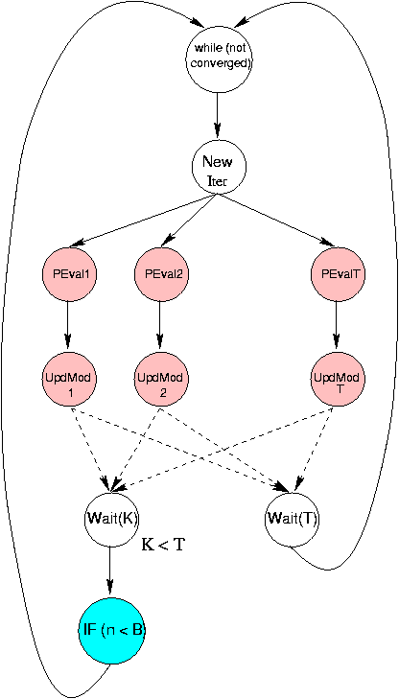
Task Graph of ATR
Adaptations:
  B: change parameter to IF
  T: add/delete tasks (PEval, UpdMod)
Notes:
There are 2 levels of parallelism, with different granularities, that we can choose for adapting. Choosing one over another depends on the resources currently available.

Slide 29
PCL Fragment for ATR
Adaptor ATRAdaptor {
  ControlParameters {
    LShapedDriver :: numInBasket; // B
    LShapedDriver :: tasks_per_iterate; // T };
  Metric iterateRate (LShapedWorker::numIterates, WorkerDone());
  Metric tWorkerTask(LShapedWorker::WSTART, TimerStart(),
  LShapedWorker::WEND, TimerEnd());
  …
  AdaptMethod void AdaptToNumProcs() {
    if (TestEvent( smallNumProcsChange )) {
      AdaptNumTasksPerIterate();
    } else if (TestEvent( largeNumProcsChange )) {
      AdaptTPIAndBasketSize();
    } else …
}

Slide 30
Specifying Correctness Criteria
Rules express the correctness criteria:
Policy( Interval [, ParamList] )
Interval: a subgraph in the static task graph
Interval <name> = { <task-list> …}
ParamList: optional parameters to be protected
Policy:
    Immediate
    ApplyAndCopy
    DeferAndBlock
    DeferAndContinue

Slide 31
Benefits of Task Graph Framework
Reasoning about adaptation
  abstract description of distributed program behavior
  structural correctness criteria
Automatic coordination
  “Remote” adaptation operations
  “Remote” performance metrics
Automatic performance monitoring and triggering
  Metrics, Events
Basis for complete programming environment

Slide 32
LLVM Status
Status:
  GCC to LLVM for C, C++
  Link-time code generation for Sparc V9
  Several intra-procedural link-time optimizations
  Next steps:
    Interprocedural link-time optimizations
    Trace construction for runtime optimization
Retargeting LLVM:
  BURS instruction selection
  Machine resource model for instruction scheduling
  Few low-level peephole optimizations

Slide 33
Outline
Introduction
  Why link-time, runtime optimization?
  The challenges
Virtual Machine approach to compilation
The Compilation Coprocessor
Virtual Machine approach to processor design

Slide 34
A Compilation Coprocessor
Break fundamental bottleneck of runtime overhead
A small, simple coprocessor
  Key: much smaller than primary processor
  Dedicated to runtime monitoring and code transformation
Many related uses:
  JIT compilation for Java, C#, Perl, Matlab, …
  Native code optimization Patel etc., Hwu etc.
  Binary translation
  Performance monitoring and analysis Zilles & Sohi
  Offload hardware optimizations to software Chou & Shen

Slide 35
Coprocessor Design Overview
Main Memory
and External Caches
L2 Cache
I-Cache
D-Cache
I-Cache
D-Cache
Reg
File
Instruction
Traces
Reg
File
Execution
Engine
Interrupts
Execution
Engine
Co-processor
Retire
In-order
Instructions
TGU
Instruction traces
Main Processor

Slide 36
Why A Dedicated Coprocessor?
Why not steal cycles from an existing CPU?
Case 1: Chip multiprocessor
  Coprocessor may benefit each CPU
  Can simplify issue logic significantly
  Key question: how best to use transistors in each CPU?
Case 2: SMT processor
  Still takes CPU resources away from application(s)
  Multiple application threads makes penalty even higher
In general:
  Coprocessor could include special hardware, instructions

Slide 37
Aggressive Optimizations for Java
More accurate analyses:
  Interprocedural dataflow analysis
  Pointer analysis
  SSA form
More powerful optimizations
  Prefetching of recursive data structures
  SSA-based instruction scheduling
  Runtime inlining, incremental scheduling, register allocation

Slide 38
Outline
Introduction
  Why link-time, runtime optimization?
  The challenges
Virtual Machine approach to compilation
The Compilation Coprocessor
Virtual Machine approach to processor design

Slide 39
Virtual Machine Architectures
ALL USER-LEVEL SOFTWARE
VA Binary
Virtual
Architecture
Interface
Static
Compiler
JIT
Compiler
Adaptive
Optimizer
Native
code
Implementation
ISA
Processor
Core
Profiling
data
[Heil & Smith, Transmeta]

Slide 40
The Importance of Being Virtual
Flexibility [Transmeta, Heil & Smith]
  Implementations independent of V-ISA
  Easier evolution of I-ISA: years, not decades
Performance [Heil & Smith]
  Faster adoption of new HW ideas in I-ISA
  Co-design of compiler and I-CPU
  Higher ILP via larger instruction windows: SW + HW
  Adaptive optimization via SW + HW
Fault-tolerance?
Could be the killer app
for virtual architectures

Slide 41
The Challenges of Being Virtual
Quality / cost of runtime code generation
But there is hope:
  JIT compilation, adaptive optimization are maturing
  Static pre-compilation is possible (unlike Java, Transmeta)
  Current processors are inflexible
    ISAs are too complex for small devices
    High cost of ISA evolution
    Static compilation is increasingly limited

Slide 42
LLVM As The V-ISA
LLVM is well-suited to be a V-ISA
  Language-independent
  Simple, orthogonal operations
  Low-level operations, high-level types
  No premature machine-dependent optimizations
Research Goals:
  Evaluate the performance cost / benefits
  Explore the advantages for fault tolerance

Slide 43
Fault Tolerance
Faults are a major cost:
  Design faults: testing is 50% of cost today
  Fabrication faults: limiting factor in die size, chip yield
  Field failures: recalls are expensive!
Fault-tolerance with a Virtual ISA
  Recompile around an erroneous functional unit
  Redundant functional units can be used until one fails
  Upgrade software instead of recalling hardware
Q. How much can be done without V-ISA?

Slide 44
Summary
Rethink the structure of compilers
  Better division of labor between
  Static
  Link-time
  Dynamic
Rethink the compiler – architecture interface
  How can the processor support dynamic compilation?
  How can dynamic compilation improve processor design?

Slide 45
LLVM Benefits, Challenges
Benefits:
  Extensive information from static compiler
  ⇒ Enables high-level optimizations
  Lower analysis costs, sparse optimizations (SSA)
  ⇒ Lower optimization overhead
  No external annotations, IRs
  Independent of static compiler
  Link/run time optimizers apply to all code
Challenges:
  Link-time code generation cost
  ⇒ Expensive for large applications?

Slide 46
LLVM Challenges
Challenges:
  Link-time code generation
  ⇒ Expensive for large applications?
  No class information, cf. JVM, CLR
  ⇒ Not as effective for Java, C#?

