Slide 1
Automatic Pool Allocation for better Memory System Performance
Presented by:
Chris Lattner
lattner@cs.uiuc.edu
Joint work with:
Vikram Adve
vadve@cs.uiuc.edu
University of Illinois at Urbana-Champaign
Compiler/Architecture Seminar
April 26, 2002

Slide 2
Talk Overview
Problems, approach
LLVM Infrastructure
Data Structure Analysis
Fully Automatic Pool Allocation
Pointer Compression
Early Results

Slide 3
The Problem
Memory system performance is important
  Fast CPU, slow memory, not enough cache
These are hard problems
  Data sets continue to grow
  Traditional scalar optimizations are not enough
Fine grain approaches have limited gains
  Prefetching recursive structures is hard
  Load/store motion can only fix some symptoms

Slide 4
Our Approach
Analyze & transform entire data structures
  Use a macroscopic approach to get biggest gains
Handle arbitrarily complex data structures
  Process lists, trees, hash tables, ASTs, etc…
This is fundamentally interprocedural:
  Perform transformations at link-time

Slide 5
Our Approach (continued)
Fully Automatic Pool Allocation
Improves Locality
Enables New Transformations:
  Pointer compression (discussed here)
  Novel prefetching schemes
  More aggressive structure reordering, splitting, …
  Transparent garbage collection
  Others ...

Slide 6
High Level Strategy
Logical Data Structure Analysis
  Identify data structures to transform
Automatic Pool Allocation
  Create and destroy memory pools
  Allocate and free from pools instead of heap
Pointer Compression
  Reduce memory bandwidth by shrinking pointers

Slide 7
Talk Overview
Problems, approach
LLVM Infrastructure
Data Structure Analysis
Fully Automatic Pool Allocation
Pointer Compression
Early Results

Slide 8
LLVM Infrastructure
Low Level IR with High Level Types
  High level transformations on 3 address code
Supports Link-Time Optimization
  All code retained in LLVM until final link
Language and target neutral
  Currently use a GCC based C front-end
  64 bit Sparc v9 back-end

Slide 9
Compiling with LLVM
Runtime
Optimizer
C, C++
Static Compiler 1
Fortran
Java
LLVM
Linker
IP Optimizer
Code-gen
• • •
Machine
code
C, C++
Static Compiler N
LLVM
Fortran
Java
LLVM or
Machine code
Precompiled
Libraries

Slide 10
Important properties of LLVM
Type information critical for our analysis
  Simple identification of unsafe type usage
malloc & free instructions built into ISA
  Simple analysis of memory traffic
  malloc returns a strongly typed pointer result
Expressive enough to represent C codes
  … but explicitly identifies unsafe pointer tricks

Slide 11
Talk Overview
Problems, approach
LLVM Infrastructure
Data Structure Analysis
Fully Automatic Pool Allocation
Pointer Compression
Early Results

Slide 12
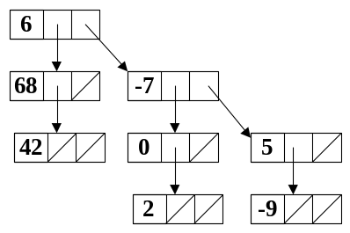
Logical Data Structure Analysis
Identify logical data structures
  Entire lists, trees, heaps, graphs, ...
Capture data structure graph concisely
Context sensitive, flow insensitive analysis
  Related to heap shape analysis, pointer analysis

Slide 13
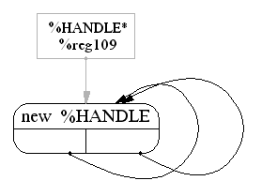
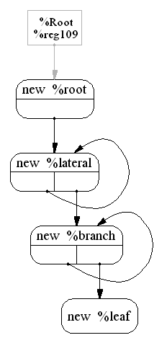
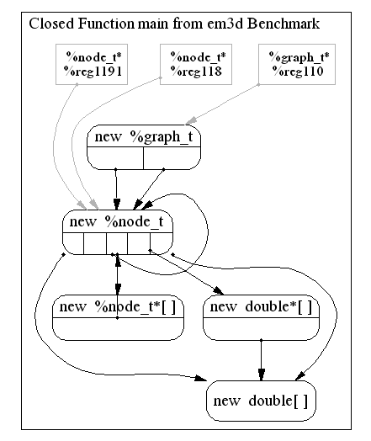
Example Data Structure Graphs
bisort
em3d
power

Slide 14
Data Structure Graph
Each node represents a memory object
  malloc(), alloca(), global variable, ...
Edges represent “may point to” set
  Set of nodes reachable from pointer
Track scalar point-to sets:
  Which graph nodes do scalars point to?
  Completely ignore integer values!

Slide 15
Analysis Outline: First pass
Initial pass over function:
  Find all pointers, global values, unknowns
  Create graph nodes, initialize scalar pointers
Example Function:
struct List { Patient *data;
List *next; };
void addList(List *list,
Patient *data) {
List *b, *nlist;
while (list ≠ NULL) {
b = list;
list = list→next;
}
nlist = malloc(sizeof(List));
nlist→data = data;
nlist→next = NULL;
b→next = nlist;
}
list
shadow List
data
next
b
nlist
new List
data
next
data
shadow Patient

Slide 16
Analysis Outline: Worklist
Add all pointer insts to a worklist. For each:
  Update graph for each instruction
  If pointer value changes, add all uses to worklist
  Merge indistinguishable nodes
Merge Nodes
Merge Nodes
Example Function:
struct List { Patient *data;
List *next; };
void addList(List *list,
Patient *data) {
List *b, *nlist;
while (list ≠ NULL) {
b = list;
list = list→next;
}
nlist = malloc(sizeof(List));
nlist→data = data;
nlist→next = NULL;
b→next = nlist;
}
shadow List
list
shadow List
shadow List
data
data
next
next
data
next
b
nlist
new List
data
next
data
shadow Patient

Slide 17
Interprocedural Closure
Inline called function graphs for IP closure
  Inline a graph in place of the call node
  Link up arguments & return values
  # of inlines proportional to # of fn calls in program!
  Resultant graphs are very compact
Example Function:
Tree* TreeAlloc(…){
if (…) return NULL;
node = malloc(…);
node→l = TreeAlloc(…);
node→r = TreeAlloc(…);
return node;
}
Local Graph:
Closed Graph:
node
return
node
return
call TreeAlloc
new Tree
call TreeAlloc
new Tree
returns
left
right
returns
left
right
shadow Tree
shadow Tree
left
right
left
right

Slide 18
Talk Overview
Problems, approach
LLVM Infrastructure
Data Structure Analysis
Fully Automatic Pool Allocation
Pointer Compression
Early Results

Slide 19
Pool Allocation Motivation
Increases performance:
  Better spatial locality
  Avoid overhead of most malloc implementations
    All elements of the pool are the same size
Enables new transformations:
  Data structure nodes all in a known place
    Can transform/rewrite heap at runtime
  Pointer compression is our first application

Slide 20
Automatic Pool Allocation
Pool alloc. is commonly applied manually
  … but never fully automatically (to our knowledge)
We have already identified logical DS’s
  Allocate each node to a different pool
Pool allocate when safe and profitable:
  All nodes of data structure subgraph are allocations
  Lifetime of DS is contained in function F
  “profitable” heuristic is true (future work)

Slide 21
Pool Allocation Transformation
1. Function F is root of call graph using DS
  Transform F and all called functions
2. Initialize pool descriptor on entry to F
3. Transform malloc & free instructions to poolalloc(&PD), poolfree(&PD) calls
4. Destroy pool descriptor on all exits of F

Slide 22
Example: treeadd Benchmark
int main() {
Tree *root = TreeAlloc(...);
result = TreeAdd(root);
}
root
new Tree
left
right
root doesn’t escape main
Allocate pool descriptor
int main() {
PoolDescriptor_t Pool;
poolinit(&Pool, sizeof(Tree));
Tree *root = pa_TreeAlloc(&Pool, ...);
result = pa_TreeAdd(&Pool, root);
pooldestroy(&Pool);
}
Initialize memory pool
Transform function body
Destroy pool on exit

Slide 23
More Complex Example: power
Each node gets separate pool
  Each pool has homogenous objects
  Improve locality in pool
Related Pool Desc’s are linked
  Isomorphic to data structure graph
Disjoint Data Structures
  Each has a separate set of pools
  E.g. two disjoint bin-trees in two pools
P1
P2
P3
P4

Slide 24
Talk Overview
Problems, approach
LLVM Infrastructure
Data Structure Analysis
Fully Automatic Pool Allocation
Pointer Compression
Early Results

Slide 25
Pointer Compression Motivation
Pointers are big and very sparse
  Full 64 bit of addressability is often unnecessary!
    Often, local data structures contain < 2¹⁶ nodes
  Pointers consume cache capacity and waste memory bandwidth
64 bit arch’s more and more prevalent
  Alpha, Sparc v9, IA64, x86-64, …
  This problem isn’t going away any time soon…
    Some vendors report Spec numbers in 32 bit mode!

Slide 26
Pointer Compression Approach
“Compress” pool pointers into pool indices
  Use a 16 or 32 bit index instead of a 64 bit pointer
  Can dramatically shrink data structure size!
Grow indices as required: 16 → 32 → 64 bit
  At runtime, if overflow detected, rewrite pool
  We know where are the references are to do this
  Guarantees transformation is safe:
    no loss of generality/power

Slide 27
Pointer Compression Strategies
#1. Replace pointers with 16 or 32 bit indices:
  Not safe: poolalloc fails when pool size exceeded
    Index would wrap around
#2. Generate generic code for any index size:
  Pool descriptor contains current index size
#3. Runtime specialization of generic code:
  Index sizes are almost always runtime constants
  Specialize code using runtime reoptimizer (future work)

Slide 28
Transformation
Transform function as before, but:
  Replace all pointers into pools with k bit indices
  Data structure types change:
    tree = { tree*, int, tree* } → newtree = { uint, int, uint }
    Can dramatically reduce memory footprint
    Scalars change as well
Load/store instructions are more complex:
  Compression makes dereferencing more expensive

Slide 29
Transforming Loads and Stores
Must have pool base to access DS node
  Maintained by pool descriptor
Transform: X = t→left;
  t_poolbase = t_pool→base;
  X = t_poolbase[t].left;
Transform: s→right = Y;
  s_poolbase = s_pool→base;
  s_poolbase[s].right = Y;
Problem: too many loads of pool base!
t→left = NULL;
t→right = NULL;
t→data = 0;
t_poolbase = t_pool→base;
t_poolbase[t]→left = NULL;
t_poolbase = t_pool→base;
t_poolbase[t]→right = NULL;
t_poolbase = t_pool→base;
t_poolbase[t]→data = 0;

Slide 30
Hacking Off Low Hanging Fruit
Pool base can change: poolalloc and poolfree
  but usually doesn’t (e.g. TreeAdd function)
Local (basic block) load elim pass
Trivially simple algorithm (~50 LOC impl)
  Removes most loads
  Better analysis could remove more!
    Loop invariant loads would be useful
t_poolbase = t_pool→base;
t_poolbase[t]→left = NULL;
t_poolbase = t_pool→base;
t_poolbase[t]→right = NULL;
t_poolbase = t_pool→base;
t_poolbase[t]→data = 0;
t_poolbase = t_pool→base;
t_poolbase[t]→left = NULL;
t_poolbase[t]→right = NULL;
t_poolbase[t]→data = 0;

Slide 31
Talk Overview
Problems, approach
LLVM Infrastructure
Data Structure Analysis
Fully Automatic Pool Allocation
Pointer Compression
Early Results

Slide 32
Early Results
Implementation Underway
  Data structure analysis complete
  Pool allocation complete
  Pointer compression strategy #1: ~85% done
    missing a few corner cases
  Local load elimination complete
  Many other optimizations/cleanup missing!
Implemented on C version of Olden suite

Slide 33
Experimental Setup
Baseline:
  Compile with LLC, the Sparc V9 LLVM backend
PointerComp 32:
  Enable 32 bit pointer compression, compile with LLC
PointerComp 16:
  Enable 16 bit pointer compression, compile with LLC
Each benchmark run four times:
  first execution discarded, rest are averaged

Slide 34
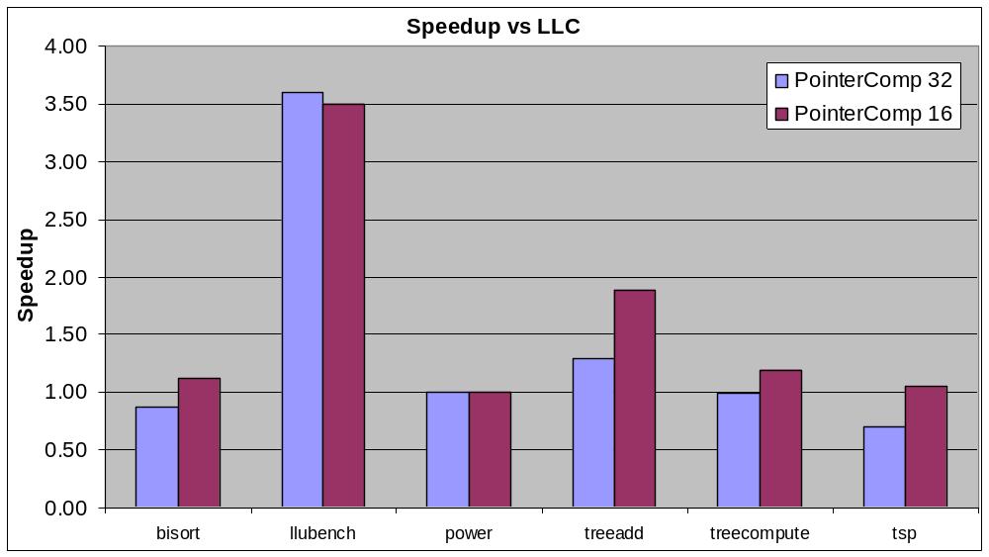
Pointer Compression Speedup
treeadd, llubench:
  heap intensive, small objects → big gains
Lets zoom in to see more detail...

Slide 35
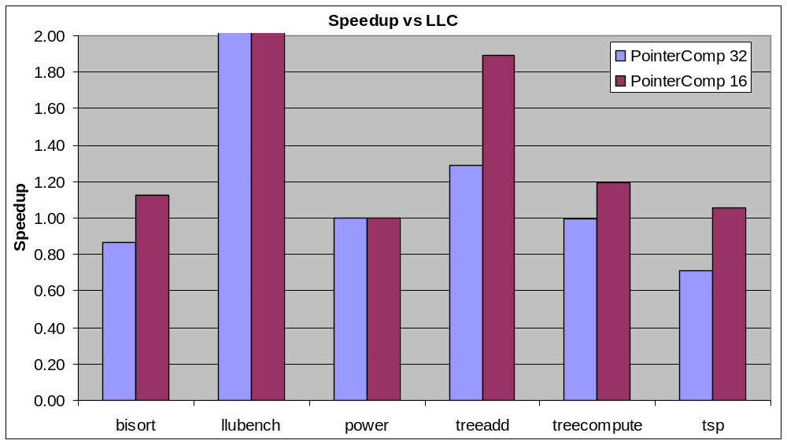
Speedups (Zoomed)
16 bit pool allocation is always a win! (1% to 350%)
power: CPU intensive → 0.2% improvement (cache is not bottleneck)
tsp, bisort: Overhead is too much for 32 bit pool allocation!
  Loss of 13% and 29% respectively, what are the sources of the overhead?
Note: These are preliminary numbers, further work is needed!

Slide 36
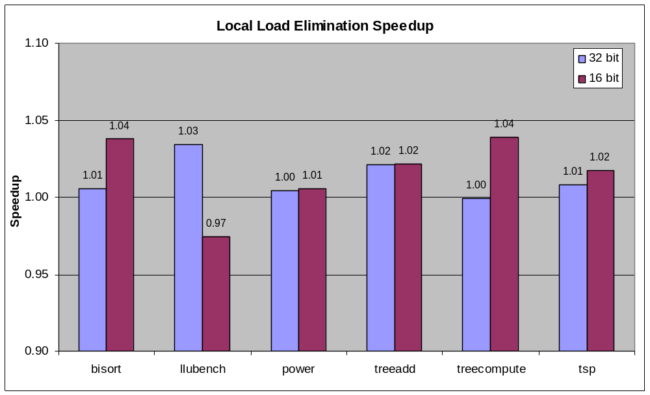
Local Load Elimination Speedups
Relatively small improvements
  A 4% gain isn’t anything to sneeze at though
What is the 3% loss from?
  Bad interaction with our untuned register allocator… ☹

Slide 37
Sources of Overhead
Extra Arguments to Functions:
  Must pass pool descriptor in with pointers
Redundant poolbase Loads
  Use pointer analysis based load elimination...
Load/Store Complexity:
  Common sub-expressions not eliminated yet!
t_poolbase = t_pool→base;
t_poolbase[t]→left = NULL;
t_poolbase[t]→right = NULL;
t_poolbase[t]→data = 0;
t_poolbase = t_pool→base;
T = &t_poolbase[t];
T→left = NULL;
T→right = NULL;
T→data = 0;

Slide 38
Future Work
Tuning, refining implementation:
  “profitable” heuristic to avoid unnecessary xforms
  Reducing other overheads
More, bigger benchmarks
Investigating pool allocation+prefetching
  Allocation order prefetching for free
  History prefetching using compressed pointers
Other applications of pool allocation

Slide 39
Conclusions
Macroscopic Data Structure Transformations
Fully Automatic Pool Allocation
  Uses data structure analysis
  Used primarily to enable new transformations
Example Usage: Pointer Compression
  Promising initial results!
Many future applications...

Slide 40
Questions?
For more information:
  http://www.cs.uiuc.edu/~vadve/lcoproject.html
To contact us:
Chris Lattner
lattner@cs.uiuc.edu
Vikram Adve
vadve@cs.uiuc.edu

