Slide 1
Automatic Pool Allocation for
Disjoint Data Structures
Presented by:
Chris Lattner
lattner@cs.uiuc.edu
Joint work with:
Vikram Adve
vadve@cs.uiuc.edu
ACM SIGPLAN Workshop on Memory System Performance (MSP 2002)
June 16, 2002
http://llvm.cs.uiuc.edu/

Slide 2
The Problem
Memory system performance is important!
  Fast CPU, slow memory, not enough cache
“Data structures” are bad for compilers
  Traditional scalar optimizations are not enough
  Memory traffic is main bottleneck for many apps
Fine grain approaches have limited gains:
  Prefetching recursive structures is hard
  Transforming individual nodes give limited gains

Slide 3
Our Approach
Fully Automatic Pool Allocation
Disjoint Logical Data Structure Analysis
  Identify data structures used by program
Automatic Pool Allocation
  Converts data structures into a form that is easily analyzable
High-Level Data Structure Optimizations!
Analyze and transform entire data structures
  Use a macroscopic approach for biggest gains
  Handle arbitrarily complex data structures
    lists, trees, hash tables, ASTs, etc…

Slide 4
Talk Overview
Problems, approach
Data Structure Analysis
Fully Automatic Pool Allocation
Potential Applications of Pool Allocation

Slide 5
LLVM Infrastructure
Strategy for Link-Time/Run-Time Optimization
Low Level Representation with High Level Types
Code retained in LLVM form until final link
Runtime
Optimizer
C, C++
Static Compiler 1
Fortran
LLVM
Java
Linker
IP Optimizer
Codegen
• • •
Machine
code
C, C++
Static Compiler N
LLVM
Fortran
Java
LLVM or
Machine code
Libraries

Slide 6
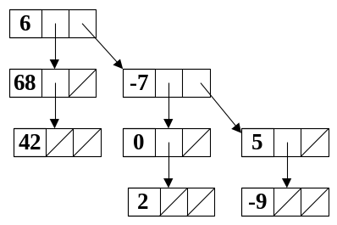
Logical Data Structure Analysis
Identify disjoint logical data structures
  Entire lists, trees, heaps, graphs, hash tables...
Capture data structure graph concisely
Context sensitive, flow insensitive analysis
  Related to heap shape analysis, pointer analysis
  Very fast: Only one visit per call site

Slide 7
Data Structure Graph
Each node represents a memory object
  malloc(), alloca(), and globals
  Each node contains a set of fields
Edges represent “may point to” set
  Edges point from fields, to fields
Scalar nodes: (lighter boxes)
  Track points-to for scalar pointers
  We completely ignore non-pointer scalars
reg107
new root
new lateral
new branch
new leaf

Slide 8
Analysis Overview
Intraprocedural Analysis (separable)
  Initial pass over function
    Creates nodes in the graph
  Worklist processing phase
    Add edges to the graph
Interprocedural Analysis
  Resolve “call” nodes to a cloned copy of the invoked function graphs

Slide 9
Intraprocedural Analysis
struct List { Patient *data; List *next }
void addList(List *list,
Patient *data){
List *b = NULL, *nlist;
while (list ≠ NULL) {
b = list;
list = list→next;
}
nlist = malloc(List);
nlist→data = data;
nlist→next = NULL;
b→next = nlist;
}
Merge Nodes
Merge Nodes
shadow List
shadow List
shadow List
list
list
list
list
data
data
next
data
next
next
next
b
b
b
new List
new List
nlist
nlist
data
data
next
next
shadow Patient
data

Slide 10
Interprocedural Closure
void addList(List *list,
Patient *data);
void ProcessLists(int N) {
List *L1 = calloc(List);
List *L2 = calloc(List);
/* populate lists */
for (int i=0; i≠N; ++i) {
tmp1 = malloc(Patient);
addList(L1, tmp1);
tmp2 = malloc(Patient);
addList(L2, tmp2);
}
}
call
call
fn addList
call
fn addList
fn
fn
fn
data
data
list
data
list
list
new List
new List
new List
L1
L1
L1
data
data
data
next
next
next
new Patient
new Patient
new Patient
tmp1
tmp1
tmp1
Merge
call
call
call
call
call
fn
fn
fn
fn
fn
list
data
data
data
data
data
list
data
list
list
list
list
Merge
new List
new List
new List
new List
new List
L2
L2
L2
data
next
L2
data
data
data
data
next
next
next
next
Two Disjoint Lists!
shad Patient
shad Patient
new Patient
new Patient
new Patient
new Patient
tmp2
tmp2
tmp2
tmp2

Slide 11
Important Analysis Properties
Intraprocedural Algorithm
  Only executed once per function
  Flow insensitive
Interprocedural
  Only one visit per call site
  Resolve calls from bottom up
  Inlines a copy of the called function’s graph
Overall
  Efficient algorithm to identify disjoint data structures
  Graphs are very compact in practice

Slide 12
Talk Overview
Problems, approach
Data Structure Analysis
Fully Automatic Pool Allocation
Potential Applications of Pool Allocation

Slide 13
Automatic Pool Allocation
Pool allocation is often applied manually
  … but never fully automatically
    … for imperative programs which use malloc & free
    We use a data structure driven approach
Pool allocation accuracy is important
  Accurate pool allocation enables aggressive transformations
  Heuristic based approaches are not sufficient

Slide 14
Pool Allocation Strategy
We have already identified logical DS’s
  Allocate each node to a different pool
  Disjoint data structures uses distinct pools
Pool allocate a data structure when safe to:
  All nodes of data structure subgraph are allocations
  Can identify function F, whose lifetime contains DS
    Escape analysis for the entire data structure
Pool allocate data structure into F!

Slide 15
Pool Allocation Transformation
void ProcessLists(unsigned N) {
List *L1 = malloc(List);
for (unsigned i=0;i≠N;++i) {
tmp = malloc(Patient);
addList(L1, tmp);
}
}
L1 is contained by ProcessLists!
new List
PoolDescriptor_t L1Pool, PPool;
L1
data
next
poolinit(&L1Pool, sizeof(List));
poolinit(&PPool, sizeof(Patient));
new Patient
tmp
List = poolalloc(&L1Pool);
Allocate pool descriptors
Initialize memory pools
tmp = poolalloc(&PPool);
pa_addList(L1, tmp);
Transform function body
Transform called function
pooldestroy(&PPool);
pooldestroy(&L1Pool);
Destroy pools on exit

Slide 16
Pool Allocation Properties
Each node gets separate pool
  Each pool has homogenous objects
  Good for locality and analysis of pool
Related Pool Desc’s are linked
  “Isomorphic” to data structure graph
    Actually contains a superset of edges
Disjoint Data Structures
  Each has a separate set of pools
  e.g. two disjoint lists in two distinct pools
reg107
P1
new root
P2
new lateral
P3
new branch
P4
new leaf

Slide 17
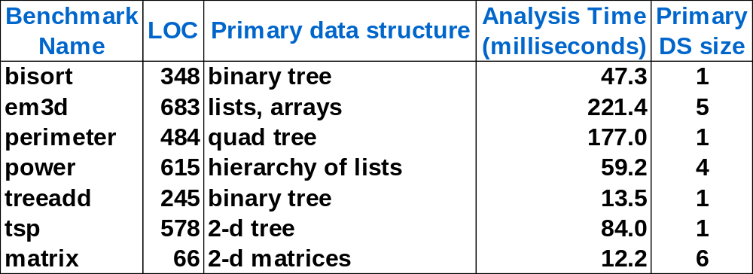
Preliminary Results
Pool allocation for most Olden Benchmarks
  Most only build a single large data structure ☹
Analysis failure for some benchmarks
  Not type-safe: e.g. “msp” uses void* hash table
  Work in progress to enhance LLVM type system

Slide 18
Talk Overview
Problems, approach
Data Structure Analysis
Fully Automatic Pool Allocation
Potential Applications of Pool Allocation

Slide 19
Applications of Pool Allocation
Pool allocation enables novel transformations
Pointer Compression (briefly described next)
New prefetching schemes:
  Allocation order prefetching for free
  History prefetching using compressed pointers
More aggressive structure reordering, splitting, …
Transparent garbage collection
Critical feature: Pool allocation provides important information at compile and runtime!

Slide 20
Pointer Compression
Pointers are large and very sparse
  Consume cache space & memory bandwidth
How does pool allocation help?
  Pool indices are denser than node pointers!
    Replace 64 bit pointer fields with 16 or 32 bit indices
  Identifying all external pointers to the data structure
  Find all data structure nodes at runtime
    If overflow detected at runtime, rewrite pool
    Grow indices as required: 16 → 32 → 64 bit

Slide 21
Contributions
Disjoint logical data structure analysis
Fully Automatic Pool Allocation
Macroscopic Data Structure Transformations
http://llvm.cs.uiuc.edu/

