Slide 1
Architecture for a
Next-Generation GCC
Chris Lattner
sabre@nondot.org
Vikram Adve
vadve@cs.uiuc.edu
http://llvm.cs.uiuc.edu/
The First Annual GCC Developers' Summit
May 26, 2003

Slide 2
GCC Optimizer Problems:
Scope of optimization is very limited:
  Most transformations work on functions…
    …and one is even limited to extended basic blocks
  No whole-program analyses or optimization!
    e.g. alias analysis must be extremely conservative
Tree & RTL are bad for mid-level opt’zns:
  Tree is language-specific and too high-level
  RTL is target-specific and too low-level

Slide 3
New Optimization Architecture:
Transparent link-time optimization:
  Completely compatible with user makefiles
Enables sophisticated interprocedural analyses (IPA) and optimizations (IPO):
  Increase the scope of analysis and optimization
A new representation for optimization:
  Typed, SSA-based, three-address code
  Source language and target-independent

Slide 4
Example Applications for GCC:
Fix inlining heuristics:
  Allows whole program, bottom-up inlining
  Cost metric is more accurate than for trees
Improved alias analysis:
  Dramatically improved precision
  Code motion, redundancy elimination gains
Work around low-level ABI problems:
  Tailor linkage of functions with IP information

Slide 5
Talk Outline:
High-Level Compiler Architecture
  How does the proposed GCC work?
Code Representation Details
  What does the representation look like?
LLVM: An Implementation
  Implementation status and experiences
Conclusion

Slide 6
Traditional GCC Organization:
Compile: source to target assembly
Assemble: target assembly to object file
Link: combine object files into an executable
Compile Time
Link Time
Source
Assembly
Object
Files
Executable
cc1
as
cc1plus
as
ld
…
as
Libs
Notes:
The problem: By the time the whole program is brought together, the program has already been converted to assembly language!

Slide 7
Proposed GCC Architecture:
Split the existing compiler in half:
  Parsing & semantic analysis at compile time
  Code generation at link-time
  Optimization at compile-time and link-time
Compile Time
Link Time
Source
Tree
New Representation
RTL
Assembly
GCC Frontend
Mid-level Optimize
Link
Whole-Program Optimize
GCC Backend
GCC Frontend
Mid-level Optimize
as
ld
Executable
Libs

Slide 8
Why Link-Time?
Fits into normal compile & link model:
  User makefiles do not have to change
  Enabled if compiling at -O4
Missing code severely limits IPA & IPO:
  Must make conservative assumptions:
    An unknown callee can do just about anything
  At link-time, most of the program is available for the first time!

Slide 9
Making Link-Time Opt Feasible:
Many commercial compilers support link-time optimization (Intel, SGI, HP, etc…):
  These export an AST-level representation, then perform all optimization at link-time
Our proposal:
  Optimize as much at compile-time as possible
  Perform aggressive IPA/IPO at link-time
  Allows mixed object files in native & IR format

Slide 10
No major GCC changes:
New GCC components:
  New expander from Tree to IR
  New expander from IR to RTL
  Must extend the compiler driver
Existing code path can be retained:
  When disabled, does not effect performance
  When -O2 is enabled, use new mid-level optimizations a function- (or unit-) at-a-time

Slide 11
Talk Outline:
High-Level Compiler Architecture
  How does the proposed GCC work?
Code Representation Details
  What does the representation look like?
LLVM: An Implementation
  Implementation status and experiences
Conclusion

Slide 12
Code Representation Properties:
Low-Level, SSA based, and “RISC-like”:
  SSA-based ≡ efficient, sparse, global opt’zns
  Orthogonal, as few operations as possible
  Simple, well defined semantics (documented)
  Simplify development of optimizations:
    Development & maintenance is very costly!
Concrete details come from LLVM:
  More details about LLVM come later in talk

Slide 13
Code Example:
tmp.0 = &P[0].0
%pair = type { int, float }
declare void %Sum(float*, %pair*)
int %Process(float* %A.0, int %N) {
entry:
%P = alloca %pair
%tmp.0 = getelementptr %pair* %P, long 0, ubyte 0
store int 0, int* %tmp.0
%tmp.1 = getelementptr %pair* %P, long 0, ubyte 1
store float 0.0, float* %tmp.1
%tmp.3 = setlt int 0, %N
br bool %tmp.3, label %loop, label %return
loop:
%i.1 = phi int [ 0, %entry ], [ %i.2, %loop ]
%A.1 = phi float* [ %A.0, %entry ],
[ %A.2, %loop ]
call void %Sum(float* %A.1, %pair* %P)
%A.2 = getelementptr float* %A.1, long 1
%i.2 = add int %i.1, 1
%tmp.4 = setlt int %i.1, %N
br bool %tmp.4, label %loop, label %return
return:
%tmp.5 = load int* %tmp.0
ret int %tmp.5
}
struct pair {
int X; float Y;
};
void Sum(float *, struct pair *P);
int Process(float *A, int N) {
int i;
struct pair P = {0,0};
for (i = 0; i < N; ++i) {
Sum(A, &P);
A++; }
return P.X;
}
A.2 = &A.1[1]
Simple type example, and example external function
Explicit allocation of stack space, clear distinction between memory and registers
High-level operations are lowered to simple operations
SSA representation is explicit in the code
Control flow is lowered to use explicit branches
Typed pointer arithmetic for explicit access to memory

Slide 14
Strongly-Typed Representation:
Key challenge:
  Support high-level analyses & transformations
  ... on a low-level representation!
Types provide this high-level info:
  Enables aggressive analyses and opt’zns:
    e.g. automatic pool allocation, safety checking, data structure analysis, etc…
  Every computed value has a type
Type system is language-neutral!

Slide 15
Type System Details:
Simple lang. independent type system:
  Primitives: void, bool, float, ushort, opaque, …
  Derived: pointer, array, structure, function
  No high-level types!
Source language types are lowered:
  e.g. T& → T*
  e.g. class T : S { int X; } → { S, int }
Type system can be “broken” with casts

Slide 16
Full Featured Language:
Should contain all info about the code:
  functions, globals, inline asm, etc…
  Should be possible to serialize and deserialize a program at any time
Language has binary and text formats:
  Both directly correspond to in-memory IR
  Text is for humans, binary is faster to parse
  Makes debugging and understanding easier!

Slide 17
Talk Outline:
High-Level Compiler Architecture
  How does the proposed GCC work?
Code Representation Details
  What does the representation look like?
LLVM: An Implementation
  Implementation status and experiences
Conclusion

Slide 18
LLVM: Low-Level Virtual Machine
A research compiler infrastructure:
  Provides a solid foundation for research
  In use both inside and outside of UIUC:
    Compilers, architecture, & dynamic compilation
    Two advanced compilers courses
Development Progress:
  2.5 years old, ~130K lines of C++ code
  First public release is coming soon:
    1.0 release this summer, prereleases via email

Slide 19
LLVM Implementation Status:
Most of this proposal is implemented:
  Tree → LLVM expander (for C and C++)
  Linker, optimizer, textual & bytecode formats
  Mid-level optimizer is sequence of 22 passes
All sorts of analyses & optimizations:
  Scalar: ADCE, SCCP, register promotion, …
  CFG: dominators, natural loops, profiling, …
  IP: alias analysis, automatic pool allocation, interprocedural mod/ref, safety verification…

Slide 20
Other LLVM Infrastructure:
Direct execution of LLVM bytecode:
  A portable interpreter, a Just-In-Time compiler
Several custom (non-GCC) backends:
  Sparc-V9, IA-32, C backend
The LLVM “Pass Manager”:
  Declarative system for tracking analysis and optimizer pass dependencies
  Assists building tools out of a series of passes

Slide 21
LLVM Development Tools:
Invariant checking:
  Automatic IR memory leak detection
  A verifier pass which checks for consistency
    Definitions dominate all uses, etc…
Bugpoint - automatic test-case reducer:
  Automatically reduces test cases to a small example which still causes a problem
  Can debug miscompilations or pass crashes

Slide 22
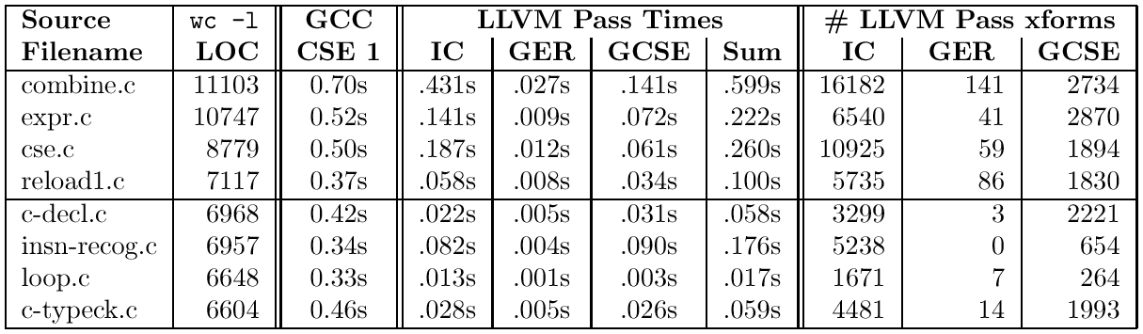
LLVM is extremely fast:
End-to-end performance isn’t great yet:
  Not yet integrated into GCC proper
But transformations are very fast:
  Some example numbers from the paper:

Slide 23
Conclusion:
Contributions:
  A realistic architecture for an aggressive link-time optimizer
  A representation for efficient and powerful analyses and transformations
LLVM is available…
  … and we appreciate your feedback!
http://llvm.cs.uiuc.edu

