Slide 1
LLVA: A Low Level Virtual Instruction Set Architecture
Vikram Adve, Chris Lattner, Michael Brukman,
Anand Shukla‡ and Brian Gaeke
Computer Science Department
University of Illinois at Urbana-Champaign
‡now at Google
Thanks: NSF (CAREER, Embedded02, NGS00, NGS99, OSC99), Marco/DARPA

Slide 2
If you’re designing a new processor family …
Would you like to be able to refine your ISA every year?
Would you like to add a new optimization without changing 7 compilers, 4 JITs and 6 debuggers to use it?
Would you like the compiler to assist your branch predictor, value predictor, trace cache, or speculation?
Would you like the program to tell you all loads/stores are independent in the next 220 static instructions?
In general, none of these is practical with today’s architectures

Slide 3
Most Current Architectures
Application Software
Operating System
Kernel
Device drivers
Hardware ISA
s/w representation
h/w control
Hardware Processor

Slide 4
VISC: Virtual Instruction Set Computers
[ IBM AS 400, DAISY,
Transmeta, Strata ]
Application Software
Operating System
Kernel
Virtual ISA: V-ISA
s/w representation
Device drivers
Processor-specific Translator (Software)
Implementation ISA (I-ISA)
s/w representation
h/w control
Hardware Processor
V-ISA can be much richer than an I-ISA can be.
Translator and processor can be co-designed,
and so truly cooperative.
2 fundamental
benefits of VISC:

Slide 5
VISC: Unanswered Questions
(1) What should the V-ISA look like?
  low-level enough to live below the OS
  language-independent
  enable sophisticated analysis and code generation
(2) How should the translation strategy work?
  Translation without OS involvement …
    … but then, can we do offline translation, offline caching?
  Exploit advances in static and dynamic optimization

Slide 6
Contributions of this Paper
LLVA: Novel V-ISA design + Translation strategy
V-ISA Design
  Low-level, yet hardware-independent, semantics
  High-level, yet language-independent, information
  Novel support for translation: exceptions, self-modifying code
Translation Strategy:
  OS-independent offline translation, caching
Evaluation of LLVA design features (not performance):
  Code size, instruction count, translation time?
  Does LLVA enable sophisticated compiler techniques?

Slide 7
Outline
Motivation and Contributions
LLVA Instruction Set
LLVA Translation Strategy
Evaluation of Design Features

Slide 8
LLVA Instruction Set
Typed assembly language + ∞ SSA register set
Low-level, machine-independent semantics
  RISC-like, 3-address instructions
  Infinite virtual register set
  Load-store instructions via typed pointers
  Distinguish stack, heap, globals, and code
High-level information
  Explicit Control Flow Graph (CFG)
  Explicit dataflow: SSA registers
  Explicit types: all values are typed, all instructions are strict

Slide 9
LLVA Instruction Set
Class
Instruction
arithmetic
bitwise
comparison
control-flow
memory
other
add, sub, mul, div, rem
and, or, xor, shl, shr
seteq, setne, setlt, setgt, setle, setge
ret, br, mbr, invoke, unwind
load, store, alloca
cast, getelementptr, call, phi
Only 28 LLVA instructions (6 of which are comparisons)‡
  Most are overloaded
  Few redundancies

Slide 10
Example
%pair = type { int, float }
declare void %Sum(float*, %pair*)
int %Process(float* %A, int %N) {
entry:
%P = alloca %pair
%tmp.0 = getelementptr %pair* %P, 0, 0
store int 0, int* %tmp.0
%tmp.1 = getelementptr %pair* %P, 0, 1
store float 0.0, float* %tmp.1
%tmp.3 = setlt int 0, %N
br bool %tmp.3, label %loop, label %next
loop:
%i.1 = phi int [0, %entry], [%i.2, %loop]
%AiAddr = getelementptr float* %A, %i.1
call void %Sum(float %AiAddr, %pair* %P)
%i.2 = add int %i.1, 1
%tmp.4 = setlt int %i.1, %N
br bool %tmp.4, label %loop, label %next
next:
%tmp.5 = load int* %tmp.0
ret int %tmp.5
}
tmp.0 = &P[0].0
struct pair {
int X; float Y;
};
void Sum(float *, pair *P);
int Process(float *A, int N){
int i;
pair P = {0,0};
for (i = 0; i < N; ++i)
Sum(&A[i], &P);
return P.X;
}
AiAddr = &A[i]
Type system includes:
Structures
Arrays
Pointers
Functions
Explicit stack allocation
exposes memory fully
abstracts layout
SSA representation is explicit in the code
Typed pointer arithmetic
machine-independent
preserves type info

Slide 11
Machine Independence (with limits)
No implementation-dependent features
  Infinite, typed registers
  alloca: no explicit stack frame layout
  call, ret: typed operands, no low-level calling conventions
  getelementptr: Typed address arithmetic
Pointer-size, endianness
  Irrelevant for “type-safe” code
  Encoded in the representation
Not a universal instruction set :
Design the V-ISA for some (broad) family of implementations

Slide 12
V-ISA: Reducing Constraints on Translation
The problem: Translator needs to reorder code
Previous systems faced 3 major challenges
[Transmeta, DAISY, Fx!32]
Memory Disambiguation
  Typed V-ISA enables sophisticated pointer, dependence analysis
Precise Exceptions
  On/off bit per instruction
  Let external compiler decide which exceptions are necessary
Self-modifying Code (SMC)
  Optional restriction allows SMC to be supported very simply

Slide 13
LLVA Exception Specification
Key: Requirements are language-dependent
On/off bit per instruction
  OFF ⇒ all exceptions on the instruction are ignored
  ON ⇒ all applicable exceptions enabled
  External compiler can decide which exceptions to enable
All enabled exceptions are precise
  Imprecise exceptions are generally difficult to use

Slide 14
LLVA: Self-modifying Code Specification
Key: Function-level JIT code generation is automatic
High performance, restricted(?) option:
  Only allowed to modify an inactive function (i.e., not on stack)
  Simply invalidate in-memory translation
  JIT will automatically re-translate …
Lower performance option:
  Modify any instruction any time: Conservative translation, execution

Slide 15
Outline
Motivation and Contributions
LLVA Instruction Set
LLVA Translation Strategy
Evaluation of Design Features

Slide 16
Translation Strategy: Goal and Challenges
Offline code generation whenever possible,
online code generation when necessary
Offline is easy if translator is integrated into OS:
  OS schedules offline translation, manages offline caching
But today’s microprocessors are OS-independent:
  Translator cannot make system calls
  Translator cannot invoke device drivers
  Translator cannot allocate external system resources (e.g,. disk)

Slide 17
OS-Independent Offline Translation
Define a small OS-independent API
Strictly optional …
  OS can choose whether or not to implement this API
  Operations can fail for many reasons
… Storage API for offline caching
  Example: void* ReadArray( char[ ] Key, int* numRead )
  Read, Write, GetAttributes [an array of bytes]

Slide 18
OS-Independent Translation Strategy
Applications, OS, kernel
Storage
Storage API
Cached
translations
Profile info
Optional
translator code
LLEE: Execution Environment ‡
V-ISA
Translator
Code
generation
Profiling
Static &
dyn. Opt.
Hardware Processor
I-ISA
‡ Currently works
above OS. Linux kernel
port to LLVA under way.

Slide 19
Overall Optimization and Translation Strategy
Extensive offline optimization by “external” compilers
Translation:
  Offline translation and caching when available
  JIT translation when all else fails
Sophisticated optimizations at runtime (by translator)
Sophisticated optimizations in “idle time”
Instruction set enables “lifelong” program optimization for any processor (VISC or not). Compiler design in [CGO 2004].
VISC inherits this capability for free.

Slide 20
Outline
Motivation and Contributions
LLVA Instruction Set
LLVA Translation Strategy
Evaluation of LLVA Design Features
  Qualitatively, does LLVA enable sophisticated compiler techniques?
  How compact is LLVA code?
  How closely does LLVA code match native code?
  Can LLVA be translated quickly to native code?

Slide 21
Compiler Techniques Enabled by LLVA
Extensive machine-independent optimizations
  SSA-based dataflow optimizations
  Control-flow optimizations
  Standard whole-program optimizations (at link-time)
Data Structure Analysis: Context-sensitive pointer analysis
Automatic Pool Allocation: Segregate logical DSs on heap
Powerful static safety checking:
  Heap safety, stack safety, pointer safety, array safety, type safety

Slide 22
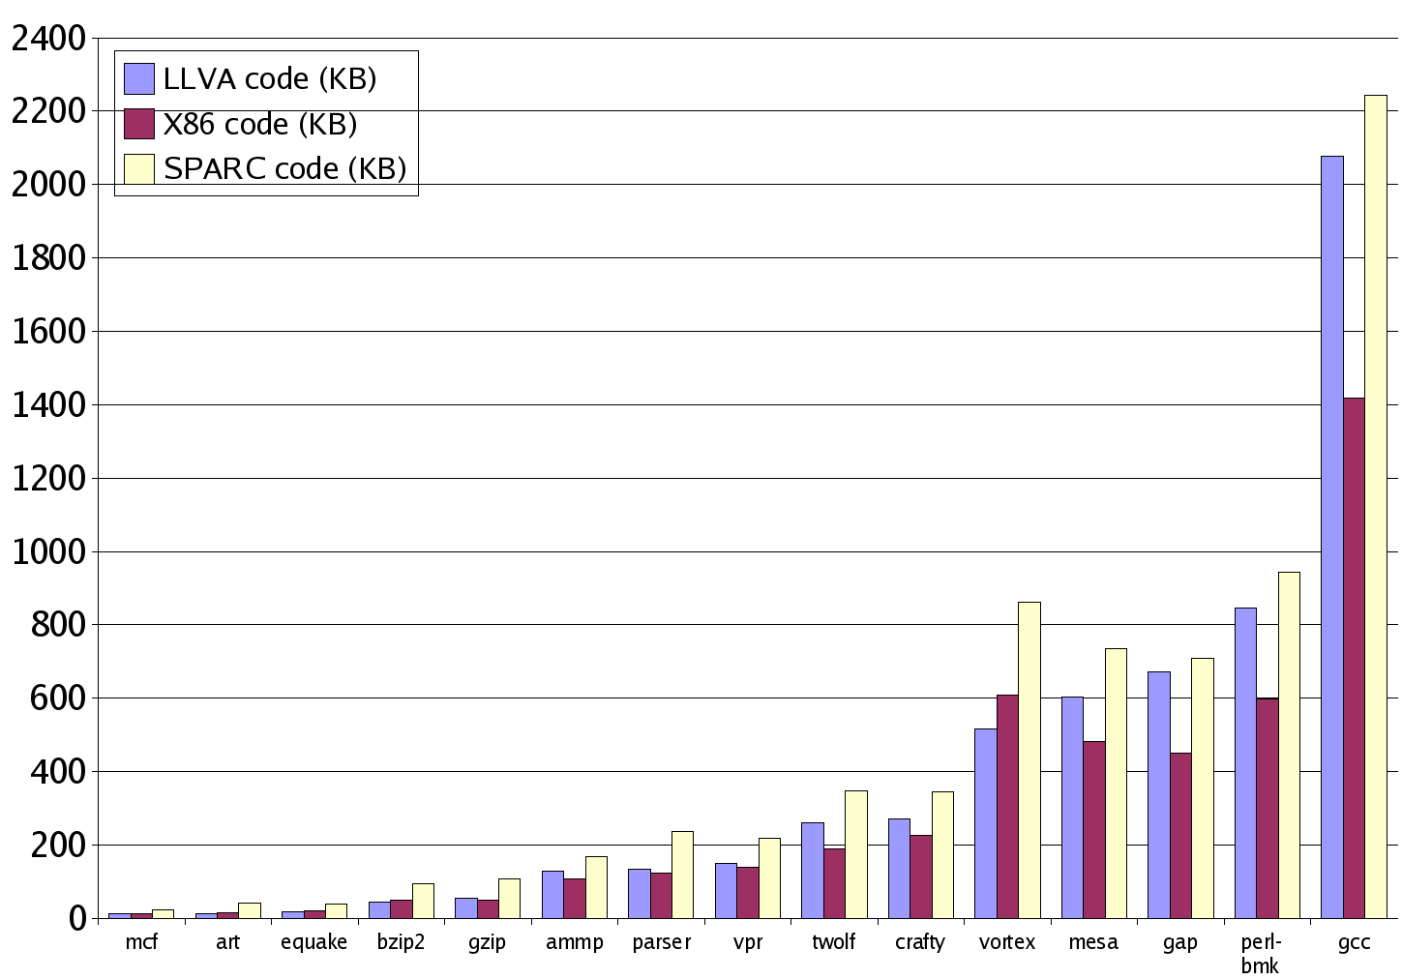
Static Code Size
Stripped binary from
gcc –O3
Average for LLVA vs. x86: 1.33 : 1
Average for LLVA vs. Sparc: 0.84 : 1
⇒ Small penalty for
extra information

Slide 23
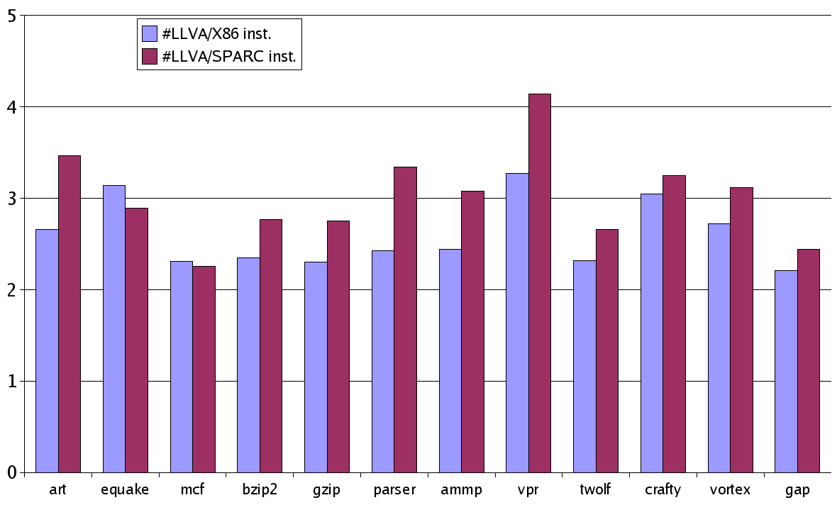
Ratio of static instructions
Average for x86: About 2.6 instructions per LLVA instruction
Average for Sparc: About 3.2 instructions per LLVA instruction
⇒ Very small semantic gap ; clear performance relationship

Slide 24
SPEC: Code generation time
Benchmark | KLOC | Translate | Run | Ratio
parser | 11.4 | 0.16 sec. | 4.72 sec. | 3.4 %
ammp | 13.5 | 0.11 | 58.76 | < 1 %
vpr | 17.7 | 0.14 | 7.92 | 2 %
twolf | 20.5 | 0.02 | 9.68 | < 1 %
crafty | 20.7 | 0.45 | 15.41 | 3 %
vortex | 67.2 | 0.78 | 6.75 | 12%
gap | 71.4 | 0.48 | 3.73 | 13%
art, equake, mcf, bzip2, gzip < 1 %
Typically « 1-3% time spent in simple translation

Slide 25
Summary
What should be the interface between hw and sw ?
A. Use a rich virtual ISA as the sole interface
Low-level, typed, ISA with ∞ SSA register set
OS-independent offline translation and caching
Results:
  LLVA code is compact despite high level information
  LLVA code closely matches generated machine code
  LLVA code can be translated extremely fast
Future Directions for VISC :
1. Parallel V-ISA. 2. Microarchitectures that exploit VISC.
3. Implications for OS. 4. Implications for JVM and CLI.

Slide 26
llvm.cs.uiuc.edu

Slide 27
LLVA: Benefits for Software
Operating Systems
  Security: Kernel-independent monitor for all hardware resources; translator hides most details of stack, data layout, etc.
  Portability: Most code depends only on LLVA
  Reliability: Static analysis on all code: kernel, devices, traps, …
Language-level virtual machines (CLI, JVM):
  Shared compiler system: code generation, runtime optimization
  Shared mechanisms: GC, RTTI, exceptions, …
Distributed Systems
  Common representation for application, middleware, libraries, …

Slide 28
Type System Details
Simple language-independent type system:
  Primitive types: void, bool, float, double, [u]int x [1,2,4,8], opaque
  Only 4 derived types: pointer, array, structure, function
Typed address arithmetic:
  getelementptr %T* ptr, long idx1, ulong idx2, …
  crucial for sophisticated pointer, dependence analyses
Language-independent like any microprocessor:
  No specific object model or language paradigm
  “cast” instruction: performs any meaningful conversion

Slide 29
VISC: Future Directions
Explicitly parallel V-ISA:
  Q. Which combination of CMP, SMT, MSSP, TRIPS, … is your favorite parallel design? How many parameters does it have?
Microarchitecture designs that exploit VISC
  Unlimited scope for cooperative hardware/software mechanisms
Implications for high-level virtual machines (JVM, CLI)
  Shared mechanisms for optimization, GC, RTTI, exceptions, …
Implications for OS
  V-ISA and translator hide most details of stack, data layout, etc.

