Slide 1
Transparent Pointer Compression for Linked Data Structures
Chris Lattner
lattner@cs.uiuc.edu
Vikram Adve
vadve@cs.uiuc.edu
June 12, 2005
MSP 2005
http://llvm.cs.uiuc.edu/

Slide 2
Growth of 64-bit computing
64-bit architectures are increasingly common:
  New architectures and chips (G5, IA64, X86-64, …)
  High-end systems have existed for many years now
64-bit address space used for many purposes:
  Address space randomization (security)
  Memory mapping large files (databases, etc)
  Single address space OS’s
  Many 64-bit systems have < 4GB of phys memory
    64-bits is still useful for its virtual address space

Slide 3
Cost of a 64-bit virtual address space
BIGGER POINTERS
Pointers must be 64 bits (8 bytes) instead of 32 bits:
  Significant impact for pointer-intensive programs!
Pointer intensive programs suffer from:
  Reduced effective L1/L2/TLB cache sizes
  Reduced effective memory bandwidth
  Increased alignment requirements, etc
Pointer intensive programs are increasingly common:
  Recursive data structures (our focus)
  Object oriented programs

Slide 4
Previously Published Approaches
Simplest approaches: Use 32-bit addressing
  Compile for 32-bit pointer size “-m32”
  Force program image into 32-bits [Adl-Tabatabai’04]
  Loses advantage of 64-bit address spaces!
Other approaches: Exotic hardware support
  Compress pairs of values, speculating that pointer offset is small [Zhang’02]
  Compress arrays of related pointers [Takagi’03]
  Requires significant changes to cache hierarchy
No previous fully-automatic compiler technique to shrink pointers in RDS’s

Slide 5
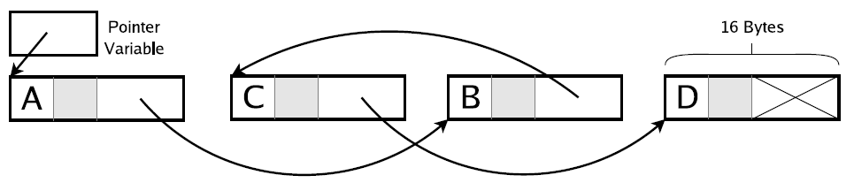
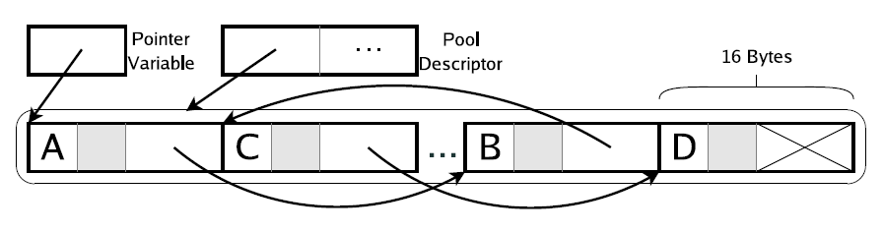
Our Approach (1/2)
Original heap layout
Use Automatic Pool Allocation [PLDI’05] to partition heap into memory pools:
  Infers and captures pool homogeneity information
Layout after pool allocation

Slide 6
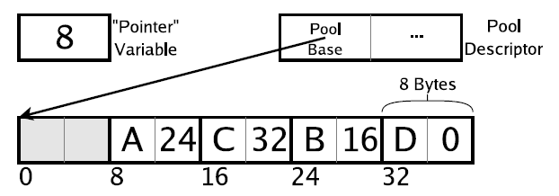
Our Approach (2/2)
Replace pointers with 64-bit integer offsets from the start of the pool
  Change *Ptr into *(PoolBase+Ptr)
Shrink 64-bit integers to 32-bit integers
  Allows each pool to be up to 4GB in size
Layout after pointer compression

Slide 7
Talk Outline
Introduction & Motivation
Automatic Pool Allocation Background
Pointer Compression Transformation
Experimental Results
Conclusion

Slide 8
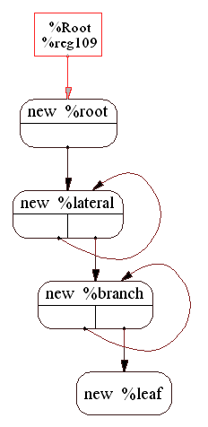
Automatic Pool Allocation
Compute points-to graph:
  Ensure each pointer has one target
    “unification-based” approach
Infer pool lifetimes:
  Uses escape analysis
Rewrite program:
  malloc → poolalloc, free → poolfree
  Insert calls to poolinit/pooldestroy
  Pass pool descriptors to functions
Pool 1
Pool 2
Pool 3
Pool 4
L1
L2
List
List
Pool 1
Pool 2
For more info: see MSP paper or talk at PLDI tomorrow

Slide 9
A Simple Pointer-intensive Example
A list of pointers to doubles
Pool allocate
List *L = 0;
for (…) {
List *N = malloc(List);
N->Next = L;
N->Data = malloc(double);
L = N;
}
List *L = 0;
for (…) {
List *N = poolalloc(PD1, List);
N->Next = L;
N->Data = poolalloc(PD2,double);
L = N;
}
L
L
List
List
List
List
PD1
double
Points-to graph
summary
double
double
PD2

Slide 10
Effect of Automatic Pool Allocation 1/2
Heap is partitioned into separate pools
  Each individual pool is smaller than total heap
List *L = 0;
for (…) {
List *N = malloc(List);
N->Next = L;
N->Data = malloc(double);
L = N;
}
List *L = 0;
for (…) {
List *N = poolalloc(PD1, List);
N->Next = L;
N->Data = poolalloc(PD2,double);
L = N;
}
L
PD1
…
List
PD2
…
double

Slide 11
Effect of Automatic Pool Allocation 2/2
Each pool has a descriptor associated with it:
  Passed into poolalloc/poolfree
We know which pool each pointer points into:
  Given the above, we also have the pool descriptor
  e.g. “N”, “L” → PD1 and N->Data → PD2
List *L = 0;
for (…) {
List *N = malloc(List);
N->Next = L;
N->Data = malloc(double);
L = N;
}
List *L = 0;
for (…) {
List *N = poolalloc(PD1, List);
N->Next = L;
N->Data = poolalloc(PD2,double);
L = N;
}

Slide 12
Talk Outline
Introduction & Motivation
Automatic Pool Allocation Background
Pointer Compression Transformation
Experimental Results
Conclusion

Slide 13
Index Conversion of a Pool
Force pool memory to be contiguous:
  Normal PoolAlloc runtime allocates memory in chunks
  Two implementation strategies for this (see paper)
Change pointers into the pool to integer offsets/indexes from pool base:
  Replace “*P” with “*(PoolBase + P)”
A pool can be index converted if pointers into it only point to heap memory (no stack or global mem)

Slide 14
Index Compression of a Pointer
Shrink indexes in type-homogenous pools
  Shrink from 64-bits to 32-bits
Replace structure definition & field accesses
  Requires accurate type-info and type-safe accesses
struct List {
struct List *Next;
int Data;
};
struct List {
int64 Next;
int Data;
};
struct List {
int32 Next;
int Data;
};
List *L = malloc(16);
L = malloc(16);
L = malloc(8);
index conversion
index compression

Slide 15
Index Conversion Example 1
Previous Example
After Index Conversion
L
L
List
Index Convert
Pools
List
64-bit integer indexes
double
double
Two pointers are compressible
Index conversion changes pointer dereferences, but not memory layout

Slide 16
Index Compression Example 1
Example after
index conversion
L
L
List
List
64-bit integer indices
32-bit integer indices
double
double
Compress pointers, change accesses to and size of structure
Compress both indexes from 64 to 32-bit ints
‘Pointer’ registers remain 64-bits

Slide 17
Impact of Type-Homogeneity/safety
Compression requires rewriting structures:
  e.g. malloc(32) → malloc(16)
  Rewriting depends on type-safe memory accesses
    We can’t know how to rewrite unions and other cases
  Must verify that memory accesses are ‘type-safe’
Pool allocation infers type homogeneity:
  Unions, bad C pointer tricks, etc → non-TH
  Some pools may be TH, others not
Can’t index compress ptrs in non-TH pools!

Slide 18
Index Conversion Example 2
unknown
type
unknown
type
L
L
64-bit integer indexes
List
List
Heap pointer points from TH pool to a heap-only pool: compress this pointer!
Index conversion changes pointer dereferences, but not memory layout
Compression of TH memory, pointed to by non-TH memory

Slide 19
Index Compression Example 2
Example after
index conversion
64-bit integer indexes
unknown
type
unknown
type
L
L
64-bit integer indexes
32-bit integer index
List
List
Next step: compress the pointer in the heap
Compress pointer in type-safe pool, change offsets and size of structure
Compression of TH memory, pointed to by non-TH memory

Slide 20
Pointer Compression Example 3
L
L
L
Array
Array
Array
unknown
type
unknown
type
unknown
type
Index convert non-TH pool to shrink TH pointers
Index compress array of pointers!
Compression of TH pointers, pointing to non-TH memory

Slide 21
Static Pointer Compression Impl.
Inspect graph of pools provided by APA:
  Find compressible pointers
  Determine pools to index convert
Use rewrite rules to ptr compress program:
  e.g. if P₁ and P₂ are compressed pointers, change:
  P₁ = *P₂ ⇒ P₁’ = *(int*)(PoolBase+P₂’)
Perform interprocedural call graph traversal:
  Top-down traversal from main()

Slide 22
Talk Outline
Introduction & Motivation
Automatic Pool Allocation Background
Pointer Compression Transformation
Dynamic Pointer Compression
Experimental Results
Conclusion

Slide 23
Dynamic Pointer Compression Idea
Static compression can break programs:
  Each pool is limited to 2³² bytes of memory
    Program aborts when 2^{32nd} byte allocated!
Expand pointers dynamically when needed!
  When 2^{32nd} byte is allocated, expand ptrs to 64-bits
  Traverse/rewrite pool, uses type information
  Similar to (but a bit simpler than) a copying GC pass

Slide 24
Dynamic Pointer Compression Cost
Structure offset and sizes depend on whether a pool is currently compressed:
  P₁ = *P₂ ⇒
Use standard optimizations to address this:
  Predication, loop unswitching, jump threading, etc.
See paper for details
if (PD->isCompressed)
P₁’ = *(int32*)(PoolBase + P₂’*C1 + C2);
else
P₁’ = *(int64*)(PoolBase + P₂’*C3 + C4);

Slide 25
Talk Outline
Introduction & Motivation
Automatic Pool Allocation Background
Pointer Compression Transformation
Experimental Results
Conclusion

Slide 26
Experimental Results: 2 Questions
Does Pointer Compression improve the performance of pointer intensive programs?
  Cache miss reductions, memory bandwidth improvements
  Memory footprint reduction
How does the impact of Pointer Compression vary across 64-bit architectures?
  Do memory system improvements outweigh overhead?
Built in the LLVM Compiler Infrastructure: http://llvm.cs.uiuc.edu/

Slide 27
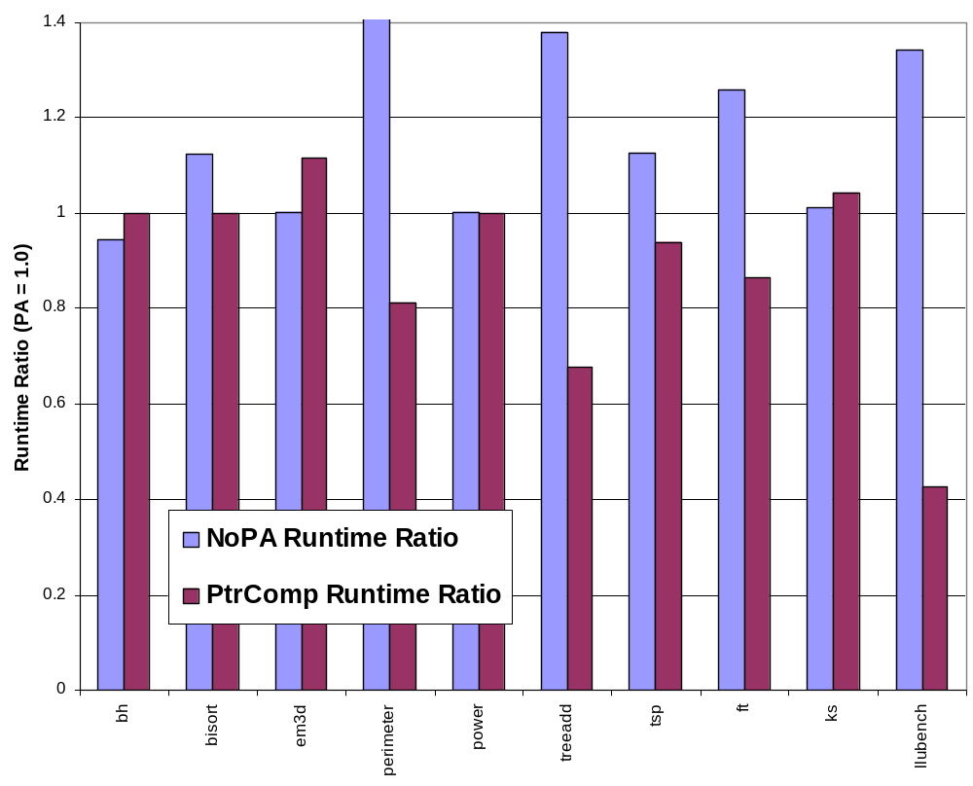
Static PtrComp Performance Impact
1.0 = Program compiled with LLVM & PA but no PC
Peak Memory Usage
 | PA | PC | PC/PA
bh | 8MB | 8MB | 1.00
bisort | 64MB | 32MB | 0.50
em3d | 47MB | 47MB | 1.00
perimeter | 299MB | 171MB | 0.57
power | 882KB | 816KB | 0.93
treeadd | 128MB | 64MB | 0.50
tsp | 128MB | 96MB | 0.75
ft | 9MB | 4MB | 0.51
ks | 47KB | 47KB | 1.00
llubench | 4MB | 2MB | 0.50
UltraSPARC IIIi w/1MB Cache

Slide 28
Evaluating Effect of Architecture
Pick one program that scales easily:
  llubench – Linked list micro-benchmark
  llubench has little computation, many dereferences
    Best possible case for pointer compression
Evaluate how ptrcomp impacts scalability:
  Compare to native and pool allocated version
Evaluate overhead introduced by ptrcomp:
  Compare PA32 with PC32 (‘compress’ 32 → 32 bits)
How close is ptrcomp to native 32-bit pointers?
  Compare to native-32 and poolalloc-32 for limit study

Slide 29
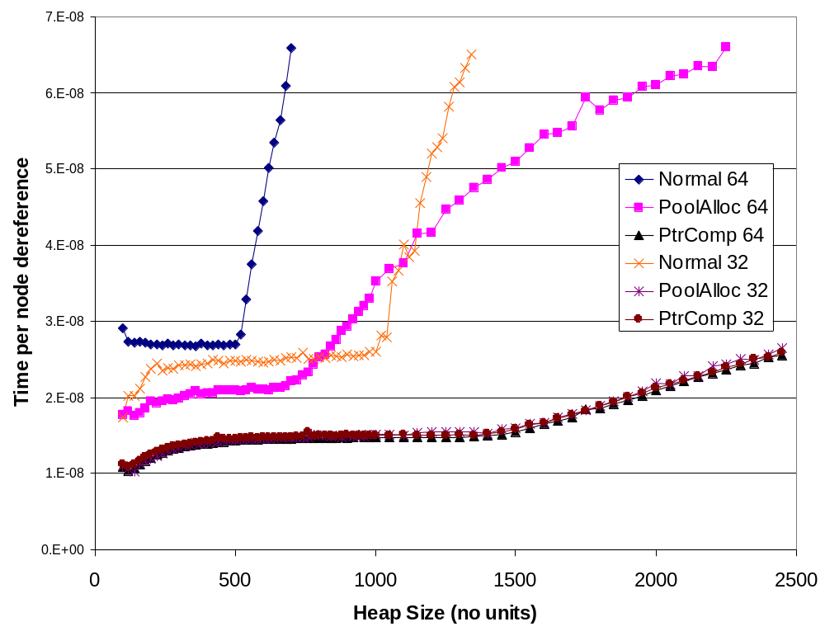
SPARC V9 PtrComp (1MB Cache)
Significant scalability impact
PtrComp overhead is very low
Notes:
Sun implementation of malloc is very very bad, basic pool allocation always beats it.
Overhead of PC is very low: PA32/PC32 basically identical.
PC64 basically matches performance of PA32, which is the theoretical optimum

Slide 30
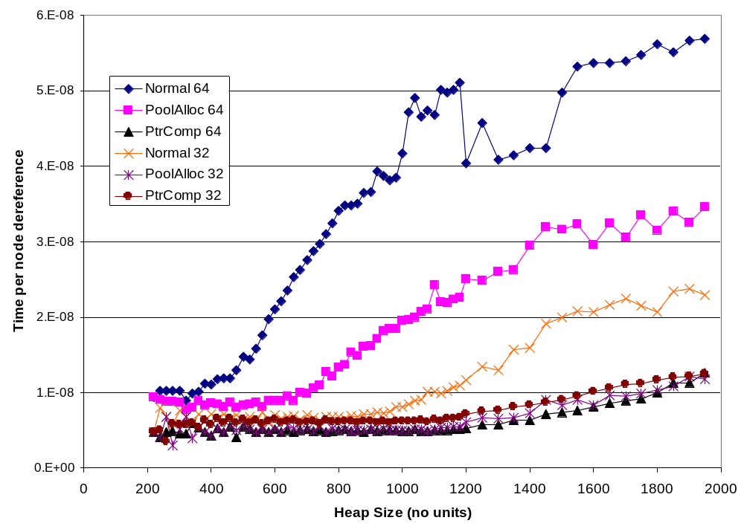
AMD64 PtrComp (1MB Cache)
Similar scalability impact
See paper for IA64 and IBM-SP
PtrComp is faster than PA32 on AMD64!
Notes:
PC64 is FASTER than PA32. 64-bit mode gives x86-64 twice as many GPRs to play with over x86-32.

Slide 31
Pointer Compression Conclusion
Pointer compression can substantially reduce footprint of pointer-intensive programs:
  … without specialized hardware support!
Significant perf. impact for some programs:
  Effectively higher memory bandwidth
  Effectively larger caches
Dynamic compression for full generality:
  Speculate that pools are small, expand if not
  More investigation needed, see paper!
Questions?
http://llvm.cs.uiuc.edu/

