Slide 1
Automatic Pool Allocation:
Improving Performance by Controlling Data Structure Layout in the Heap
Chris Lattner
lattner@cs.uiuc.edu
Vikram Adve
vadve@cs.uiuc.edu
June 13, 2005
PLDI 2005
http://llvm.cs.uiuc.edu/

Slide 2
What is the problem?
List 1
Nodes
List 2
Nodes
Tree
Nodes
What the program creates:
What the compiler sees:
What we want the program to create and the
compiler to see:

Slide 3
Our Approach: Segregate the Heap
Step #1: Memory Usage Analysis
  Build context-sensitive points-to graphs for program
  We use a fast unification-based algorithm
Step #2: Automatic Pool Allocation
  Segregate memory based on points-to graph nodes
  Find lifetime bounds for memory with escape analysis
  Preserve points-to graph-to-pool mapping
Step #3: Follow-on pool-specific optimizations
  Use segregation and points-to graph for later optzns

Slide 4
Why Segregate Data Structures?
Primary Goal: Better compiler information & control
  Compiler knows where each data structure lives in memory
  Compiler knows order of data in memory (in some cases)
  Compiler knows type info for heap objects (from points-to info)
  Compiler knows which pools point to which other pools
Second Goal: Better performance
  Smaller working sets
  Improved spatial locality
  Sometimes convert irregular strides to regular strides

Slide 5
Contributions
First “region inference” technique for C/C++:
  Previous work required type-safe programs: ML, Java
  Previous work focused on memory management
Region inference driven by pointer analysis:
  Enables handling non-type-safe programs
  Simplifies handling imperative programs
  Simplifies further pool+ptr transformations
New pool-based optimizations:
  Exploit per-pool and pool-specific properties
Evaluation of impact on memory hierarchy:
  We show that pool allocation reduces working sets

Slide 6
Talk Outline
Introduction & Motivation
Automatic Pool Allocation Transformation
Pool Allocation-Based Optimizations
Pool Allocation & Optzn Performance Impact
Conclusion

Slide 7
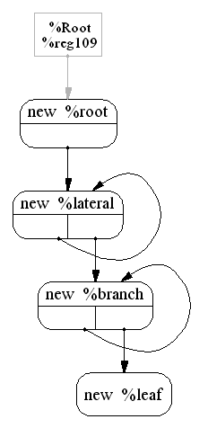
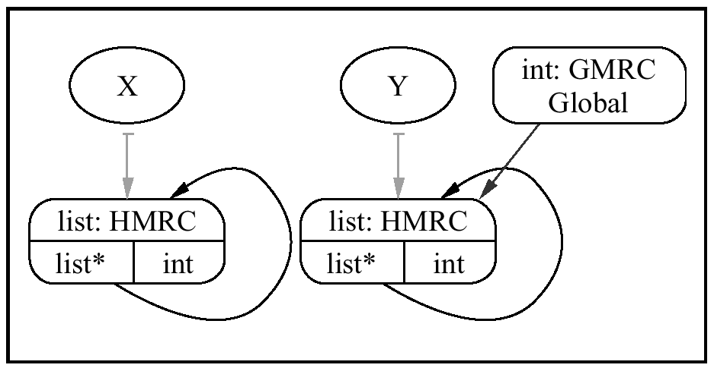
Automatic Pool Allocation Overview
Segregate memory according to points-to graph
Use context-sensitive analysis to distinguish between RDS instances passed to common routines
Points-to graph (two disjoint linked lists)
Pool 1
Pool 2
Pool 3
Pool 4
Pool 1
Pool 2

Slide 8
Points-to Graph Assumptions
Specific assumptions:
  Build a points-to graph for each function
  Context sensitive
  Unification-based graph
  Can be used to compute escape info
Use any points-to that satisfies the above
Our implementation uses DSA [Lattner:PhD]
  Infers C type info for many objects
  Field-sensitive analysis
  Results show that it is very fast
Linked List
head
list: HMR
list*
int

Slide 9

Pool Allocation: Example
list *makeList(int Num) {
list *New = malloc(sizeof(list));
New->Next = Num ? makeList(Num-1) : 0;
New->Data = Num; return New;
}
int twoLists( ) {
list *X = makeList(10);
list *Y = makeList(100);
GL = Y;
processList(X);
processList(Y);
freeList(X);
freeList(Y);
}
, Pool* P){
poolalloc(P);
, P)
Change calls to free into calls to poolfree → retain explicit deallocation
Pool* P2
Pool P1; poolinit(&P1);
, &P1)
, P2)
, &P1)
, P2)
pooldestroy(&P1);
P1
P2

Slide 10
Pool Allocation Algorithm Details
Indirect Function Call Handling:
  Partition functions into equivalence classes:
    If F1, F2 have common call-site ⇒ same class
  Merge points-to graphs for each equivalence class
  Apply previous transformation unchanged
Global variables pointing to memory nodes
  See paper for details
poolcreate/pooldestroy placement
  See paper for details

Slide 11
Talk Outline
Introduction & Motivation
Automatic Pool Allocation Transformation
Pool Allocation-Based Optimizations
Pool Allocation & Optzn Performance Impact
Conclusion

Slide 12
Pool Specific Optimizations
Different Data Structures Have Different Properties
Pool allocation segregates heap:
  Roughly into logical data structures
  Optimize using pool-specific properties
Examples of properties we look for:
  Pool is type-homogenous
  Pool contains data that only requires 4-byte alignment
  Opportunities to reduce allocation overhead
build
traverse
destroy
head
head
head
complex allocation pattern
list: HMR
list: HMR
list: HMR
list*
int
list*
int
list*
int

Slide 13
Looking closely: Anatomy of a heap
Fully general malloc-compatible allocator:
  Supports malloc/free/realloc/memalign etc.
  Standard malloc overheads: object header, alignment
  Allocates slabs of memory with exponential growth
  By default, all returned pointers are 8-byte aligned
In memory, things look like (16 byte allocs):
4-byte padding for user-data alignment
4-byte object header
16-byte
user data
16-byte
user data
16-byte
user data
One 32-byte Cache Line

Slide 14
PAOpts (1/4) and (2/4)
Selective Pool Allocation
  Don’t pool allocate when not profitable
PoolFree Elimination
  Remove explicit de-allocations that are not needed
See the paper for details!

Slide 15
PAOpts (3/4): Bump Pointer Optzn
If a pool has no poolfree’s:
  Eliminate per-object header
  Eliminate freelist overhead (faster object allocation)
Eliminates 4 bytes of inter-object padding
  Pack objects more densely in the cache
Interacts with poolfree elimination (PAOpt 2/4)!
  If poolfree elim deletes all frees, BumpPtr can apply
16-byte
user data
16-byte
user data
16-byte
user data
16-byte
user data
One 32-byte Cache Line

Slide 16
PAOpts (4/4): Alignment Analysis
Malloc must return 8-byte aligned memory:
  It has no idea what types will be used in the memory
  Some machines bus error, others suffer performance problems for unaligned memory
Type-safe pools infer a type for the pool:
  Use 4-byte alignment for pools we know don’t need it
  Reduces inter-object padding
4-byte object header
16-byte
user data
16-byte
user data
16-byte
user data
16-byte
user data
One 32-byte Cache Line

Slide 17
Talk Outline
Introduction & Motivation
Automatic Pool Allocation Transformation
Pool Allocation-Based Optimizations
Pool Allocation & Optzn Performance Impact
Conclusion

Slide 18
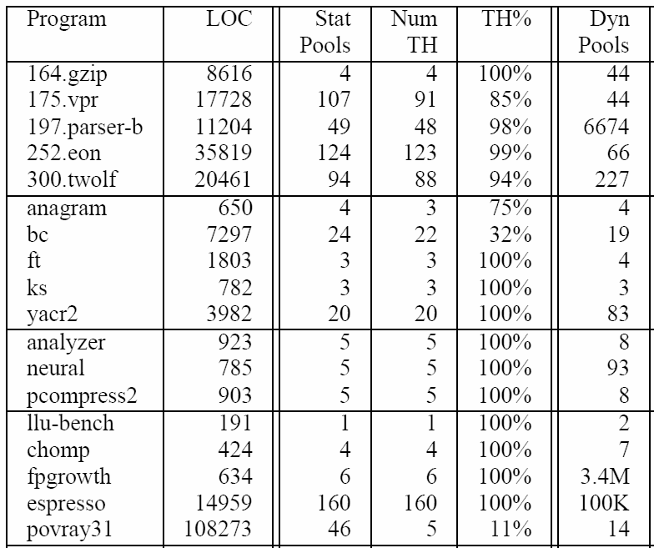
Simple Pool Allocation Statistics
Programs from SPEC CINT2K, Ptrdist, FreeBench & Olden suites, plus unbundled programs
DSA is able to infer that most static pools are type-homogenous
91
DSA + Pool allocation compile time is small: less than 3% of GCC compile time for all tested programs. See paper for details

Slide 19
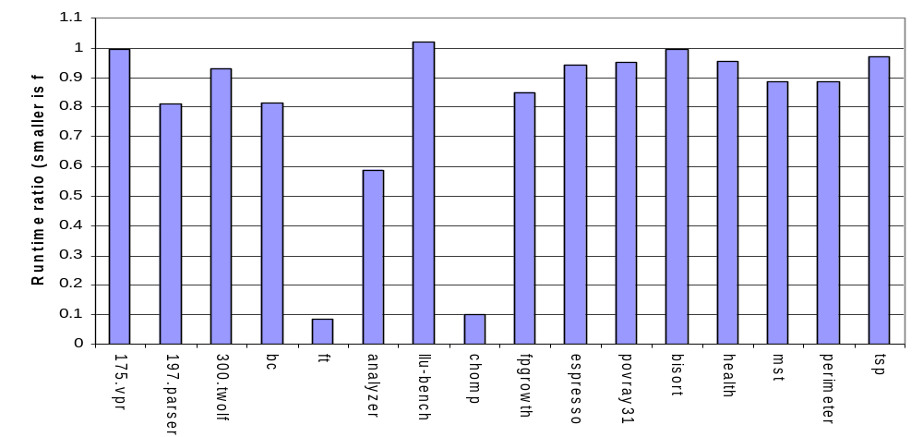
Pool Allocation Speedup
Most programs are 0% to 20% faster with pool allocation alone
Two are 10x faster, one is almost 2x faster
Several programs unaffected by pool allocation (see paper)
Sizable speedup across many pointer intensive programs
Some programs (ft, chomp) order of magnitude faster
See paper for control experiments (showing impact of pool runtime library, overhead induced by pool allocation args, etc)

Slide 20
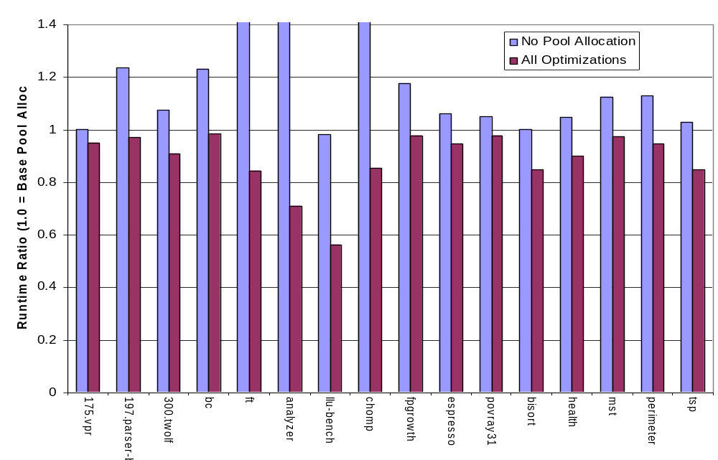
Pool Optimization Speedup (FullPA)
PA Time
Most are 5-15% faster with optimizations than with Pool Alloc alone
One is 44% faster, other is 29% faster
Pool optzns effect can be additive with the pool allocation effect
Pool optimizations help some progs that pool allocation itself doesn’t
Baseline 1.0 = Run Time with Pool Allocation
Optimizations help all of these programs:
  Despite being very simple, they make a big impact

Slide 21
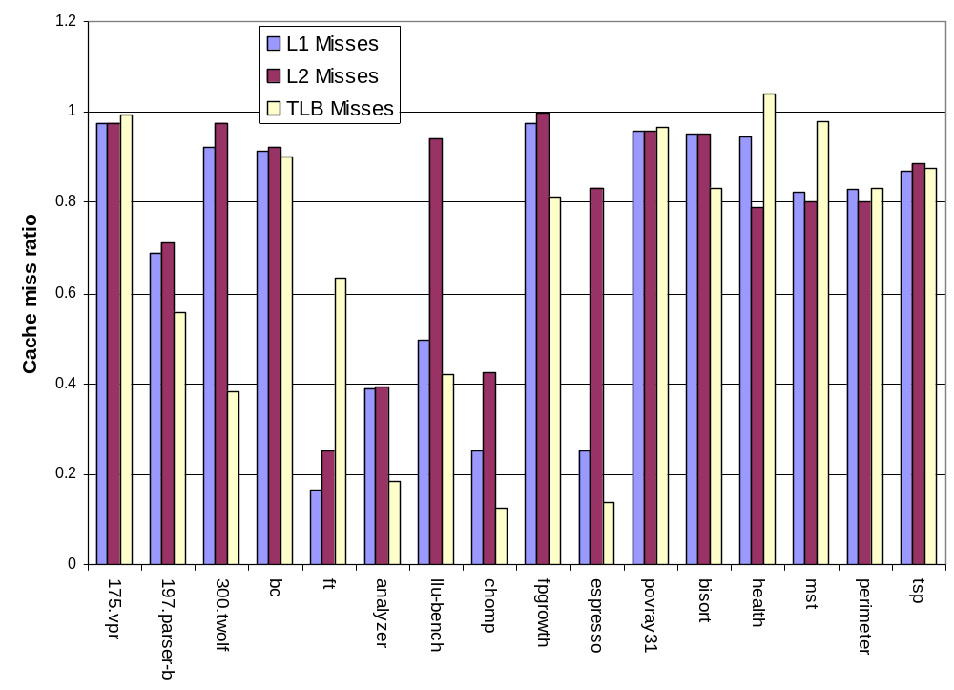
Cache/TLB miss reduction
Miss rate measured
with perfctr on AMD Athlon 2100+
Sources:
  Defragmented heap
  Reduced inter-object padding
  Segregating the heap!

Slide 22
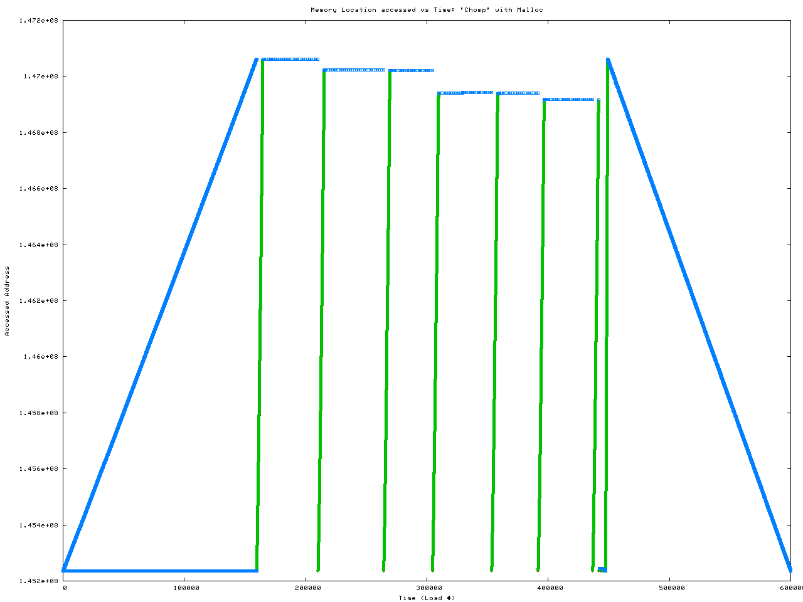
Chomp Access Pattern with Malloc
Allocates three object types (red, green, blue)
Each traversal sweeps through all of memory
Blue nodes are interspersed with green/red nodes
Spends most time traversing green/red nodes

Slide 23
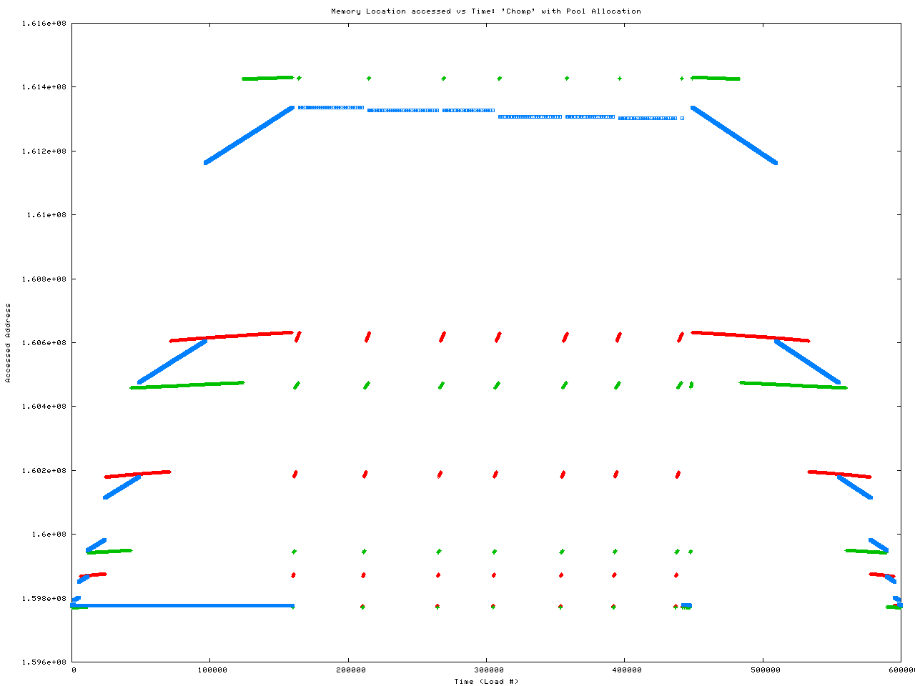
Chomp Access Pattern with PoolAlloc

Slide 24
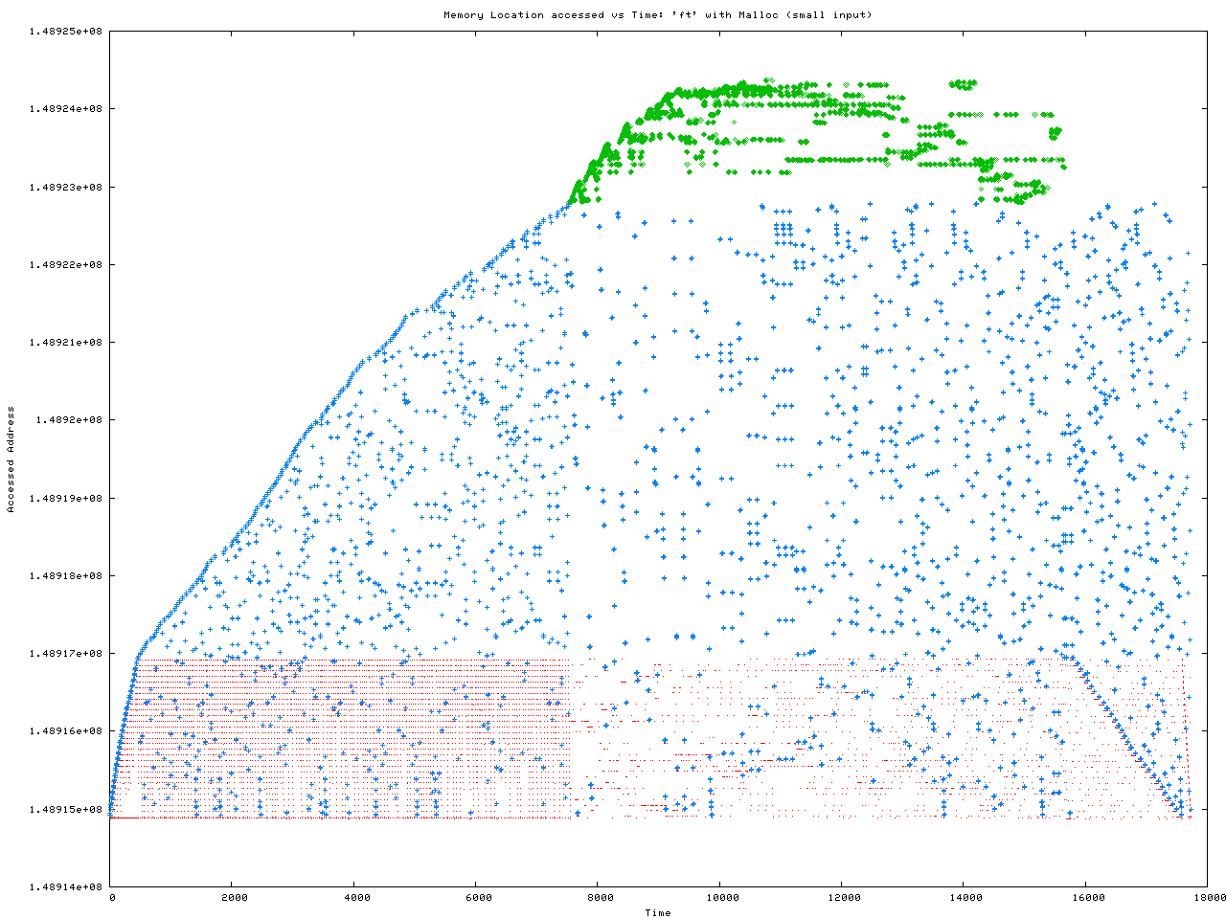
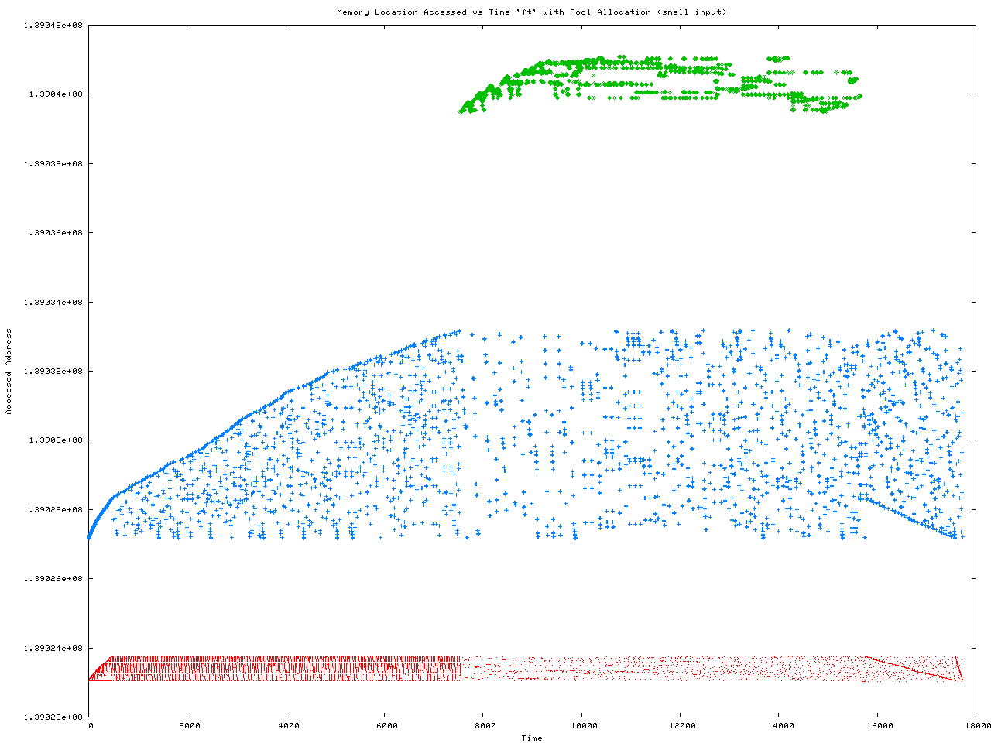
FT Access Pattern With Malloc
Heap segregation has a similar effect on FT:
  See my Ph.D. thesis for details

Slide 25
Related Work
Heuristic-based collocation & layout
  Requires programmer annotations or GC
  Does not segregate based on data structures
  Not rigorous enough for follow-on compiler transforms
Region-based mem management for Java/ML
  Focused on replacing GC, not on performance
  Does not handle weakly-typed languages like C/C++
  Focus on careful placement of region create/destroy
Complementary techniques:
  Escape analysis-based stack allocation
  Intra-node structure field reordering, etc

Slide 26
Pool Allocation Conclusion
  Goal of this paper: Memory Hierarchy Performance
Two key ideas:
Segregate heap based on points-to graph
  Give compiler some control over layout
  Give compiler information about locality
  Context-sensitive ⇒ segregate rds instances
Optimize pools based on per-pool properties
  Very simple (but useful) optimizations proposed here
  Optimizations could be applied to other systems
http://llvm.cs.uiuc.edu/

Slide 27
How can you use Pool Allocation?
We have also used it for:
  Node collocation & several refinements (this paper)
  Memory safety via homogeneous pools [TECS 2005]
  64-bit to 32-bit Pointer compression [MSP 2005]
Segregating data structures could help in:
  Checkpointing
  Memory compression
  Region-based garbage collection
  Debugging & Visualization
  More novel optimizations
http://llvm.cs.uiuc.edu/

