Slide 1
A Virtual Instruction Set Interface for Operating System Kernels
John Criswell, Brent Monroe, Vikram Adve
University of Illinois at Urbana-Champaign

Slide 2
Outline
Motivation
LLVA-OS Design
  Hardware Control
  State Manipulation
Preliminary Performance Results

Slide 3
Motivation
OS/Hardware interface is non-standard & often machine code
  Difficult to analyze OS
    difficult to infer all control flow information
    some type information lost
    no ability to track virtual memory map changes
  Difficult to adapt OS
    memory safety transforms (SAFECode)
    changes in processor instruction set
  Difficult for hardware to infer OS behavior
    context switching

Slide 4
Motivation
Solution: decouple program representation (Virtual ISA) from hardware control (Native ISA)
Execution Engine translates between Virtual ISA and Native ISA
Virtual ISA design aids software analysis and transformation
Software
Virtual ISA
Hardware
Execution Engine
Native ISA

Slide 5
LLVA Code Example [MICRO 03, CGO 04]
/* C Source Code */
int SumArray(int Array[],
int Num)
{
int i, sum = 0;
for (i = 0; i < Num; ++i)
sum += Array[i];
return sum;
}
;; LLVA Translated Code
int %SumArray(int* %Array, int %Num)
{
bb1:
%cond = setgt int %Num, 0
br bool %cond, label %bb2, label %bb3
bb2:
%sum0 = phi int [%tmp10, %bb2], [0, %bb1]
%i0 = phi int [%inc, %bb2], [0, %bb1]
%tmp7 = cast int %i0 to long
%tmp8 = getelementptr int* %Array, long %tmp7
%tmp9 = load int* %tmp8
%tmp10 = add int %tmp9, %sum0
%inc = add int %i0, 1
%cond2 = setlt int %inc, %Num
br bool %cond2, label %bb2, label %bb3
bb3:
%sum1 = phi int [0, %bb1], [%tmp10,%bb2]
ret int %sum1
}
Architecture-neutral
Low-level operations
SSA representation
Strictly-typed
High-level semantic info

Slide 6
LLVA-OS: Extend LLVA to OS Kernels
Kernels require new functionality
  Hardware Control
    I/O
    MMU
  State Manipulation
    context switching

Slide 7
Outline
Motivation
LLVA-OS Design
  Hardware Control
  State Manipulation
Preliminary Performance Results

Slide 8
Hardware Control
Registration functions
  void llva_register_syscall (int number, int (*f)(…))
  void llva_register_interrupt (int number, int (*f)(void * icontext))
  void llva_register_exception (int number, int (*f)(void * icontext))
I/O
  int llva_io_read (void * ioaddress)
  void llva_io_write (void * ioaddress, int value)
Memory Management
  void llva_load_pgtable (void * table)
  void * llva_save_pgtable ()

Slide 9
Outline
Motivation
LLVA-OS Design
  Hardware Control
  State Manipulation
Preliminary Performance Results

Slide 10
Virtual and Native State
Virtual State
  Virtual Registers
  Program Counter
  Privilege Mode
  Interrupt Flag
  Stack Pointer
  MMU State
Native State
  General Purpose Registers
  Control Registers
  MMU Registers

Slide 11
Challenges with Virtual State
Mapping between virtual state and native state changes over short time intervals, requiring a large mapping structure
Manipulating virtual state is cumbersome
  Many virtual registers per function
  Many virtual registers are dead

Slide 12
State Saving/Restoring Instructions
Solution: Expose existence of native state
Define native state based on correlation to virtual state
  integer state
  floating point (FP) state
Instructions
  void llva_save_integer (void * buffer)
  void llva_load_integer (void * buffer)
  void llva_save_fp (void * buffer, bool save_always)
  void llva_load_fp (void * buffer)

Slide 13
Interrupted Program State
Execution Engine must save program state when entering the OS
Problem: Want to minimize the amount of state saved
  No need to save FP state
  How do we use low latency interrupt facilities
    shadow registers (e.g. ARM)
    register windows (e.g. SPARC)

Slide 14
Solution: Interrupt Context
Processor
Kernel Stack
Definition: Reserved space on kernel stack
Conceptually: the saved Integer State of the interrupted program
On interrupt, Execution Engine saves subset of Integer State on the kernel stack
Can leave state in registers if kernel does not overwrite it
Kernel can convert Interrupt Context to/from Integer State
Pointer to Interrupt Context passed to system call, interrupt, and trap handlers
ControlReg 1:
0xC025E525
ControlReg 1:
0xC025E525
ControlReg 2:
0x4EF23465
ControlReg 2:
0x4EF23465
GPR 1:
0xBEEF0000
GPR 1:
0xBEEF0000
GPR N:
0x00000000
GPR N:
0x00000000

Slide 15
Manipulating Interrupt Context
Push function frames
  void llva_ipush_function (void * icontext,
  void (*f)(…), …)
Interrupt Context Integer State
  void llva_icontext_save (void * icontext,
  void * buffer
  void llva_icontext_load (void * icontext,
  void * buffer)

Slide 16
Example: Signal Handler Dispatch
User Space
Kernel Space
Save program state with llva_icontext_save()
Save FP state with llva_save_fp()
Push new function frame on to program stack with llva_ipush_function()
Stack
Stack
Function 1
Interrupt Context
Signal
Handler
Trap Handler
Heap
Processor
FP Registers
Other Registers

Slide 17
Outline
Motivation
LLVA-OS Design
  Hardware Control
  State Manipulation
Preliminary Performance Results

Slide 18
LLVA-OS Prototype
LLVA-OS
  C and i386 assembly code for Pentium 3
  Compiled to native code library ahead of time
  Some instructions inlined through header files
Linux 2.4.22 port to LLVA-OS
  Like a port to a new architecture
  Inline assembly replaced with LLVA-OS instructions
  Compiled with GCC and linked with LLVA-OS library

Slide 19
Performance Evaluation
Nano- and micro-benchmarks
  Based on HBench-OS benchmark suite
  Run for 100 iterations
  Identify overheads in key kernel operations
Macro-benchmarks
  Determine impact of overheads on real application loads

Slide 20
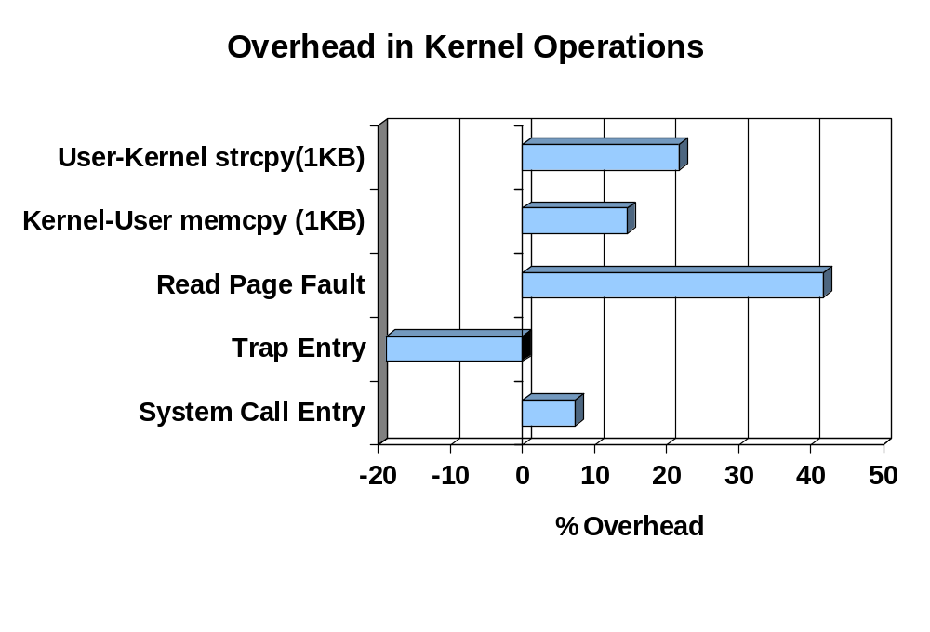
Nanobenchmarks

Slide 21
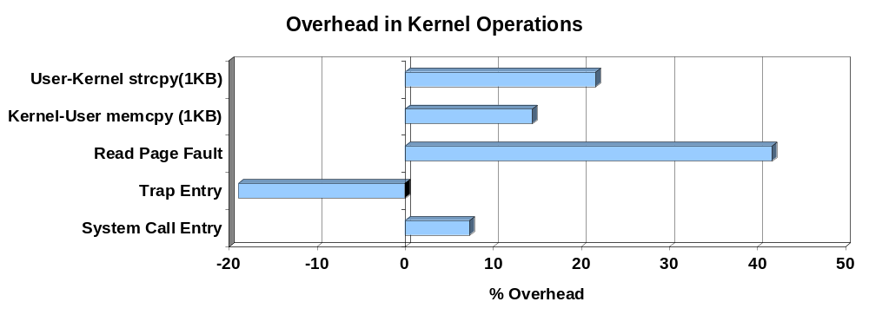
Nanobenchmarks
Absolute increase in page fault latency is very small
User-Kernel strcpy overhead due to inefficient strcpy routine
Trap entry is faster (no VM86 mode)

Slide 22
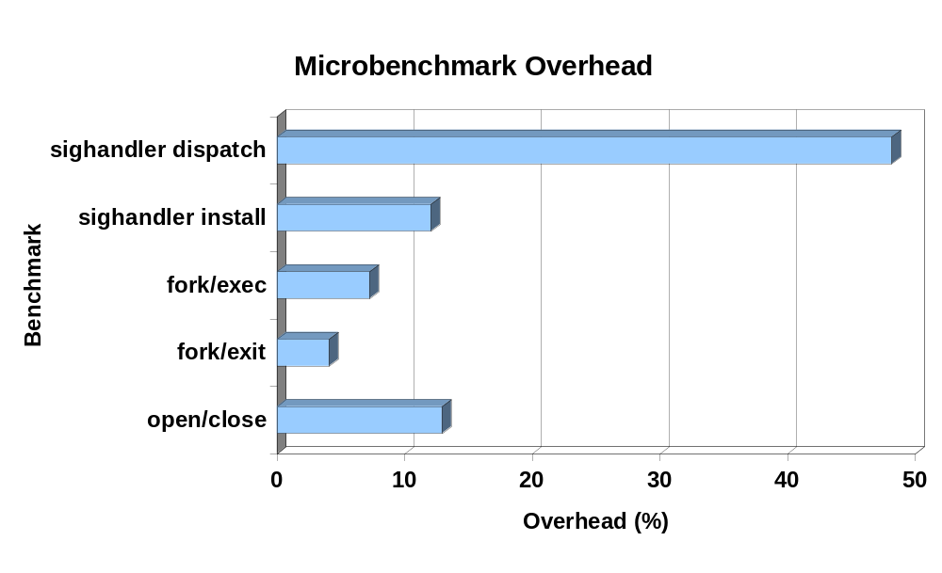
Microbenchmarks

Slide 23
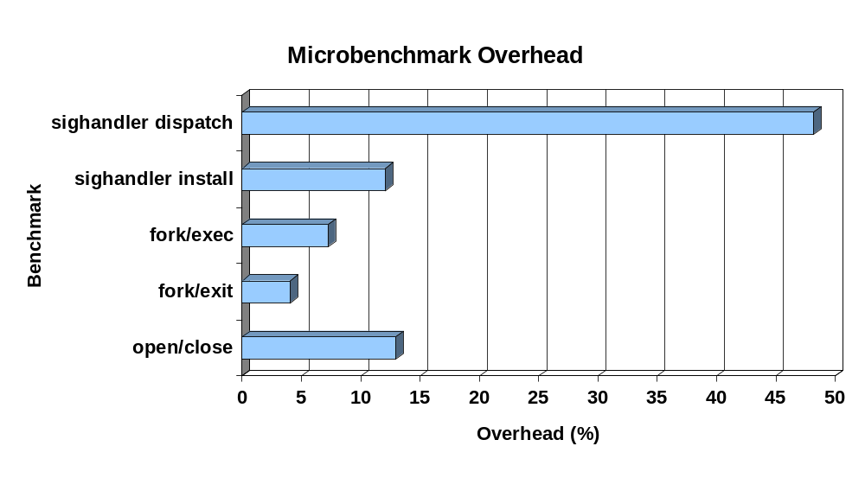
Microbenchmarks
Signal Handler Dispatch overhead due to extraneous FP state loading on sigreturn()
Open/Close has user to kernel strncpy() overhead

Slide 24
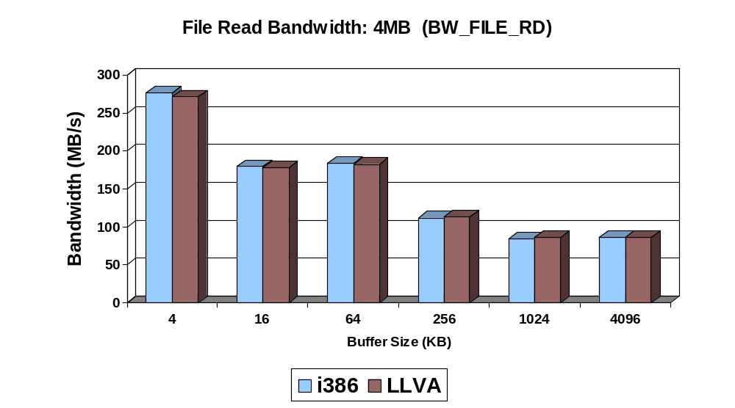
Microbenchmarks: Filesystem

Slide 25
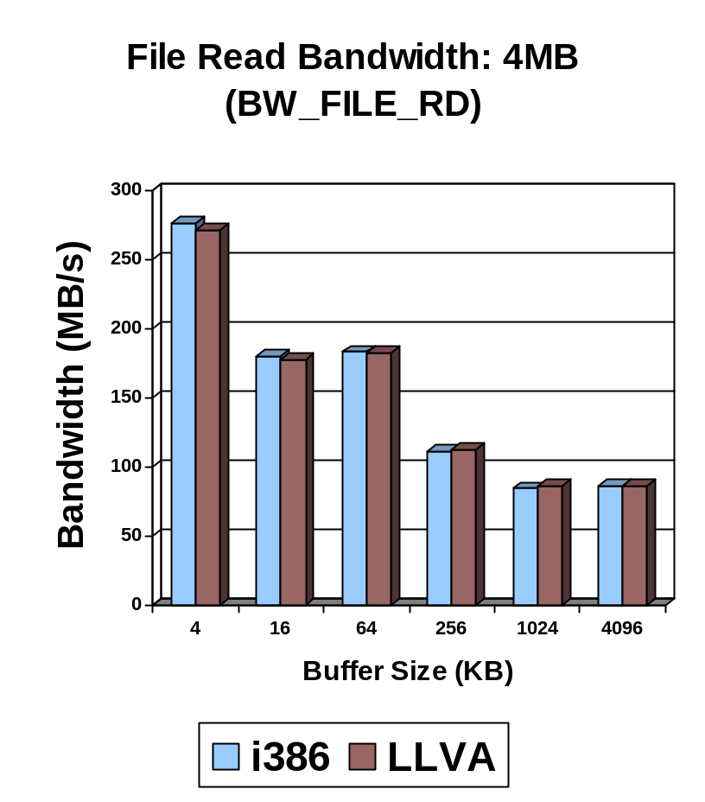
Microbenchmarks: Filesystem
Maximum overhead is 2%
Benchmark reads file using repeated read() calls
No I/O overhead (file in buffer cache)

Slide 26
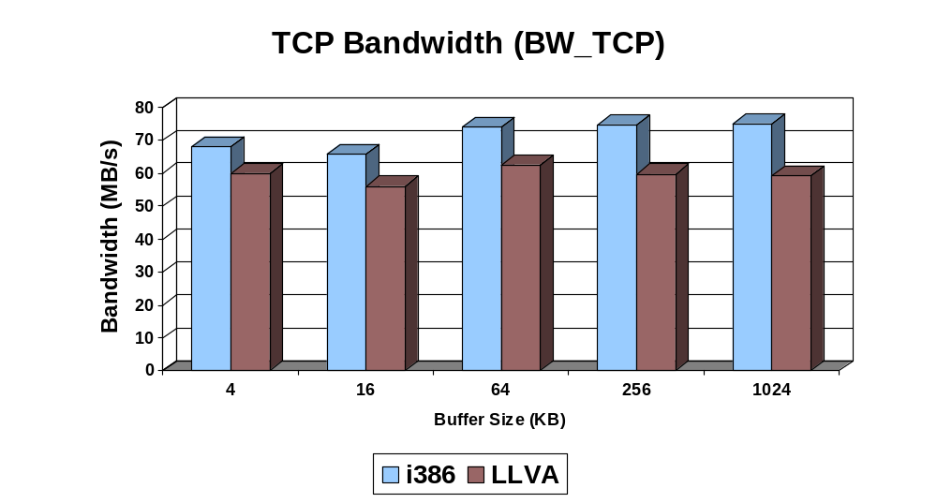
Microbenchmarks: TCP

Slide 27
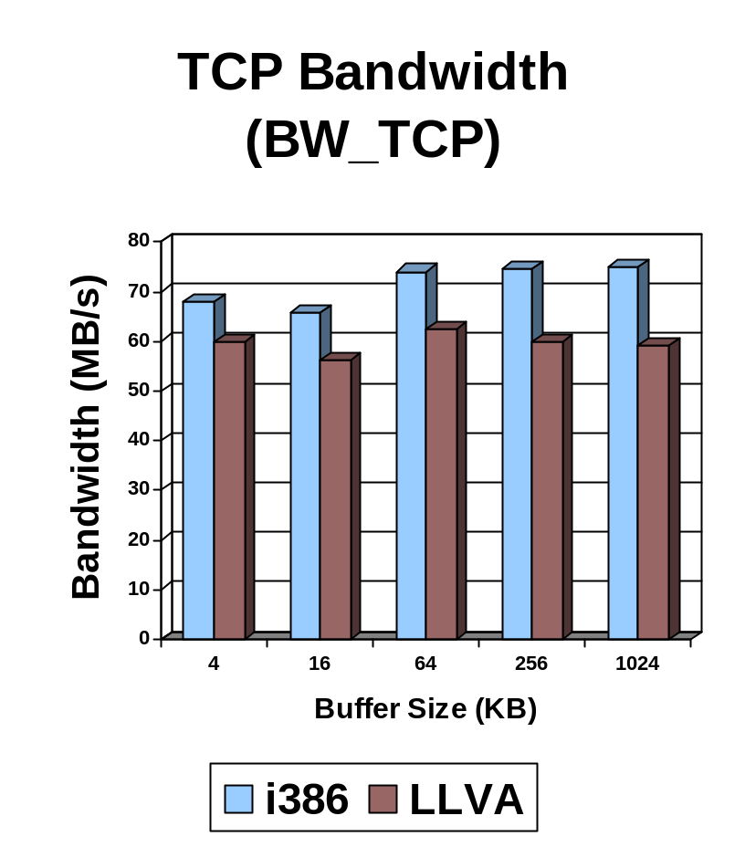
Microbenchmarks: TCP
Maximum overhead is 21%
Server process reads at least 10 MB from client process

Slide 28
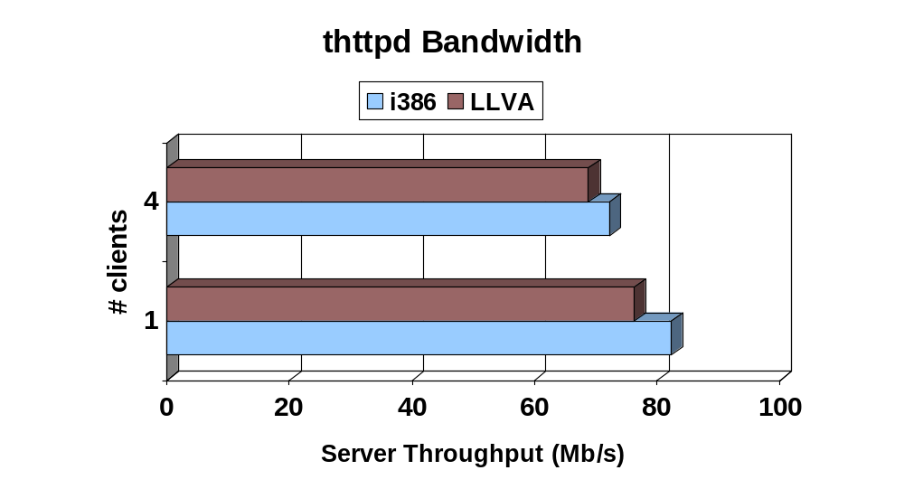
Performance: Macrobenchmarks

Slide 29
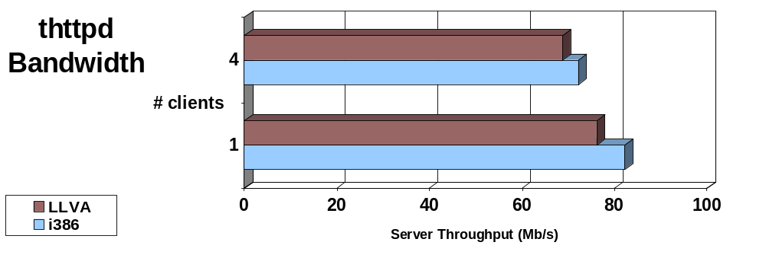
Performance: Macrobenchmarks
WebStone: standard workload
Less than 8% overhead to thttpd

Slide 30
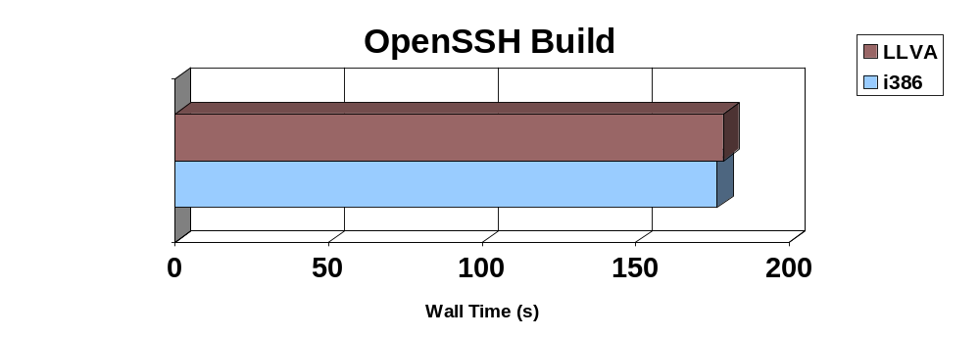
Performance: Macrobenchmarks
1.01% overhead
Primarily CPU bound process

Slide 31
Future Work
Performance tuning of LLVA-OS implementation
Framework for providing additional security
  Memory safety for OS kernel
  Protect application memory from kernel
  Translator enforced system call policies
  Install time privilege bracketing

Slide 32
Acknowledgements
Pierre Salverda
David Raila
LLVM Developers, past and present
The Reviewers
And all the others who gave us feedback and input

Slide 33
Summary
LLVA-OS uses novel approaches to virtualize state manipulation
More tuning to the implementation is necessary but possible
Linux on LLVA-OS
  No assembly code
  Many compiler opportunities

