Slide 1
Subreddit Classifier: Movie vs Music
Lionel lwamba

Slide 2


Why is this important?
Problem: Online communities are flooded with content. Effective classification is important for users to find what interests them.
Goal: Build an NLP model to automatically categorize Reddit posts as "Movies" or "Music."

Slide 3
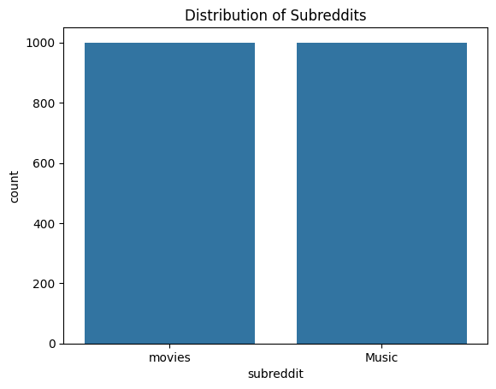
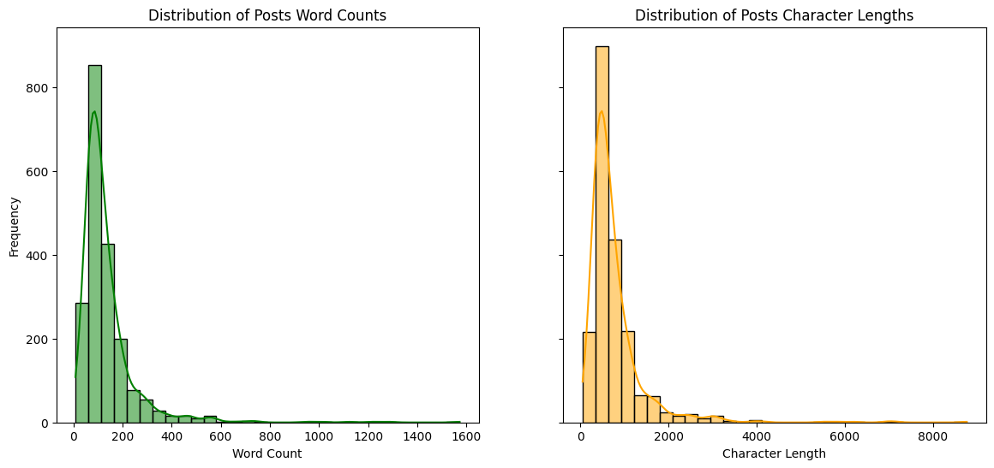
DATA EXPLORATION
Scraped 2000 Reddit post
Main Features: Title and Self-Text
Remove duplicates, and collect data with Title and Self-Text not empty
Label: Music-0, Movies-1
Post Character Length Median: 769
Post Word Count Standard Deviation: 708
Post Word Count Mean: 135
Word Count Standard Deviation: 126

Slide 4
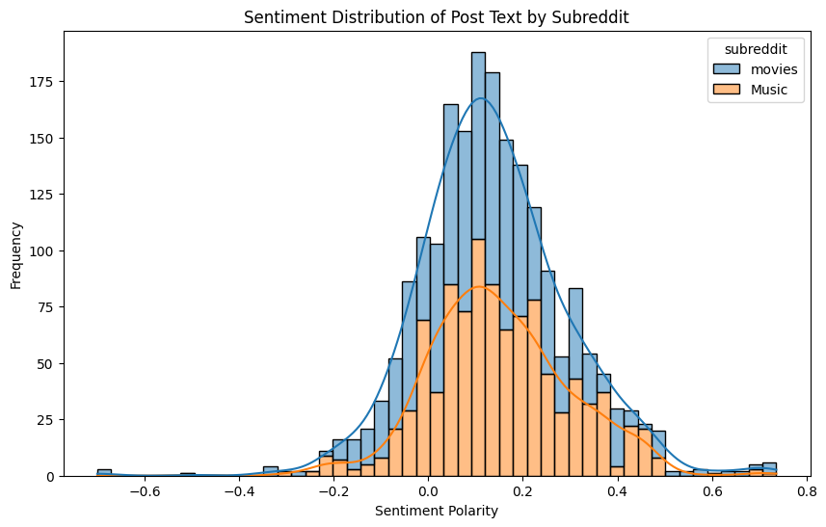
Exploring Sentiment and Topics on Reddit
Analyze sentiment polarity in movie and music posts on Reddit.
Most data falls within -.2 and .5
Neutral to slightly positive sentiment

Slide 5
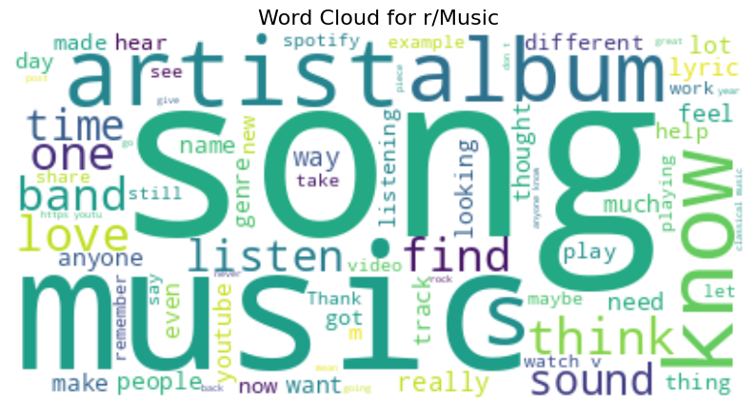
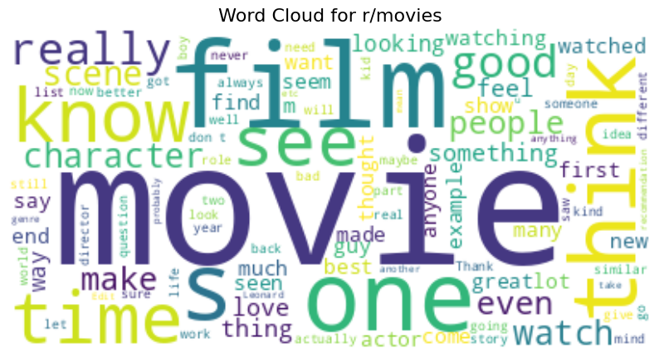
Word Clouds for Subreddits
Visual representation of most frequent words in movies and music subreddits
Size of each word reflects its frequency in the text data

Slide 6
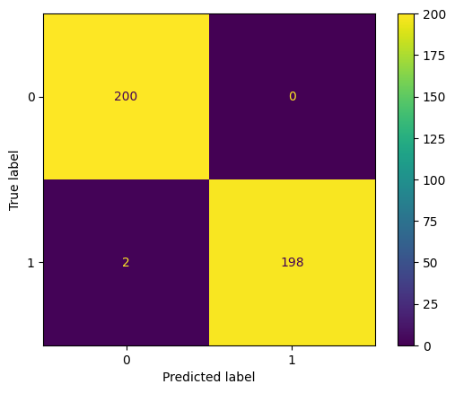

CountVectorizer + XGBoostClassifier
Model evaluation
CountVectorizer + Logistic Regression

Slide 7
Model comparison
Model | Training Score | Testing Score
Logistic Regression + Counvectorizer | 1 | .99
Logistic Regression + TfidfVectorizer | 1 | .99
Multinomial Naïve Bayes + Counvectorizer | .99 | .98
Multinomial Naïve Bayes + TfidfVectorizer | .99 | .98
XGBoost + CountVectorizer | 1 | 1
Baseline Model : .5
Most models shows good generalization on train and test sets
Models have higher accuracy, and some is slightly overfitting

Slide 8
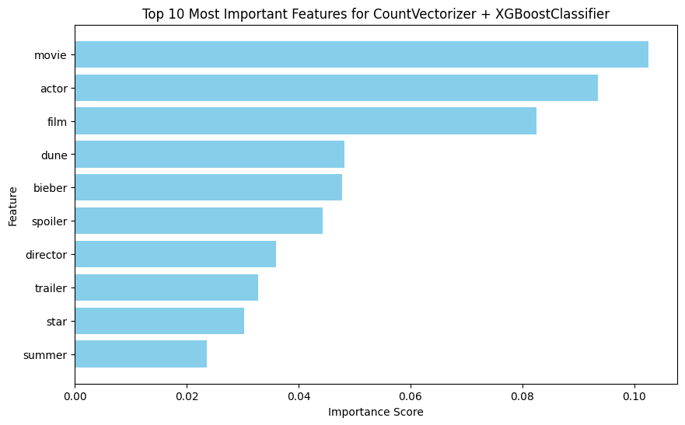
FEATURE IMPORTANCE CountVectorizer + XGBoost Classifier

Slide 9
CONCLUSION
Built NLP models to classify Reddit posts ("Movies" or "Music")
All the models achieved a high accuracy on the training and test set between .98 and 1.00)
XGBoost Classifier had higher score on train and test set.
For future improvement Larger & More Diverse Dataset

Slide 10
THANK YOU
https://www.reddit.com/

