Slide 1
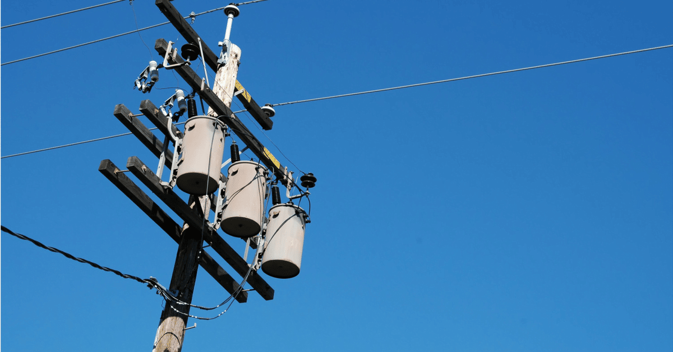
CAPSTONE PROJECT:
Energy Consumption Forecasting
LIONEL LWAMBA

Slide 2
Problem Statement
Challenge: Accurately predicting future energy consumption is very important for utilities, and could also be important for households
Impact:
a. Matches power supply to household or consumers demand
b. Predicting use helps utilities avoid waste, potentially lowering your electricity bill.
c. By predicting peak usage, utilities can prevent outages and ensure reliable electricity

Slide 3
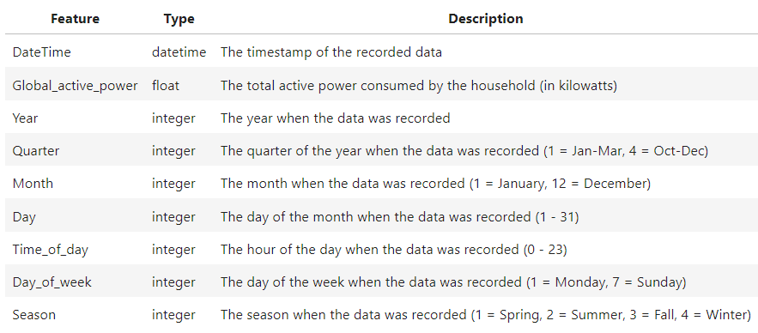
DATA SOURCE & CLEANING
Data Source: "Individual household electric power consumption" dataset downloaded from the UCI Machine Learning Repository.
Data gathered in a city neared Paris, France between December 2006 and November 2010 (47 months)
Converted data types to numerical and DateTime
1.25% missing data that was dropped
Resampled data from minutes to hourly
Featured Engineering for further analysis

Slide 4
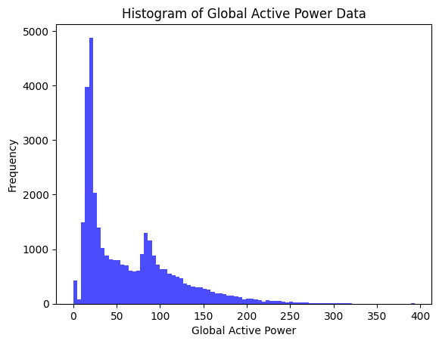
Exploratory Data Analysis (EDA)
Global active power is the total amount of electrical power consumed over a given period of time.
Global active power is not normally distributed

Slide 5
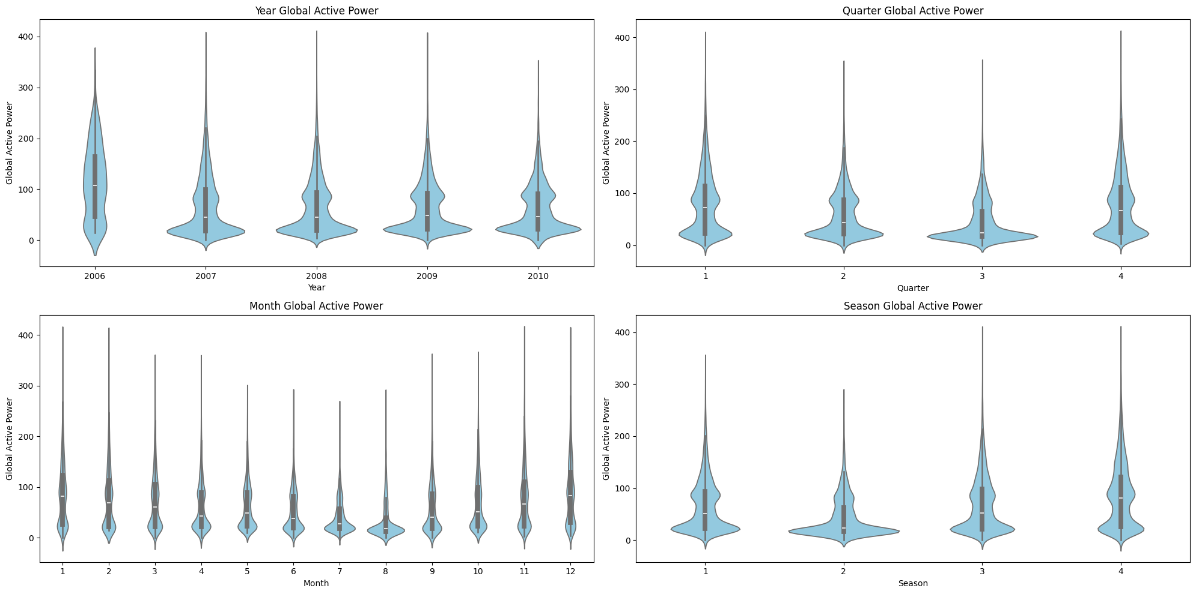
Exploratory Data Analysis (EDA)
Data transformed using feature engineering

Slide 6
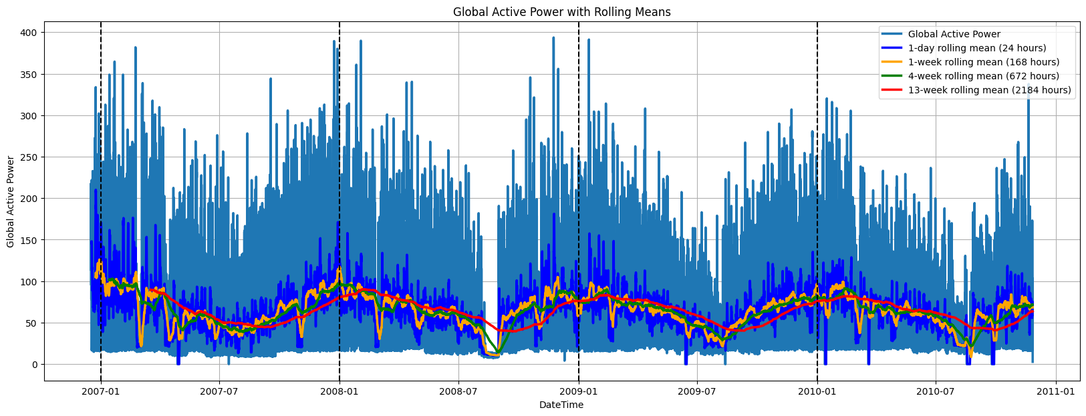
Active Power Consumption WITH ROLLING MEANS

Slide 7
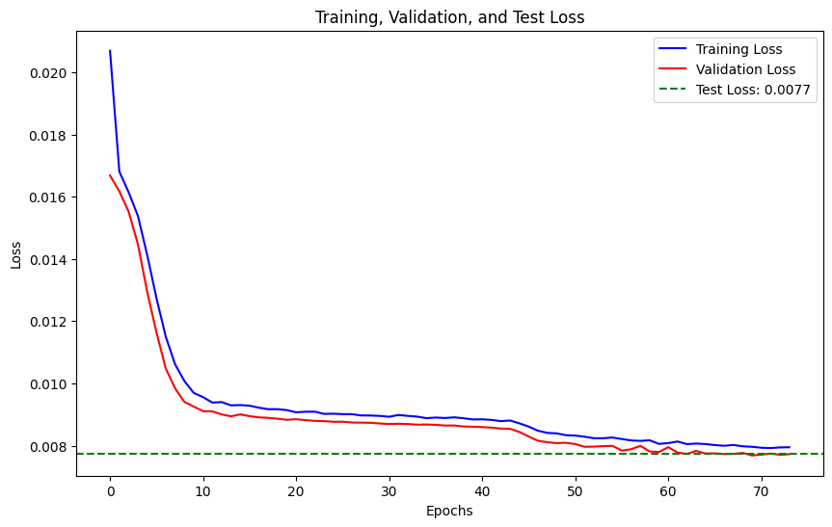
LSTM Model Development
Train LSTM architectures using historical energy consumption data
optimize with techniques like dropout and early stopping.
Evaluate model performance (MAE, MSE) on training and testing data

Slide 8
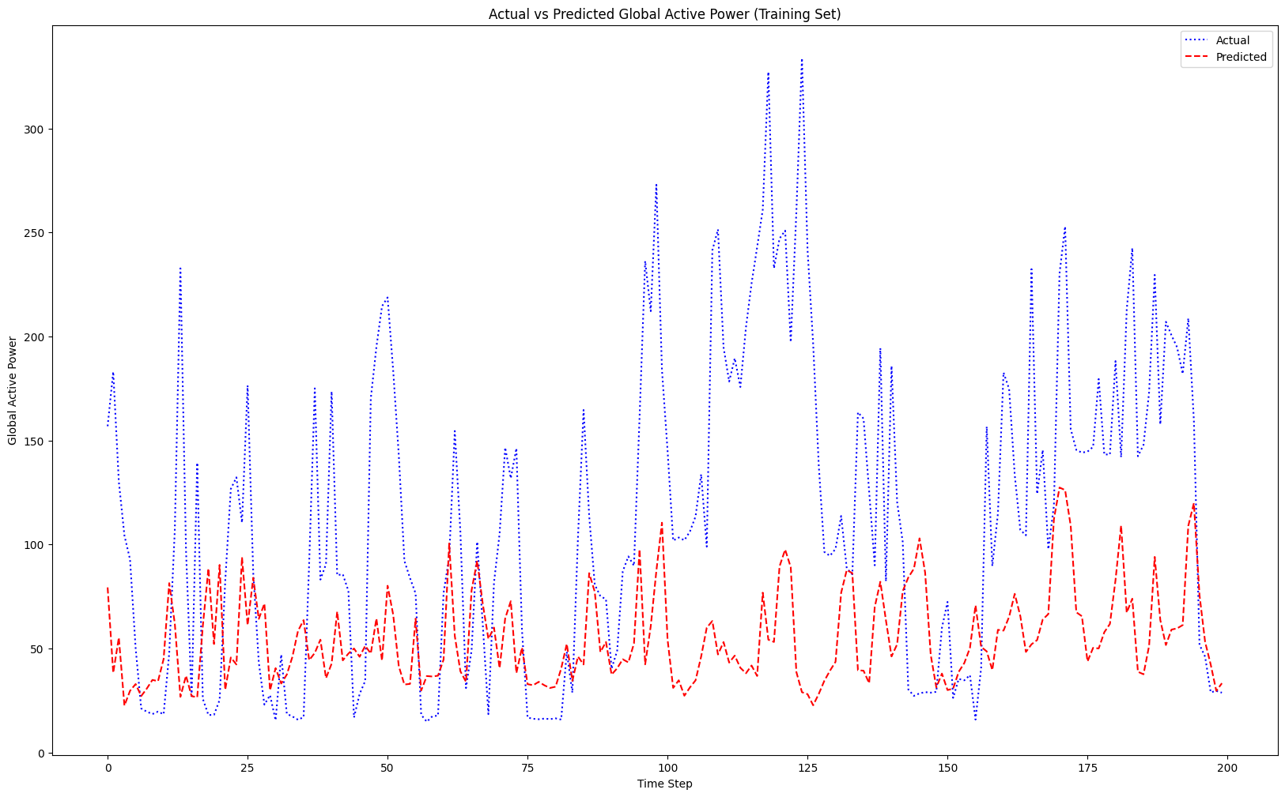
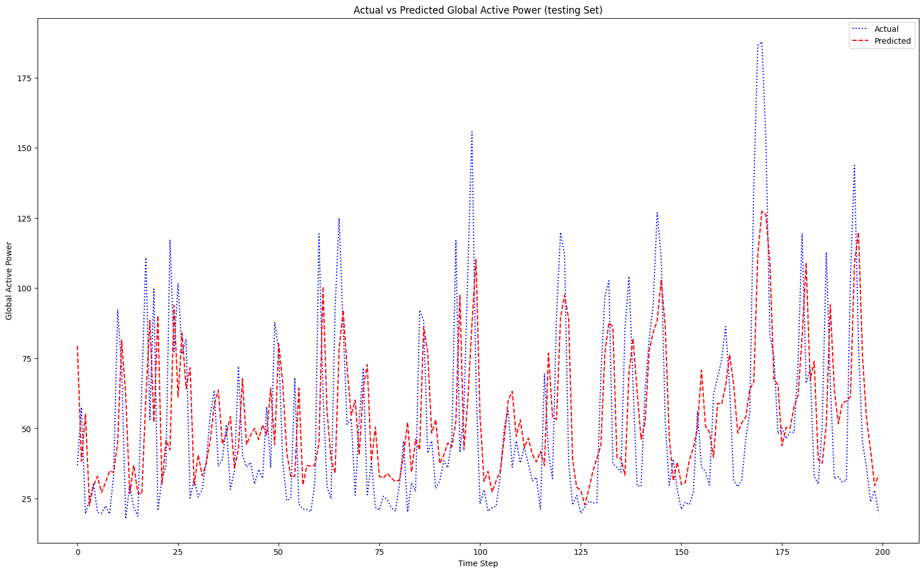
LSTM Model actual vs prediction

Slide 9
MODEL COMPARISON
LSTM Model:
MAE-Train: 25.26, & Test: 20.90
MSE-Train: 1274.81, & Test: 856.86
Consistent performance on training and test data suggests good generalization.
ARIMA (2,0,2):
Training MSE: 1445.72
Test MSE: 2155.50
Higher test error indicates overfitting to training data.
ARIMA (52,0,1):
Training MSE: 1253.20
Test MSE: 2141.75
Slightly better than (2,0,2) but still shows overfitting.

Slide 10
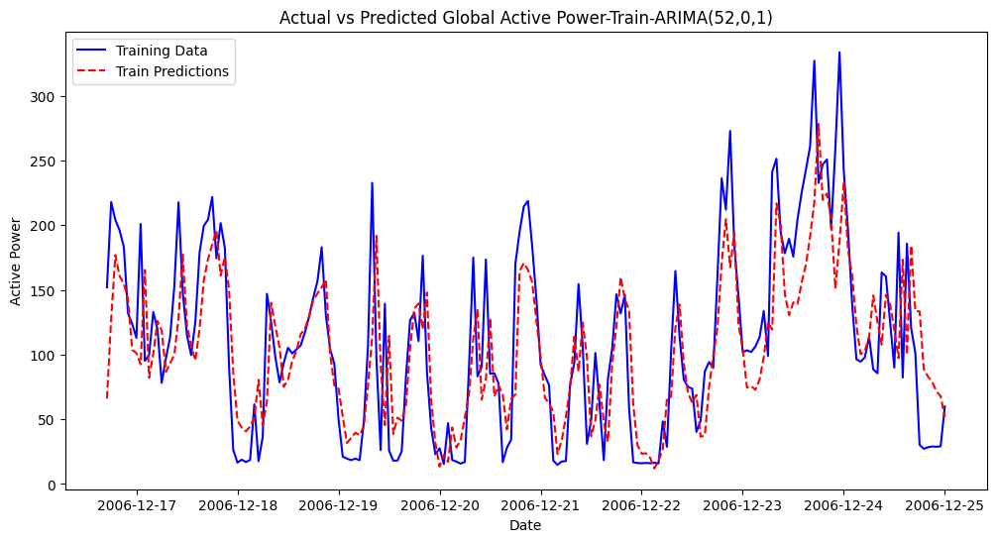
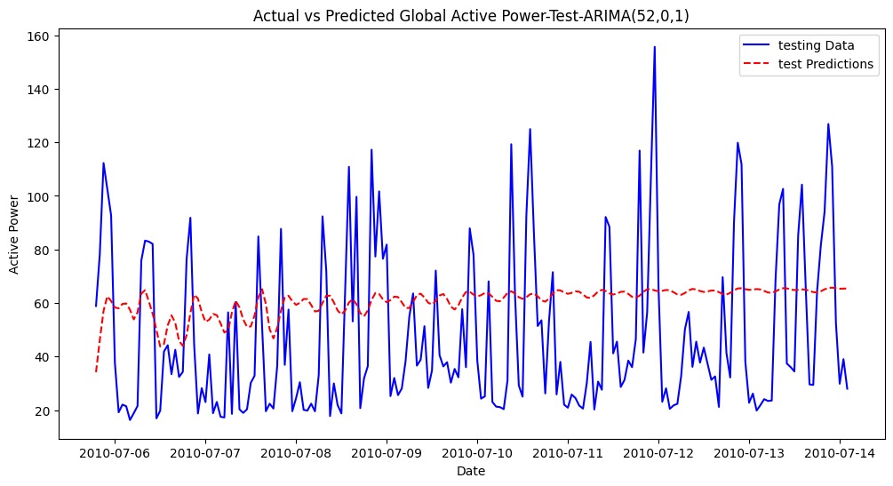
ARIMA MODEL(52,0,1) actual vs prediction

Slide 11
CONCLUSION & RECOMMENDATIONS
LSTM model outperforms ARIMA in forecasting energy consumption.
Continuously update and refine the model with additional data sources for improved accuracy
Larger timeframe evaluation

Slide 12

Thank you
References:
Individual Household Electric Power Consumption. UCI Machine Learning Repository. Hebrail, Georges & Berard, Alice. (2012). Individual Household Electric Power Consumption. UCI Machine Learning Repository. DOI: https://doi.org/10.24432/C58K54

