Slide 1


The Influence Gap
Why Followers and Engagement Don't Reliably Predict Behavior
Platforms optimize for interaction. Markets require action. The gap between the two is where performance breaks.

Slide 2
The Assumption
The industry runs on a broken proxy. Brands select creators by follower count and engagement rate. Platforms surface creators by interaction volume. The implicit logic: more engagement = more influence.
This assumption has never been validated against actual buyer behavior. It remains the default selection signal across the entire influencer economy.

Slide 3

The Problem
Engagement is a platform metric, not a market signal.
Platform Design Reality
What Brands Are Actually Buying
Platforms are engineered to maximize interaction — because interaction keeps users on-platform and drives ad revenue. That optimization loop has nothing to do with whether an audience will click, buy, or return to purchase again.
Likes that don't convert
Comments that don't signal intent
Shares that don't drive traffic
Saves that don't generate revenue
The gap isn't a measurement error. It's a design feature.
Every engagement metric you're reporting on was built to keep eyeballs on a feed — not to send money to your checkout page.

Slide 4
The Data
This analysis is built on a dataset large enough to stress-test the industry's core assumptions.
150,000
7 Categories
Influencer campaigns across TikTok, Instagram, YouTube, and Twitter
Beauty, Fashion, Food, Fitness, Travel, Tech, and Gaming
5 Campaign Types
3 Derived Fields
Product Launch, Seasonal Sale, Brand Awareness, Giveaway, Event Promotion
CTR, conversion rate, and action yield — built using HypeAuditor 2024 and Influencer Marketing Hub benchmarks
Engineered fields were derived using platform benchmarks from HypeAuditor 2024 and Influencer Marketing Hub 2024, providing a standardized basis for cross-platform behavioral comparison.

Slide 5

The Framework
Four independently meaningful dimensions of creator power — each measuring a different layer of audience behavior.
Reach Power
Interaction Power
How many people could realistically see this content? Raw potential audience exposure — the top of the funnel.
Did the audience respond? Likes, comments, shares — the platform layer. Valuable, but not the whole story.
Action Power
Retention Power
Did the audience do something in the market? Clicks, purchases, sign-ups — the signal that actually moves revenue.
Did the behavior repeat? Compounding loyalty is the rarest and most valuable creator attribute in the market.

Slide 6
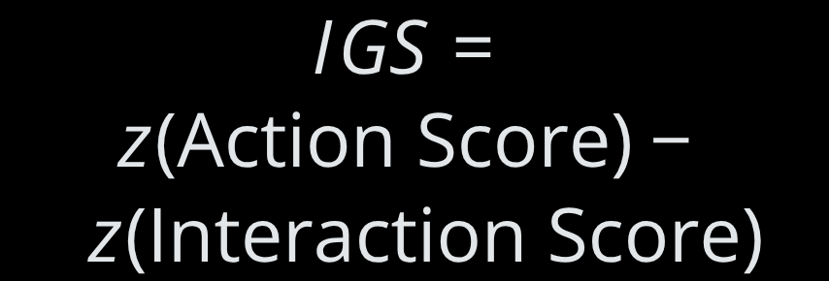

The Influence Gap Score
The Formula
What IGS Tells You
Positive IGS
Negative IGS
Action outpaces engagement. The creator converts more than their interaction metrics predict. Underpriced.
Engagement outpaces action. The audience performs for the platform, not the brand. Engagement theater.
Standardized scores allow cross-platform, cross-category comparison. The delta between action and interaction is the gap — made visible and measurable.
IGS is not a ranking. It is a diagnostic. It makes the mismatch visible.

Slide 7
The Archetypes
Seven creator segments defined by IGS and behavioral pattern — each requiring a fundamentally different strategy.
Ghost Amplifier
Engagement Trap
Quiet Converter
Spike Artist
High reach, zero resonance
High interaction, no conversion
Low engagement, high conversion. Most underpriced creator in the market.
Viral moments, no repeatability
Platform Native
Loyalty Engine
Full-Funnel Creator
Optimized for the feed, not the funnel
Consistent, compounding audience value
Rare. Performs across all four dimensions.

Slide 8
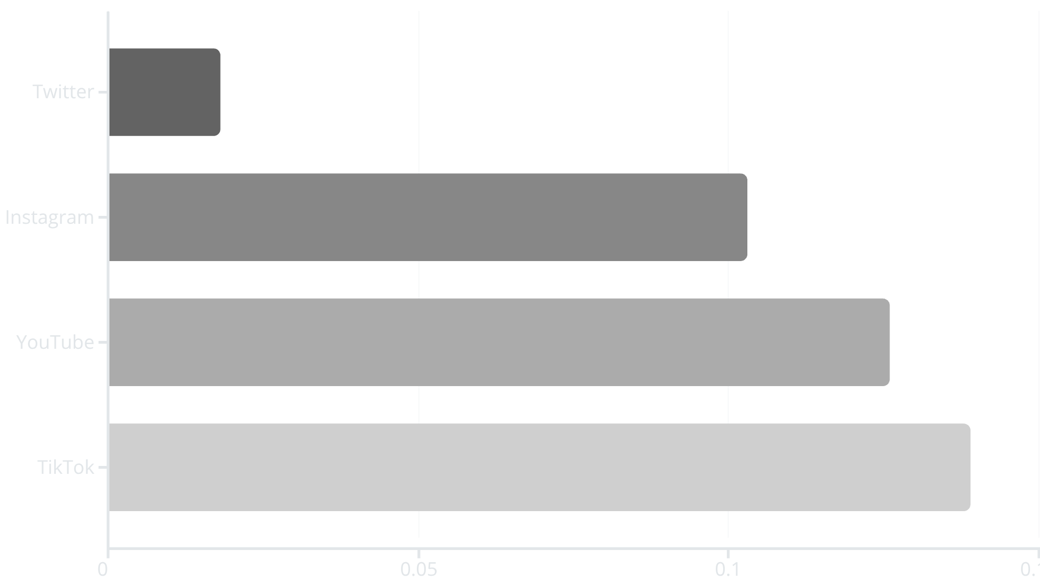

The Evidence: Decoupling
Pearson correlation between engagement rate and conversion rate — measured across 150,000 campaigns.
Pearson r by Platform
Twitter r = 0.018
Instagram r = 0.103
YouTube r = 0.126
TikTok r = 0.139
What This Means
Engagement explains less than 2% of conversion variance on Twitter. Even TikTok — the strongest performer — explains under 2% of variance at r = 0.139.
Every brief built on engagement rate as a primary signal is built on a correlation that explains almost nothing.
The correlation is statistically real. But it is practically meaningless as a creator selection signal. You are optimizing for noise.

Slide 9
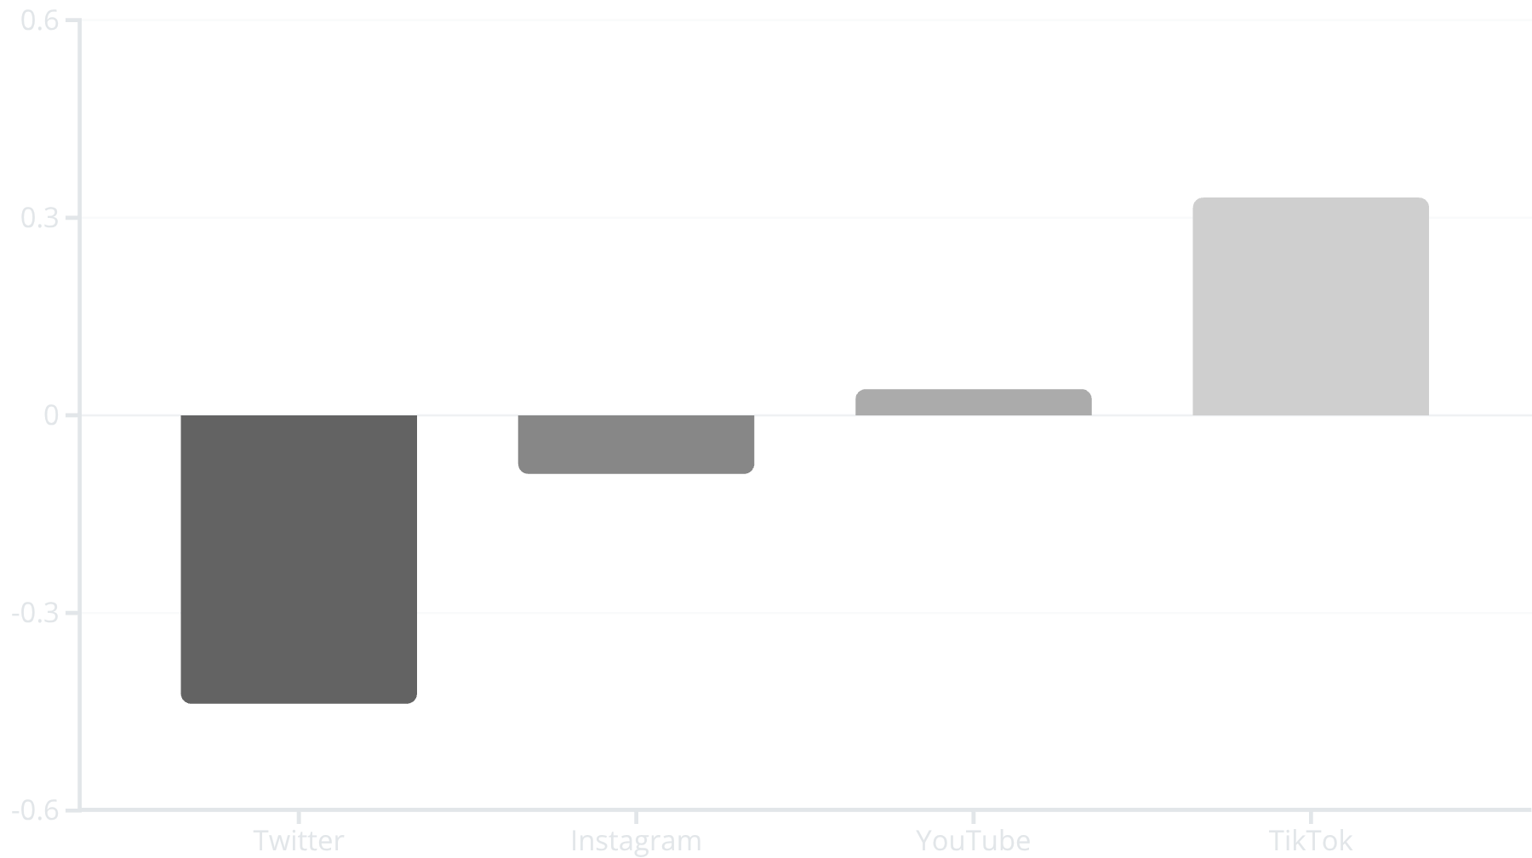
The Evidence: Platform Gap
IGS is not random — it is structurally determined by platform architecture. Different platforms produce systematically different ratios of engagement to action.
Twitter: −0.44
TikTok: +0.33
Engagement-heavy, action-light. The most overhyped platform for conversion-focused campaigns.
Action-positive. Short-form video drives behavior at a rate engagement metrics don't predict.
The gap is structural — a product of platform architecture, not creator quality. Creators don't fail platforms. Platforms fail brands.

Slide 10
The Money Slide
Same budget. Radically different outcomes. This is not a performance variance — it is a selection failure.
66,942
20,072
6,203×
Avg. Engagements
Avg. Engagements
More Action
Engagement Trap creator — high interaction, high cost, 4 average conversions per campaign
Quiet Converter creator — low interaction, lower cost, 807 average conversions per campaign
Quiet Converters deliver 6,203× more action per engagement unit — with 3× less raw engagement
Brands optimizing for engagement metrics are systematically overpaying for the wrong signal — and leaving measurable ROI on the table with every brief they sign.

Slide 11
The Product: InfluenceOS
Before signing a creator brief, a strategist pulls their IGS trend across their last 5 campaigns. If it’s negative and declining, they’re an Engagement Trap — regardless of what the rate card says.
A creator intelligence layer built to replace gut feel and engagement proxies with behavioral precision.
What It Does
Built For
Scores and segments creators by IGS, archetype, and behavioral trend
Updates automatically after every campaign cycle
Replaces engagement-proxy shortlisting with action-based selection
Surfaces Quiet Converters before your competitors find them
Brand Strategists
Know the difference between a Quiet Converter and an Engagement Trap before you sign the brief
Agencies
Replace vanity metric reporting with behavioral evidence your clients can act on
DTC Brands & Platforms
Allocate creator spend where action yield is proven, not assumed

Slide 12
Implications
The measurement infrastructure of influencer marketing was built for platform retention — not brand outcomes. That's the gap. And it is solvable.
For Brands
For Platforms
For the Industry
Stop buying engagement. Buy action yield. Every selection decision made on follower count or engagement rate is a bet placed on the wrong variable.
IGS as a ranking signal surfaces higher-ROI creators to brand partners — aligning platform incentives with actual advertiser outcomes.
The current measurement infrastructure optimizes for platform retention, not brand outcomes. Adopting behavioral metrics is not an upgrade — it is a correction.
The gap between engagement and action is not a bug in the data. It is the business model of every major platform. Knowing that changes everything about how you buy.

