Slide 1
Olympics Stats Analysis

Slide 2
Contents
Introduction
Question/Hypothesis/Approach
Entity Relationship Diagram (ERD)
Exploratory analysis
Deeper analysis
Hypothesis Result

Slide 3
Introduction

Slide 4

OLYMPIC GAMES
Olympics Games is a global sporting events featuring summer and winter competitions in which 1000 of athletes from around the world participate in a variety of competitions.
Olympic Games are normally held every four years, alternating between the Summer and Winter Olympics.

Slide 5
If you fail to prepare, you’ve prepared to fail.
Mark Spitz, American swimmer and 9-time Olympic medalist

Slide 6
Goal
To provide an interesting insight to the local news outlet from the 120 years of data collected by SportsStats on the Olympics Games.
Scope
The analysis will only be performed for the Summer version of the Olympics Games.

Slide 7
Question/Hypothesis/Approach

Slide 8
Questions
How the athlete's physical attributes or characteristics affect their performance at the Olympics?
a. This may help the trainer or staff to set the goal for the optimal attribute of the athlete.
b. Make the job easier for the scout to filter the athlete.
2. How the economy of the nation determine the chance of winning a medal at the Olympics?
a. This show if the external factor increase the chance of success or not.
3. Does the participation rate increase the chance of winning a medal at the Olympics?
a. To show if participation count increase the chance of success or not.

Slide 9
Initial Hypothesis
Depend on the attributes of the athlete,
a. The higher height (above 180cm for male and above 165cm for female) will probably increase the chance of success rate.
b. The lower age ( 21 to 23-year-old) will probably increase the chance of success rate.
c. The higher weight will probably increase the chance of success rate. (This is debatable depending on the sport, some sport (Sumo or wrestling) required high weigh to win)
2. The better the economy of the nation, the higher chance of success.
a. As sport required money for various reasons (facilities, medical or wages) to run, therefore, Assuming the better the country economy -> the higher the country GDP -> the wealthier the nation -> the more exposure and support the athlete gets.
3. The high participation rate increase the chance of success.

Slide 10
Data Analysis Approach
Clean Data for the summer events
Exploratory Analysis
Look around the dataset and look for interesting statistics.
Physical attributes to medal count.
GDP to medal count.
Team count to medal count.
Look for relationship for the metrics
Explain Result

Slide 11
Entity Relationship Diagram

Slide 12
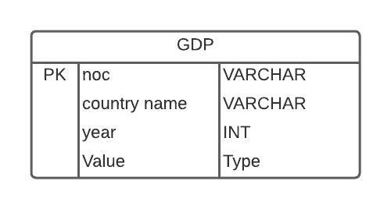
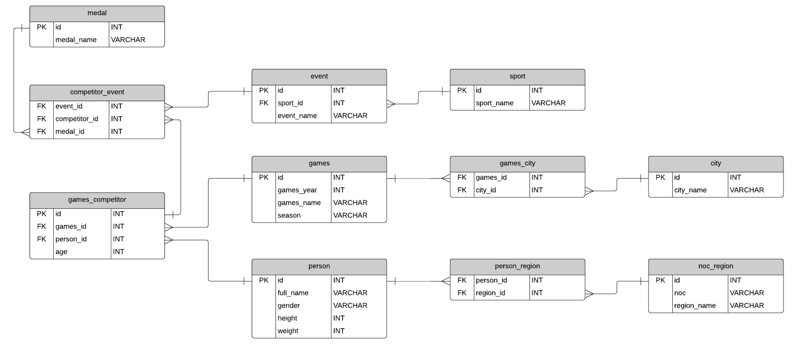
Entity Relationship Diagram
This ERD is available online and used the same dataset as ours. In addition to this dataset, I joined the GDP table with this dataset to used GDP as the wealth metric for a country.
gdp_csv.csv
Athlete_events.csv
Source: https://datahub.io/core/gdp
Source: https://www.databasestar.com/sample-database-olympic-games/

Slide 13
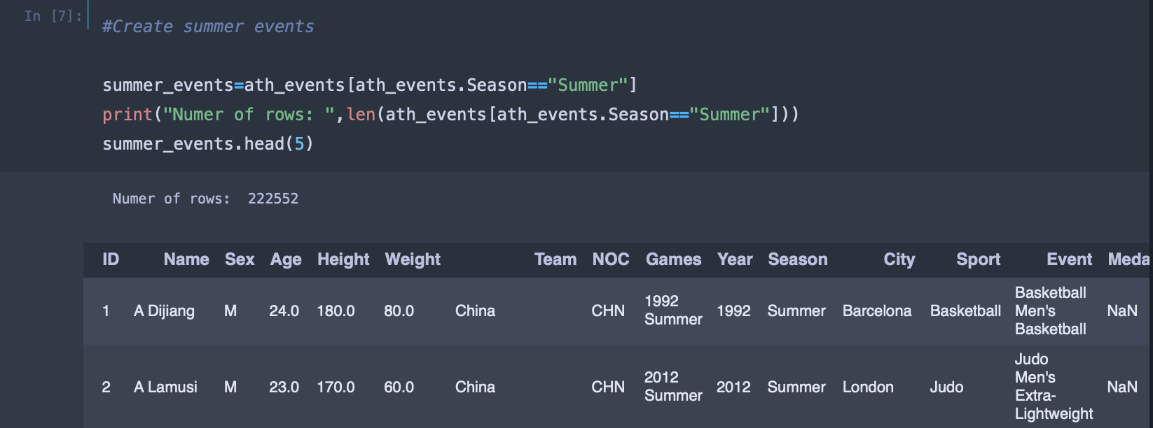
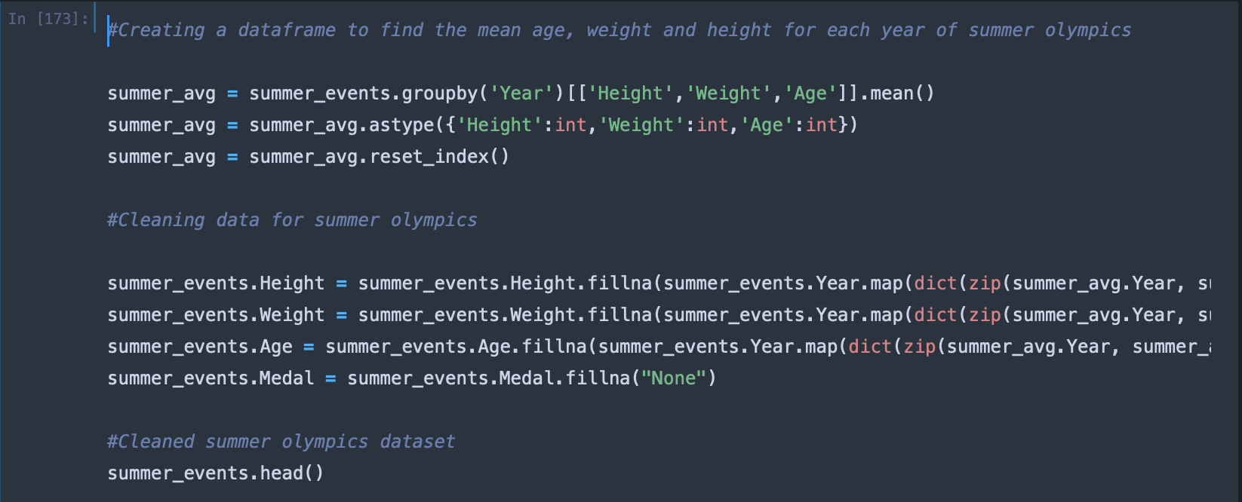
Clean Data
The data cleaning process is done using Python in jupyter notebooks.
Filter only Summer events
Change null height to the mean height of other athlete in that specific year.
Do the same for age and weight.
Fill null medal with “None”

Slide 14
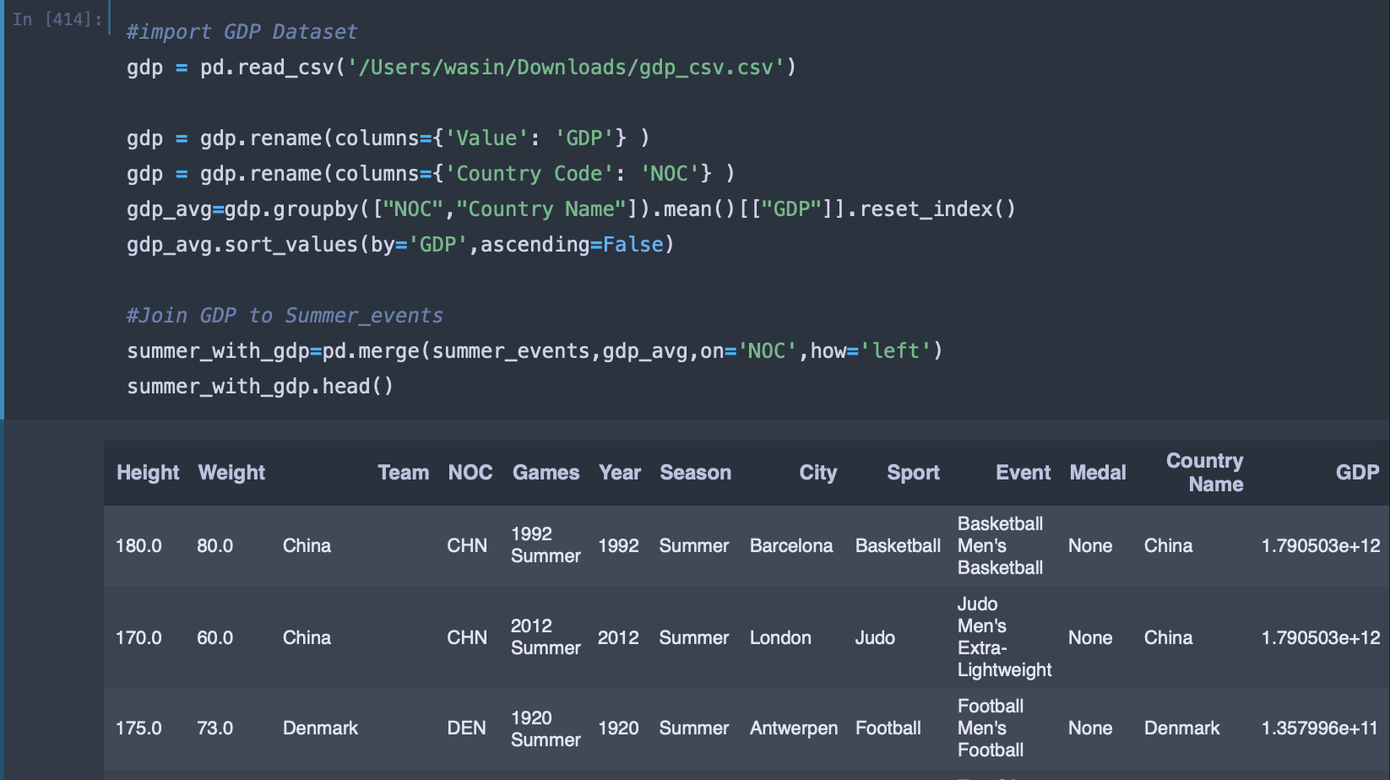
Clean Data (Cont.)
Import and clean GDP dataset
Join both dataset

Slide 15
Exploratory Analysis

Slide 16
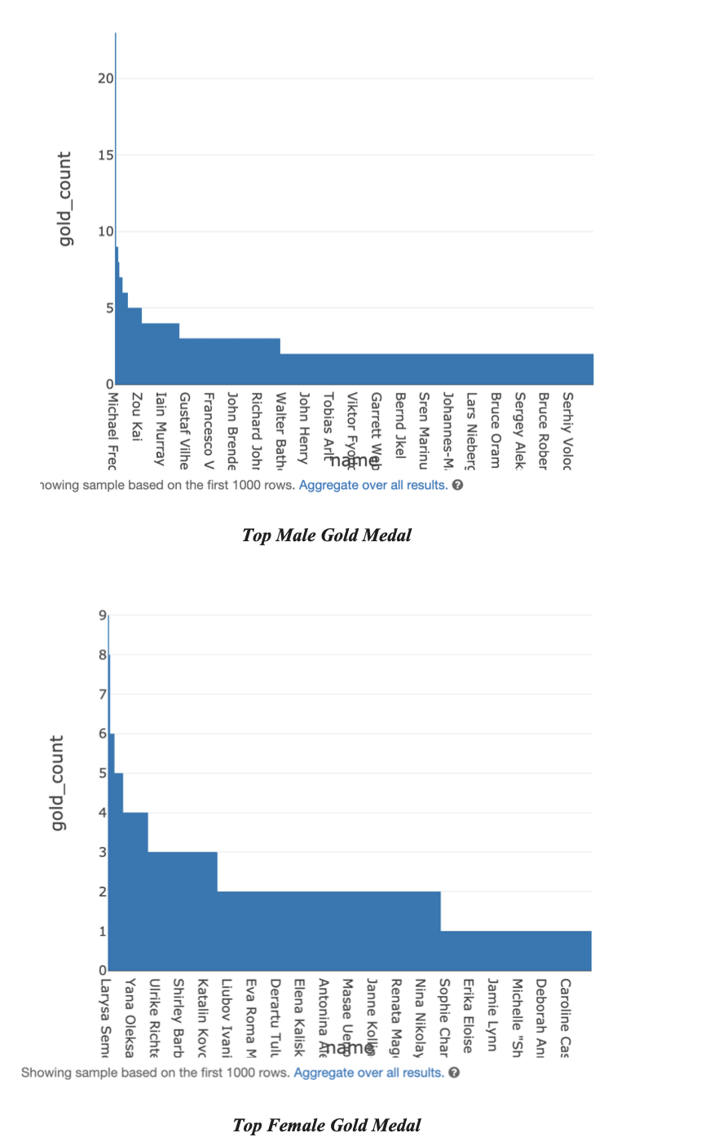
Exploratory Analysis
Looking at all the Gold medal earners in the last 120 years of Olympics. Michael Phelps of USA seems to lead by some margins.

Slide 17
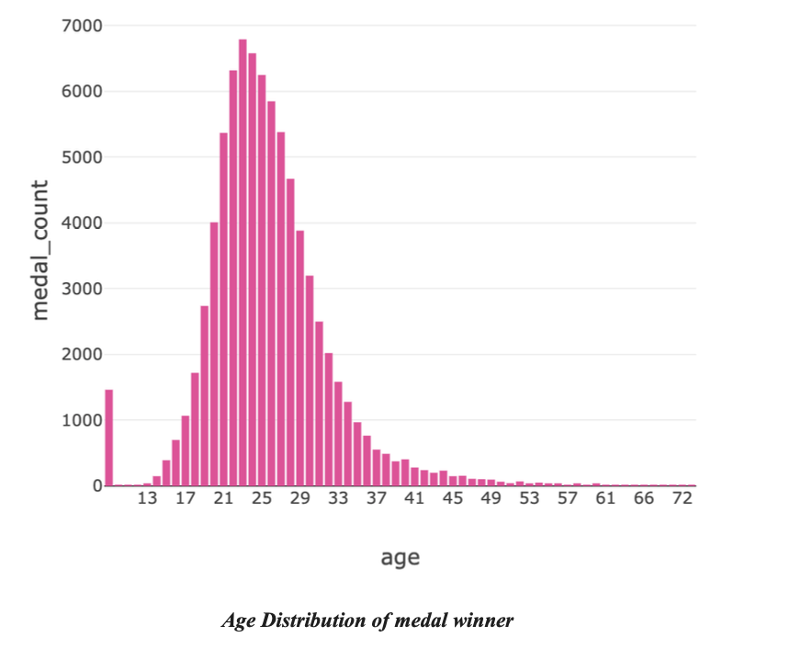
Exploratory Analysis (Cont.)
Looking at the age distribution of all the medal winner, it seems that the peaks years seems to be around 23 to 26 years. Therefore, the initial hypothesis is close but still short by a few years as the medal count still increases after 23-year-old.

Slide 18
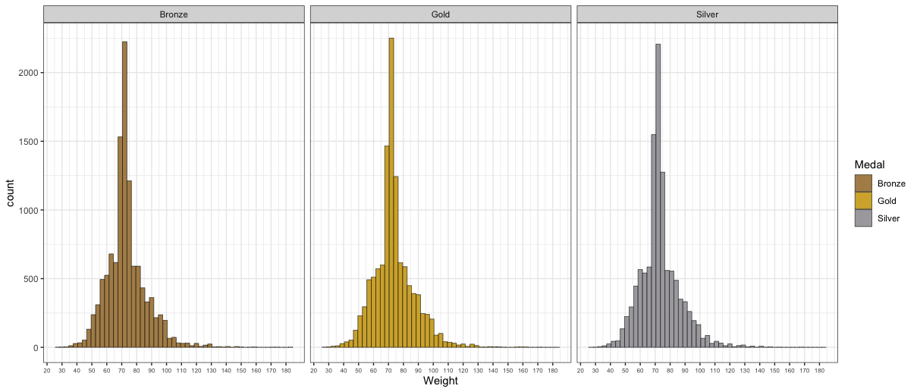
Exploratory Analysis (Cont.)
Looking at the weight distribution for all the medal winner, interestingly, the most optimal weight to win any of the medal lies between 70 to 73 kg. (note that is the average for both male and female)

Slide 19
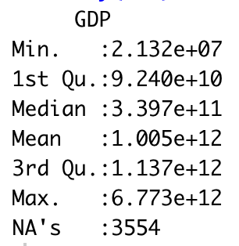
Exploratory Analysis (Cont.)
Here are some statistics of the GDP of the participated nations.
The next slide will show the top and bottom 15 countries with highest and lowest Avg.GDP respectively.
It will be compared to the top 40 Countries to ever win any Olympics medal.

Slide 20
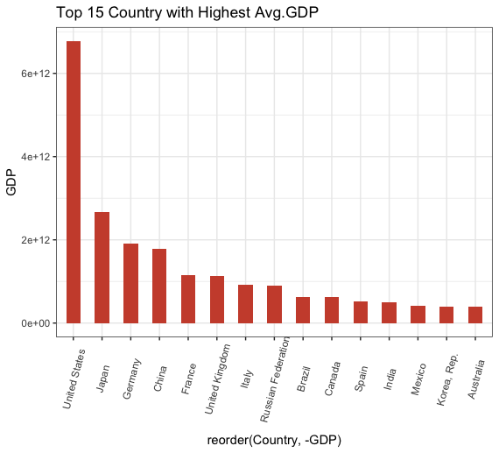
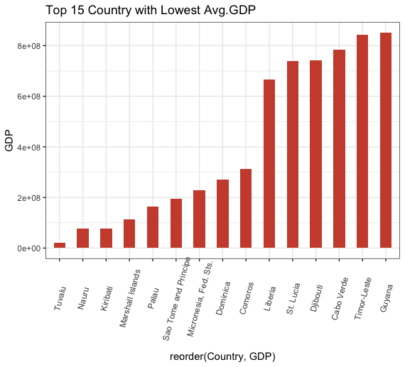
Exploratory Analysis (Cont.)

Slide 21
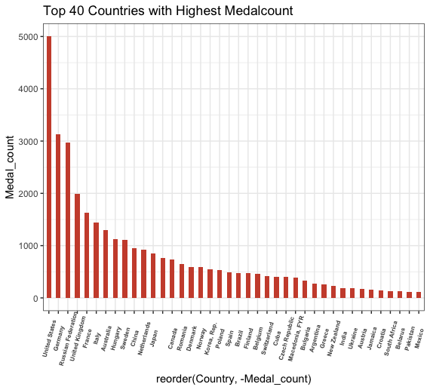
Exploratory Analysis (Cont.)
By comparing the previous 2 graph wih the this graph, it is clearly seen that the country economy condition clearly contribute to the chance of winnning at the Olympics.
Notice that all the top 15 countries with the highest Avg. GDP are also in the top 40 countries to win an Olympics medal.

Slide 22
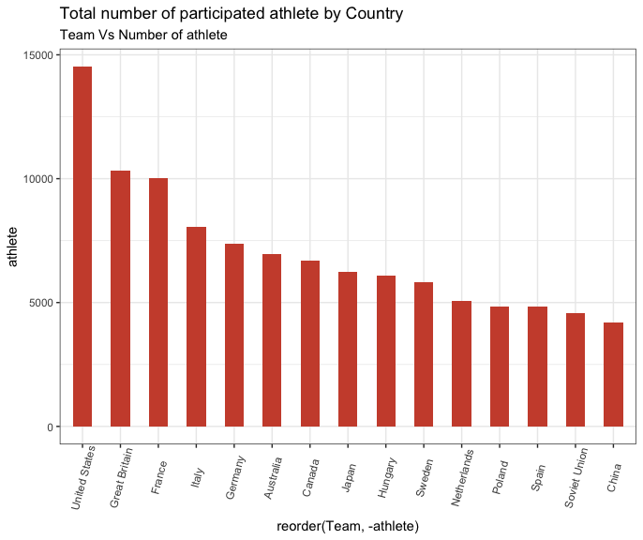
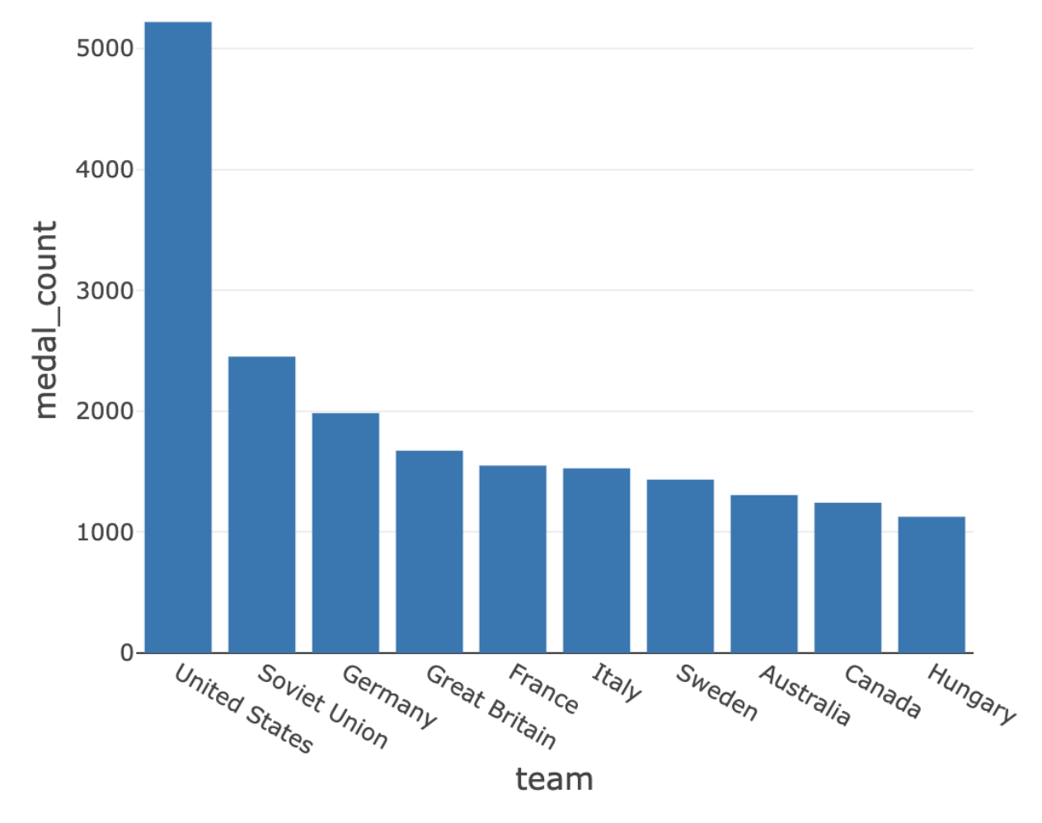
Exploratory Analysis (Cont.)
Looking at the Medal count plot and Participation vount plot seems to confirm the third hypothesis as the all the top 10 medal earners nations are also presented in the top 15 participated nations.
Medal count plot
Participation plot

Slide 23
Deeper Analysis

Slide 24
Deeper Analysis
The exploratory analysis pretty much approved the 2nd and 3rd hypotheses. However, the first hypothesis is still unclear as physical attributes depends on various factors.
To reduce bias in the calculation, the analysis on athlete physical attributes will be done for male and female seperately.
The focus of analysis will be on the weight of the athlete as this attribute of the athlete is the only metric that can be most likely changes.
For instances, the trainer might wanted to preapare the athlete to be in the right shape for the upcoming Olympics,
in this scenario, the trainer will most likely focus on the weight of the athlete rather than their age or height.

Slide 25
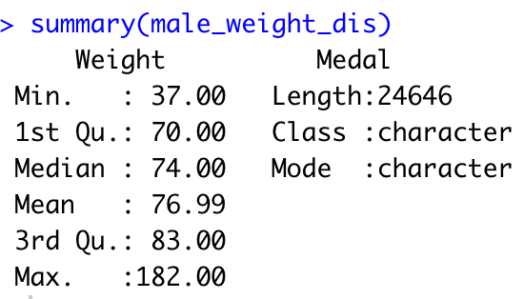
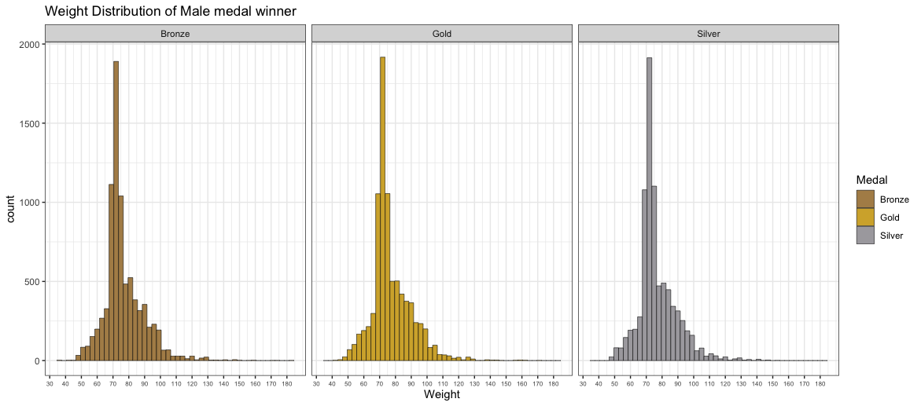
Deeper Analysis (Cont.)

Slide 26
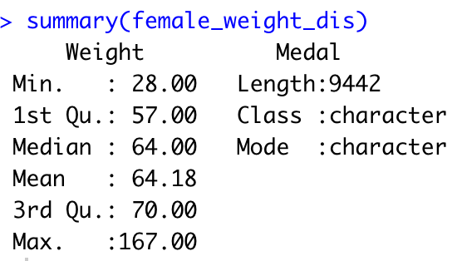
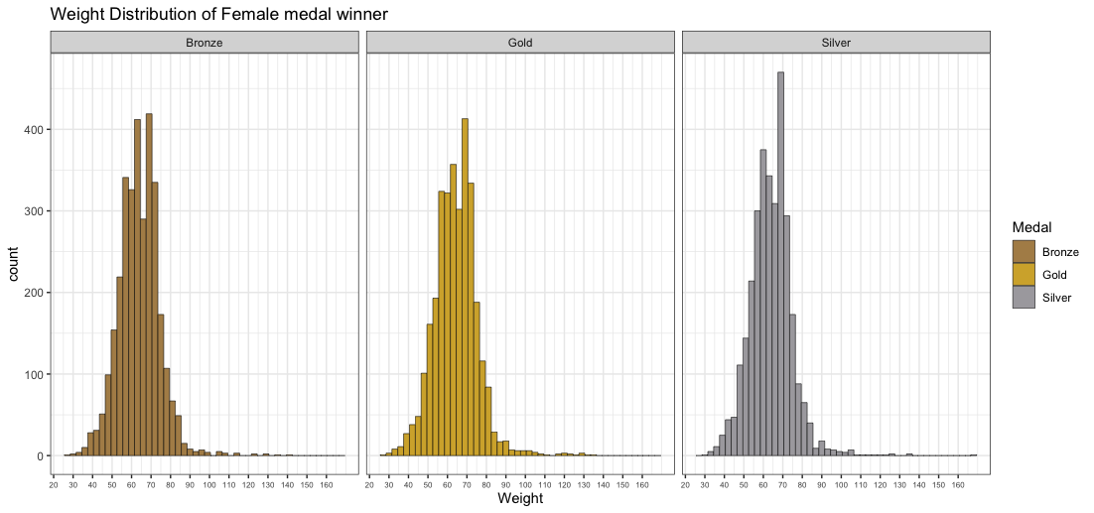
Deeper Analysis (Cont.)

Slide 27


Deeper Analysis (Cont.)
Male avg.weight
Female avg.weight
Interestingly, the most optimum weight for winning all the medal (gold, silver and bronze) lies in the same bin for both men and women, with men at about 70-73 kg and women at about 67-70 kg.
Another point to note is that, while the optimum weight for men lies below the average value by about 4-7 kg,
the optimum weight for women lies above the average value by about 3-6 kg.
For the weight analysis, the higher weight does increase the chance of winning a medal at Olympics, but the chances start decreasing once the weight reached certain point (In this case, 70-73 kg for men and 67-70 kg for women)

Slide 28
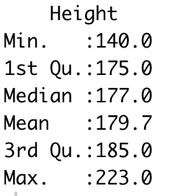
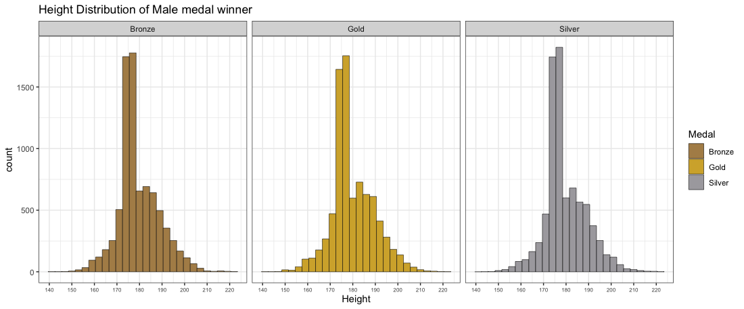
Deeper Analysis (Cont.)

Slide 29
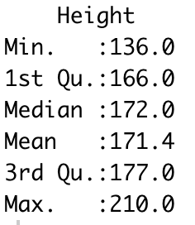
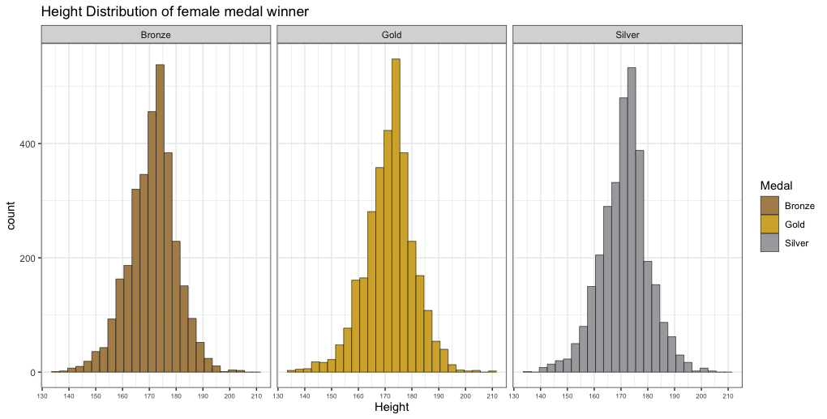
Deeper Analysis (Cont.)

Slide 30
Deeper Analysis (Cont.)
For height analysis, the most optimum height for winning all the medal (gold, silver and bronze) lies in the same bin for both men and women, with men at about 175-178 cm and women at about 173-175 cm.
Another point to note is that, while the optimum height for men lies below the average value by about 1-3 cm,
the optimum height for women lies above the average value by about 2-5 cm.
For the weight analysis, the higher weight does increase the chance of winning a medal at Olympics, but the chances start decreasing once the weight reached certain point (In this case, 175-178 cm for men and 173-175 kg for women).
Therefore, the initial hypothesis is rejected for men but approved (to some extent) for women.

Slide 31
Hypothesis Result

Slide 32
Hypothesis Result
Hypothesis on athlete’s attribute,
a. Height: Initial hypothesis is rejected for men , approved for women.
b. Age: The athlete did win more medal with lower age, therefore , hypothesis approved.
c. Weight: Initial hypothesis is approved as the athlete did win more medal with higher weight.
2. The country with better economic condition did win more medal, hypothesis approved.
3. The high participation rate did increase the chance of success, hypothesis approved.

Slide 33
End Slide

