Slide 1
JSOC Pipeline Processing:
Modules and data access
Rasmus Munk Larsen, Stanford University
rmunk@quake.stanford.edu
650-725-5485

Slide 2
Overview
Overview
  System architecture
SUMS
  Architecture, tape robot GUI, API
DRMS data model
  Data objects: series, records, keywords, links, segments…
  Dataset naming and query syntax
  Internal storage format
DRMS API
  Functions
  Code examples

Slide 3


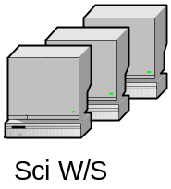







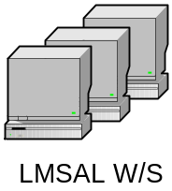


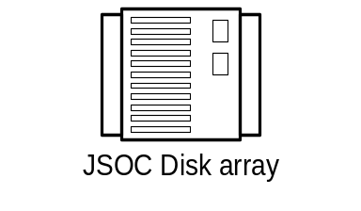
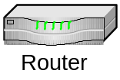
JSOC Connectivity
Stanford
DDS
JSOC Disk array
NASA
AMES
LMSAL
1 Gb
Private line
MOC
“White”
Net

Slide 4
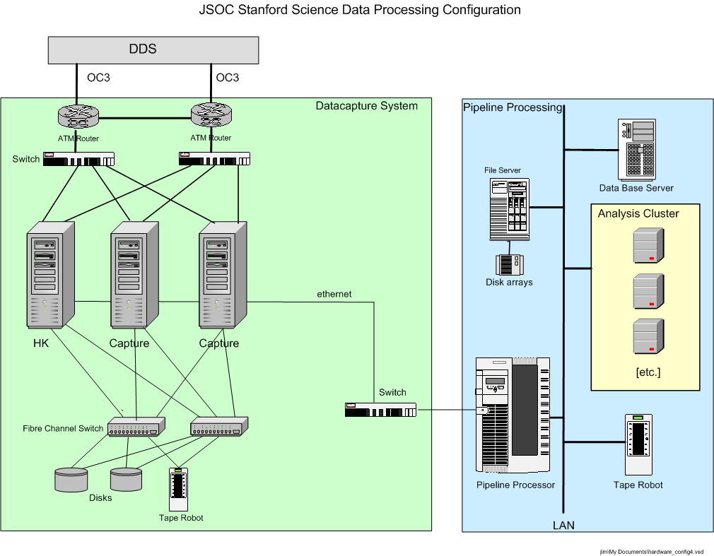
JSOC Hardware configuration

Slide 5
JSOC subsystems
SUMS: Storage Unit Management System
  Maintains database of storage units and their location on disk and tape
  Manages JSOC storage subsystems: Disk array, Robotic tape library
    Scrubs old data from disk cache to maintain enough free workspace
    Loads and unloads tape to/from tape drives and robotic library
  Allocates disk storage needed by pipeline processes through DRMS
  Stages storage units requested by pipeline processes through DRMS
  Design features:
    RPC client-server protocol
    Oracle DBMS (to be migrated to PostgreSQL)
DRMS: Data Record Management System
  Maintains database holding
    Master tables with definitions of all JSOC series and their keyword, link and data segment definitions
    One table per series containing record meta-data, e.g. keyword values
  Provides distributed transaction processing framework for pipeline
  Provides full meta-data searching through JSOC query language
    Multi-column indexed searches on primary index values allows for fast and simple querying for common cases
    Inclusion of free-form SQL clauses allows advanced querying
  Provides software libraries for querying, creating, retrieving and storing JSOC series, data records and their keywords, links, and data segments
    Currently available in C. Wrappers (with read-only restriction?) for Fortran, Matlab and IDL are planned.
  Design features:
    TCP/IP socket client-server protocol
    PostgreSQL DBMS
    Slony DB replication system to be added for managing query load and enabling multi-site distributed archives

Slide 6
Pipeline software/hardware architecture
JSOC Science
Libraries
Utility Libraries
Pipeline program “module”
OpenRecords
CloseRecords
GetKeyword, SetKeyword
GetLink, SetLink
OpenDataSegment
CloseDataSegment
File I/O
DRMS Library
Data Segment I/O
JSOC Disks
JSOC Disks
Record Cache (Keywords+Links+Data paths)
JSOC Disks
JSOC Disks
DRMS socket protocol
Data Record
Management Service
(DRMS)
Data Record
Management Service
(DRMS)
Storage Unit
Management Service
(SUMS)
Storage unit transfer
Data Record
Management Service
(DRMS)
AllocUnit
GetUnit
PutUnit
Storage unit transfer
SQL queries
Robotic Tape
Archive
Database
Server
SQL queries
SQL queries
Record
Catalogs
Record
Catalogs
Series
Tables
Record
Tables
Storage Unit
Tables

Slide 7
JSOC Pipeline Workflow
Pipeline Operator
Pipeline processing plan
DRMS session
Module3
PUI
Pipeline User Interface
(scheduler)
Processing script, “mapfile”
List of pipeline modules with needed datasets for input, output
Module2
Module1
Processing History Log
DRMS
Data Record
Management service
DRMS
Data Record
Management service
SUMS
Storage Unit
Management System

Slide 8
DRMS Session: Pipeline transaction processing
A DRMS session is encapsulated in a single database transaction:
  If no module fails all data records are commited and become visible to other clients of the JSOC catalog at the end of the session
  If failure occurs all data records are deleted and the database rolled back
  It is possible to force DRMS to commit data produced so far during a sessions (checkpoint)
Pipeline batch = atomic transaction
Module 2.2
Start DRMS
server
Module 1
Module N
Stop DRMS
server
DRMS API
…
DRMS API
DRMS API
DRMS API
DRMS API
Module 2.1
DRMS API
Input data
records
Output data
records
DRMS Service = Session Master
Record & Series
Database
SUMS

Slide 9
JSOC Tape Block Diagram
SUM
API
SUM
API
TUI
(status & robot to shelf control)
sum_svc
tape_svc
tapearc
(originates read requests)
(originates write requests)
(access to all tape services)
robot0_svc
robot1_svc
(slot to drive control)
drive0_svc
drive1_svc
drive0_svc
drive1_svc
(controls tape positioning
and read/write)
JSOC_Tape_Block_Dia

Slide 10
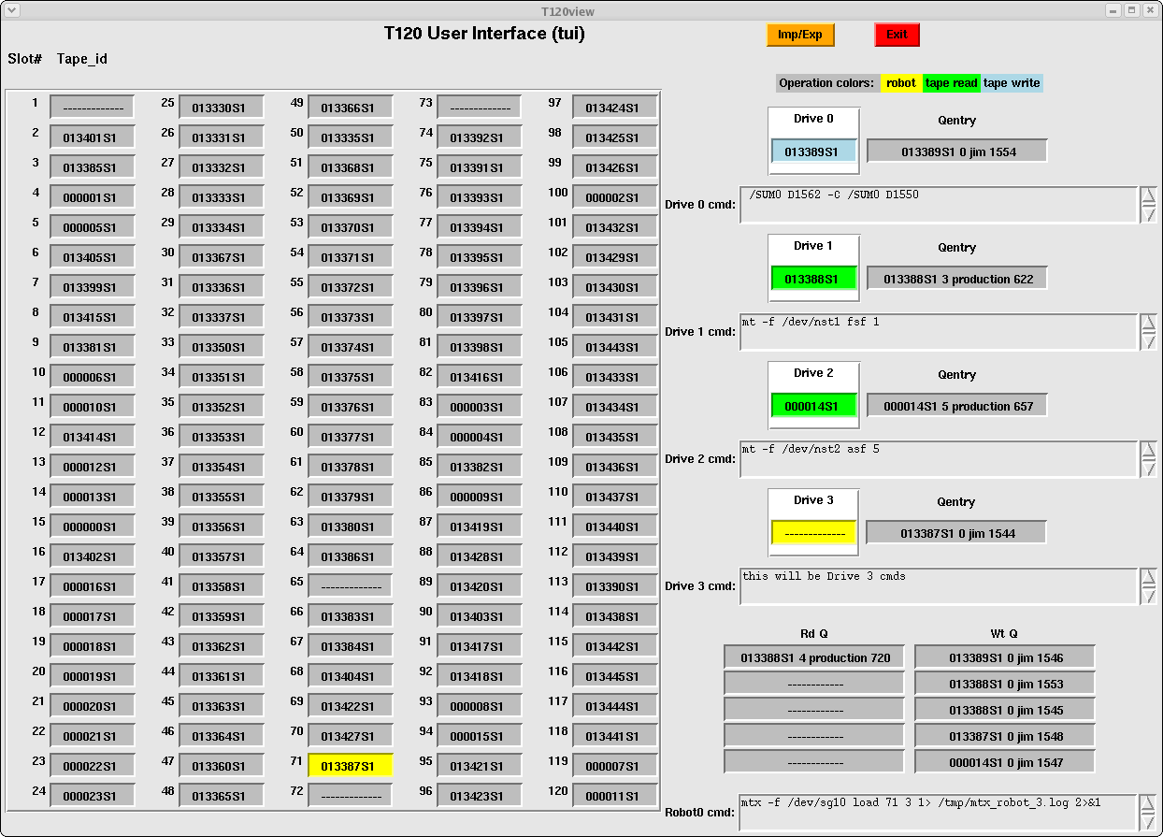
tui - Tape service user interface

Slide 11
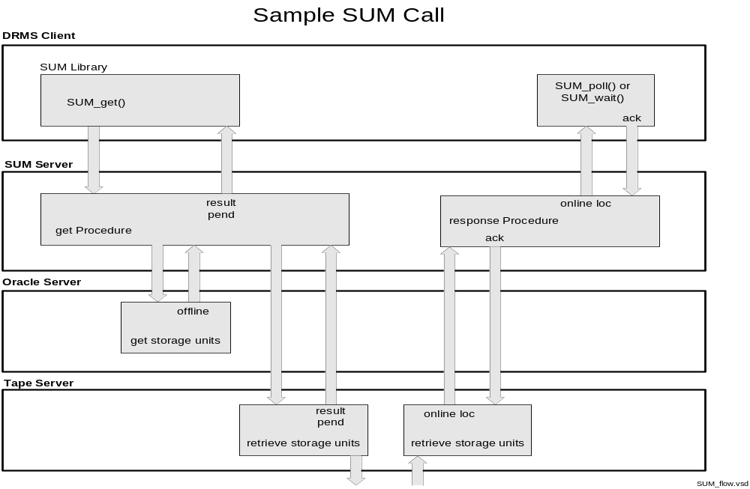
SUM_get() API Call Sequence

Slide 12
Storage Unit Management System (SUMS) API
SUM *SUM_open(char *dbname)
Start a session with the SUMS
int SUM_close(SUM *sum)
End a session with the SUMS
int SUM_alloc(SUM *sum)
Allocate a storage unit on the disks
int SUM_get(SUM *sum)
Get the requested storage units
int SUM_put(SUM *sum)
Put a previously allocated storage unit
int SUM_poll(SUM *sum)
Check if a previous request is complete
int SUM_wait(SUM *sum)
Wait until previous request is complete

Slide 13
JSOC data model: Motivation
Evolved from MDI dataset concept to
  Enable record level access to meta-data for queries and browsing
  Accommodate more complex data models required by higher-level processing
Main design features
  Lesson learned from MDI: Separate meta-data (keywords) and image data
    No need to re-write large image files when only keywords change (lev1.8 problem)
    No out-of-date keyword values in FITS headers - can bind to most recent values on export
  Easy data access through query-like dataset names
    All access in terms of (sets of) data records, which are the “atomic units” of a data series
    A dataset name is a query specifying a set of data records:
      jsoc:hmi_lev1_V[#3000-#3020] (21 records from with known epoch and cadence)
      jsoc:hmi_lev0_fg[t_obs=2008-11-07_02:00:00/8h][cam=‘doppler’] (8 hours worth of filtergrams)
  Storage and tape management must be transparent to user
    Chunking of data records into storage units for efficient tape/disk usage done internally
    Completely separate storage and meta-data (i.e. series & record) databases: more modular design
    MDI data and modules will be migrated to use new storage service
  Store meta-data (keywords) in relational database
    Can use power of relational database to rapidly find data records
    Easy and fast to create time series of any keyword value (for trending etc.)
    Consequence: Data records for a given series must be well defined (i.e. have a fixed set of keywords)

Slide 14
JSOC data model
JSOC Data is organized according to a data model with the following classes
Series: A sequence of like data records, typically data products produced by a particular analysis
  Attributes include: Name, Owner , primary search index, Storage unit size, Storage group
Record: Single measurement/image/observation with associated meta-data
  Attributes include: ID, Storage Unit ID, Storage Unit Slot#
  Contain Keywords, Links, Data segments
  Records are the main data objects seen by module programmers
Keyword: Named meta-data value, stored in database
  Attributes include: Name, Type, Value, Physical unit
Link: Named pointer from one record to another, stored in database
  Attributes include: Name, Target series, target record id or primary index value
  Used to capture data dependencies and processing history
Data Segment: Named data container representing the primary data on disk belonging to a record
  Attributes include: Name, filename, datatype, naxis, axis[0…naxis-1], storage format
  Can be either structure-less (any file) or n-dimensional array stored in tiled, compressed file format
Storage Unit: A chunk of data records from the same series stored in a single directory tree
  Attributes: include: Online location, offline location, tape group, retention time
  Managed by the Storage Unit Manager in a manner transparent to most module programmers

Slide 15

JSOC data model
JSOC Data Series
Data records for
series hmi_lev1_fd_V
Single hmi_lev1_fd_V data record
Keywords:
RECORDNUM = 12345 # Unique serial number
SERIESNUM = 5531704 # Slots since epoch.
T_OBS = ‘2009.01.05_23:22:40_TAI’
DATAMIN = -2.537730543544E+03
DATAMAX = 1.935749511719E+03
...
P_ANGLE = LINK:ORBIT,KEYWORD:SOLAR_P
…
hmi_lev0_cam1_fg
aia_lev0_cont1700
hmi_lev1_fd_V#12345
hmi_lev1_fd_M
hmi_lev1_fd_V#12346
hmi_lev1_fd_V
hmi_lev1_fd_V#12347
aia_lev0_FE171
hmi_lev1_fd_V#12348
Links:
ORBIT = hmi_lev0_orbit, SERIESNUM = 221268160
CALTABLE = hmi_lev0_dopcal, RECORDNUM = 7
L1 = hmi_lev0_cam1_fg, RECORDNUM = 42345232
R1 = hmi_lev0_cam1_fg, RECORDNUM = 42345233
…
…
hmi_lev1_fd_V#12349
hmi_lev1_fd_V#12350
hmi_lev1_fd_V#12351
hmi_lev1_fd_V#12352
hmi_lev1_fd_V#12353
Data Segments:
V_DOPPLER =
…
Storage Unit
= Directory

Slide 16
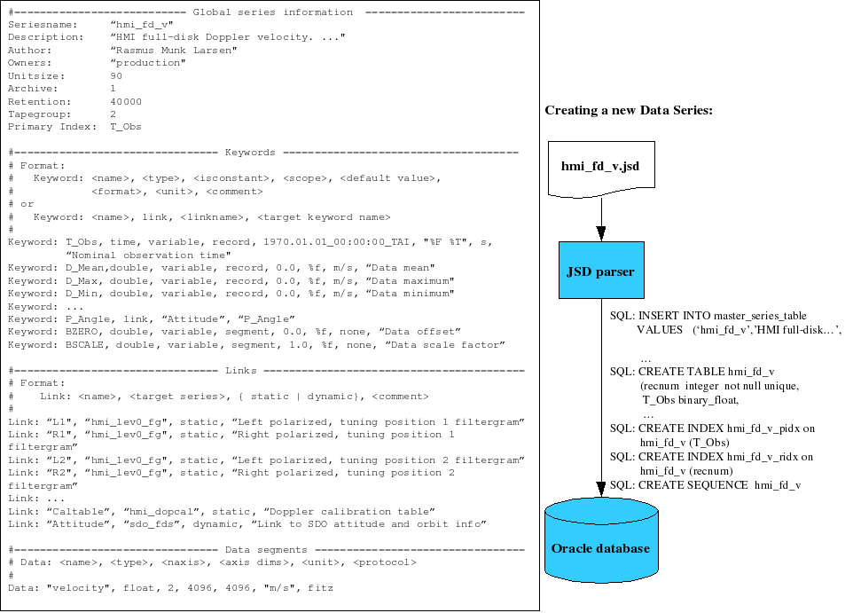
JSOC Series Definition

Slide 17
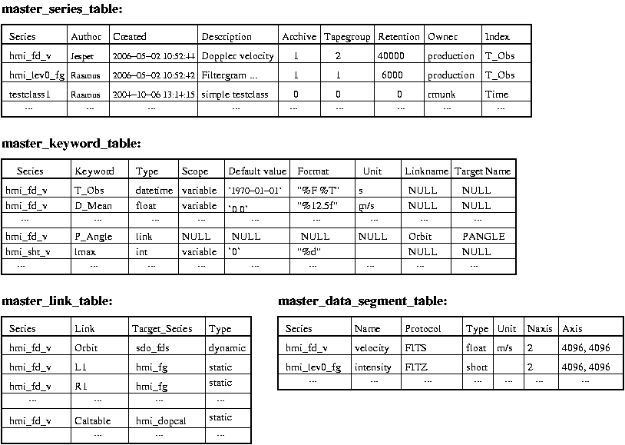
Global Database Tables

Slide 18
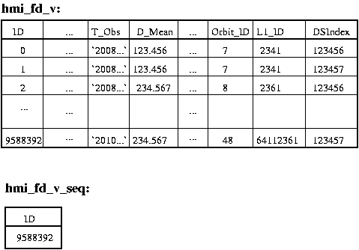
Database tables for example series hmi_fd_v
Tables specific for each series contain per record values of
  Keywords
  Record numbers of records pointed to by links
  DSIndex = an index identifying the SUMS storage unit containing the data segments of a record
  Series sequence counter used for generating unique record numbers

Slide 19
JSOC Internal file format: Tiled Array Storage
File format (little endian):
“DRMS TAS” | 8 bytes of magic
datatype | int32
compression | int32
indexstart | int64
heapstart | int64
naxis | int32
axis[0:naxis-1] | int32 array
blksz[0:naxis-1] | int32 array
Extract
Block index: (heap offset, compressed size, Adler32 checksum) for each block. | (int64, int64, int32) array
Heap: Compressed data for each block | “raw bits”
Scale & Convert
Compress
Write

Slide 20
Dataset names = DRMS query language
<RecordSet> ::= <SeriesName> <RecordSet_Filter>
<SeriesName> ::= <String>
<RecordSet_Filter> ::= '[' (<RecordList> | <RecordQuery> ) ']' { <RecordSet_Filter> }
<RecordQuery> ::= '?' <SQL where clause> '?'
<RecordList> ::= ( ':'<RecnumRangeSet> | {<Primekey_Name>'='}<PrimekeyRangeSet> )
<RecnumRangeSet> ::= <IndexRangeSet>
<Primekey_Name> :: <String>
<PrimekeyRangeSet> ::= ( <IndexRangeSet> | <ValueRangeSet> )
<IndexRangeSet> ::= ( '#' <Integer> |
'#' <Integer> '-' '#' <Integer> { '@' <Integer> } |
'#' <Integer> '/' <Integer> { '@' <Integer> }
) { ',' <IndexRangeSet> }
<ValueRangeSet> ::= ( <Value> |
<Value> '-' <Value> { '@' <Value_Increment> } |
<Value> '/' <Value_Increment> { '@' <Value_Increment> }
) { ',' <ValueRangeSet> }
<Value> ::= <Integer> | <Real> | <Time> | '<String>'
<Value_Increment> ::= <Integer> | <Real> | <Time_Increment>
<Time_Increment> ::= <Real><Time_Increment_Specifier>
<Time_Increment_Specifier> ::= 's' | 'm' | 'h' | 'd'

Slide 21
Query examples
Simple value range queries (primary key=t_obs):
hmi_XXX[t_obs=2009-11-01_00:00:00-2009-11-01-00:59:59]
hmi_XXX[2009-11-01/1h] (primary key implied)
aia_XXX[2009-11-01/1h,2009-12-01/3h] (multiple intervals)
aia_XXX[2009-11-01/1h@3m] (subsampling)
Multi-valued primary key (t_obs,lat,long):
aia_YYY[2009-11-01_03:00:00/8h][-45-45][10-40]
Equally spaced time series (t_obs_epoch and t_obs_step must be present)
hmi_ZZZ[t_obs=#7532-#7731]
hmi_ZZZ[#7532/200@10]
Freeform SQL where-clause:
hmi_VVV[2009-11-01/1h][$ datamean>7.5 AND lat*lat+long*long<27 $]
Absolute record number
aia_VVV[:#43214432-#43214460]

Slide 22
DRMS API: Record sets
DRMS_RecordSet_t *drms_open_records(DRMS_Env_t *env, char *datasetname, int *status)
Retrieve a recordset specified by the dataset name. The datasetname is translated into an SQL query. The matching
records are retrieved, inserted into the record cache and marked read-only.
DRMS_RecordSet_t *drms_create_records(DRMS_Env_t *env, int n, char *seriesname, int *status)
Create a new set of n new records with unique record IDs. Assign keywords & links their default values specified
in the series definition.
DRMS_RecordSet_t *drms_clone_records(DRMS_RecordSet_t *recset, int mode, int *status)
Clone a set of records: Create a new set of n new records with unique record IDs. Assign keywords, links, and
segments their values from the record set given as input.
If mode = DRMS_SHARE_SEGMENTS the clones inherit their data segments, which cannot be modified, from
their parent. If mode=DRMS_COPY_SEGMENTS the clones are assigned a new storage unit slot and the contents
of their parent’s storage unit slot is copied there and can be modified at will.
int drms_close_records(DRMS_RecordSet_t *rs, int action)
Close a set of records and free them from the record cache.
action = DRMS_COMMIT_RECORD or DRMS_DISCARD_RECORD
int drms_closeall_records(DRMS_Env_t *env, int action)
Executes drms_close_record for all records in the record cache that are not marked read-only.
action = DRMS_COMMIT_RECORD or DRMS_DISCARD_RECORD

Slide 23
DRMS API: Records
DRMS_Record_t *drms_create_record(DRMS_Env_t *env, char *series, int *status)
DRMS_Record_t *drms_clone_record(DRMS_Record_t *oldrec, int mode, int *status)
int drms_close_record(DRMS_Record_t *rec, int action)
Create, clone and close functions for a single record.
FILE *drms_record_fopen(DRMS_Record_t *rec, char *filename, const char *mode)
Asks DRMS to open or create a file in the directory (storage unit slot) associated with
a data record. As for the regular fopen mode = “r”, “w”, or “a”.
void drms_record_directory(DRMS_Record_t *rec, char *path)
Returns the full path of the directory (storage unit slot) assigned to this record.
void drms_record_print(DRMS_Record_t *rec)
"Pretty" print the contents of a record data structure to stdout.

Slide 24
DRMS API: Keywords
char drms_getkey_char(DRMS_Record_t *rec, const char *key,int *status)
short drms_getkey_short(DRMS_Record_t *rec, const char *key, int *status)
int drms_getkey_int(DRMS_Record_t *rec, const char *key, int *status)
long long drms_getkey_longlong(DRMS_Record_t *rec, const char *key, int *status)
float drms_getkey_float(DRMS_Record_t *rec, const char *key, int *status)
double drms_getkey_double(DRMS_Record_t *rec, const char *key, int *status)
char *drms_getkey_string(DRMS_Record_t *rec, const char *key, int *status)
Return the value of a keyword converted from its internal type (specified in the series definition) to the desired
target type. If status!=NULL the return codes are:
DRMS_SUCCESS: The type conversion was successful with no loss of information.
DRMS_INEXACT: The keyword value was within the range of the target, but some loss of information occurred
due to rounding.
DRMS_RANGE: The keyword value was outside the range of the target type. The standard missing value for the target type is returned.
DRMS_BADSTRING: When converting from a string, the contents of the string did not match a valid constant of
the target type.
DRMS_ERROR_UNKNOWNKEYWORD: No such keyword.
int drms_setkey_char(DRMS_Record_t *rec, const char *key, char value)
int drms_setkey_short(DRMS_Record_t *rec, const char *key, short value)
int drms_setkey_int(DRMS_Record_t *rec, const char *key, int value)
int drms_setkey_longlong(DRMS_Record_t *rec, const char *key, long long value)
int drms_setkey_float(DRMS_Record_t *rec, const char *key, float value)
int drms_setkey_double(DRMS_Record_t *rec, const char *key, double value)
int drms_setkey_string(DRMS_Record_t *rec, const char *key, char *value)
Set the value of a keyword, converting the given value to the internal type of the keyword. Return codes as above.

Slide 25
DRMS API: Links
DRMS_Record_t *drms_link_follow(DRMS_Record_t *rec, const char *linkname, int *status)
Follow a link to its target record, retrieve the record and return a pointer to it. If the link is dynamic the record with
the highest record number out of those with values of the primary index keywords matching those in the link is
returned.
DRMS_RecordSet_t *drms_link_followall(DRMS_Record_t *rec, const char *linkname, int *status)
Follow a link to its target records, retrieve them and return them in a RecordSet_t structure.
If the link is dynamic the function returns all records with values of the primary index keywords matching
those in the link. If the link is static only a single record is contained in the RecordSet.
int drms_setlink_static(DRMS_Record_t *rec, const char *linkname, int recnum)
Set a static link to point to the record with absolute record number "recnum" in the target series of the link.
int drms_setlink_dynamic(DRMS_Record_t *rec, const char *linkname, DRMS_Type_t *types,
DRMS_Type_Value_t *values)
Set a dynamic link to point to the record(s) with primary index values matching those given in the "types" and
"values" arrays. When a dynamic link is resolved, records matching these primary index values are selected.
int drms_linkrecords(DRMS_Record_t *src_rec, char *linkname, DRMS_Record_t *dst_rec)
Set a link in the source record to point to the destination record. An error code is returned if the destination record
does not belong to the target series of the named link in the source record.

Slide 26
DRMS API: Segments
DRMS_Array_t *drms_segment_read(DRMS_Segment_t *seg, DRMS_Type_t type, int *status)
Read the contents of a data segment into an array structure, converting it to the specified type.
a) If the corresponding data file exists and type!=DRMS_TYPE_RAW, then read the entire data array into memory.
Convert it to the type given as argument and transform the data according to bzero and bscale. The array struct will
have israw==0.
b) If the corresponding data file exists and type=DRMS_TYPE_RAW then the data is read into an array of the same
type as it is stored on disk with no scaling. The array struct will have israw==1.
c) If the data file does not exist, then return a data array filed with the MISSING value specified for the segment.
The fields arr->bzero and arr->bscale are set to the values that apply to the segment.
Error codes related to the type conversion are as for the setkey/getkey family of functions.
DRMS_Array_t *drms_segment_readslice(DRMS_Segment_t *seg, DRMS_Type_t type, int *start, int *end,
int *status)
Read a slice from a data segment file. The start offsets will be copied to the array struct such that mapping back into
the parent segment array is possible. Type conversion and scaling is performed as in drms_segment_read.
int drms_segment_write(DRMS_Segment_t *seg, DRMS_Array_t *arr)
Write an array to a segment file. The number and size of dimensions of the array must match those of the segment.
The data values are scaled and converted to the representation determined by the segment’s bzero, bscale and
type. The values of arr->bzero, arr->bscale, arr->israw are used to determine how to properly scale the data.
Three distinct cases arise:
1. arr->israw==0: (The values in the array have been scaled to their "true“ values.)
x = (1.0 / bscale) * y - bzero / bscale (y = value in array, x = value written to file)
2. arr->israw==1 and arr->bscale==bscale and arr->bzero==bzero:
x = y
3. arr->israw==1 and (arr->bscale!=bscale or arr->bzero==bzero):
x = (arr->bscale/bscale)*y + (arr->bzero-bzero)/bscale

Slide 27
DRMS API: Segments (cont.)
int drms_segment_setscaling(DRMS_Segment_t *seg, double bzero, double bscale)
Set segment scaling. Can only be done for an array segment and only when creating a new record. Otherwise the
error codes DRMS_ERROR_INVALIDACTION and DRMS_ERROR_RECORDREADONLY are returned
respectively.
int drms_segment_getscaling(DRMS_Segment_t *seg, double *bzero, double *bscale)
Get scaling for a segment. If the segment is not an array segment an error of
DRMS_ERROR_INVALIDACTION is returned.
void drms_segment_setblocksize(DRMS_Segment_t *seg, int blksz[DRMS_MAXRANK])
Set tile/block sizes for tiled storage format.
void drms_segment_getblocksize(DRMS_Segment_t *seg, int blksz[DRMS_MAXRANK])
Get tile/block sizes for tiled storage format.
DRMS_Segment_t *drms_segment_lookup(DRMS_Record_t *rec, const char *segname)
Look up segment by name.
DRMS_Segment_t *drms_segment_lookupnum(DRMS_Record_t *rec, int segnum)
Look up segment by number.
void drms_segment_filename(DRMS_Segment_t *seg, char *filename)
Return absolute path to segment file in filename.

Slide 28
DRMS API: Array functions
DRMS_Array_t *drms_array_create(DRMS_Type_t type, int naxis, int *axis, void *data, int *status)
Assemble an array struct from its constituent parts. If data==NULL then allocate a new array and fill it with
MISSING.
DRMS_Array_t *drms_array_convert(DRMS_Type_t dsttype, double bzero, double bscale,
DRMS_Array_t *src)
Convert array from one DRMS type to another with scaling.
DRMS_Array_t *drms_array_slice(int *start, int *end, DRMS_Array_t *src)
Take out a hyper-slab of an array.
DRMS_Array_t *drms_array_permute(DRMS_Array_t *src, int *perm, int *status)
Rearrange the array elements such that the dimensions are ordered according to the permutation given in "perm".
This is a generalization of the matrix transpose operator to n dimensions.
void drms_array2missing(DRMS_Array_t *arr)
Set entire array to MISSING according to arr->missing.
long long drms_array_count(DRMS_Array_t *arr)
Calculate the total number of entries in an n-dimensional array.
long long drms_array_size(DRMS_Array_t *arr)
Calculate the size in bytes of an n-dimensional array.
[Poor man’s subset of Fortran 90/Matlab without the syntactic sugar ☹]

Slide 29
A Simple module: Export approach
#include "jsoc_main.h"
DefaultParams_t default_params[] = {{NULL, NULL}};
int DoIt(void)
{
int i, j, status;
DRMS_RecordSet_t *rs;
DRMS_Record_t *rec;
char *rsname;
rsname = cmdparams_getarg(&cmdparams,i++)))
rs = drms_open_records(drms_env, rsname, &status);
for (j=0; j<rs->n; j++)
{
rec = rs->records[j];
sprintf(filename,“%06d.fits”,j);
drms_record2FITS(rec,filename);
}
drms_close_records(rs, DRMS_DISCARD_RECORD);
system(“idl analyze_this.idl”); /* A miracle occurs. */
rec = drms_create_record(drms_env, “my_data_series”, &status);
drms_FITS2record(“result.fits”, rec);
drms_close_record(drms_env, rec, DRMS_COMMIT_RECORD);
return 0;
}

Slide 30
Example module: scalesegment.c
/* This module updates records in recordsets specified on the command line by rescaling segment “image” and recomputing its mean value. */
#include "jsoc_main.h"
DefaultParams_t default_params[] = { {"alpha", NULL}, {"beta", NULL}, {NULL, NULL}};
int DoIt(void)
{
int j,k, count;
DRMS_RecordSet_t *oldrs, *newrs;
DRMS_Array_t *array;
DRMS_Segment_t *oldseg, *newseg;
double alpha, beta, *data, sum;
alpha = cmdparams_get_double(&cmdparams, "alpha", &status); /* Read scaling parameter from command line. */
beta = cmdparams_get_double(&cmdparams, "beta", &status); /* Read offset parameter from command line. */
rsname = cmdparams_getarg(&cmdparams,1); /* Get query string from command line. */
oldrs = drms_open_records(drms_env, rsname, &status); /* Query DRMS for record set. */
newrs = drms_create_records(drms_env, oldrs->n, oldrs->records[0]->seriesinfo.seriesname, &status); /* Create new record set. */
for (j=0; j<oldrs->n; j++) /* Loop over records in record set. */
{
oldseg = drms_segment_lookup(oldrs->records[I], “image”);
newseg = drms_segment_lookup(newrs->records[i],”image”);
array = drms_segment_read(oldseg, DRMS_TYPE_DOUBLE, &status); /* Read old segment, converting to double. */
n = drms_array_count(array); /* Get number of array elements. */
data = array->data; count = 0; sum = 0.0;
for (k=0; k<n; k++)
if (data[k] != DRMS_MISSING_DOUBLE)
{
count++; data[k] = alpha*data[k] + beta; sum += data[k]; /* Scale array and and compute new statistics. */
}
drms_setkey_double(newrs->records[j], “datamean”, sum/count); /* Set datamean keyword. */
status = drms_segment_write(newseg, array); /* Write array to new record segment. */
drms_free_array(array);
}
drms_close_records(oldrs, DRMS_DISCARD_RECORD);
drms_close_records(newrs, DRMS_COMMIT_RECORD); /* Close new record set, insert it into the database. */
return 0;
}

