Slide 1
Supervised, Unsupervised and Semi-supervised Learning

Slide 2
Outline
Supervised Models
Regression: Linear Regression
Classification: Decision Trees
Unsupervised Models
Kmeans
Semi Supervised Models

Slide 3
Machine Learning Process
Clean your Data
Missing Data
Find a viable solution
Run your model
Validate your results

Slide 4
Clean your Data!
Data preprocessing transforms the raw data into a format that will be more easily and effectively processed for the purpose of the user.
The machine learning process needs data without nulls, and in all numerical values, so we need to transform our data if needed.
Some things to watch out for:
Sampling
Noise Treatment
Normalization
Feature extraction

Slide 5
Missing Data
Missing data are a part of almost all research, and we have to decide how to deal with it.
Substitution:
Mean Value: replace the missing value with the mean of the column
Regression substitution: replace the missing value with historical value from similar case
Matching Imputation: for each unit with a missing y, find a unit with similar values of x in the observed data and take its y value

Slide 6
What algorithm should I use?
Regression:
Predict a continuous value based on past data
Compute the new values for unseen data using the features for a new example.
Classification:
Divide samples into 2 classes or more
Use a trained set of previously labeled data
Clustering
Partitioning of a data set into subsets so that data in each subset ideally share common characteristics

Slide 7
Machine Learning Types
Type of Learning:
Supervised
Unsupervised
Semi-supervised

Slide 8
Supervised Learning
Training data includes both the input and the desired results.
For some examples the correct results (targets) are known and are given in the input to the model during the learning process
Have to be able to generalize: give the correct results when new data is given in input without knowing the target a priori.

Slide 9
Unsupervised Learning
The model is not provided with the correct results during the training.
Can be used to cluster the input data in classes on the basis of their statistical properties only.
Cluster significance and labeling
The labeling can be carried out even if the labels are only available for a small number of objects represented of the desired classes.

Slide 10
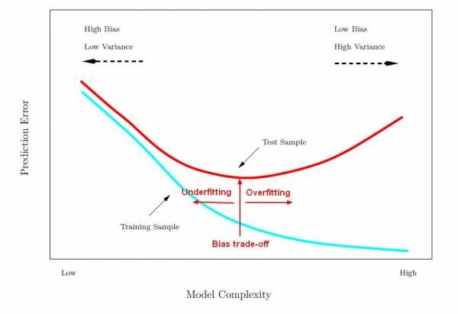
A common problem: OVERFITTING
Learn the “data” and not the underlying function
Performs well on the data used during the training but poorly on unseen data.

Slide 11
Datasets
Training set: a set of examples used for learning
Validation set: a set of examples used to tune the architecture of a classifier and estimate the error.
Test set: used only to assess the performances of a classifier. It is never used during the training process so that the error on the test set provides an unbiased estimate of the generalization error.

Slide 12
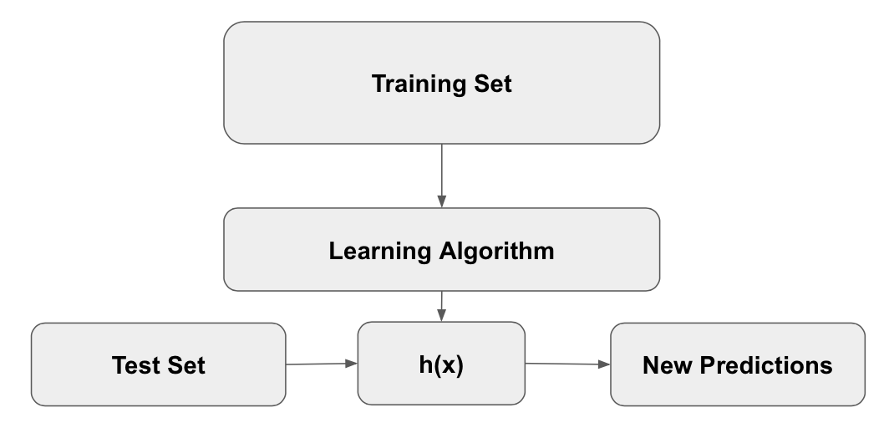

Slide 13
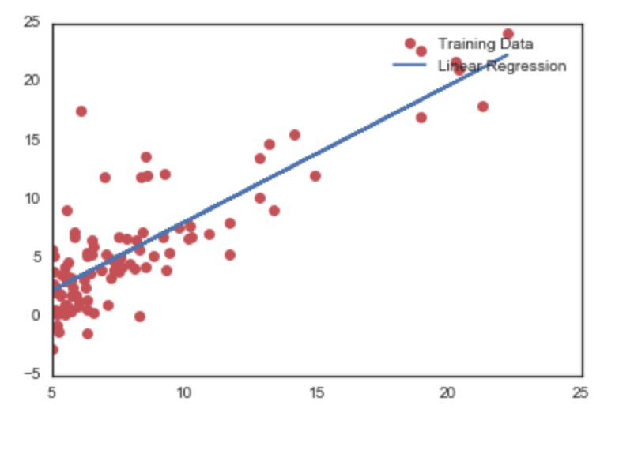
Linear Regression
ALGORITHM
Pick weights that could approximate the line.
Calculate the cost function to see how far off you are.
Use gradient descent to find the next values of weights to try.
Continue this process until your cost is barely changing.

Slide 14
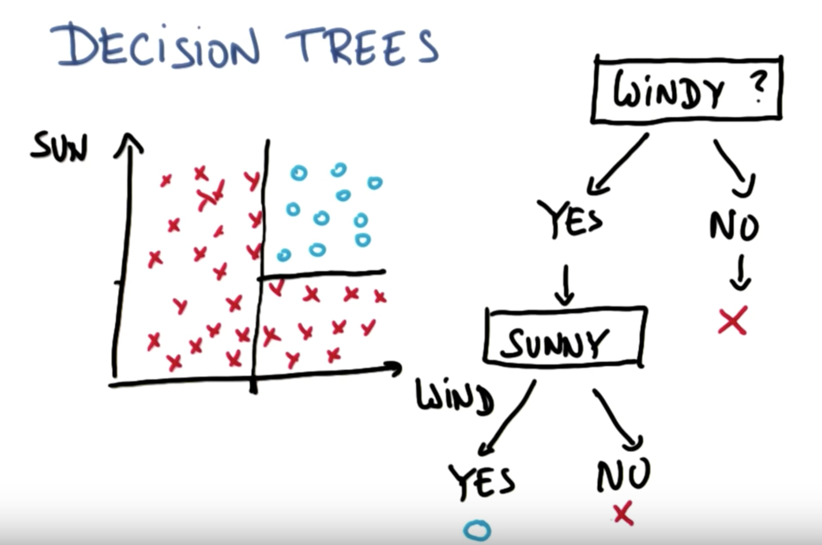
Decision Trees
1. Email: Spam / Not Spam?
2. Online Transactions:
Fraudulent (Yes / No)?
3. Tumor: Malignant / Benign ?
- 0: “Negative Class”
(e.g., benign tumor)
- 1: “Positive Class”
(e.g., malignant tumor)

Slide 15
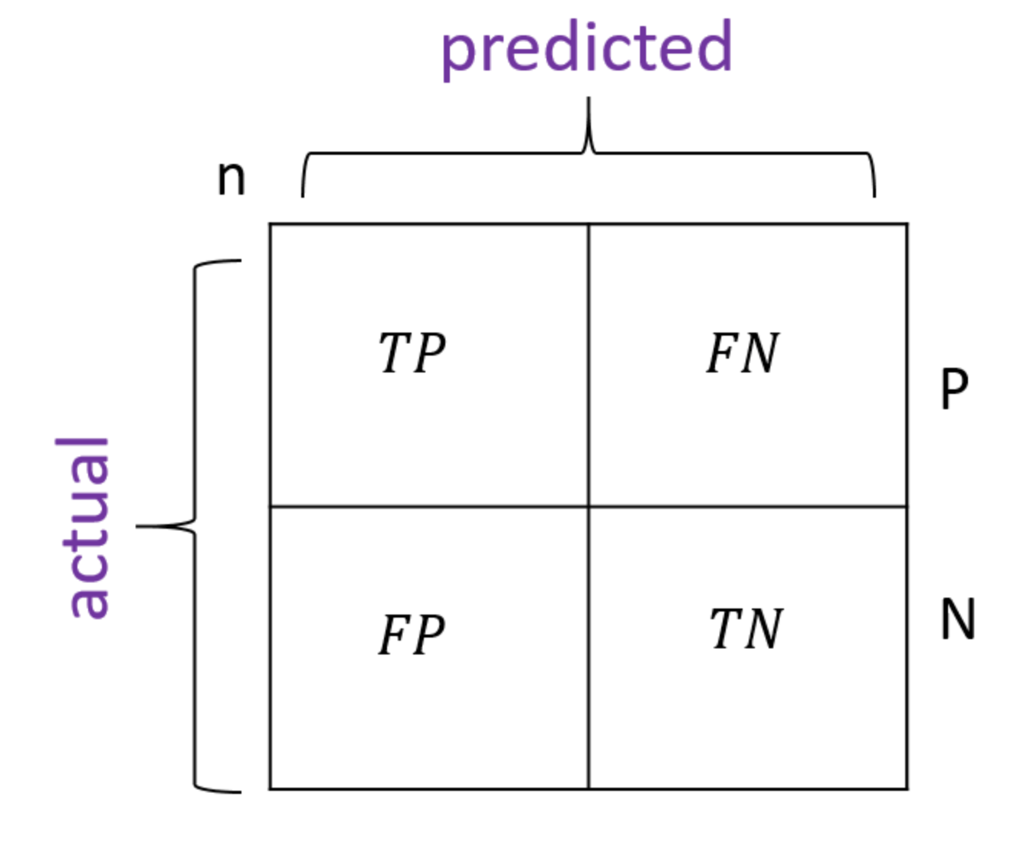
Confusion Matrix
A way to measure in binary classification how good your classifier has done.

Slide 16
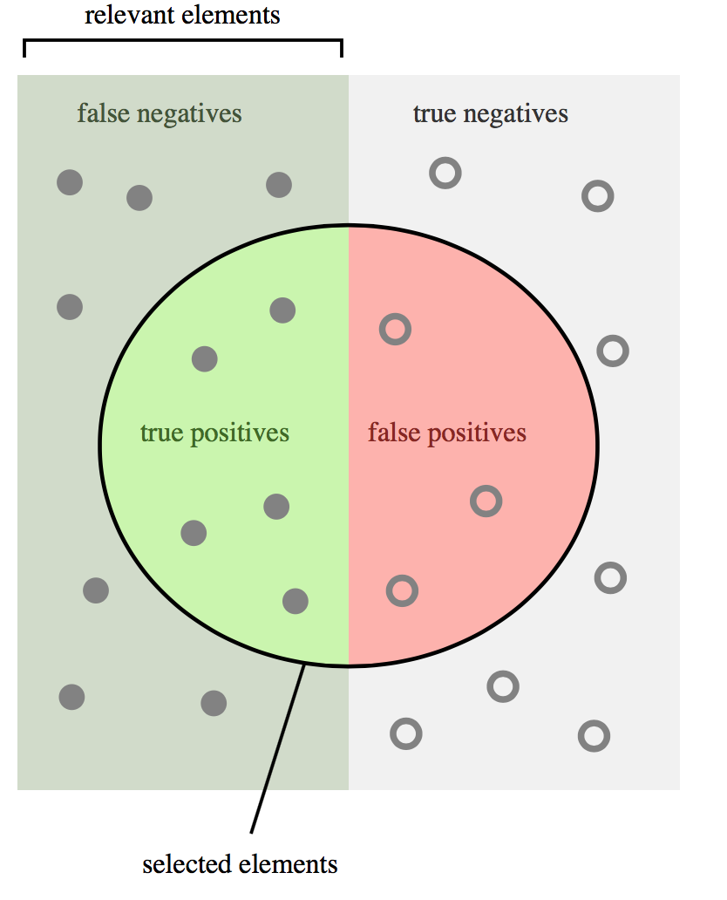
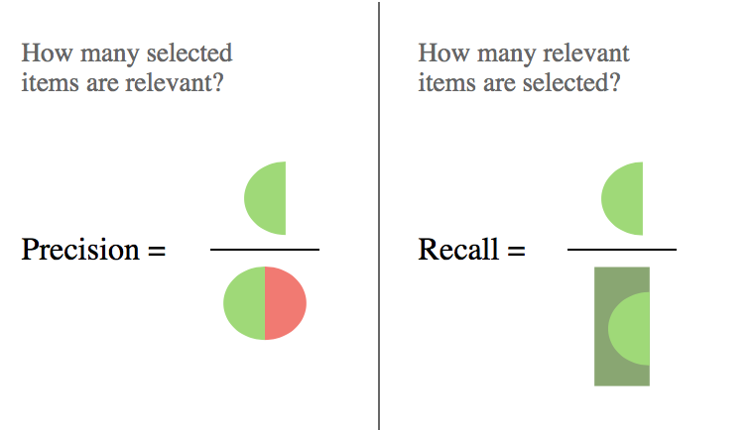
Precision and Recall

Slide 17
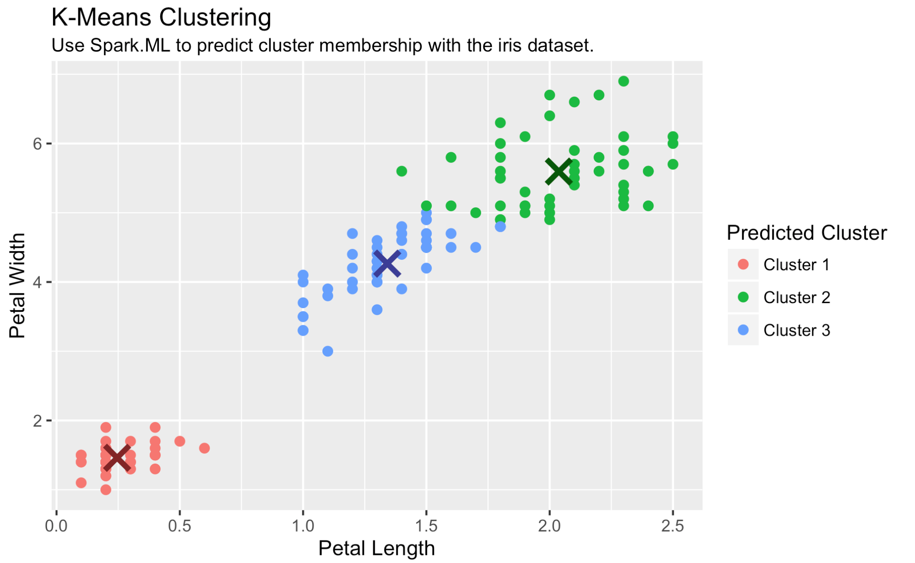
Unsupervised Learning
ALGORITHM:
1. Randomly initialize K cluster centroids
2. Find the closest Euclidian distance to each of the points
3. Update the centroids

Slide 18
Problems with Supervised Learning
Problems with Unsupervised Learning
What if we don’t have Labeled data?
Can we hand label it?
How time consuming would it be?
While we understand clusters, do we know what clusters represent what?

Slide 19
Solution? Semi Supervised Learning
A class of supervised learning that also makes use of unlabeled data for training.
Typically a small amount of labeled data with a large amount of unlabeled data.
It has been found that unlabeled data, when used in conjunction with a small amount of labeled data can produce considerable improvement in learning accuracy.
When you have unlabeled data the cost of trying to fully label the data is expensive and sometimes impossible.

Slide 20
Practical Example - Cyber Security
Big Data - compounds everyday
Majority of traffic is okay
So how can we make the data easier to deal with, ignore all the traffic for which we believe is okay.
Just focus on suspicious or malicious network traffic.
Approach
Clustering
data set with malicious domains to filter out non-suspicious data
Identify percent of unseen and potentially malicious data

Slide 21
The Paper
Extracting feature from raw passive DNS data
Injecting a small amount of known malicious domains to encourage cluster creation, a filtering scheme can be developed to quickly and accurate filter out 97% of the typically non-malicious DNS queries/responses.
Sensitivity (precision is the metric)

