Slide 1
X-Bit Architecture
robin

Slide 2
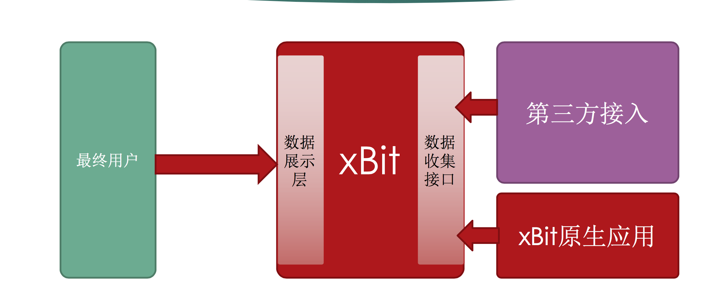
Overall

Slide 3
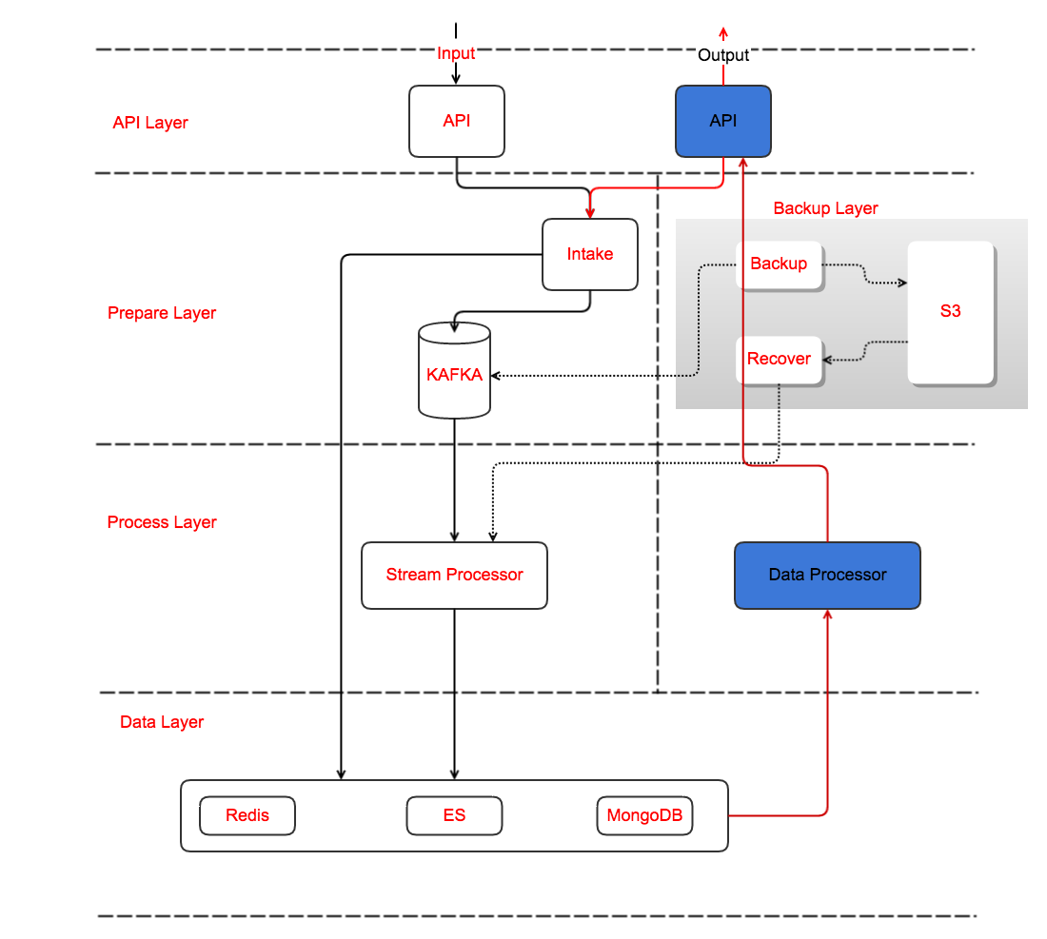

Slide 4
API Layer
Input & Output
Send the GPS raw data;
Gather the GPS aggregation data;
AngularJS

Slide 5
Prepare Layer
Intake: authentication, validation etc.
Queue: Buffer the data

Slide 6
Processor Layer
Process the raw data and save to Storage
Storm, spark

Slide 7
Data Layer
Redis for in-memory db
ES for custom data (time-series) data
MongoDB for Configurations

Slide 8
Backup Layer
Backup: Get the data from KAFKA and send to S3
Recover: Get the raw data from S3 and send to Processor layer to recover the data

