Slide 1
















MicroEnsemble
Jonathan Weyn
Microsoft
Hannah Guan
Harvard University
Soukayna Mouatadid
University of Toronto
Paulo Orenstein
Instituto de Matemática Pura e Aplicada
Judah Cohen
MIT
Lester Mackey
Microsoft Research
Alex Lu
Microsoft Research
Genevieve Flaspohler
Rhiza Research
Zekun Ni
Microsoft
Haiyu Dong
Microsoft

Slide 2
“Huracan” aka “PoET”
ECMWF S2S hindcasts and forecasts
Static variables
ERA5 targets
Post-processing with ensemble transformer
100-member ensemble forecasts
Probability = #members in each quintile
Improving Medium-Range Ensemble Weather Forecasts with Hierarchical Ensemble Transformers (2024), a.k.a. “PoET”
Inputs consist of all 85 parameters available in S2S plus 37 prescribed static variables
10-member perturbed hindcasts for training
The model is agnostic to ensemble size so inference is done on the 100-member operational ensemble
RPSS (2024 test forecasts) | PoET | ECMWF (raw)
tas – day 19 | 0.1886 | -0.0761
tas – day 26 | 0.1670 | -0.0982
mslp – day 19 | 0.0979 | -0.0899
mslp – day 26 | 0.0659 | -0.1173
pr – day 19 | 0.0404* | 0.0308
pr – day 26 | 0.0281* | 0.0157
Notes:
Our first model, Huracan, is based on the approach called PoET based on the publication listed here.
A full ensemble for ECMWF S2S hindcasts or forecasts, with some static inputs, is provided to a transformer model operating on the ensemble dimension.
The final forecast is the number of members predicting within each quintile bound.
Our metrics show consistent improvement over the input raw ECMWF forecasts.

Slide 3
Probabilistic Bias Correction (PBC)
Dynamical / AI Model Forecasts
Lagged Observations
Learns to correct forecasting errors using adaptive training periods
Learning-enhanced forecasts for each site and horizon
Climatological Quintiles
Inspired by Adaptive bias correction for improved subseasonal forecasting (Mouatadid et al., Nature Communications, 2023)
Notes:
The second component of our solution is a new method we call Probabilistic Bias Correction or PBC for short.
PBC takes as input the raw forecasts of a dynamical or AI model, lagged observations of weather variables, and climatological quintiles and outputs a learning-enhanced forecast designed to correct historical forecasting errors.
Our approach was inspired by the deterministic forecasting work of Soukayna Mouatadid et al. called adaptive bias correction.
https://www.nature.com/articles/s41467-023-38874-y

Slide 4
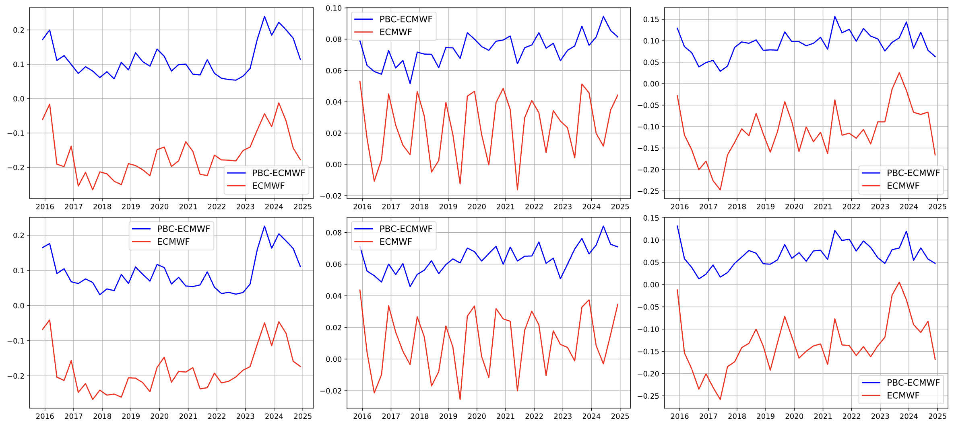
StillLearning Seasonal RPSS (2016-2024)
Temperature
Precipitation
Sea-Level Pressure
Horizon 19
Horizon 26
Notes:
In the weather quest, our StillLearning model is the result of applying PBC to raw ECMWF forecasts.
Across all seasons and all years from 2016-2024, we find that PBC substantially boosts the ranked probability skill score of raw ECMWF for each variable and horizon.

Slide 5
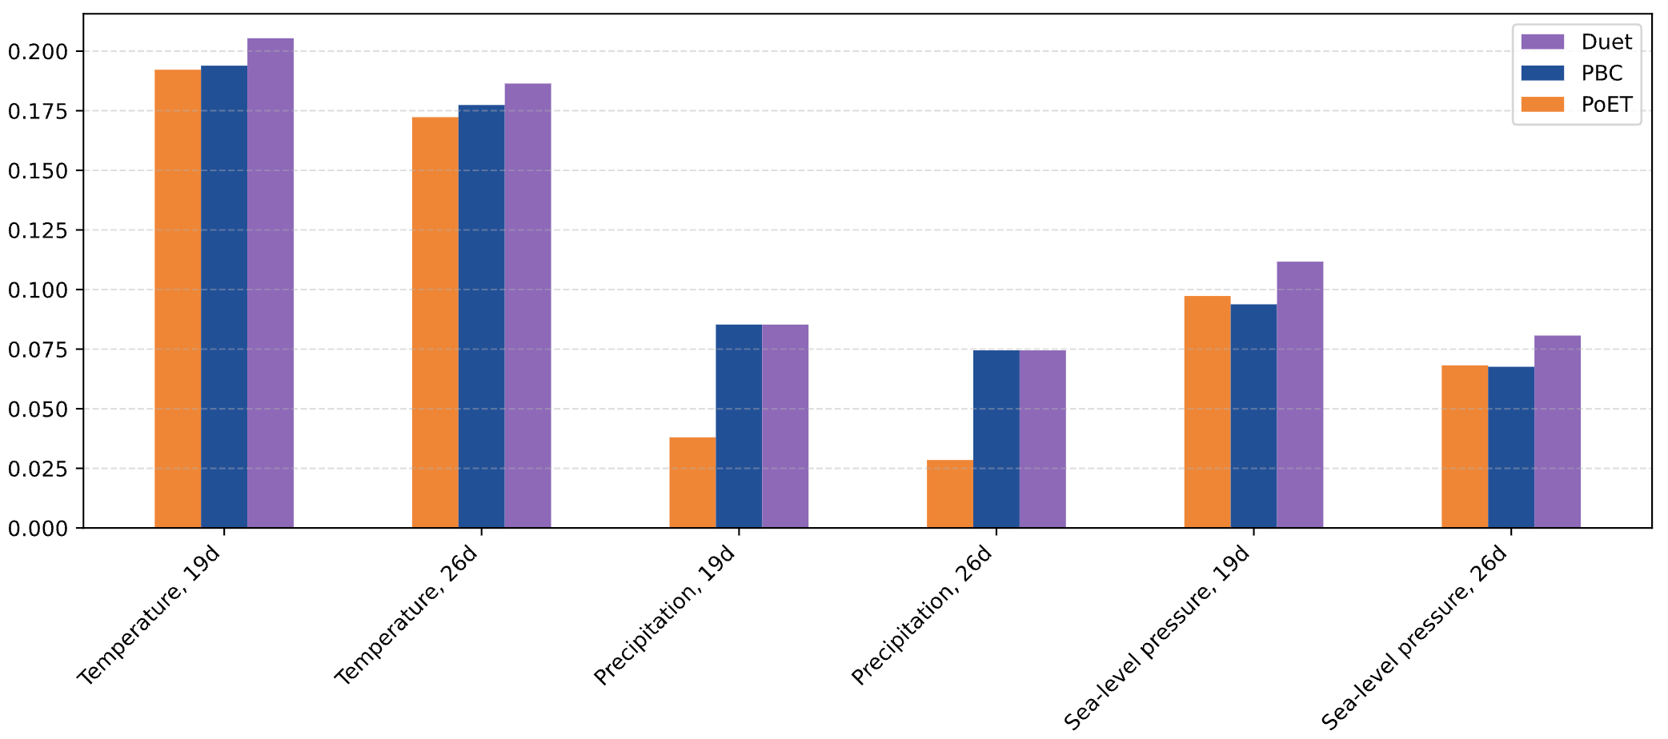
Duet RPSS (2024)
Duet combines the strengths of PBC and PoET
Notes:
Our final Duet model is an ensemble of PBC and PoET designed to capture the strengths of each model.
We find that Duet offers the best performance overall for each variable and horizon.

Slide 6
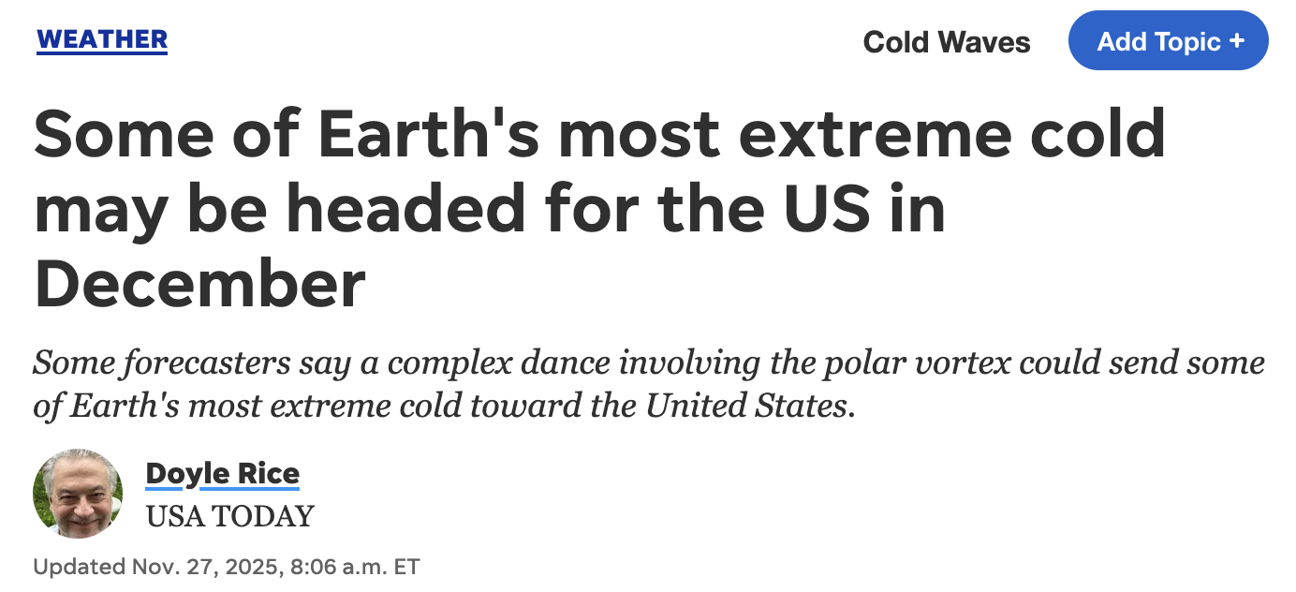
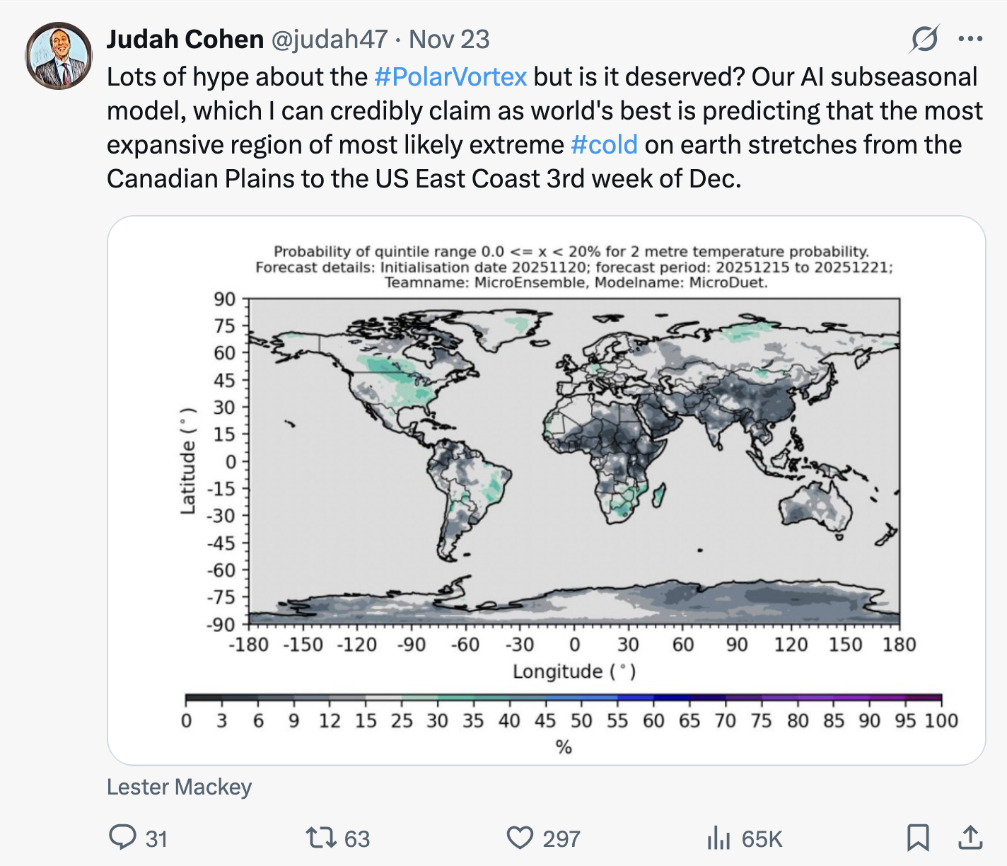
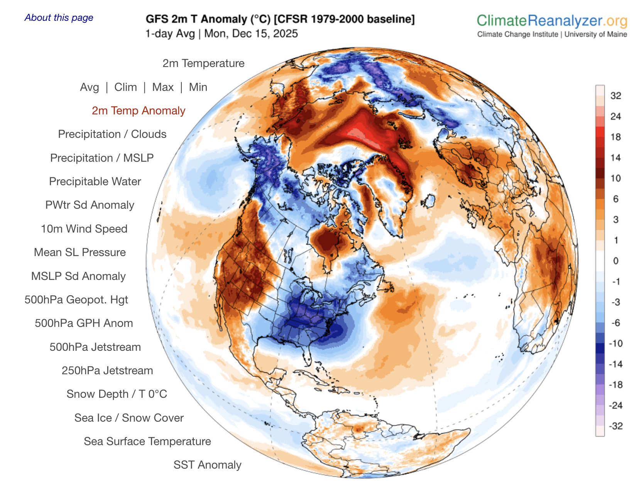
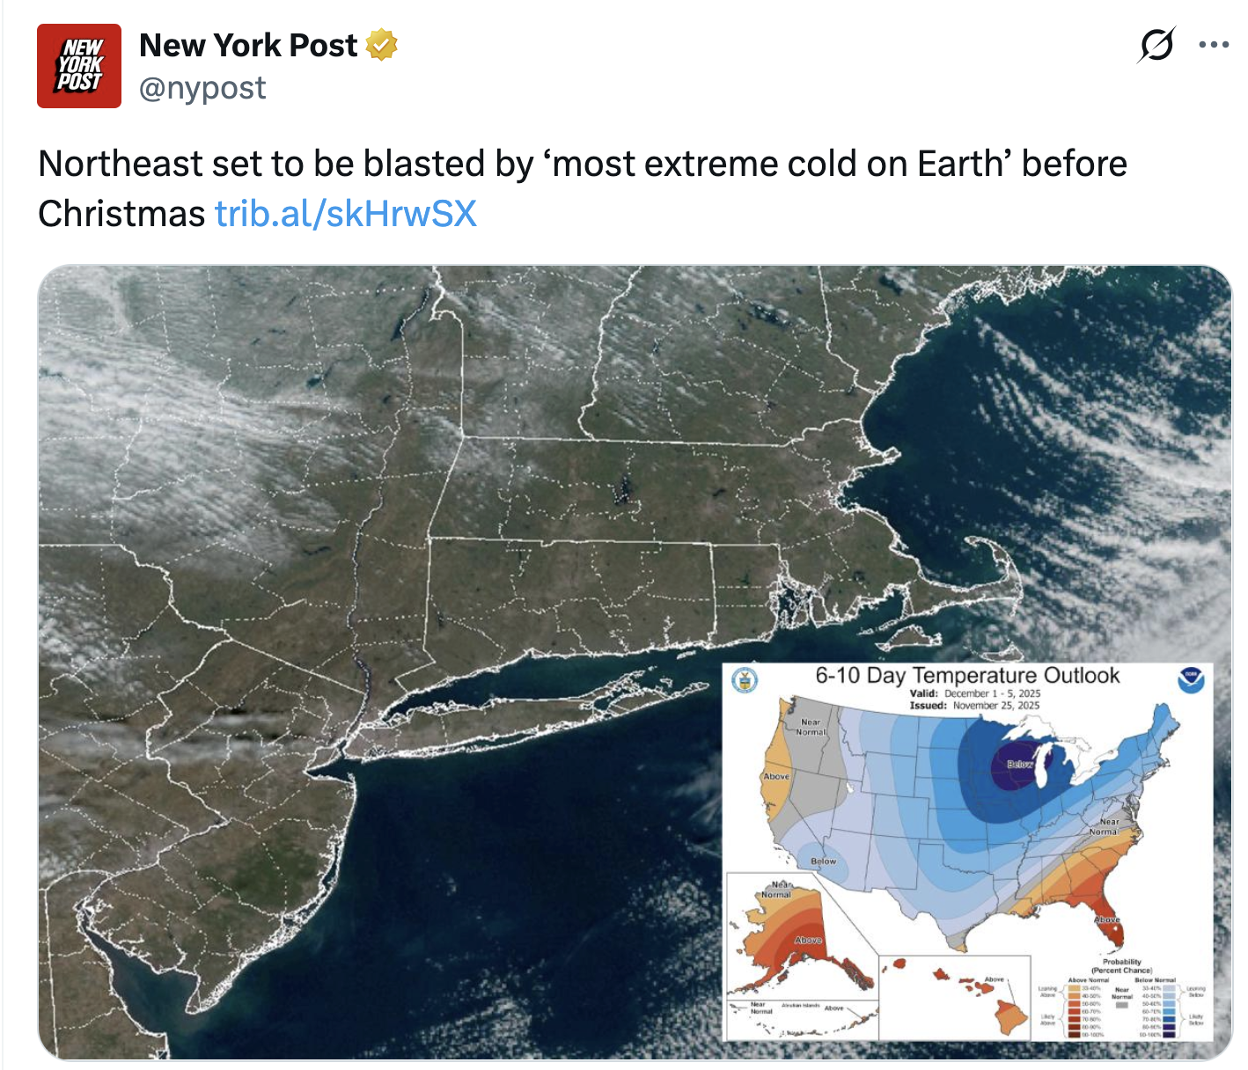

Duet Extreme Temperature Forecast
Notes:
Recently, Duet showed a strong signal for extreme cold in the week four period in the Central and Eastern US.
This forecast was shared in real-time on social media and picked up by many media outlets.
The forecast is verifying at the skill level expected on short term weather forecasts.
Potentially represents a significant advance of accurate and timely prediction of extreme weather on a subseasonal timescale.

