Slide 1
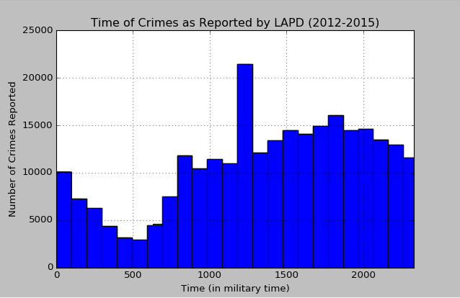
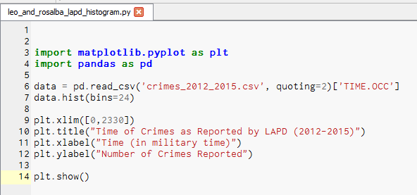
When should the LAPD issue more police in the streets?
The histogram to the left displays the number of crimes reported by LAPD from 2012 to 2015 based on the time of day that it was reported.
The histogram displays peak crime reporting at approximately 1:00pm.
The histogram also shows an interval of peak crime reporting between 3:00pm and 8:00pm.

