Slide 1




Canary Current Large Marine Ecosystem (CCLME) Coastal Marine Atlas
DATA, METADATA AND DATA PRODUCTS
By
Anis DIALLO
NODC-SN DATA MANAGER, CRODT/ISRA, BP. 2241 Dakar, Senegal
Email: anisml.diallo@gmail.com

Slide 2
INTRODUCTION
CCLME Coastal marine atlas was design under the ODINAFRICA project,
(http://www.odinafrica.org/) in the context of ‘African Coastal Marine Atlas’ (AMA)
(http://www.africanmarineatlas.org/)

Slide 3

DATA AND DATA MINING
National Data are collected from participative National Data Centers;
Data mining are also done from differente sources.

Slide 4
DATA AND DATA MINING
1.(http://iridl.ldeo.columbia.edu/SOURCES/.NOAA/.NODC/.WOA05/.Grid-1x1/.Monthly/.an/)
2.http://www.esrl.noaa.gov/psd/data/gridded/data.coads.2deg.html
3.http://ferret.pmel.noaa.gov/NVODS/

Slide 5

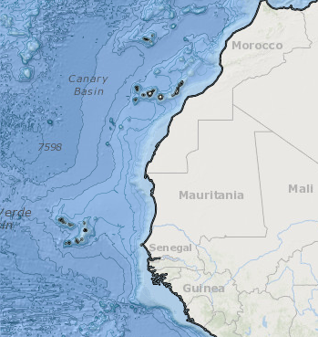
AREA OF INTEREST
The Area of Interest (AOI) was drawed in a zone from Morocco to Sierra Leone: (35N, 6N, -31W and -0.5W).

Slide 6


DATA ARCHITECTURE
FOLDER STRUCTURES
1. ATMOSPHERE (Precipitation/ Relative humidity/ Air temperatrure/ Wind speed & vector/ Sea level presure/ Sea level rise);
2. BASEMAPS (Bathymetry/ Coastline/ Elevation/ Relief/ Srmt);
3. BIOSPHERE (Amps/ Chlorophyl/ Fishery/ Habitat/ Land cover/ Longhust province/ Mangrove/ Marine primary production)

Slide 7
DATA ARCHITECTURE
FOLDER STRUCTURES
4. GEOSPHERE (Coastal soil type/ Energy minerals/ Erosion/ Non energy mineral/ Sediment/ Soil);
5. HUMAN (Administrative boundries/ EEZ/ Population density/ Ports/ Raiways/ Roads);
6. HYDROSPHERE (AOU/ Current/ Nitrate/ Oxygen/ Phosphates/ Salinity/ Silicate/ Temperature/ Mixed layer depth/ Rivers)

Slide 8

DATA PRODUCTS
CCLME, Coastline and Depth contours

Slide 9
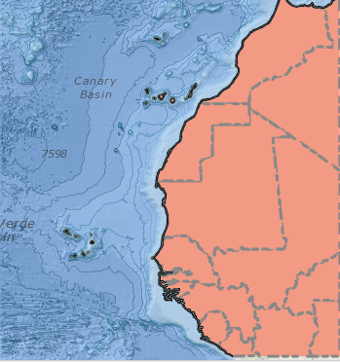
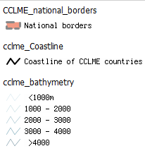
DATA PRODUCTS
CCLME, National borders

Slide 10
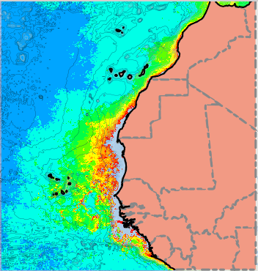
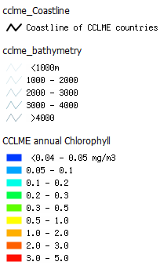
DATA PRODUCTS
CCLME, annual Chlorphyll

Slide 11
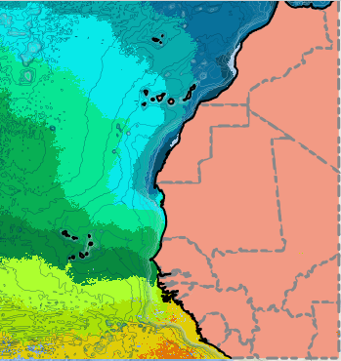
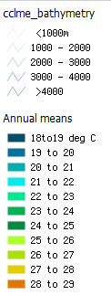
DATA PRODUCTS
CCLME, annual mean temperatures

Slide 12
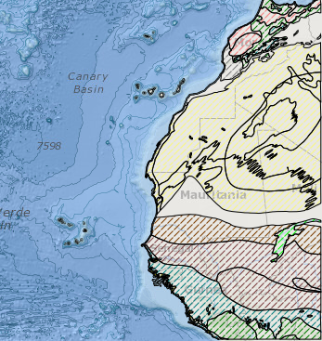
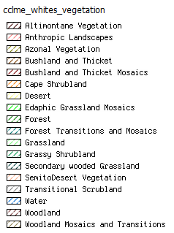
DATA PRODUCTS
CCLME, whites vegetations

Slide 13
METADATA 1
http://geonetwork.iode.org/geonetworkAMA/srv/en/main.home

Slide 14

METADATA 2
National Databases
(SN_Metadata bases)

Slide 15

THANK YOU FOR YOUR ATTENTION

