Slide 1

The Gif-FInder
Not the gift we want but the gift they deserve

Slide 2

Introduction
The major objective of this website is to help people find the right gift to offer their family, friends, love ones and anyone they want.
It can also be used to find your one right gift.

Slide 3

1º Step
Develop a website where users from all around glob can find the perfect gift. How?

Slide 4
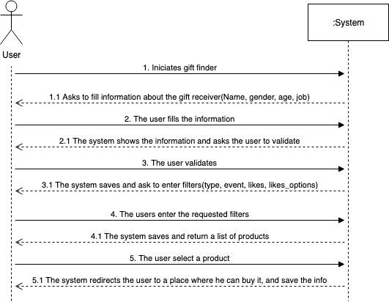
User interaction

Slide 5
Users
 |  | Users
id | name | email | psw | role_id | location
1 | teste | teste@gmail.com | #abc123# | 2 | Portugal
2 | client | client@gmail.com | 12345 | 1 | Portugal
3 | manager | manager@gmail.com | 123456 | 3 | Portugal
 | Roles
id | name
1 | admin
2 | client
3 | Present_manager
 | Modules
id | name | path | role_id
1 | Novo Produto | /newproduct | 1
2 | Gift Finder | /gift | 2
Information about a user:
Two types of users: client, admin, present manager
Client can only search gifts
Admin creates and validates list of products
Present manager can manage the products list.
Every search made by a user is stored in a history log.
 |  | History
id | user_id | product_id | Filterperson_id | timestamp
1 | 1 | 1 | 1 | 01/01/00 00:00
 |  | History_Complete
id | history_id | event_id | like_id | likeoption_id | type_id
1 | 1 | 2 | 3 | 1 | 3

Slide 6
Finding the perfect gift
First the user must describe the person whose gonna receive the gift by selecting the following options:
Name (fills a form)
Age
Gender
Job

Slide 7
Age Filter
 | Age_Filter
id | name | age_max | value
1 | baby | 2 | 1
2 | big baby | 5 | 2
3 | child | 10 | 3
4 | Stubborn phase | 14 | 4
5 | Adolescent | 18 | 5
6 | Maybe Unemployed | 23 | 6
7 | Grown Child | 28 | 7
8 | Struggling | 34 | 8
9 | The pathfinder | 40 | 9
10 | Suit Up | 50 | 10
11 | Sick of life | 55 | 11
12 | Still sick | 60 | 12
13 | Proud | 70 | 13
14 | Even more proud | 75 | 14
15 | Retired | 80 | 15
16 | Amazing | 90 | 16
The user selects one of this options where the receiver age is between one of those ages

Slide 8
Gender Filter
 | Gender_Filter
id | name | value
1 | Male | 1
2 | Female | 2
3 | Not sure | 3
4 | Closet door closed | 4
5 | Closet door open | 5
6 | Closet door bit open | 6
7 | Both? | 7
The user selects one of this options as the receiver gender

Slide 9
Job Filter
 | Job_Filter
id | name | description | value
1 | Unemployed | we all been there | 1
2 | IT support | Magician around computers | 2
The user selects the job that the receiver has.

Slide 10
Gift Objective Filters
To help find the best gift off all, the user must select other filters:
Type of gift he wants to give
Event where he gonna give the gift
Likes of the receiveir
Inside the likes, others likes that are more sutting to the receiver

Slide 11
Filter - Type of gift
id | name | value
1 | Trying to get in the receiver pants | 1
2 | Joking | 2
3 | Married to the receiver | 3
4 | Not my real friend | 4
5 | Obligated to buy a present | 5
6 | My wife told me to | 6
7 | My mom told me to | 7
8 | All women told me to | 8
9 | trying to make the receiver healthy | 9
10 | the receiver has “big bones” | 10
11 | food junkie | 11
12 | Son of a mother | 12
13 | Son of me | 13
14 | Not my favourite child | 14

Slide 12
Filter – gift Event
id | Name | Value
1 | Christmas | 1
2 | Halloween | 2
3 | Easter | 3
4 | New Year | 4
5 | Birthday | 5
6 | Graduation | 6
7 | Wedding | 7
8 | New Home | 8
9 | Valentine | 9
10 | First month | 10
11 | Just cause | 11
12 | Newborn | 12
13 | He deserves it | 13
14 | She deserves it | 14

Slide 13
Filter – Receiver Likes
id | Name | Value
1 | Sports | 1
2 | Jokes | 2
3 | Music | 3
4 | Dance | 4
5 | Cars | 5
6 | Motorcycles | 6
7 | Gadgets | 7
8 | Computers | 8
9 | Cats | 9
10 | Dogs | 10
11 | Games | 11
12 | Films | 12
13 | Tv | 13
14 | Boozing | 14
15 | Food | 15
16 | Gym | 16
17 | Cool tech | 17
18 | Home styling | 18
19 | Reading | 19
20 | Art | 20
21 | Jewellery | 21
22 | Boats | 22
23 | Craft | 23

Slide 14
Filter – Likes of Likes of the receiver
id | like_id | name | value
1 | 1 | Futebol | 1
2 | 2 | Black Humor | 2
3 | 3 | Sound Quality | 3

Slide 15
So how the products are selected?
As you were able to repair in each filter table there was a column called value, where each option had an associated value. This value is saved and used to filter the list of products.
At the end of chosing all the filters it shows only the products that contain all of those values.

Slide 16
List of products seleCted by filter
id | name | description | price | Currency | link | gender_value | age_value | job_value | event_value | like_value | likeoption_value | type_value
1 | Bola futebol | redonda | 10 | € | www.qql.com | [1,2,3,4] | [3,4,5,6,7] | [8] | [1,3,5,6,7] | [1,11,16] | [1] | [12,13,14]
The user selects a product and then has a link where he can buy that product. We work as middle-man.

Slide 17
How Do we make money
With advertsiment implemented on our website. Google AdSense.

Slide 18
2º Phase
Create a Blog and get Blogs to talk about our website and promote it.
Get sponsors from AliExpress, Gearbest and other online stores
Create an APP(android and IOS) with premium version withou ads (0.99€)

Slide 19
3º Phase
Create our own brand and products and sell them in our Application

Slide 20
Ready to be rich?

