Slide 1

The Gif-FInder
Not the gift we want but the gift they deserve

Slide 2

Introduction
The major objective of this website is to help people find the right gift to offer their family, friends, love ones and anyone they want.
It can also be used to find your one right gift.

Slide 3

1º Step
Develop a website where users from all around glob can find the perfect gift. How?

Slide 4
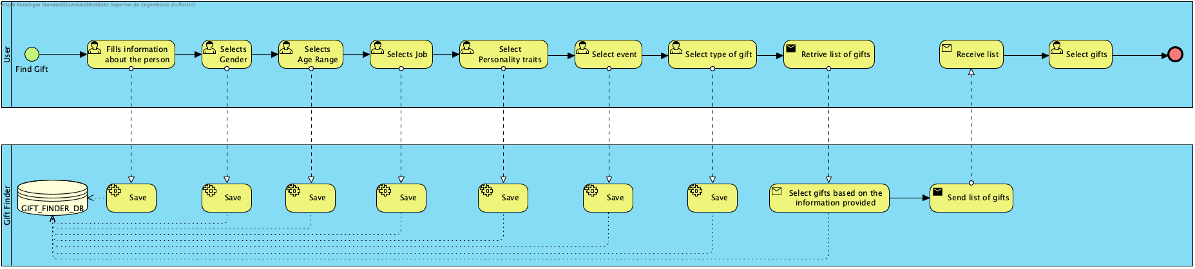
User interaction

Slide 5
Users
Users
id | name | email | psw | role_id | location
1 | teste | teste@gmail.com | #abc123# | 2 | Portugal
2 | client | client@gmail.com | 12345 | 1 | Portugal
3 | manager | manager@gmail.com | 123456 | 3 | Portugal
Information about a user:
Two types of users: client, admin, present manager
Client can only search gifts
Admin creates and validates list of products
Present manager can manage the products list.
Every search made by a user is stored in a history log.
Roles
id | name
1 | admin
2 | client
3 | Present_manager
Modules
id | name | path | Request | role_id
1 | Novo Produto | /newproduct | POST | 1
2 | Gift Finder | /gift | GET | 2

Slide 6
Finding the perfect gift
First the user must describe the person whose gonna receive the gift by selecting the following options:
Name
Age
Gender
Job

Slide 7
Age Filter
 | Age_Filter
id | name | age_max
1 | baby | 2
2 | big baby | 5
3 | child | 10
4 | Stubborn phase | 14
5 | Adolescent | 18
6 | Maybe Unemployed | 23
7 | Grown Child | 28
8 | Struggling | 34
9 | The pathfinder | 40
10 | Suit Up | 50
11 | Sick of life | 55
12 | Still sick | 60
13 | Proud | 70
14 | Even more proud | 75
15 | Retired | 80
16 | Amazing | 90
The user selects one of this options where the receiver age is below one of those ages

Slide 8
Gender Filter
 | Gender_Filter
id | name
1 | Male
2 | Female
3 | Not sure
4 | Closet door closed
5 | Closet door open
6 | Closet door bit open
7 | Maybe Both?
The user selects one of this options as the receiver gender

Slide 9
Job Filter
Job_Filter
id | name | description
1 | Unemployed | we all been there
2 | Lame Desk Job | it’s boring like sales
3 | Awesome Desk Job | Does cool stuff like coding
4 | Moves money | Bank Job or Financial area or Rich
5 | Means Business | Works in suit maybe lawer
6 | Does you can’t do teach | Works in the educational or gives lectures
7 | Cool Drawings | Works in arts or design or goes in the kindergarten
8 | Bookworm | Still in school
9 | Helpdesk | Helps people solve their problems
10 | Engineer | The coolest jobs
11 | Saves life | Healthcare System
12 | War games | Military
13 | Food | Chef or pizza delivery guy
14 | Musician | Probably uses music to pick up girls
The user selects the job that the receiver has.

Slide 10
Gift Objective Filters
To help find the best gift off all, the user must select other filters:
Type of gift he wants to give
Event where he gonna give the gift
Personality traits of the receiveir
Likes of the receiver

Slide 11
Filter - Type of gift
id | name | value
1 | Trying to get in the receiver pants | 1
2 | Joking | 2
3 | Married to the receiver | 3
4 | Not my real friend | 4
5 | Obligated to buy a present | 5
6 | My wife told me to | 6
7 | My mom told me to | 7
8 | All women told me to | 8
9 | trying to make the receiver healthy | 9
10 | the receiver has “big bones” | 10
11 | food junkie | 11
12 | Son of a mother | 12
13 | Son of me | 13
14 | Not my favourite child | 14

Slide 12
Filter – gift Event
id | Name | Value
1 | Christmas | 1
2 | Halloween | 2
3 | Easter | 3
4 | New Year | 4
5 | Birthday | 5
6 | Graduation | 6
7 | Wedding | 7
8 | New Home | 8
9 | Valentine | 9
10 | First month | 10
11 | Just cause | 11
12 | Newborn | 12
13 | He deserves it | 13
14 | She deserves it | 14

Slide 13
Filter – Personality traits
id | name
1 | Opened up
2 | Mysterious
3 | Submissive
4 | Bossy
5 | Hot headed
6 | Prudent
7 | Funny
8 | Boring
9 | Honest
10 | Phony
11 | Creative
12 | Copy Paste
13 | Predictable
14 | Random
15 | Energetic
16 | Lazy
17 | Curious
18 | Distracted
19 | Competitive
20 | Secretly Competitive
21 | Brave
22 | Chicken
23 | Perfectionist
24 | Faith

Slide 14
Filter – Receiver Likes
id | Name | Value
1 | Sports | 1
2 | Jokes | 2
3 | Music | 3
4 | Dance | 4
5 | Cars | 5
6 | Motorcycles | 6
7 | Gadgets | 7
8 | Computers | 8
9 | Cats | 9
10 | Dogs | 10
11 | Games | 11
12 | Films | 12
13 | Tv | 13
14 | Boozing | 14
15 | Food | 15
16 | Gym | 16
17 | Cool tech | 17
18 | Home styling | 18
19 | Reading | 19
20 | Art | 20
21 | Jewellery | 21
22 | Boats | 22
23 | Craft | 23

Slide 15
So how the products are selected?
Each product has a set of options for each filter related to the product itself.At the end of chosing all the filters it shows only the products that contain all of those values.
When a user selects certain options from all the filters the service shows the products that are more close to the options selected.
The only filters that will work with odds are the personality traits.

Slide 16

Example
Produto 1:
{nome, descrição,
filtros: {
age:[1,2,3];
gender:[4,5];
job:[1,2,3,4,5,6];
traits:[1,80;2,50;3,100];
type:[3,4,5];
event:[1,2,3,5];
average_price:120;
}
Store_link}

Slide 17
List of products seleCted by filter
id | name | description | price | Currency | link | gender_value | age_value | job_value | event_value | trait_value | like_value | type_value
1 | Bola futebol | redonda | 10 | € | www.qql.com | [1,2,3,4] | [3,4,5,6,7] | [8] | [1,3,5,6,7] | [1,80;2,50;6,80] | [1] | [12,13,14]
The user selects a product and then this go to a list of potential presents that can fit the user need. We work as middle-man.

Slide 18
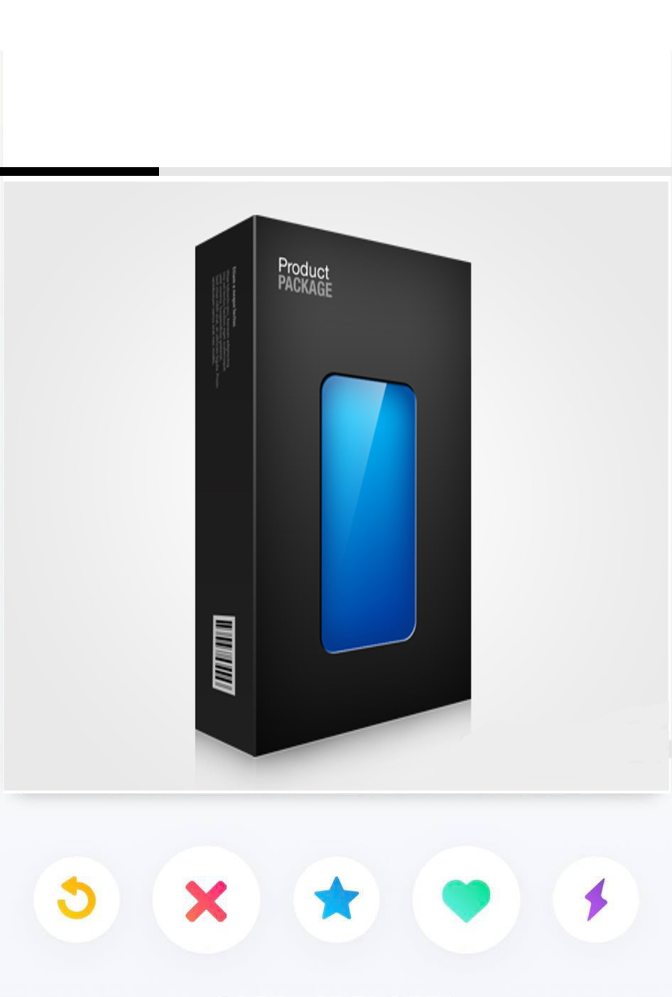
The selection
To make this appealing and interaction with the user we thought of making it like the “Tinder” of Presents.

Slide 19
How Do we make money
With advertsiment implemented on our website. Google AdSense.

Slide 20
2º Phase
Create a Blog and get people to talk about our website and promote it.
Get sponsors from AliExpress, Gearbest and other online stores
Create an APP(android and IOS) with premium version withou ads (0.99€)

Slide 21
3º Phase
Create our own brand Of products and sell them in our Application

Slide 22
Ready to be rich?

