Slide 1
Hazira Port
Lucy Malmud

Slide 2
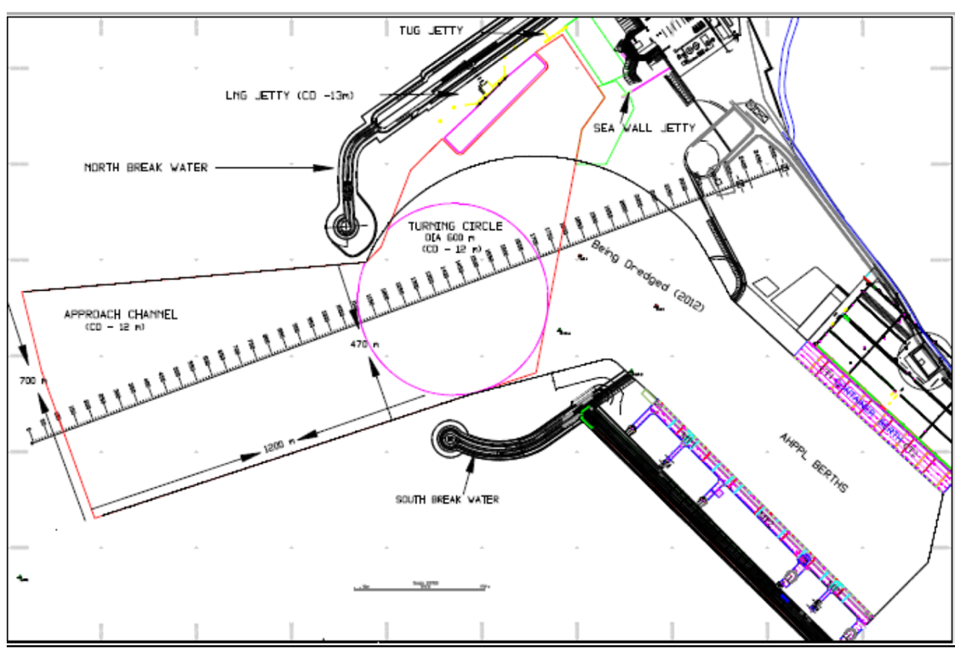
Hazira Port liquefied natural gas terminal 20 miles south of Surat
6 berths
4 multipurpose
2 container
32 acres of empty storage container
Possible 10 acre expansion
Up to 120,000 TEU

Slide 3
Hazira Port – Analysis
Objective | Key Methods
Generate data related to key port operations | Simulate berth occupancy, vessel arrivals, crane downtime, energy consumption
Compute approximated costs | Consolidate simulation results into annual volumes in order to compute costs
Apply various improvement scenarios | Modify simulation data and compute new costs
In developing this simulation and conducting the resulting financial analysis, we hope to identify areas that, when subject to targeted improvement, would yield the best increase in profits.

Slide 4
Model Limitations & Assumptions
Limitation | Assumption / Fix
Little information on yard layout and resources available | Treated resources (i. e. lights) as one “pool” resource, which may later be adjusted
Missing financial information | All values are dynamically referenced – one update will propagate throughout
Underspecified distributions | Dummy values inserted which may easily be updated
Specific port operations unknown (i. e. how are vessels assigned to berths upon arrival?) | Implemented most intuitive and efficient schedule

Slide 5

Key Simulation: Vessel Turnaround
What the simulations answers…
When do vessels arrive?
Which berth are they assigned to upon arrival?
How long does processing take?
Why is this relevant?
Foundation for later simulations (container movement, for example, as containers must be unloaded from vessels)

Slide 6
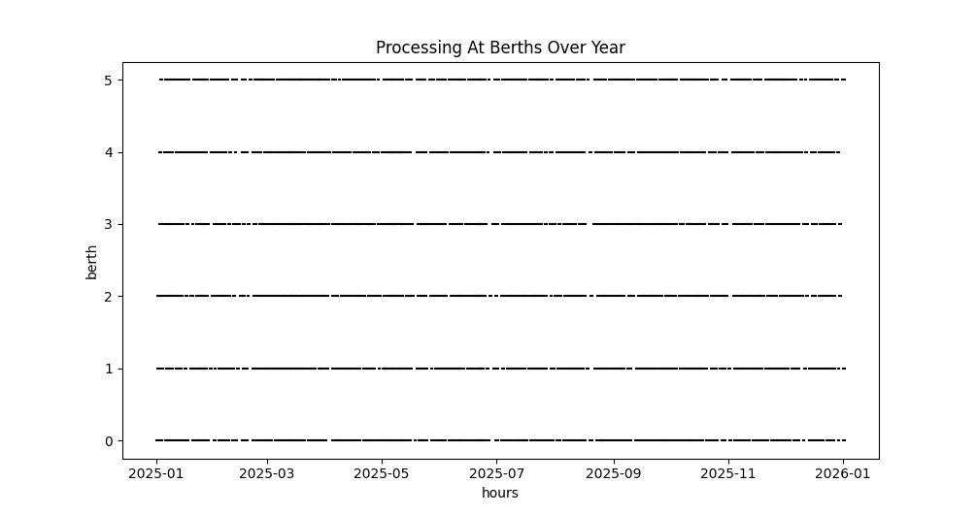
Figure: Vessel Turnaround
Lines indicate time that a berth is occupied by a vessel.

Slide 7
Cost Model
Using the provided unit costs and generated yearly simulation data, we have a total cost of 39,770 cr. Note that for the year ended March 2024, the total operating expenses were 31,958 cr

Slide 8
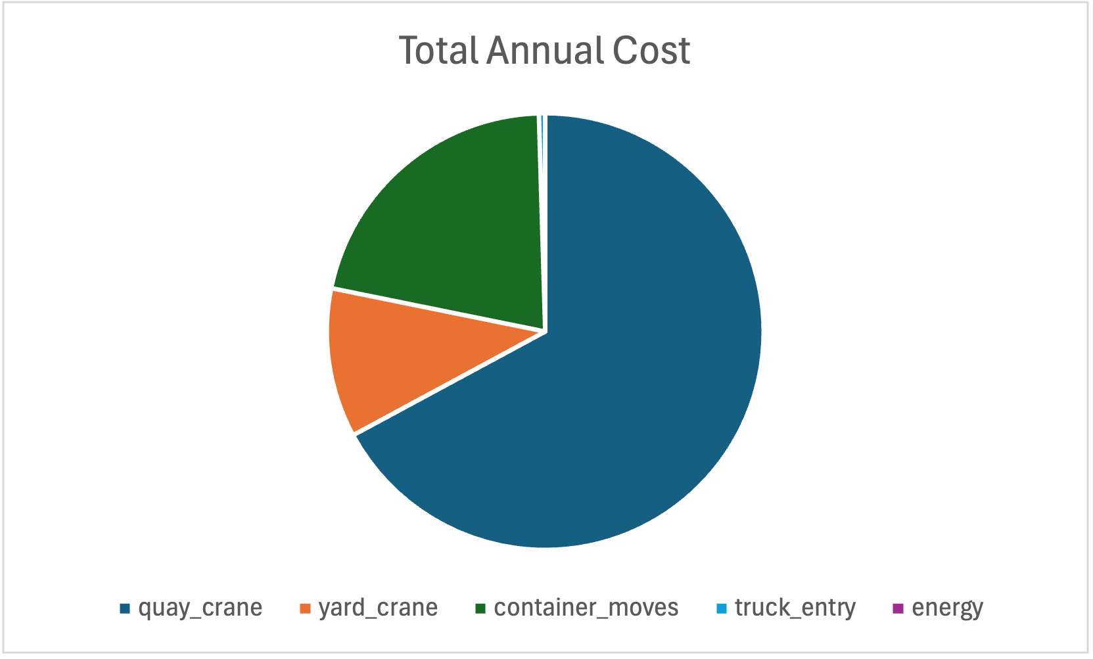
Cost Model Results
Total Annual Cost: 39,770cr
Metric | Volume | Unit Cost | Total Cost
Quay Crane | 52343.1 | 0.51 | 26694.981
Yard Crane | 122215.458 | 0.036 | 4399.7565
Container Moves | 1543655 | 0.0055 | 8490.1025
Truck Entry | 47753 | 0.0038 | 181.4614
Energy | 47753 | 0.000078 | 3.724734

Slide 9
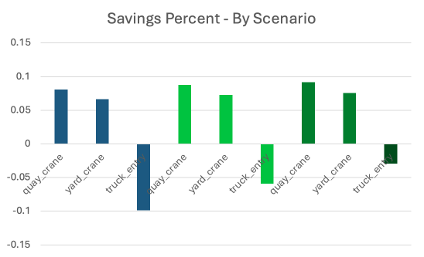
Scenario Model
Scenario Name | Vessel Service Time | Crane Downtime | Gate Speed
Conservative | .95 | .96 | 1.03
Moderate | .90 | .92 | 1.06
Aggressive | .80 | .85 | 1.10
Based on these different parameters to modify vessel service time, crane downtime, and gate speed, we can recompute costs and determine percent saved.

Slide 10
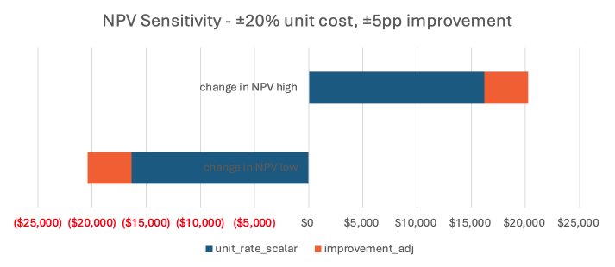
Sensitivity Analysis
Conservative Scenario Results
We allow for a change in the unit rate and a performance adjustment. In order to implement these changes:
we multiply the variable_cost_savings by the unit_rate_scalar
We also multiply by 1 + improvement_adj_pp
This suffices as a linear approximation to the simulated costs.

Slide 11
Thank you

